Slide 1

Bontle: Operational Intelligence for Multi-Location Service Teams
Product Analytics Case Study by Kabelo Makua
React | FastAPI | PostgreSQL | Docker | CI/CD

Slide 2
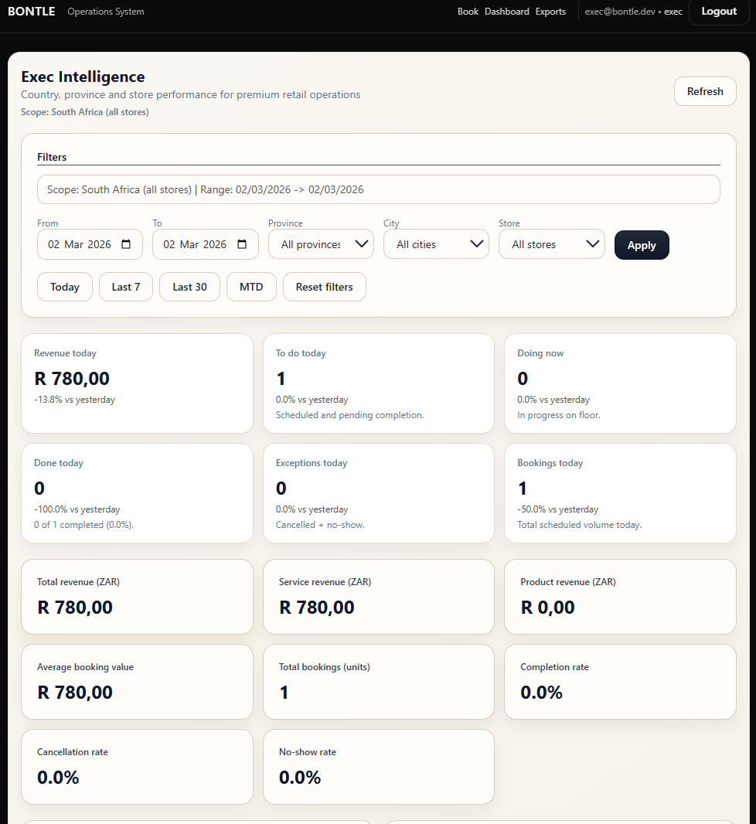
A Different Thesis
I explored a unique approach: to build a booking system as an operational state engine. This design makes analytics native and inherently defensible, moving beyond mere scheduling to deep operational insight.
The Strategic Insight
Traditional Booking Platforms
  Optimize calendar visualization
  Treat analytics as a reporting layer
  Focus on scheduling UX

Slide 3

The Core Problem
Service Teams Struggle With:
Executive Blind Spots:
Executives frequently lack real-time insights into service delivery, hindering strategic decisions.
  Slow handoffs & booking conflicts
  Reassignment friction
  Weak cross-store visibility
  Data trapped in operational silos
The real gap isn’t just scheduling; it’s effective operational measurement.

Slide 4


The Innovation: State-Driven Workflow
Moving beyond a simple calendar-first design, Bontle redefines every booking.
Booking Created
In Progress
Completed
Initial request, awaiting assignment or confirmation.
Service actively being delivered, real-time tracking.
Service finished, ready for analytics and feedback.
Every booking transforms into:
  A state transition
  A measurable throughput unit
  An auditable event
  A direct KPI input
This foundational shift enables robust, lifecycle-based analytics.

Slide 5
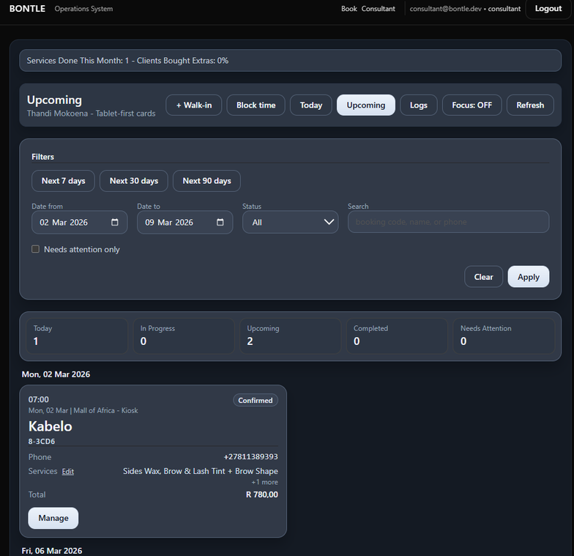
Workflow & Control Layer
Ensuring Operational Integrity
Designed for rigorous operational control under real-world mutation conditions.
Server-enforced status transitions
Optimistic concurrency (version checks)
Mutation audit logs (before/after JSON)
Reassignment request & approval flow
Role-aware scope (store / area / system admin)
Idempotency for safe retries

Slide 6
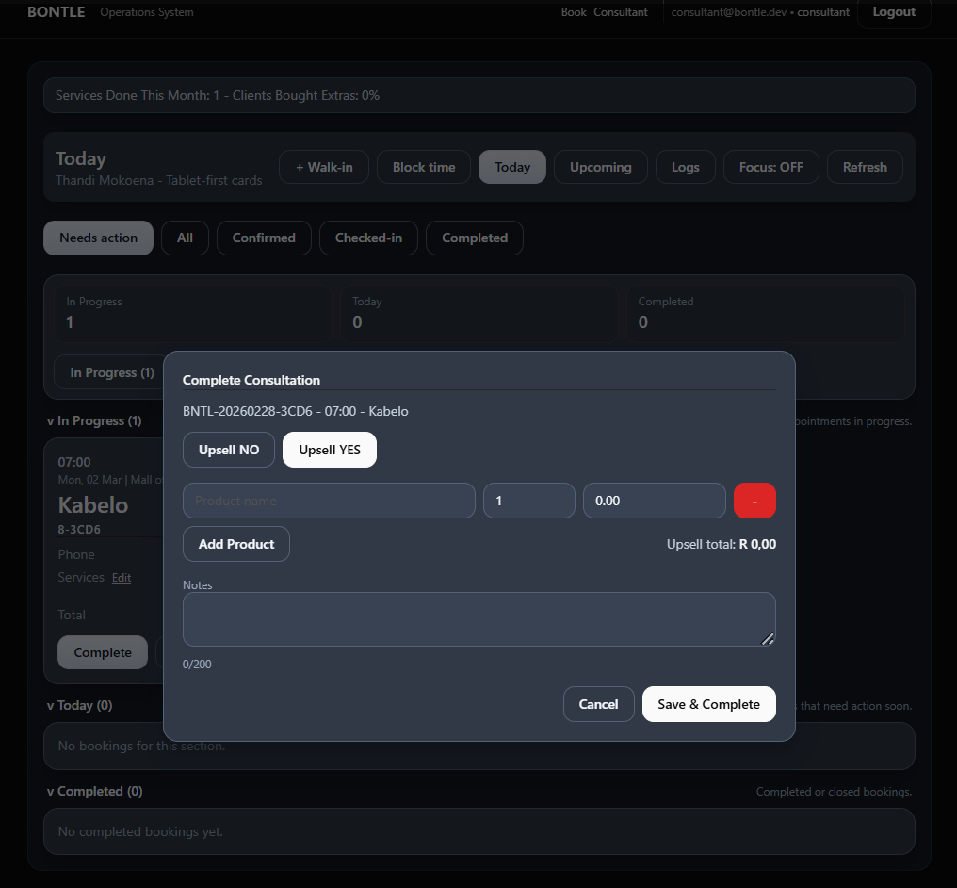
Frontline + Ops Execution
Consultant Board
Operations Queue
  Today / In Progress / Completed lanes for clear status visualization.
  Quick actions: reassign, reschedule, cancel, no-show.
  Completion capture with integrated upsell tracking.
  Multi-store filters for aggregated views.
  Dedicated "Needs Attention" workflow to flag critical items.
  Scoped reassignment authority for streamlined management.
These tools reduce ambiguity and proactively surface operational risks.

Slide 7
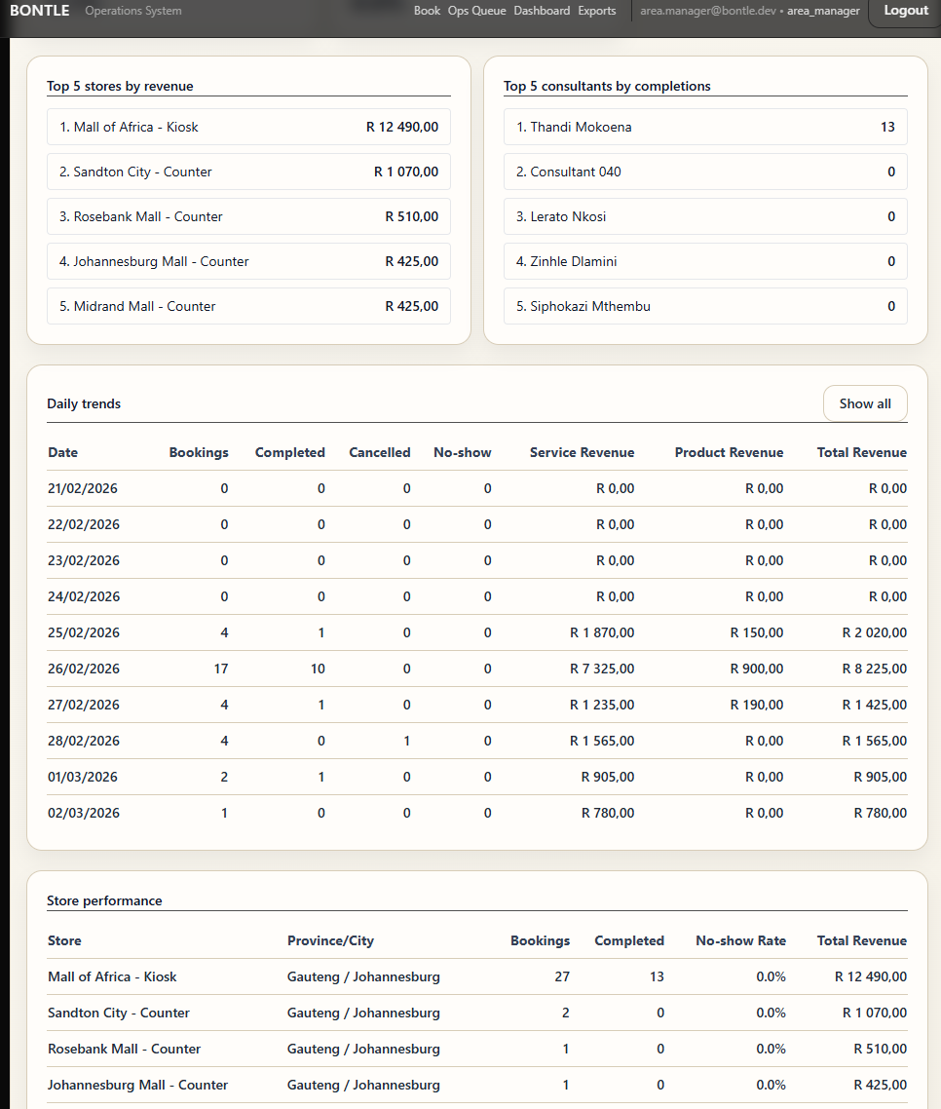




Executive Analytics Layer
The structured state model provides unparalleled insights:
Throughput
  Completed bookings per consultant/store
  Area performance comparisons
Execution Quality
  No-show rate
  Cancellation rate
  Reassignment frequency
Utilization
  Consultant service time vs. availability
  Booking lead time
Revenue Intelligence
  Upsell attach rate
  Upsell per consultant/store
All data is readily available for BI ingestion via CSV/JSON exports.

Slide 8
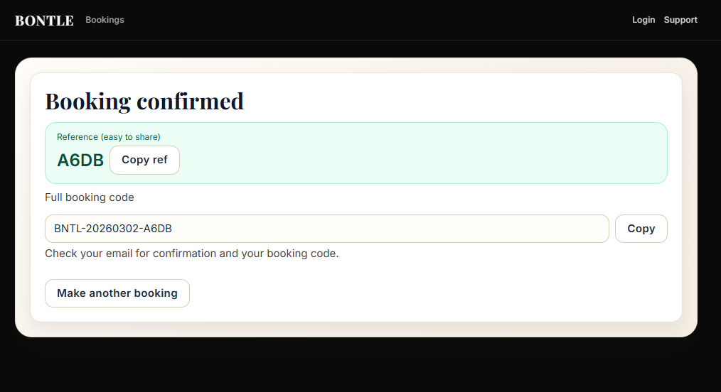
Data Integrity & KPI Trust
Dashboards are only as valuable as the data they represent. Bontle is built on a foundation of trust.
Built-in Safeguards
  Mutation versioning for every change
  Full audit trail of all actions
  Trend vs. export reconciliation tooling
  Masked PII on all exports
  SQL pagination to prevent distortions
Designed for explainable and reliable metrics, ensuring confidence in every decision.

Slide 9
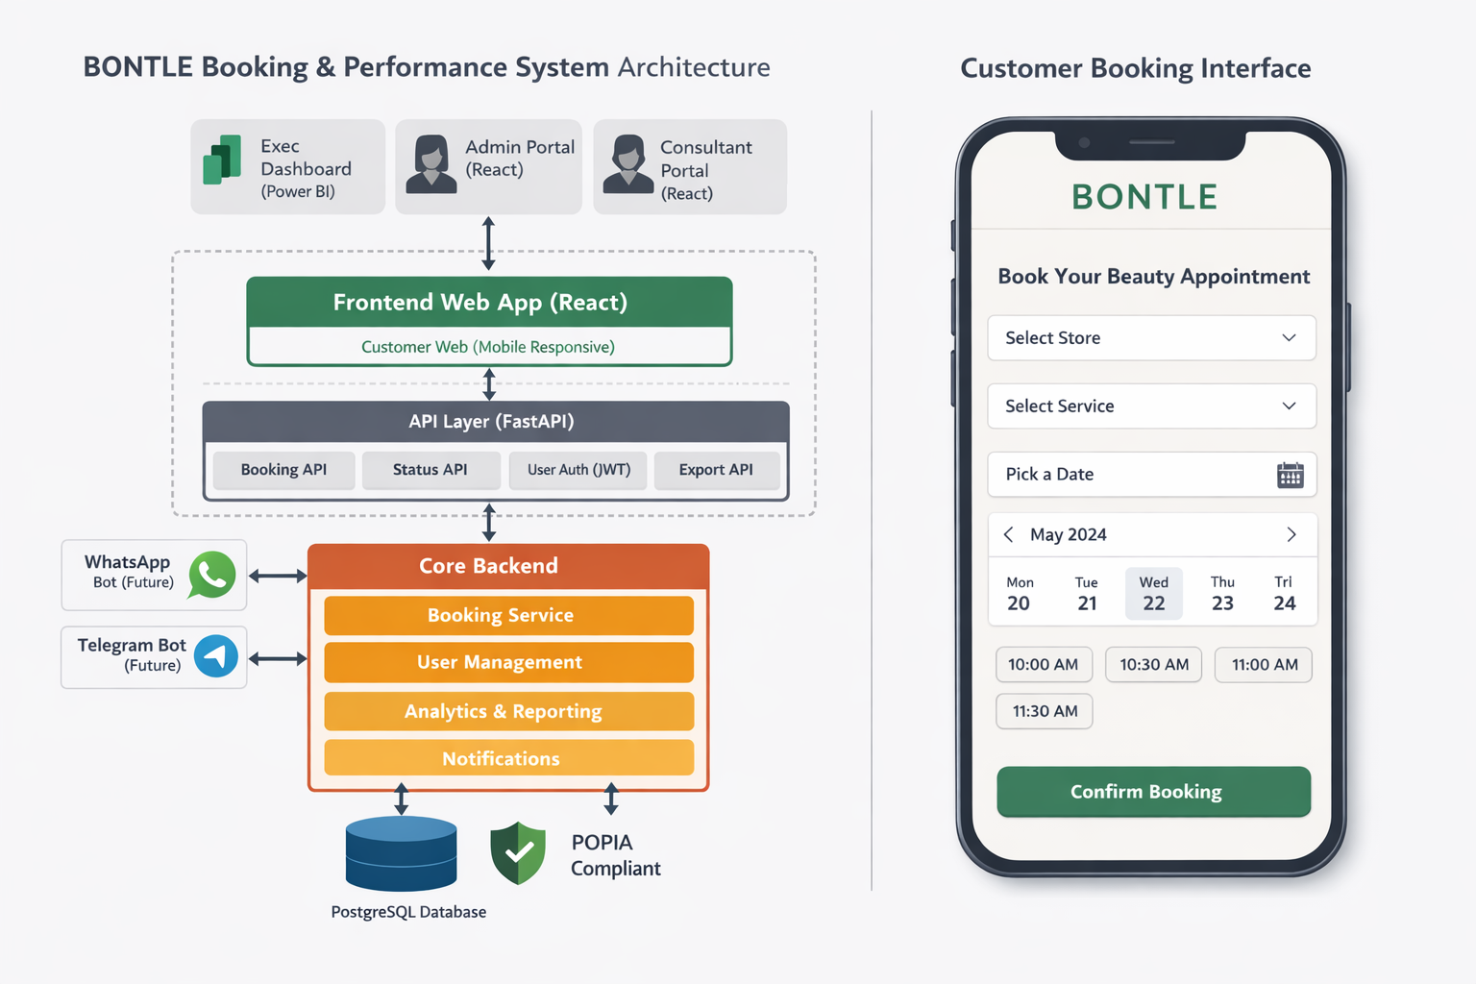



Architecture & Delivery
Frontend
React + TypeScript + Vite
Backend
FastAPI + SQLModel + PostgreSQL
Infrastructure
Dockerized services, Render deployment
Deployment
GitHub CI, JWT RBAC enforcement
This project demonstrates full-stack ownership, from API development to the sophisticated analytics layer.

Slide 10
What This Demonstrates
Bontle is a testament to comprehensive product development:
1
2
3
Product Analytics Thinking
KPI Modeling
Operational Data Architecture
Grounded in workflow states
4
5
6
Backend Reliability & Auditability
Executive Dashboard Framing
Competitive Iteration
Informed by Zenoti/Fresha/Booksy analysis
7
AI-Accelerated Delivery
Human-governed implementation
It successfully bridges Business Analysis → Product Ownership → Product Analytics → Systems Engineering.

