Slide 1
ATBRG: Adaptive Target-Behavior Relational Graph Network for Effective Recommendation
SIGIR 2020
Alibaba & Ant Financial Services

Slide 2
Current Method
explore independent meta-paths for user-item pairs over KG
(fails to capture info fully)
employ GNN on whole KG to produce representations for users and items separately
(GNN enriches repre. U and I separately by neighbors, ignores mutual effect during propagation)

Slide 3
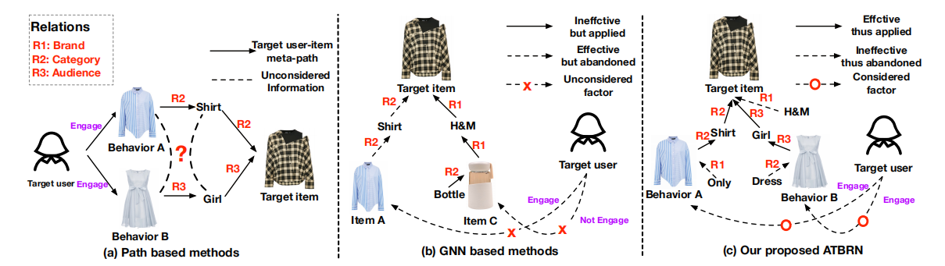
Core problem

Slide 4
Main Work
Propose a new framework,
Adaptive Target-Behavior Relational Graph network
to capture structural relations of target user-item pairs over KG
to associate the given target item with user behaviors over KG

Slide 5
Main Work
Graph connect and graph prune techniques
to construct adaptive target-behavior relational graph
Improvement of 5.1% on CTR of Taobao App

Slide 6
ATBRG
Graph construction part
Model part

Slide 7
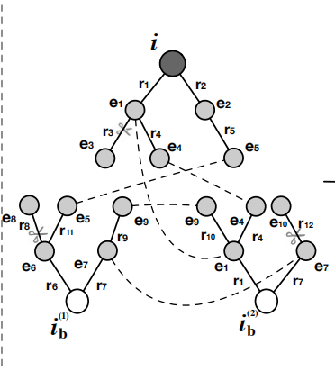
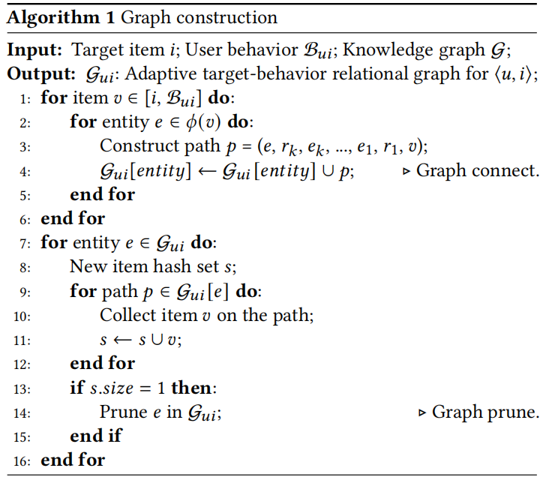
Graph construction

Slide 8
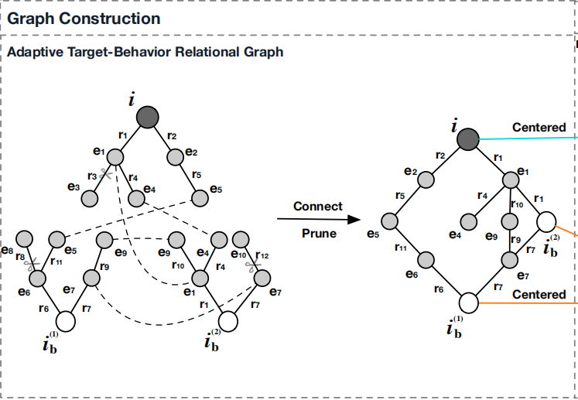

Slide 9
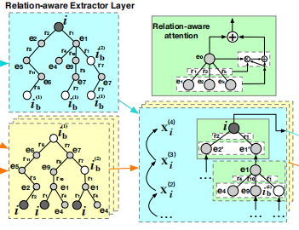
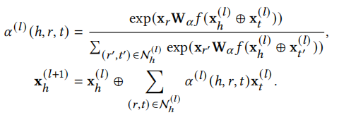
Model Part
1. Embedding layer
2. Relation-aware Extractor layer

Slide 10
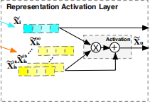
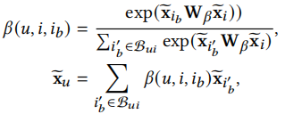
3. Representation Activation Layer

Slide 11
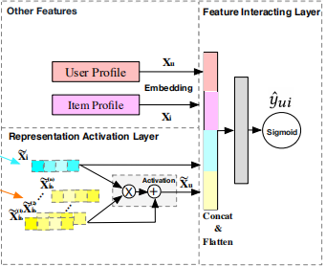

4. Feature Interaction Layer

Slide 12
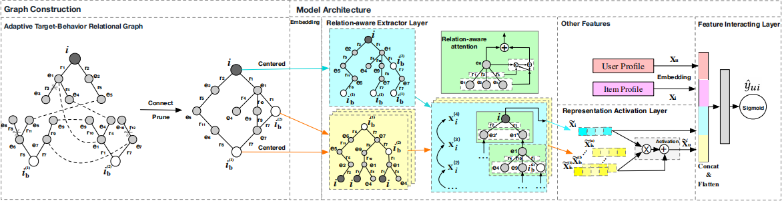

Slide 13
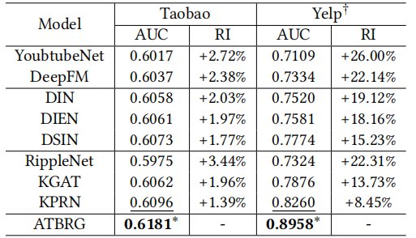
Experiments
Dataset：
Taobao
YELP

