Slide 1
Self-training Improves Pre-training for Natural Language Understanding and Distilling Task-Specific Knowledge from BERT into Simple Neural Networks

Slide 2
Self-training Improves Pre-training for Natural Language Understanding

Slide 3
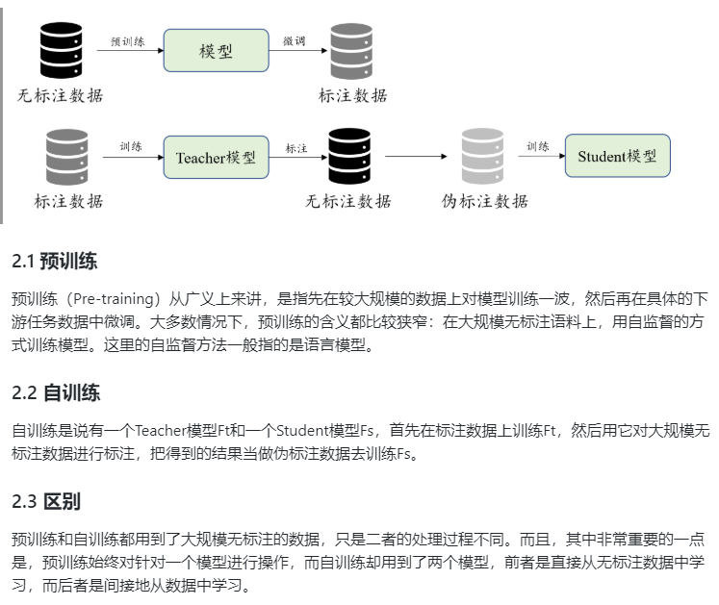
一、前期知识

Slide 4
二、问题提出
问题一: do pre-training and self-training capture the same information, or are they complementary? 【预训练和自训练会捕获相同的信息，还是它们是互补的？】
问题二: how can we obtain large amounts of unannotated data from specific domains?【如何从特定域中获取大量未注释的数据？】

Slide 5
三、论文方法
问题二解决方法：提出 SentAugment 方法 从 web 上获取有用数据；
问题一解决方法：使用标记的任务数据训练一个 teacher 模型，然后用它对检索到的未标注句子进行标注，并基于这个合成数据集训练最终的模型。

Slide 6
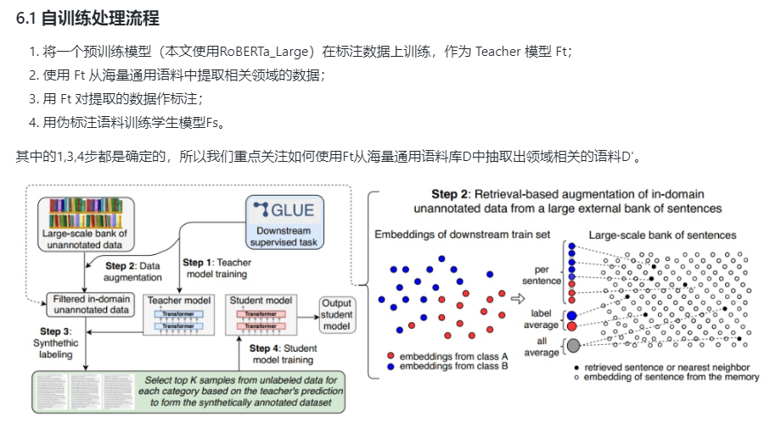

Slide 7
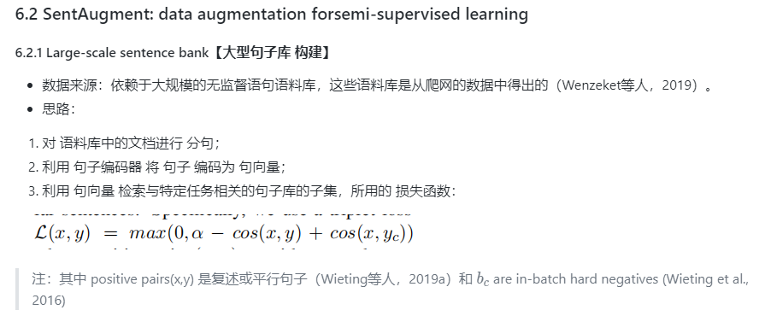

Slide 8
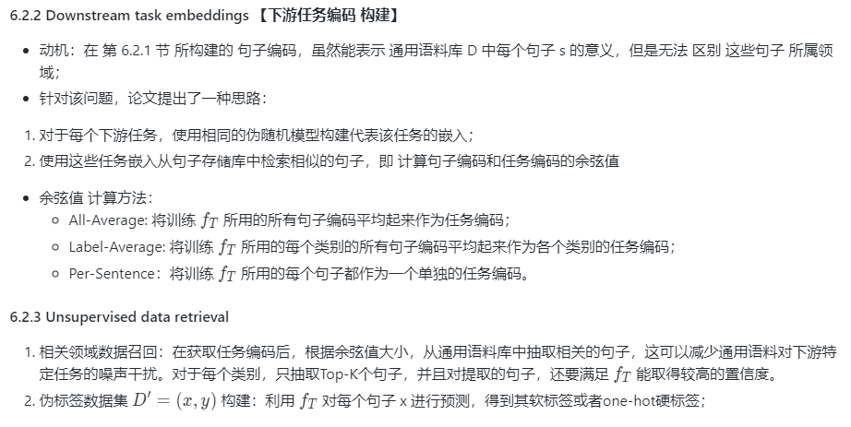

Slide 9
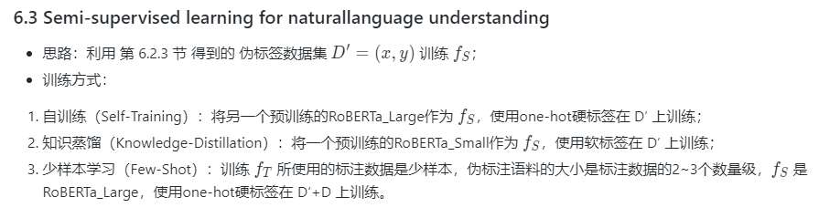

Slide 10
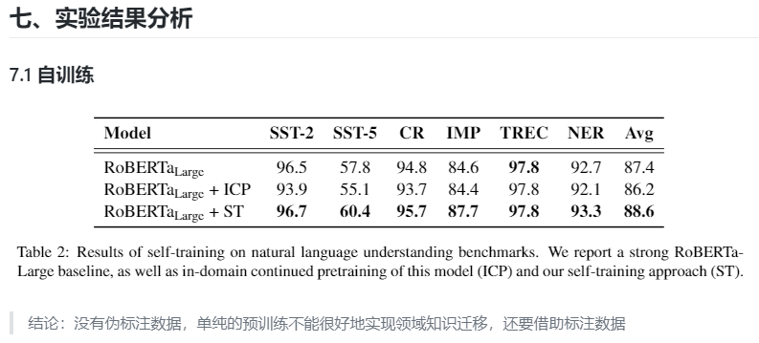

Slide 11
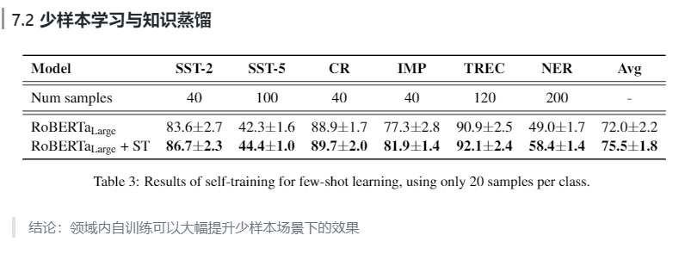

Slide 12
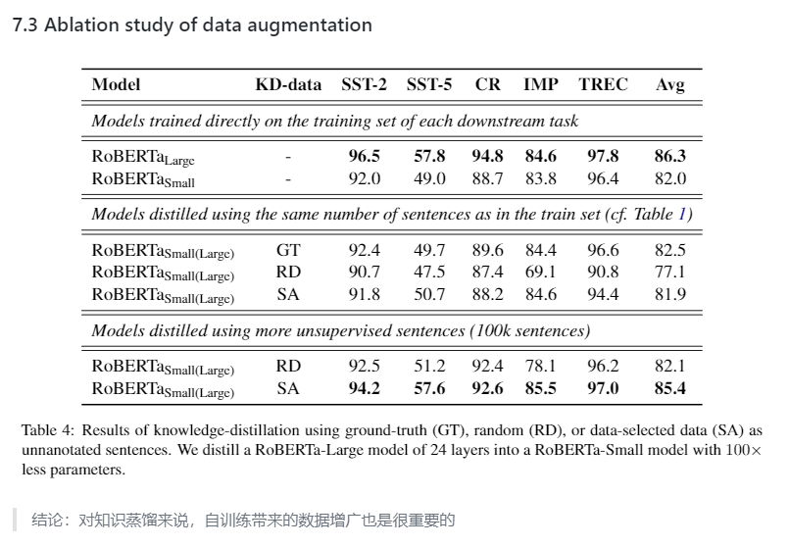

Slide 13
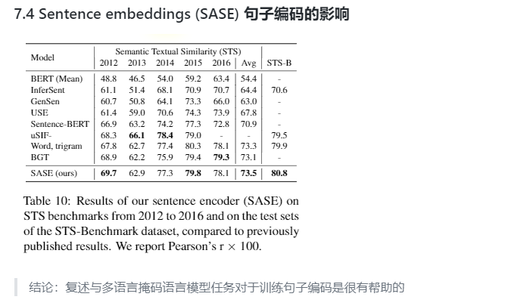

Slide 14
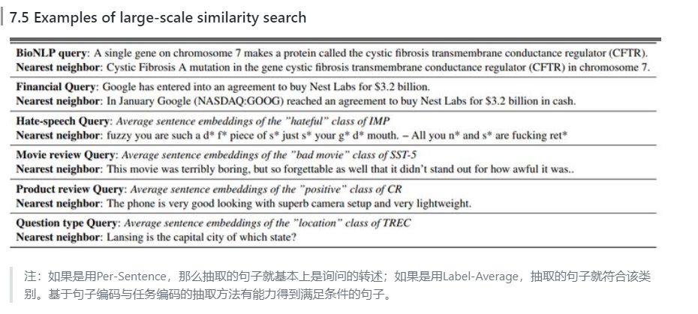

Slide 16
Distilling Task-Specific Knowledge from BERT into Simple Neural Networks

Slide 17
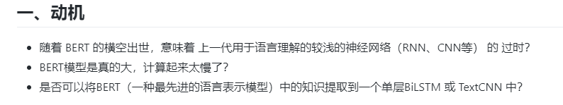

Slide 18
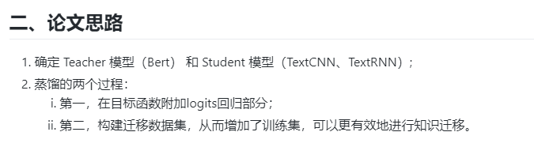

Slide 19
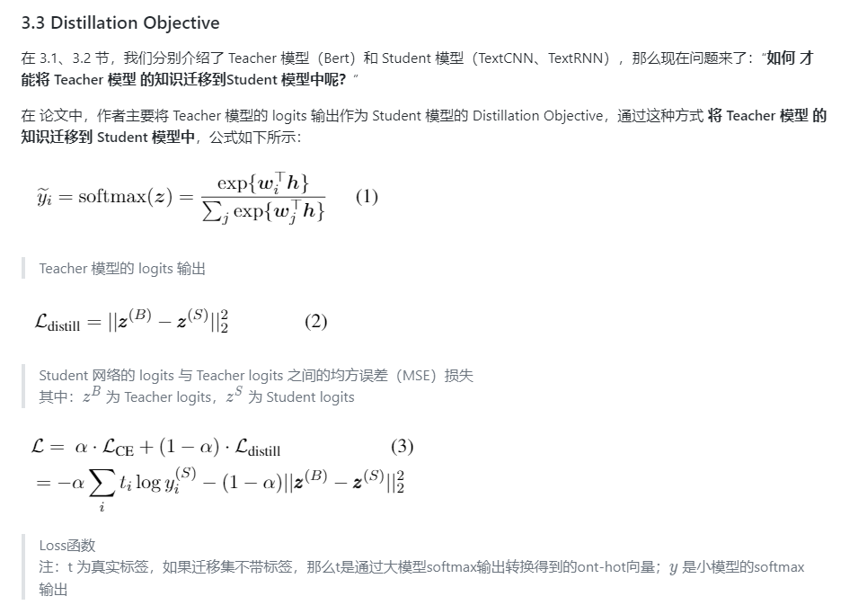

Slide 20
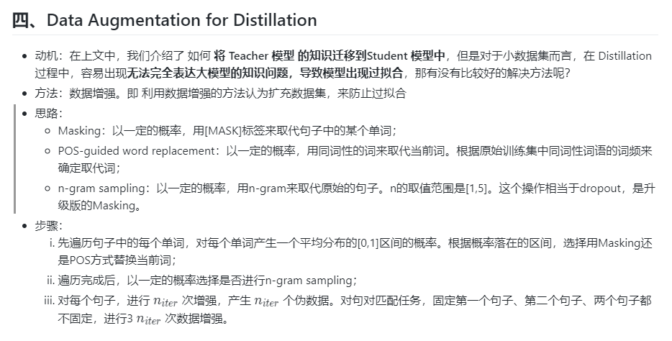

Slide 21
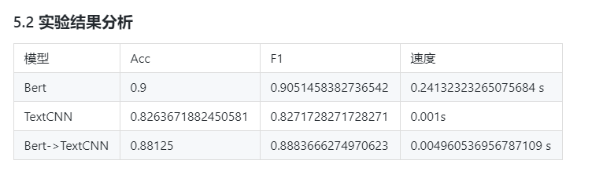

Slide 22
