Slide 1

Mobilithon: Final Presentation Guidelines
August 4-6, 2014

Slide 2
Contents
Team Name & Structure
Application Vision
Demo
Tool and Assets Used
Challenges/ Roadblocks

Slide 3
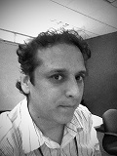

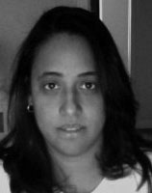
Team Name and Team Structure
Team Name : BraveHackers
Total Team Size : 6
Team Member details
LOPEZ, MAURICIO <ml5174@att.com>
Emerging Product Portals Delivery
Architect
Developer
Team Member details
REYF, MARIA <mr271r@att.com>
Cloud Services Portal
Graphic Designer
Web Developer
Team Member details
RENNER, ZANIAH<zr9157@att.com>
Cloud Services Portal
Graphic Designer
Front End Developer

Slide 4

Team Name and Team Structure
Cont..
Team Member details
LOPEZ, MAURICIO <ml5174@att.com>
Emerging Product Portals Delivery
Architect
Developer
Team Member details
LOPEZ, MAURICIO <ml5174@att.com>
Emerging Product Portals Delivery
Architect
Developer
Team Member details
BRAKKE, STEVE <sb1960@att.com>
Service Provisioning
Developer
REST, AngularJS

Slide 5
Application Vision and Use Cases
I can help you with that P2R
Giving employees the tools to help them help their friends find at&t products and services that are perfect for them.
Use Cases (100% Complete, https://codecloud.web.att.com/projects/ST_MCOEMT/repos/team04)
URL Shortener View List (REST API, UI)
Create (REST API, UI)
Details (REST API, UI)
Report (REST API, UI)
Redirect (I can help you with that UI, Service)
Customized Recommendation ( T.Data Personalized Recommendation API)
Social Sharing (Twitter, Black Flag API Recommendation)

Slide 6
Business Impact
Improved employee referrals by providing personalized recommendations and tracking of usage of recommendation leveraging a reusable URL Shortening API.
Should the API be implemented as a CSI service other business opportunities present themselves.
See genesis of the idea..
“i can get 2015 funding for it “ Jeff Garrow

Slide 7
Demo
Embed Demo file or a link to recoding – mandatory
Present recorded demo
Note: Do not use ATT Connect for recording the demo. The final presentation to the judges will be done over ATT Connect, only one connect session is possible at a time

Slide 8
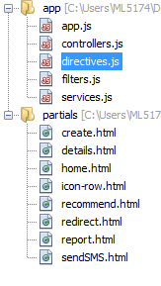
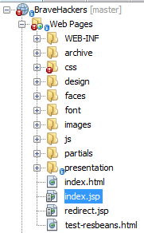
Client Tools, APIs and Assets Used
Tools & Assets | Experience of using the tool
Platform used | ATT Sandbox
Development tools used | Sublime Editor, Wamp Server, Angular JS, HTML, CSS, Jquery, NetBeans IDE
Test tools used | Google Chrome with mobile emulation
MFMP* Assets used | ATT Sandbox
APIs used
*MFMP – Mobile First Meta Platform

Slide 9
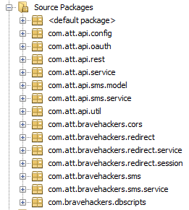
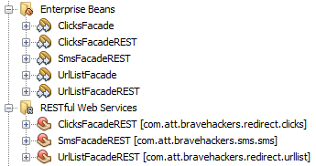
Server Tools, APIs and Assets Used
Tools & Assets | Experience of using the tool
Oracle DB with EclipseLink | JPA made object relation mapping a breeze
Jersey 2.0 REST API | Annotation to expose Entity Beans through standard REST HTTP Methods
NetBeans | Auto Generated Entity Beans and REST Methods from Database. Integration with Git, Glassfish and Oracle Database. Support for HTML 5, Angularjs and CSS
APIs used | Black Flag SMS CSP (Global Login) T.Data Recommendation Service

Slide 10
Efforts Spent
Total Team Effort spent on developing the App :
Planning effort : 18hrs
Development effort : 200hrs
Test effort : 30hrs
Note : Provide the total hours spent and splitting it into Planning/Dev/Test efforts is optional.

Slide 11
Challenges/Roadblocks and Mitigation
Challenges | Mitigation
IBM WorkLight was difficult to integrate with our workflow. Spent too much time trying to work with/in the tool instead of developing use cases. | Switched to NetBeans and Glassfish improved our speed dramatically.
Sandbox 3.1 had little Angular JS Support, and Sandbox 3.2 was not ready for use yet. | Retrofitting Sandbox 3.1 with Angular components.
Sandbox not made for responsive web design. Missing responsive features of Bootstrap | Limited wrapper width and re-adjusted positions for desktop display

