Slide 1
Data Exploration Findings and Analysis
Home Loan Application Acceptance Capstone Project
Kevin Malis

Slide 2
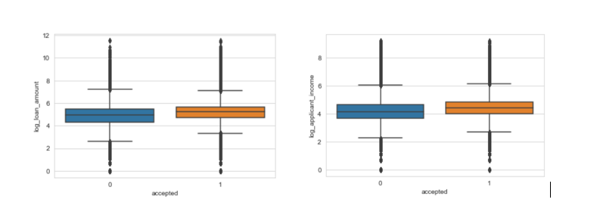
Numerical Feature Correlations with Label
Python Seaborn package used to graph numerical features correlation with acceptance rate
Concluded that applicant income and loan amount features had significant correlation with whether the loan was accepted, but this was only evident after a log transformation had been applied to both features

Slide 3
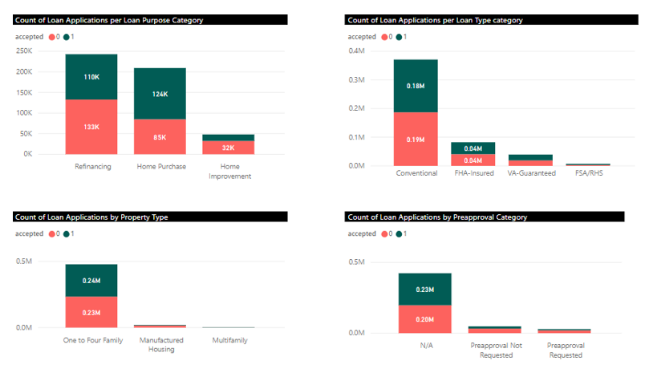
Categorical Variables versus Label
Loaded the sample data into power BI in order to create visualizations for data exploration
Stacked column charts suggests that loan purpose would be an important feature to include in the model

Slide 4
Correlation Matrices of Out of the Box features and Engineered Features
Correlation matrix between the provided features of the data set
Loan purpose and applicant income are the two strongest correlations with acceptance but are still small in absolute value
Categorical features were engineered and replaced with numerical rate features using python pandas manipulations
Lender rate, applicant income, and loan purpose rate become the strongest correlated features with acceptance
Model with engineered features with stronger correlations performed much better at accurately classifying home loan applications as accepted or rejected.

