Slide 1
Data Exploration Findings and Analysis
Heart Disease Capstone Prediction
Kevin Malis

Slide 2
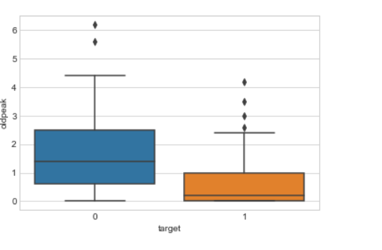
Numerical Feature Correlations with Label
Used python seaborn package to create visualizations that show how each feature is distributed when grouped by the target(i.e. having heart disease or not)
Oldpeak was determined to be significant factor in predicting heart disease, this type of visualization was done for all features

Slide 3
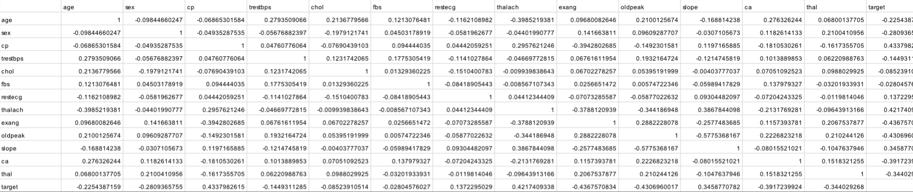
Correlation Matrices
Above is a table that shows correlations between patient characteristics and the target heart disease variable
This table is the starting off point for determining which features are included in the model, which features are correlated with each other/collinear, etc.

