Slide 1
ENGI 301 Drumset Proposal
2/12/23
Kendall Cooney

Slide 2
Background Information
What is being proposed?
A new kind of metronome!
Uses a sound sensor to listen to a song, determine beat, and play along
Signal processing likely required to determine bpm of input
Considering using fourier transform to extract main frequencies/bpm
If “beat extraction” not possible, could just put a metronome close to microphone instead, or have a potentiometer to personally set bpm
What sensors will be used?
Amazon microphone sensor, has power/ground pin as well as analog and digital output pins

Slide 3
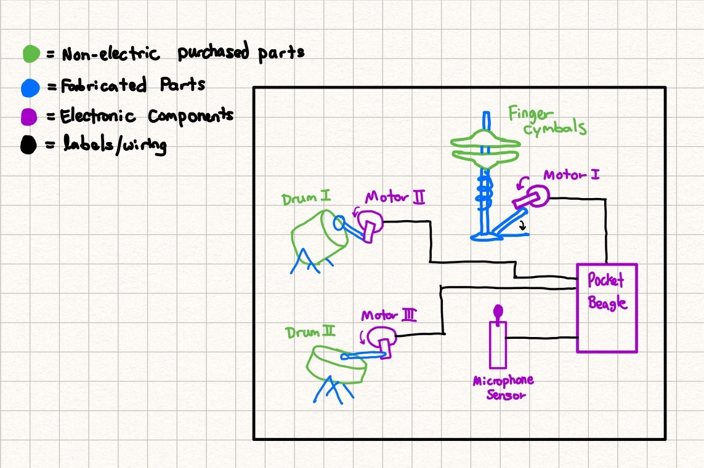
System Block Diagram
Need Moderate Level of Detail

Slide 4
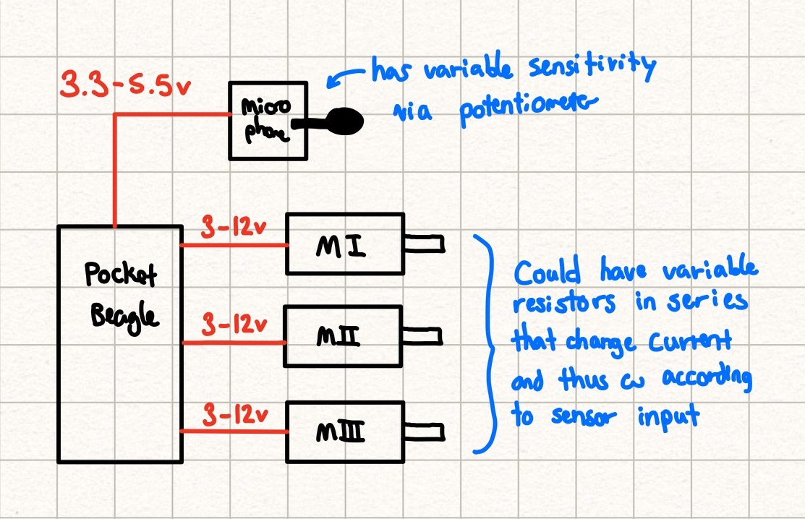
Power Block Diagram

Slide 5
Components / Budget
Component | Need to Buy | Cost
https://www.amazon.com/EUDAX-Electric-Magnetic-Propeller-Connector/dp/B08GPPJR1T (Question - Better way to control RPM?) | Yes | $11.99
https://www.amazon.com/uxcell-Microphone-Detection-Digital-Projects/dp/B07VPWM8WY | Yes | $8.50
https://www.amazon.com/House-of-Marbles-Monkey-Drum/dp/B004JMETGQ | Yes | $9.90
https://www.amazon.com/Musical-Instrument-Dancing-Accessory-Cymbals/dp/B098F74F1V | Yes | $7.99
https://www.amazon.com/Musical-Percussion-Instruments-Children-Birthday/dp/B0BKL8KP5C | Yes | $23.99
ROUNDED UP TOTAL: |  | $63.00

