Slide 1
ENGI 301 – Drumset Software/Pin Diagrams
Kendall Cooney

Slide 2
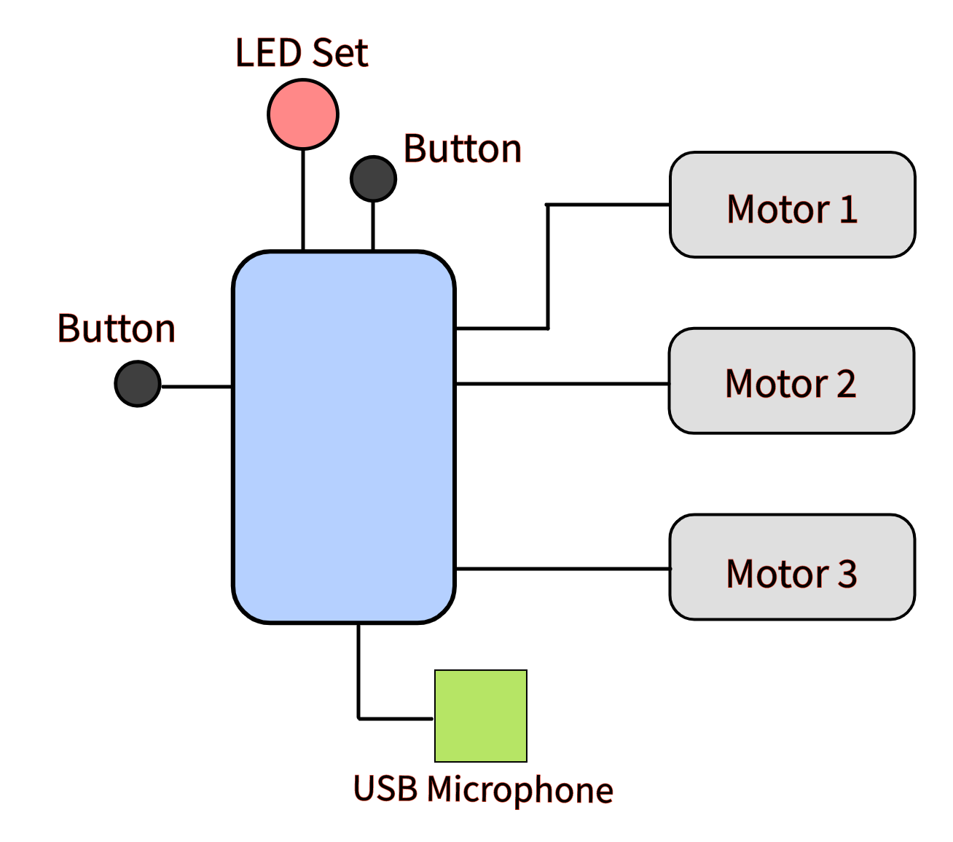
System Block Diagram

Slide 3
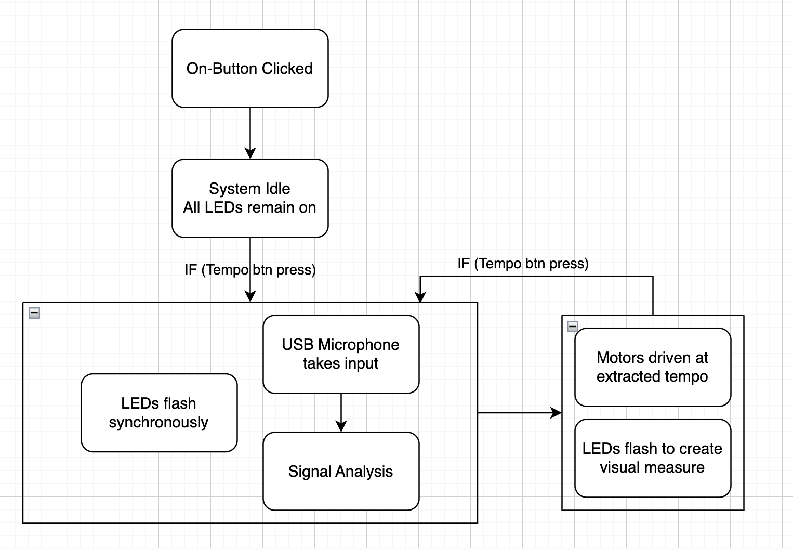
Software Block Diagram

Slide 4
OVERARCHING SOFTWARE SETUP
when POWER == OFF & powButton == PRESSED:
turn on
when POWER == ON
LED set == ON, steady state
currentTemp = 0
when POWER == ON & syncButton == wasPressed:
while (tempoNOTfound)
Blink all LEDs in set simultaneously
Activate USB microphone
Analyze AUDIO input
currentTemp == Tempo found by analysis
Blink LEDs consecutively @ currentTemp (signify 4 beats per measure)
driveMotor(hh,currentTemp)

Slide 5
SPECIFIC FUNCTIONS
ledBlink(tempo)
Takes integer bpm as input
Activates individual LEDs consecutively to generate visual 4-beat measure
driveMotor(type, tempo)
Takes string drum type (hh = “High hat”, td = “Tom drum”) and integer bpm as input
Drives motor through custom rhythm prescribed by drum type at input bpm

Slide 6
ledBlink() Pseudocode
INPUTS:
int tempo
CODE:
Input into function = bpm
bpm/60 = bps
float spb = 1/bps
Input HIGH LED pin 1
Wait (spb)
Input LOW LED pin 1
Input HIGH LED pin 2
Wait(spb)
Repeat for all LEDs

Slide 7
driveMotor() Pseudocode
INPUTS:
int tempo
str drumtype
CODE:
All rhythms originally generated for 60 bpm, or 1 bps
Drumtype
Corresponds to list of num of seconds to wait after playing said note in one measure, for 60 bpm
Example: four quarter-notes = (1,1,1,1) @ 60 bpm
int alpha = tempo/60
Scalar we will multiply list by to get list corresponding to extracted tempo
list driveList = alpha*rhythms(drumtype)
Spin motor
Wait(driveList(1))
Spin motor
Wait(driveList(2))
Spin motor
Wait(drivelist(3))
Spin motor
Wait (drivelist(4))

