Slide 1
ENGI 301 Drumset Proposal
2/12/23
Kendall Cooney

Slide 2
Background Information
What is being proposed?
A new kind of metronome!
Uses a sound sensor to listen to a song, determine beat, and play along
Signal processing likely required to determine bpm of input
Considering using fourier transform to extract main frequencies/bpm
If “beat extraction” not possible, could just put a metronome close to microphone instead, or have a potentiometer to personally set bpm
What sensors will be used?
Amazon microphone sensor, has power/ground pin as well as analog and digital output pins

Slide 3
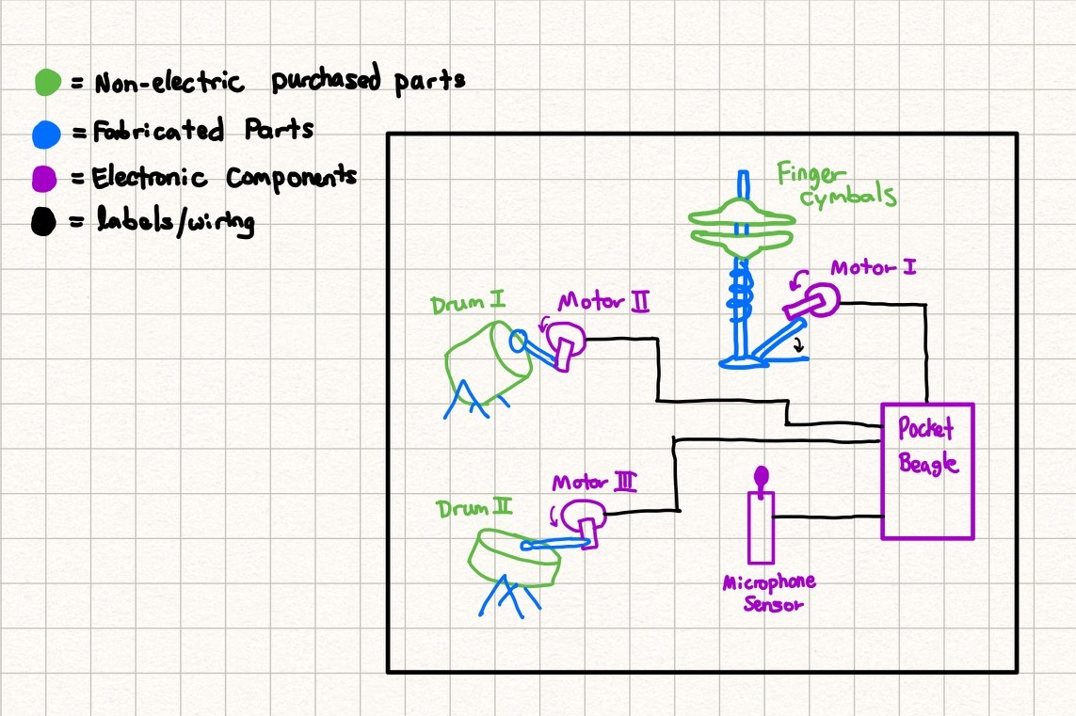
System Block Diagram
Need Moderate Level of Detail

Slide 4
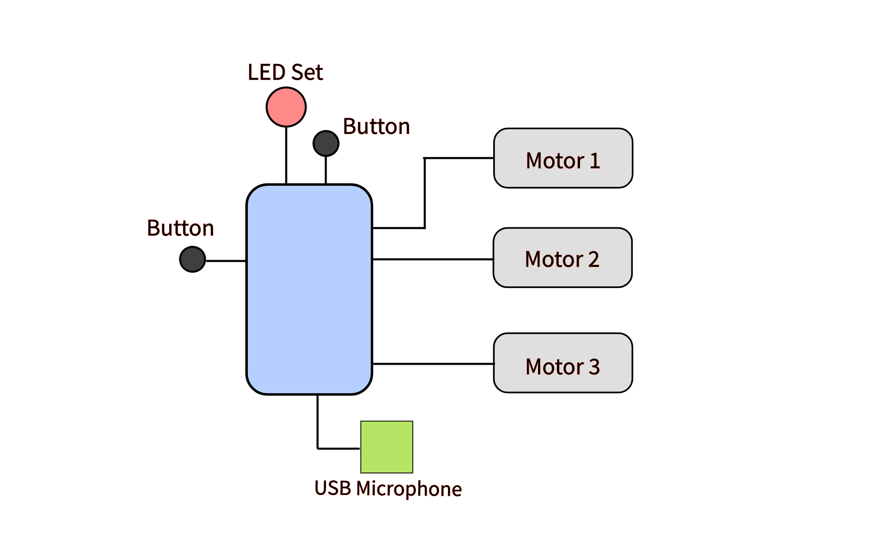

Slide 5
Components / Budget
Component | Need to Buy | Cost
https://www.amazon.com/EUDAX-Electric-Magnetic-Propeller-Connector/dp/B08GPPJR1T (Question - Better way to control RPM?) | Yes | $11.99
https://www.amazon.com/gp/product/B01MQ2AA0X | Yes | $7.99
https://www.amazon.com/House-of-Marbles-Monkey-Drum/dp/B004JMETGQ | Yes | $9.90
https://www.amazon.com/Musical-Instrument-Dancing-Accessory-Cymbals/dp/B098F74F1V | Yes | $7.99
https://www.amazon.com/Musical-Percussion-Instruments-Children-Birthday/dp/B0BKL8KP5C | Yes | $23.99
ROUNDED UP TOTAL: |  | $63.00

Slide 6
OVERARCHING SOFTWARE SETUP
when POWER == OFF & powButton == PRESSED:
turn on
when POWER == ON
LED set == ON, steady state
currentTemp = 0
when POWER == ON & syncButton == wasPressed:
while (tempoNOTfound)
Blink all LEDs in set simultaneously
Activate USB microphone
Analyze AUDIO input
currentTemp == Tempo found by analysis
Blink LEDs consecutively @ currentTemp (signify 4 beats per measure)
driveMotor(hh,currentTemp)

Slide 7
SPECIFIC FUNCTIONS
ledBlink(tempo)
Takes integer bpm as input
Activates individual LEDs consecutively to generate visual 4-beat measure
driveMotor(type, tempo)
Takes string drum type (hh = “High hat”, td = “Tom drum”) and integer bpm as input
Drives motor through custom rhythm prescribed by drum type at input bpm

