Slide 1
Social App Accessibility for Deaf Signers
Kelly Mack, Danielle Bragg, Meredith Ringel Morris,
Maarten Bos, Isabelle Albi, Andrés Monroy-Hernández
Paper, accessible slides, and transcripts available at kmack3.github.io
Notes:
Hi everyone, my name is Kelly Mack and I am a second year PhD student at the University of Washington. Today I’d like to share with you work that I did at Snap Research with my colleagues Danielle Bragg, Meredith Ringel Morris, Maarten Bos, Isabelle Albi, and AMH. This work is about Social App Accessibility for Deaf signers. A screen-reader accessible version of these slides, and a full transcript of this presentation can be found on my website: kmack3.github.io

Slide 2
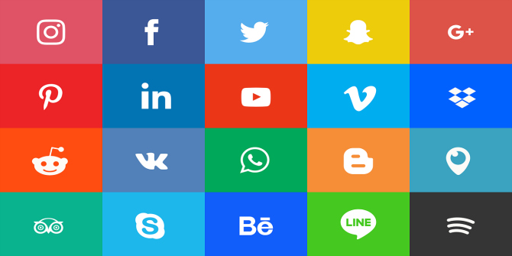
Motivation
Create more inclusive and accessible social media experiences for all
Notes:
Social media apps are now a ubiquitous part of technology that are designed to bring people together. However, social media platforms are often designed for specific user personas, and those personas do not often have a diverse range of abilities. Specifically, in this work we are discussing how social apps can be more accessible and supportive of people who are deaf and use sign languages, like American Sign Language (or ASL), to communicate.

Slide 3
Research Questions
How and with whom are Deaf signers communicating on social media platforms?
What accessibility barriers do Deaf signers face on social media platforms?
Notes:
More specifically, we wanted to better understand two things: First: how and with whom do Deaf signers communicate on social media today? And second: what accessibility barriers do Deaf signers face in doing so.

Slide 4

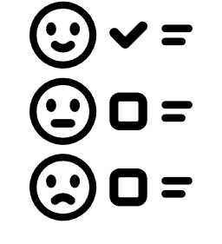
Methods
7 Interviewees
65 Survey Respondents
Age: 37.3 (SD=9.9)
Gender: 4 female, 3 male
Hearing status: all identified as deaf
Preferred language: 5 ASL, 1 English, 1 English & ASL equally
Age: 35.7 (SD=12.4)
Gender: 63% female, 32% male, 1.2% other
Hearing status: 74% severe to profound hearing loss
Preferred language: 76% sign language
Notes:
Now, I acknowledge that I am a hearing researcher new to ASL and the Deaf community, and therefore we sought to act as apprentices in this work. And so we reached out to the Deaf community to indicate direction of this research. To do so, we started by interviewing 7 Deaf signers about how they communicate with social apps, allowing them to discuss the benefits of these apps and the challenges they face. Our interviewees were all deaf and 6 preferred communicating in sign language. Based on what we learned from our interviewees, we created a survey that was completed by 65 Deaf signers. Here, we had 74% people with severe to profound hearing loss and 76% preferred some form of sign language for communication.

Slide 5
Paradox: People prefer ASL but use English
Deaf signers prefer ASL or other sign and visual communication
6/7 of interviewees and 76% of respondents preferred sign language
Interviewees brought up the use of GIFs and emojis
GIFs by Jessica Flores
Notes:
While I believe we have many interesting findings, due to time I am going to share the two that are most interesting.
First, I want to discuss communication patterns today. Our participants overwhelmingly preferred using sign language for communication in general, 6/7 of interviewees and 76% of survey respondents. Interviewees also brought up the importance of visual communication with GIFs and emojis because, as one person described “we use our facial expressions all the time for ASL”. Another interviewee commented: “I love using GIFs!!! GIFs are [a] way to express my wacky sense of humor to communicate with both D/HH and hearing community”. Below you can see two GIFs by Deaf artist Jessica Flores, one saying “I love you” and the other saying “what’s up” in sign language. Both have facial expressions, as facial expressions are a part of the language.

Slide 6

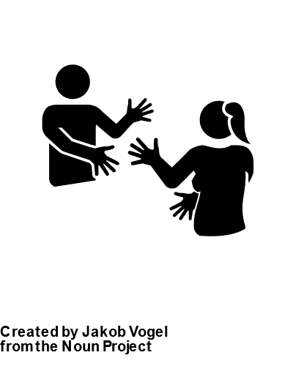
Paradox: People prefer ASL but use English
80%
55%
English
Sign Language
English was used by more participants and more frequently than any other method of sharing on public feeds
Speed
Ease of use
Ability to share with both hearing and deaf friends
Notes:
Despite this preference towards visual communication and sign language, the method of communication on public feeds used by respondents was English, with nearly 80% stating they use this method, while only around 55% stated that they communicated with sign language. When asked what method they used the most frequently, 23% said English and only 6% said videos with sign language. Looking to the people who used English the most frequently, the most commonly cited reasons for its use were its speed, its ease of use, and the ability to share with DHH and hearing audiences. We hypothesized that the reason for this contradiction between preferences and actual behavior is that something is limiting Deaf signers in terms of speed and ease when they try to record and share videos with sign language.

Slide 7



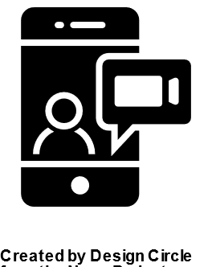

Barriers to sharing signed content
89%
77%
72%
72%
70%
It’s hard to create captions of ASL
Recording/
uploading a video takes too long
Signing into the camera makes it hard to sign
Recorded videos take too much data to upload/send
It's hard to prop up my phone so I can record myself signing
Notes:
So, based on literature and our interviews, we created a list of 9 potential barriers to sharing in sign language for the survey, the top 5 of which are above. Some of these results relate to physical challenges in recording. For example, ASL uses both hands, signs can easily range from the top of the head to the waist, and, as facial expressions are integral to the language, one must be well lit in order to be understood. This helps explain, the third and fifth most popular issues which that cameras make it hard to sign and that it is difficult to prop up the phone to record signing. Similarly, these issues can contribute to the second most popular issue that recording/uploading a video takes to long. What we found most surprising is that the top challenge by far, faced by 89% of respondents, was that “it is hard to create captions of sign language for hearing friends”

Slide 8
What can researchers do?
It’s hard to create captions of ASL
Improve ASL to English captioning
Recorded videos take too much data to upload/send
Develop background targeted compression algorithms
Signing into the camera makes it hard to sign
Explore Hardware improvements
Better lighting
Solutions for recording hands free on the go
It's hard to prop
up my phone
Notes:
So what can researchers do? This work unveiled several avenues for researchers to pursue, including creating better algorithms for ASL to English captioning, improving compression algorithms so that they focus on compressing the background and keep the quality of the face and hands clear, and developing hardware solutions to support hands free recording on the go and better light the signer.

Slide 9
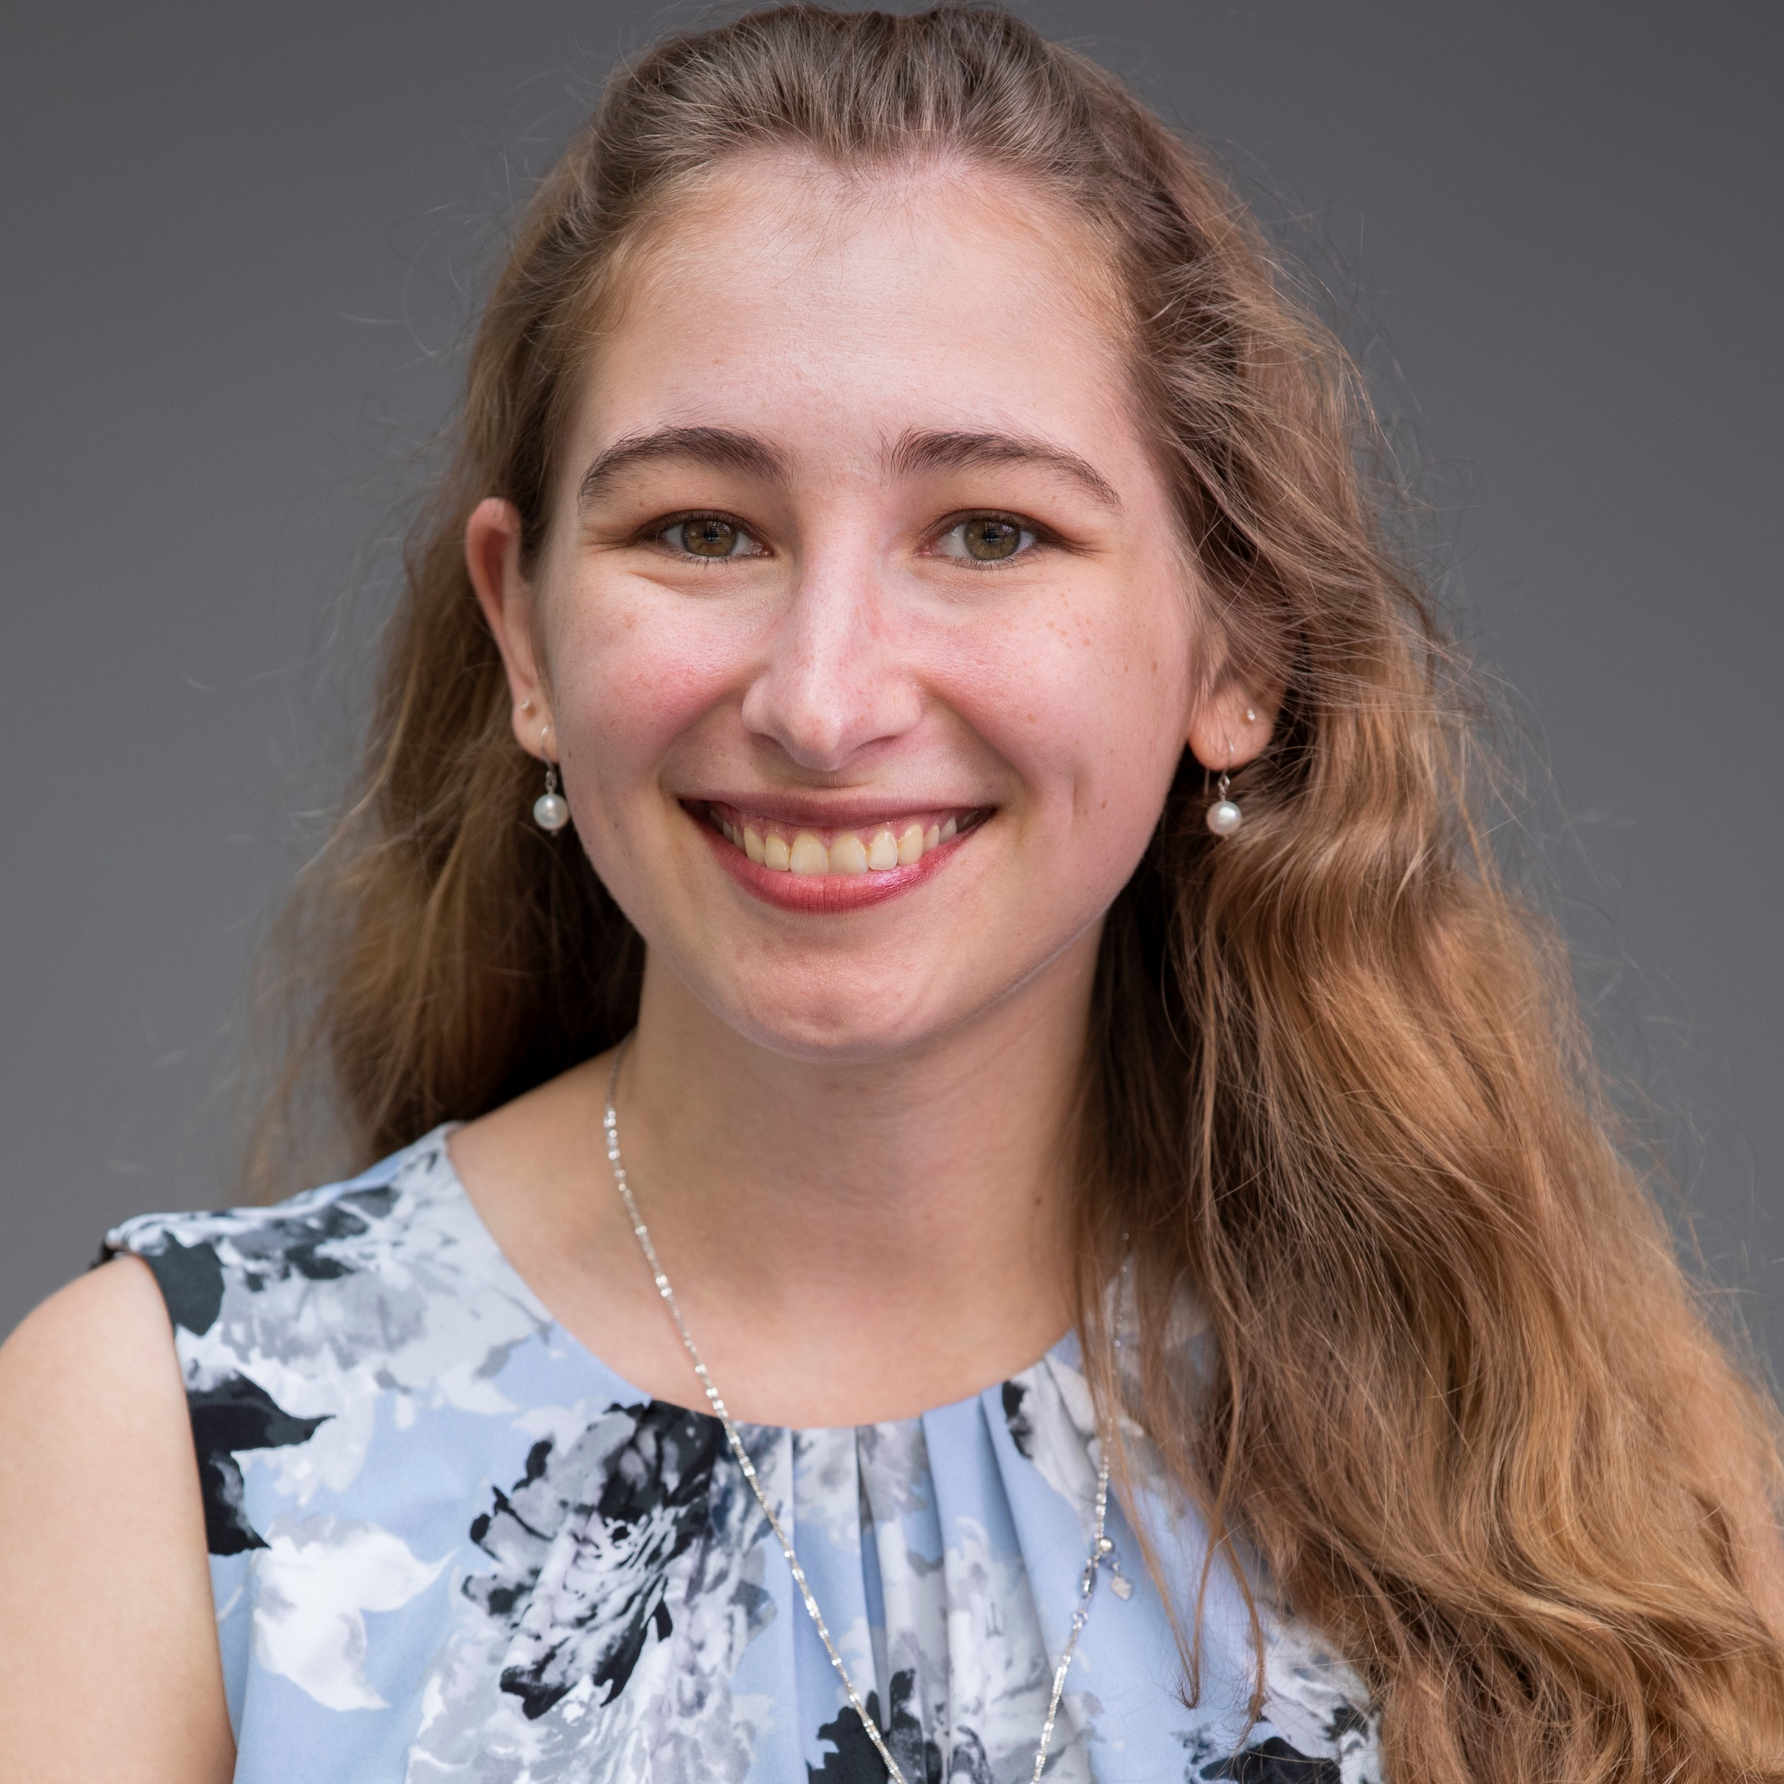
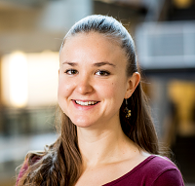

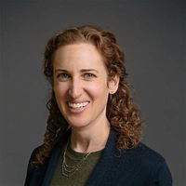


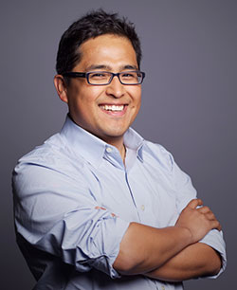
Thank you. Questions?
Kelly Mack
Snap Inc. Research; Uni. of Washington
@A11yKelly
Danielle Bragg
Microsoft Research
@DanielleKBragg
Meredith Ringel Morris
Microsoft Research
@merrierm
Snap Research
Maarten Bos
Snap Inc. Research
@maartenwbos
Paper: aka.ms/sociala11y
Isabelle Albi
Snap Inc. Engineer
Andrés Monroy-Hernández
Snap Inc. Research
@andresmh
Image credits:
Survey by Arafat Uddin from the Noun Project; Language English by Hamfif from the Noun Project; Sign Language by Jakob Vogel from the Noun Project; subtitle by shashank singh from the Noun Project; Time by Lonewolf Design from the Noun Project; Hand x by David S from the Noun Project; Upload by Maciej Świerczek from the Noun Project; Video Call by Design Circle from the Noun Project; Logo: https://en.wikipedia.org/wiki/Snapchat
Notes:
Finally, I’d like to thank my colleagues who performed this work with me, Snap Inc. and Snap Research for providing the funding for this work. Thank you all for your attention, and I’ll take any questions now.

