Slide 1

Expression differences between healthy and type II diabetes
Andrew Jackson, Victoria App, Dylan Fain, Kevin Maehlmann, Adam Rustom
Team 9

Slide 2
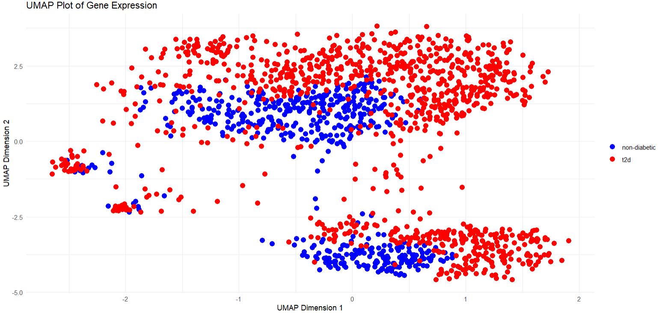
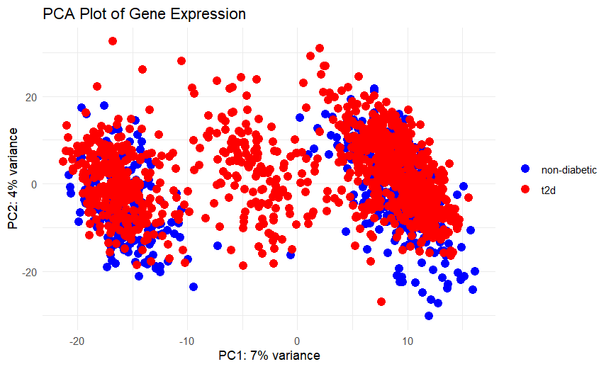
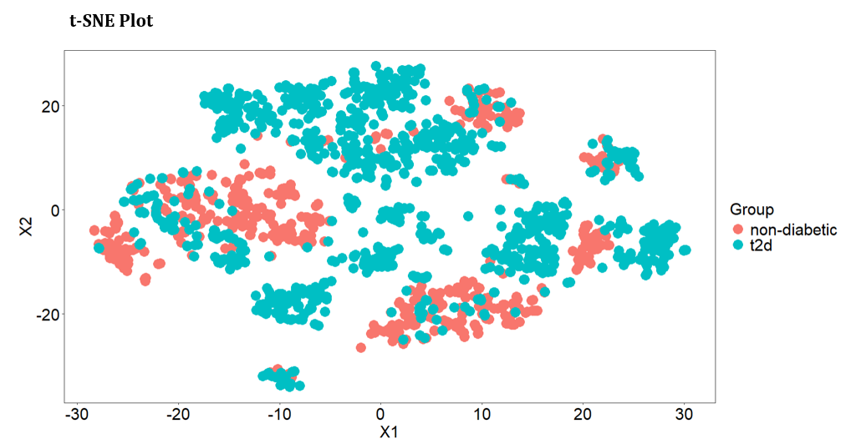
Introduction
TEAM NUMBER
Our approach involved filtering and normalizing the gene expression data to identify the most variable and biologically relevant genes. We could then perform differential expression to identify statistical differences in gene expression between T2D and non-T2D pancreatic islet cells. We then applied multiple clustering and enrichment methods to group samples and analyzed these clusters in relevant biological pathways.

Slide 3
Hypothesis
TEAM 9
Is there a significant difference in gene expression between non-Type II and Type II Diabetes pancreatic islet cell samples?
We chose this question because pancreatic islet cells regulate blood glucose levels through the secretion of important hormones. The dysfunction of these cells is important to the development of Type II Diabetes. By analyzing the genetic information in the cell samples, we can identify expression differences between non-T2D and T2D samples, which can lead to insights about the disease.

Slide 4
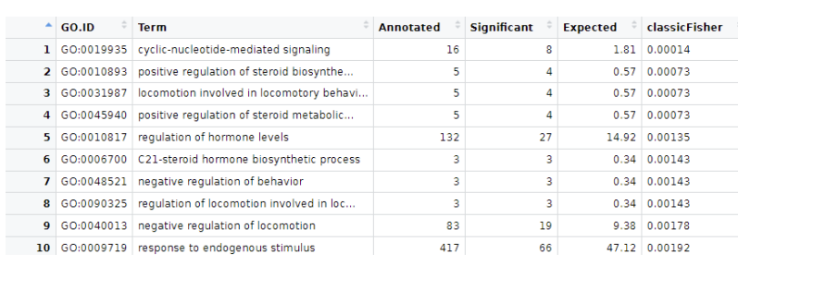
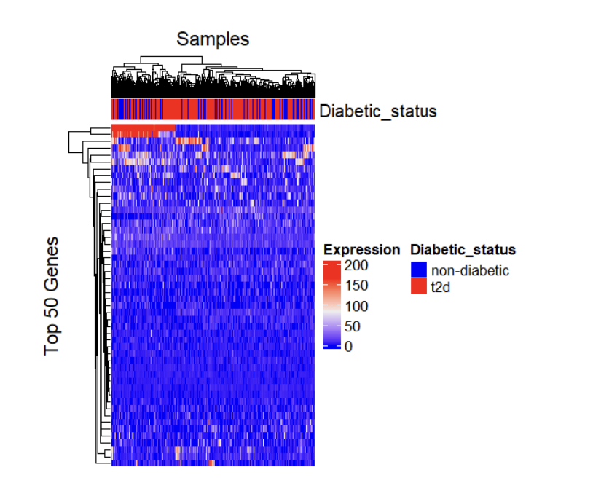
Differential Expression & Enrichment
TEAM 9
Heatmap
The terms that are the most significantly enriched in the dataset. These processes can be investigated further and potentially link to Type II Diabetes.
The visual difference between the expression profiles of diabetic and non-diabetic samples provides strong evidence that gene expression varies significantly between the two groups.

Slide 5
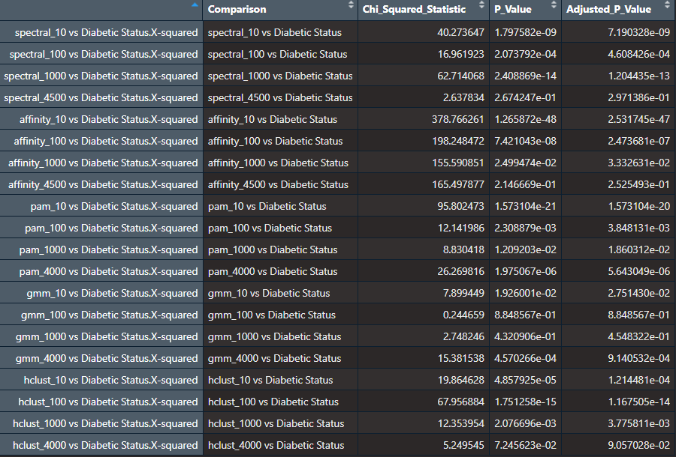
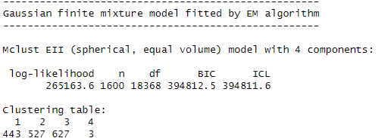
Clustering & Enrichment
TEAM 9

Slide 6
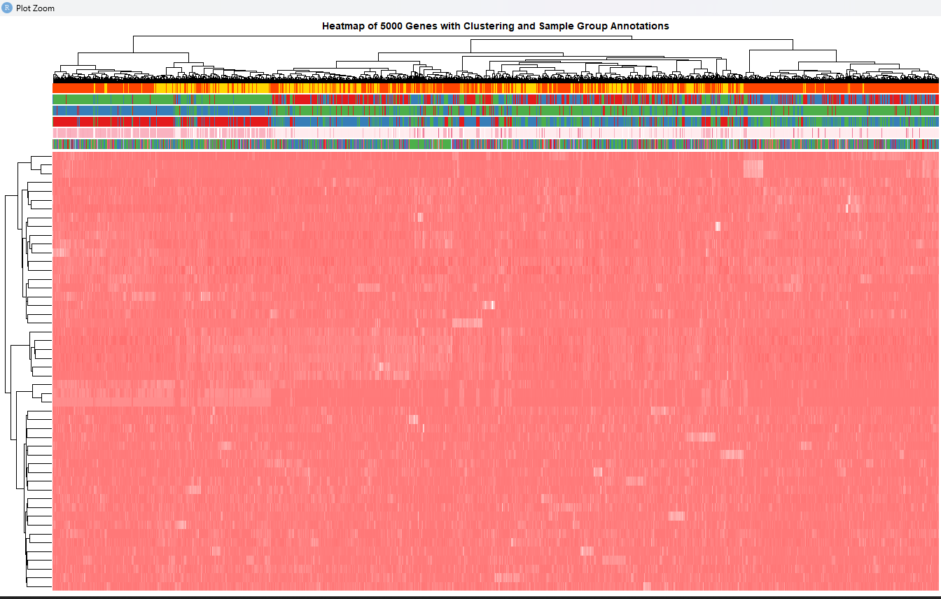
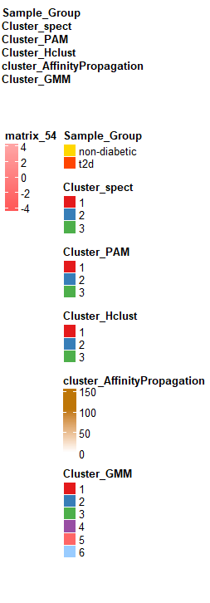
Clustering & Enrichment (Cont.)
TEAM 9

Slide 7
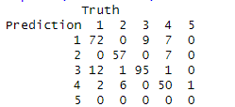

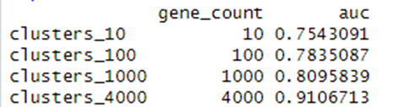
Predictive Modeling
TEAM 9
Random Forest Prediction of Assignment 1 Groupings “non-diabetic vs. t2d"
Accuracy ~ 70%
Random Forest Prediction of Assignment 3 Clusters

Slide 8
Conclusions & Future Work
TEAM 9
Hypothesis: Is there a significant difference in gene expression between non-Type II and Type II Diabetes pancreatic islet cell samples?
In summary, the results from differential expression, GO enrichment, clustering, and predictive modeling all point toward a significant difference in gene expression between Type 2 Diabetes and non-diabetic pancreatic islet cells, confirming our initial hypothesis.
In terms of improvements and future analysis we would like to do the following:
Future analysis could be done on the specific terms found to be significantly enriched in the data. Further investigation of these enriched processes could provide valuable insights into disease biology and potentially identify new therapeutic targets or biomarkers for Type 2 Diabetes.
Chiefly we would like to focus on enriched processes. Further analysis of the enriched processes we found could provide deeper insights into how specific pathways contribute to Type II Diabetes.
This would be done by selecting the most significantly enriched pathways from the data and performing studies using specific (sometimes experimental) models, such as testing gene knockouts or evaluating overexpression of genes in pancreatic islet cells. By comparing these results to known diabetes phenotypes we would perhaps be able to confirm the relevance and biological significance of certain processes to Diabetes.

