Slide 1
Clustering Algorithms
A Comparative Study
Mall Customers Dataset | 11 Algorithms
11
200
2
5
Algorithms
Customers
Features
Clusters

Slide 2
What We'll Cover
11 scikit-learn clustering algorithms applied to Mall Customers data
01
K-Means
Centroid-based, uses elbow method
07
Feature Agglomeration
Feature-side clustering
02
Agglomerative
Hierarchical, bottom-up merging
08
Mean Shift
Mode-seeking, bandwidth-based
03
Affinity Propagation
Message-passing, auto clusters
09
Spectral Clustering
Graph-based, manifold aware
04
BIRCH
Tree-based, memory efficient
10
OPTICS
Density, variable eps
05
Bisecting K-Means
Divisive variant of K-Means
11
Gaussian Mixture
Probabilistic, soft assignments
06
DBSCAN
Density-based, handles noise

Slide 3
Dataset Overview
Mall Customers · 200 rows · 5 columns · Features: Annual Income & Spending Score
CustomerID
Genre
Age
Unique ID for each customer
Male / Female
Customer age in years
Annual Income
Spending Score
In thousands of dollars
Score 1–100 assigned by mall
Clustering targets the 2 key behavioral features: Annual Income & Spending Score

Slide 4
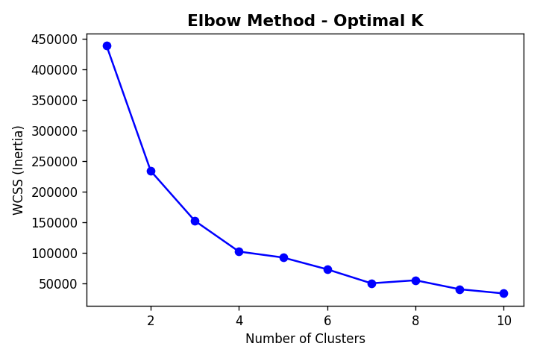
Elbow Method — Optimal Cluster Count
Key Observations
WCSS drops sharply from k=1 to k=5
Elbow point clearly at k = 5
Used as reference by K-Means, BisectingKMeans, Spectral & GMM

Slide 5
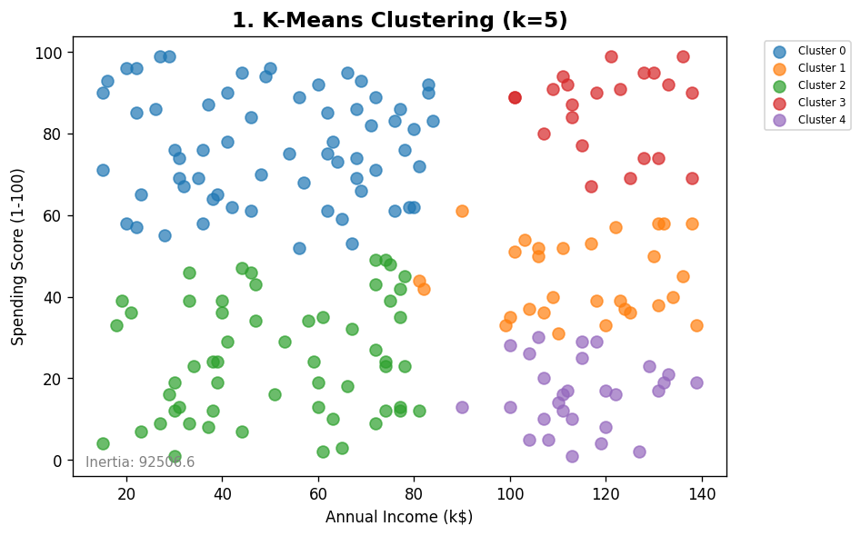
01
K-Means Clustering
Centroid-based · n_clusters=5, init=k-means++
✓ Pros
Fast & scalable
Globally consistent clusters
Interpretable centroids
✗ Cons
Must specify k
Sensitive to outliers
Assumes spherical clusters
Result
5 well-separated customer segments identified. Clear income–score groupings.
★★★★★ Excellent

Slide 6
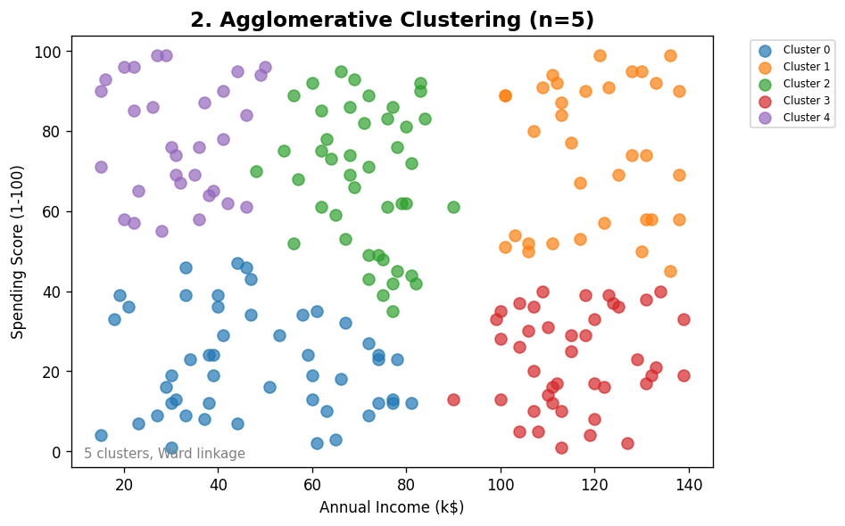
02
Agglomerative Clustering
Hierarchical · n_clusters=5, linkage=Ward
✓ Pros
No need for random init
Dendrogram gives insights
Deterministic
✗ Cons
O(n²) memory
Must specify k upfront
Slower on large data
Result
Clean 5-cluster split similar to K-Means; dendrogram confirms k=5.
★★★★☆ Very Good

Slide 7
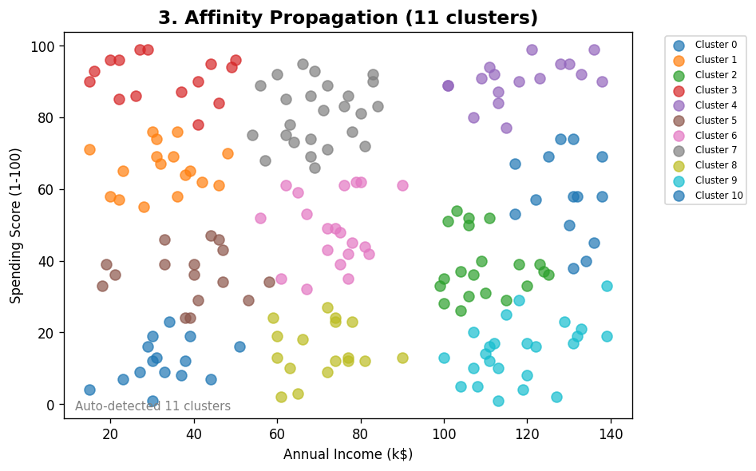
03
Affinity Propagation
Message-Passing · random_state=15
✓ Pros
Auto-detects cluster count
No random initialization
Exemplar-based
✗ Cons
O(n²) complexity
Many clusters possible
Sensitive to damping
Result
Many small clusters detected — may over-segment the mall data.
★★★☆☆ Moderate

Slide 8
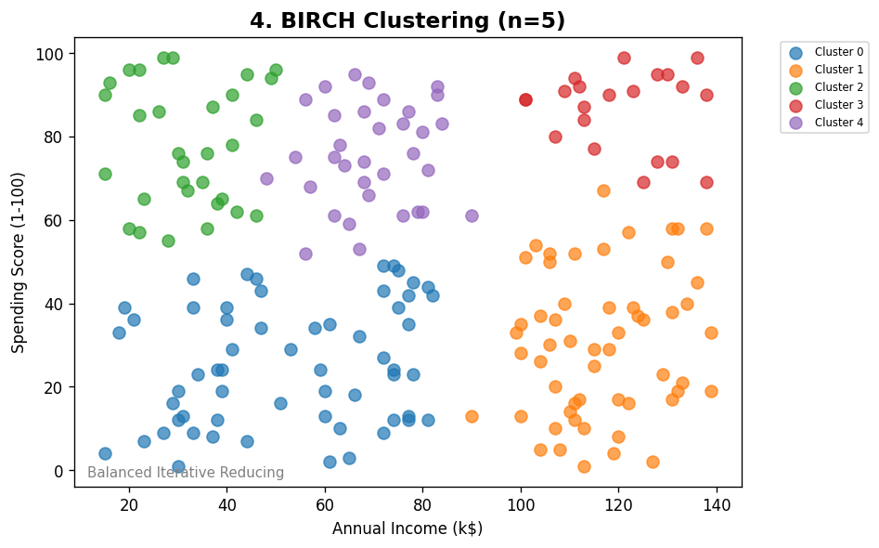
04
BIRCH
Tree-Based · n_clusters=5
✓ Pros
Memory efficient
Fast on large datasets
Good for streams
✗ Cons
Less effective in high dimensions
Sensitive to threshold
Result
Produces 5 clusters comparable to K-Means; efficient performance.
★★★★☆ Very Good

Slide 9
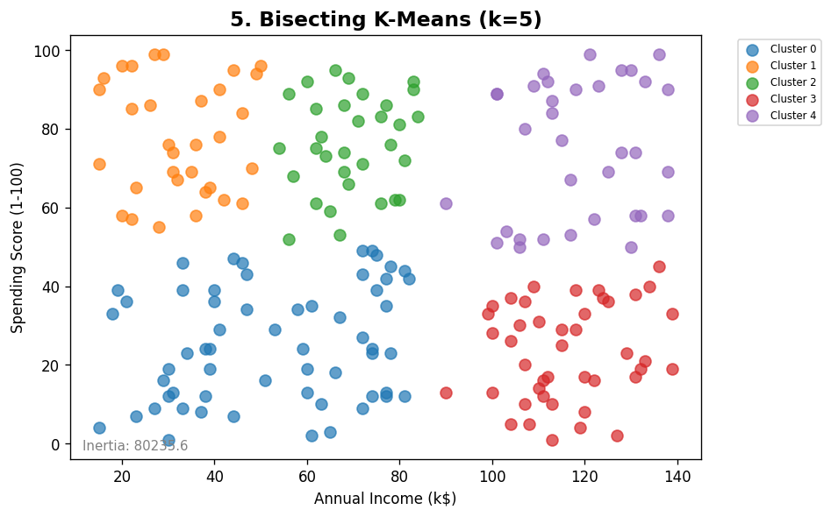
05
Bisecting K-Means
Divisive · n_clusters=5, random_state=42
✓ Pros
More stable than standard K-Means
Hierarchical structure
Scalable
✗ Cons
Bisection decisions are final
Still needs k specified
Result
Results closely match K-Means with slight boundary differences.
★★★★☆ Very Good

Slide 10
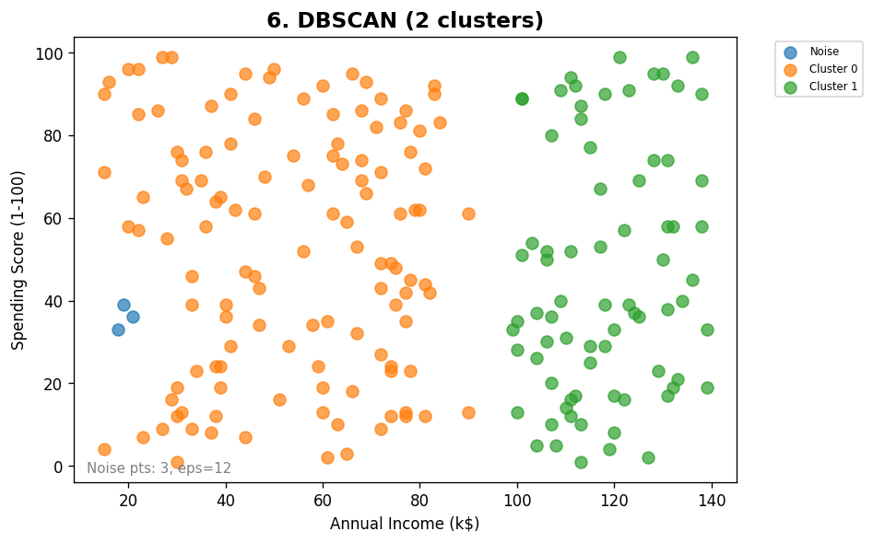
06
DBSCAN
Density-Based · eps=12, min_samples=4
✓ Pros
No need to specify k
Finds arbitrary shapes
Handles noise/outliers
✗ Cons
eps tuning is critical
Struggles with varying density
Not great for uniform data
Result
Handles noise well; cluster count depends on eps — sensitive to tuning.
★★★☆☆ Context-Dependent

Slide 11
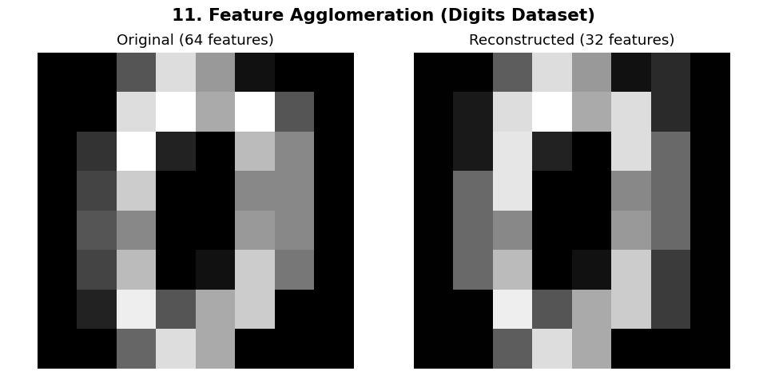
07
Feature Agglomeration
Feature-Side Clustering · n_clusters=32 (features)
✓ Pros
Reduces feature dimensionality
Good for high-dim data
Unsupervised compression
✗ Cons
Not sample clustering
Lossy compression
Loses some fine details
Result
Reduces 64 digit features to 32 — good reconstruction fidelity shown.
★★★☆☆ Different Purpose

Slide 12
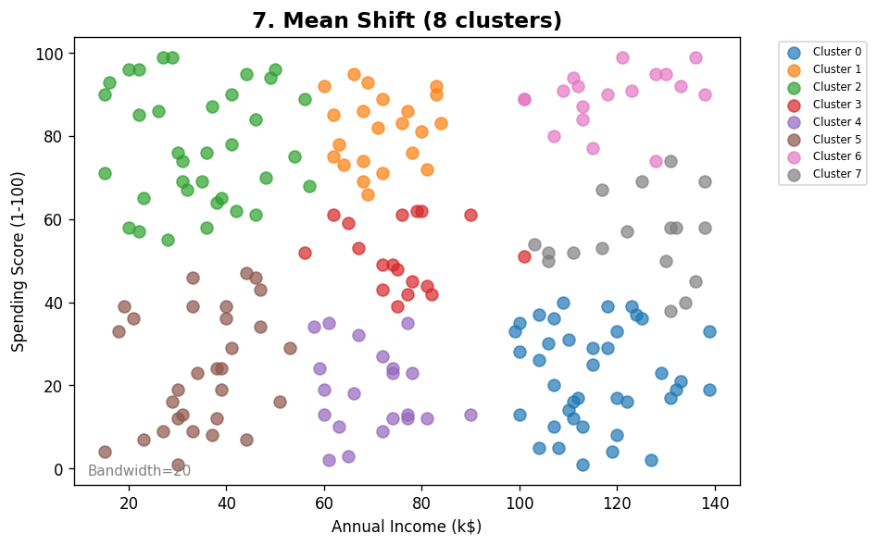
08
Mean Shift
Mode-Seeking · bandwidth=20
✓ Pros
Auto-detects clusters
No assumed shape
Robust to outliers
✗ Cons
Bandwidth must be set
Slow O(n²)
Merges nearby clusters
Result
Good separation with bandwidth=20; compact well-centered clusters.
★★★★☆ Good

Slide 13
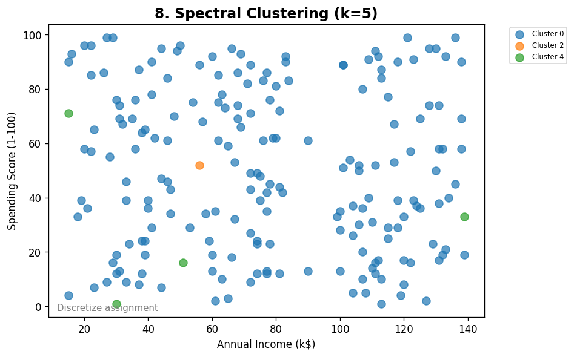
09
Spectral Clustering
Graph-Based · n_clusters=5, assign_labels=discretize
✓ Pros
Handles non-convex shapes
Powerful for complex manifolds
✗ Cons
Expensive O(n³)
Needs k upfront
Sensitive to graph params
Result
5 clusters formed; convergence warning noted — data may be too uniform.
★★★☆☆ Moderate

Slide 14
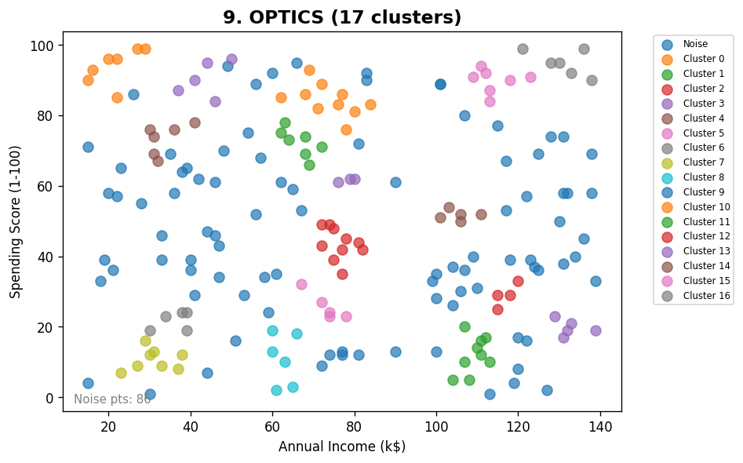
10
OPTICS
Density-Based (Enhanced) · min_samples=4
✓ Pros
Variable density handling
No need to specify eps
Hierarchical output
✗ Cons
Complex output interpretation
Slow on large datasets
Hard to tune
Result
Detects density-connected clusters but may label many points as noise.
★★★☆☆ Moderate

Slide 15
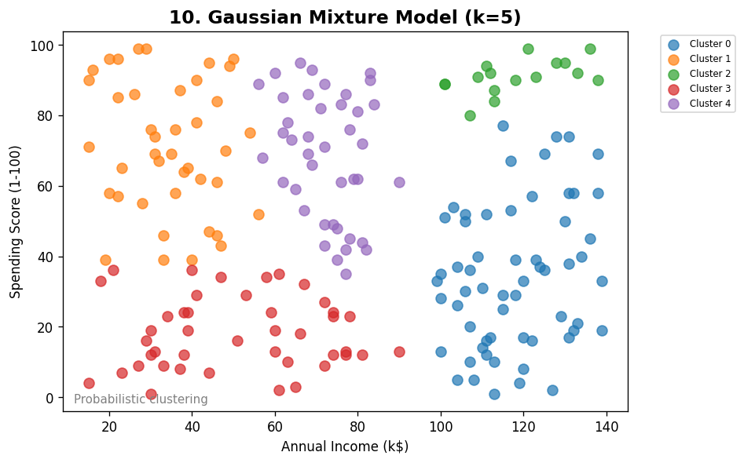
11
Gaussian Mixture Model
Probabilistic · n_components=5, random_state=0
✓ Pros
Soft cluster assignments
Handles elliptical clusters
EM-based, principled
✗ Cons
Needs k specified
Can overfit with many components
Slower than K-Means
Result
Smooth probabilistic boundaries; slightly different from hard clustering.
★★★★☆ Very Good

Slide 16
Algorithm Comparison & Verdict
Algorithm
Clusters
Noise
Speed
Interpretability
Rating
K-Means
5 (set)
None
Fast
High
★★★★★
Agglomerative
5 (set)
None
Med
High
★★★★☆
Affinity Prop
Auto
None
Slow
Med
★★★☆☆
BIRCH
5 (set)
None
Fast
Med
★★★★☆
Bisecting K-M
5 (set)
None
Fast
High
★★★★☆
DBSCAN
Auto
Yes
Med
Med
★★★☆☆
Feature Agglo
N/A
N/A
Fast
Low
★★★☆☆
Mean Shift
Auto
None
Slow
Med
★★★★☆
Spectral
5 (set)
None
Slow
Low
★★★☆☆
OPTICS
🏆 BEST for Mall Data: K-Means (k=5) — Fast, interpretable, clean 5-segment split confirmed by elbow method
Auto
Yes
Slow
Low
★★★☆☆
Gauss. Mixture
5 (set)
None
Med
High
★★★★☆

