Slide 1


Slide 2
contents
Initial Look
Check for categorical and numeric variables
Results of EDA for categorical variables
  Important variables likely to affect outcome
Check of continuous variables for missing values and outliers
Correlation of numeric variables with outcome variable
  Important variables likely to affect outcome
Model Building
  Logistics Regression
  Decision Tree
Scorecard Building
Financial benefit of model

Slide 3
Initial Look
Problem Statement reads
“Both files contain a performance tag which represents whether the applicant has gone 90 days past due or worse in the past 12-months (i.e. defaulted) after getting a credit card.”
  Performance Tag column showed number of bads = 2,948
  No of defaulters per the 90 DPD in last 12 months = 20,754
Assumption being the Performance Tag column is not updated correctly, it was updated as per the 90 DPD in the last 12 months
  Could have gone with the original data but there was no ‘client’ we could ask to verify authenticity of data and hope this assumption does not adversely affect our project

Slide 4
Check for categorical and numeric variables, Duplicates, Conversions
Age, No of dependents, Income, No of months in current residence, No of months in current company, No of times DPD, No of trades opened in last xx months, No of PL trades opened in last xxx months, No of inquiries in last xxx months, outstanding balance, total no of trades are numeric
Presence of open home loan, presence of open auto loan were changed from integer to categorical; gender, marital status, education, profession, type of residence are categorical
3 duplicates found in each file and removed
Presence of open home loan and open auto loan were converted to categorical
Performance Tag data was updated from 1 and 0 to “Yes” and “No” for better understanding when doing EDA

Slide 5
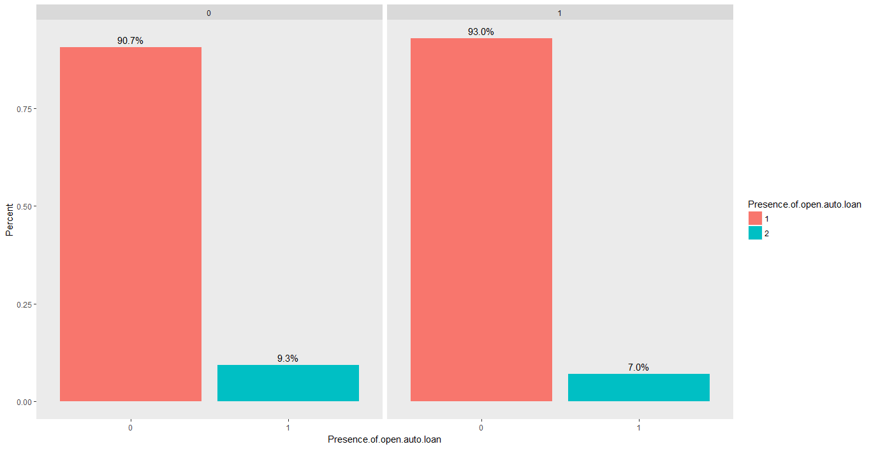
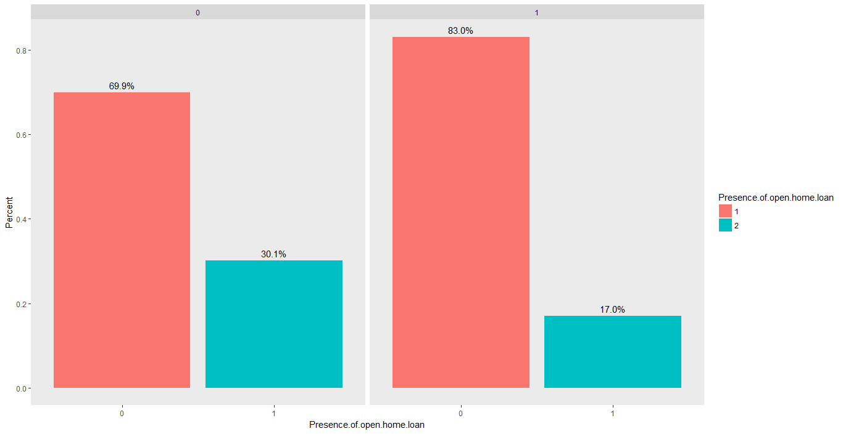
Results of EDA for categorical variables
None of the categorical variables were seen to significantly affect the outcome variable except the “presence of open home loan” and “presence of open auto loan”. In both these categories, the % of bads were lesser in case the people had an open home or auto loan. Does presence of a loan make a person more financially responsible?
It is likely that of a model is constructed out of only the demographic data, it may not accurate, specific or sensitive
Presence of open auto loan
Presence of open home loan

Slide 6
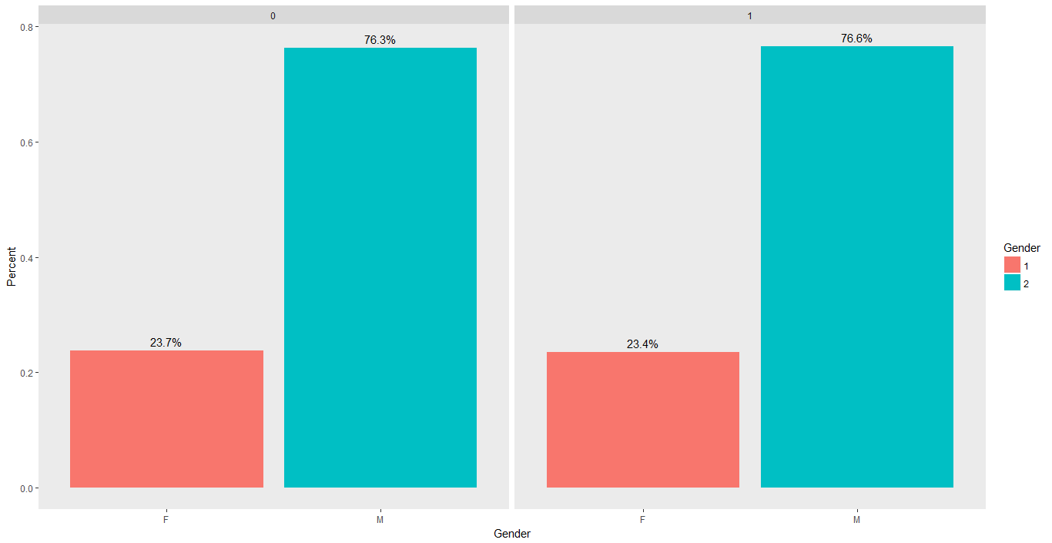
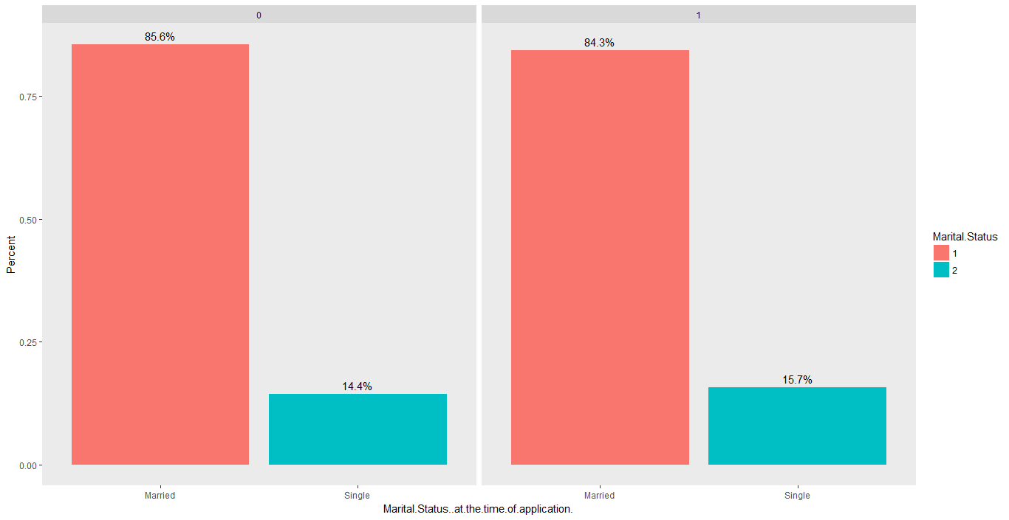
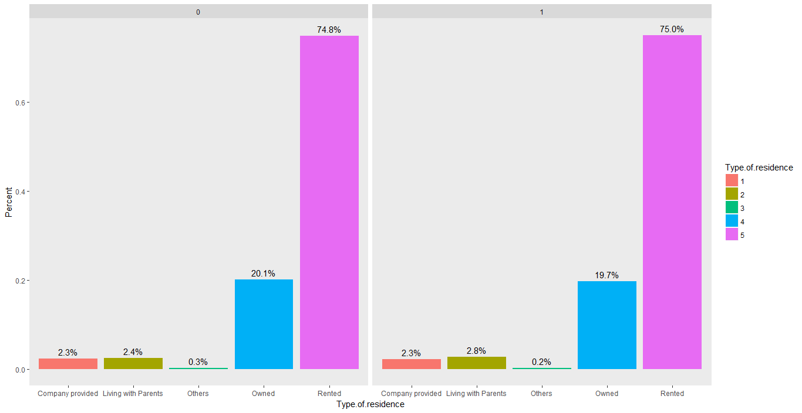
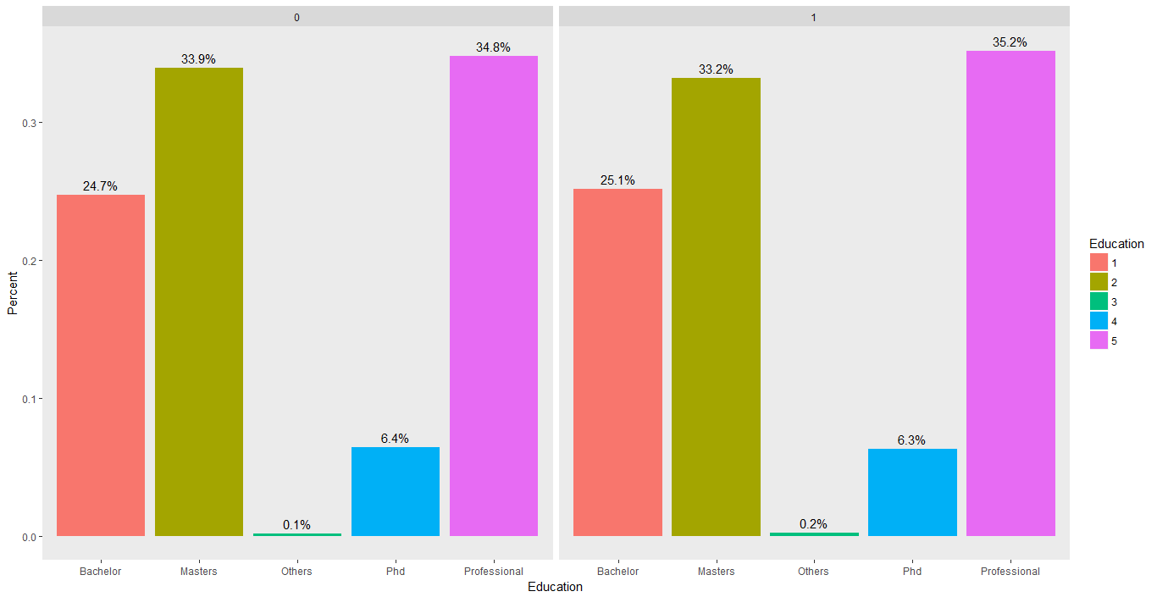
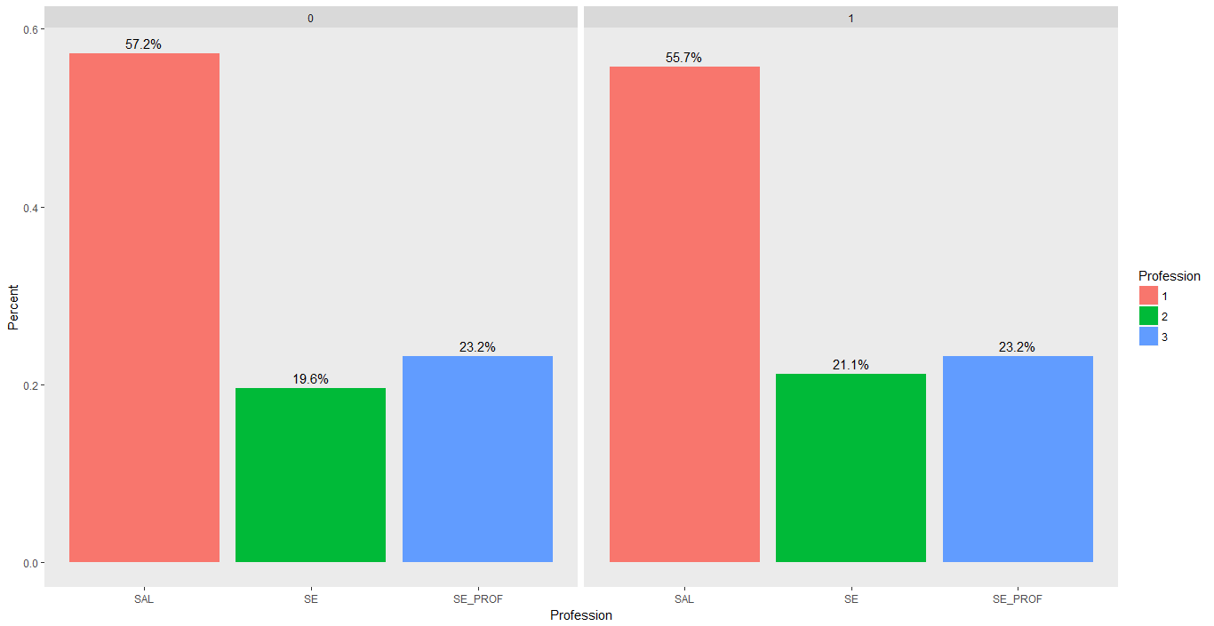
Categorical Variables against Performance
Gender
Marital Status
type of residence
Education
profession

Slide 7
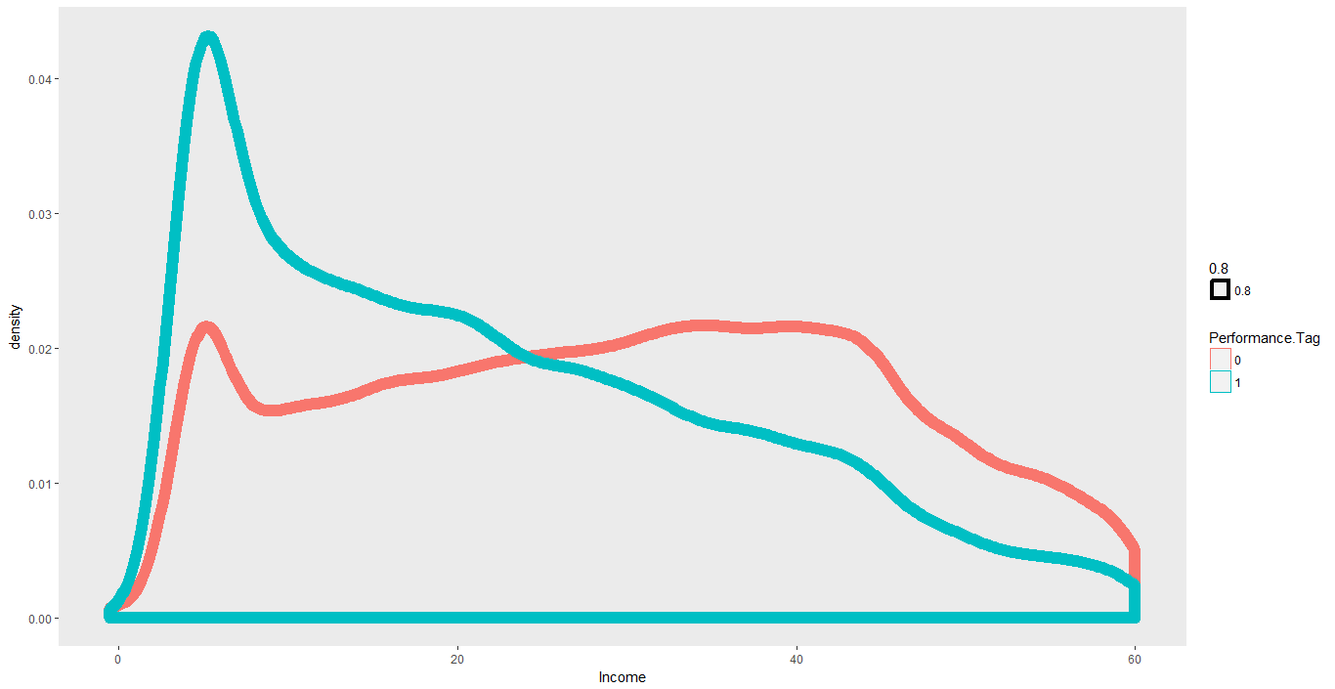
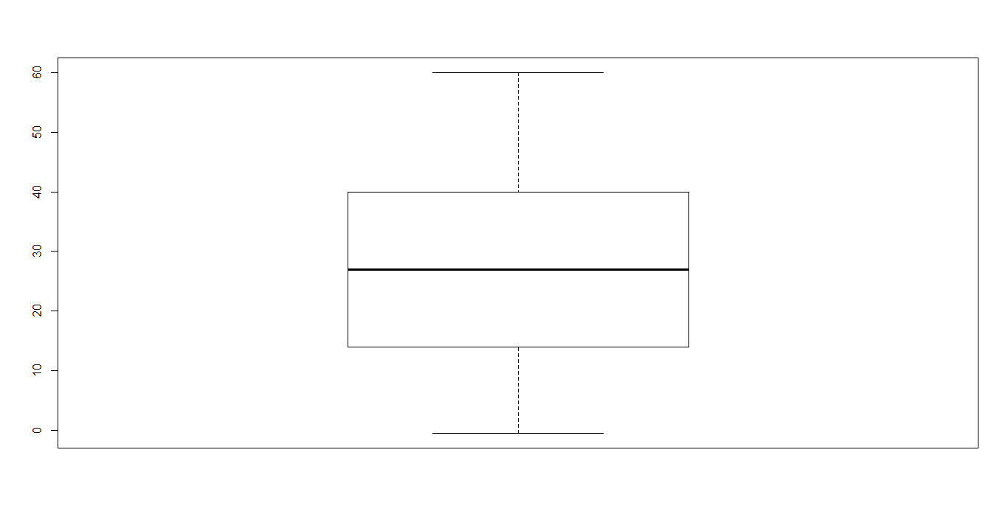
Analysis of numeric variables for outliers - Income
Income density plot against performance
Income Box plot
It is seen that the people who have not defaulted seem to have a higher income on average and overall

Slide 8
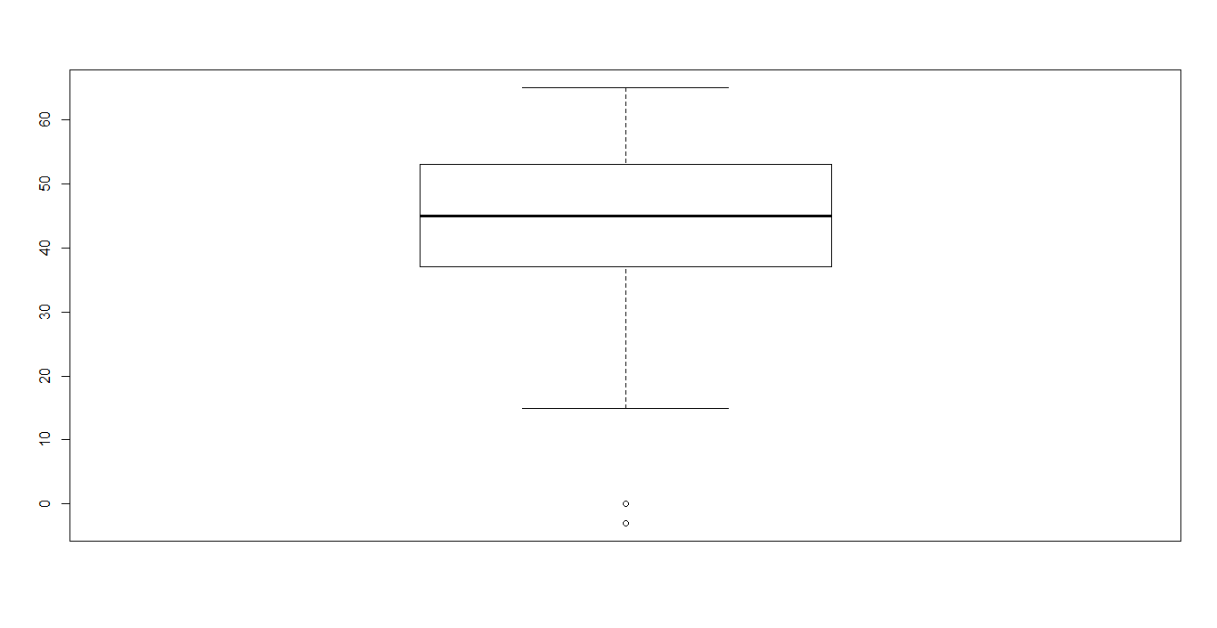
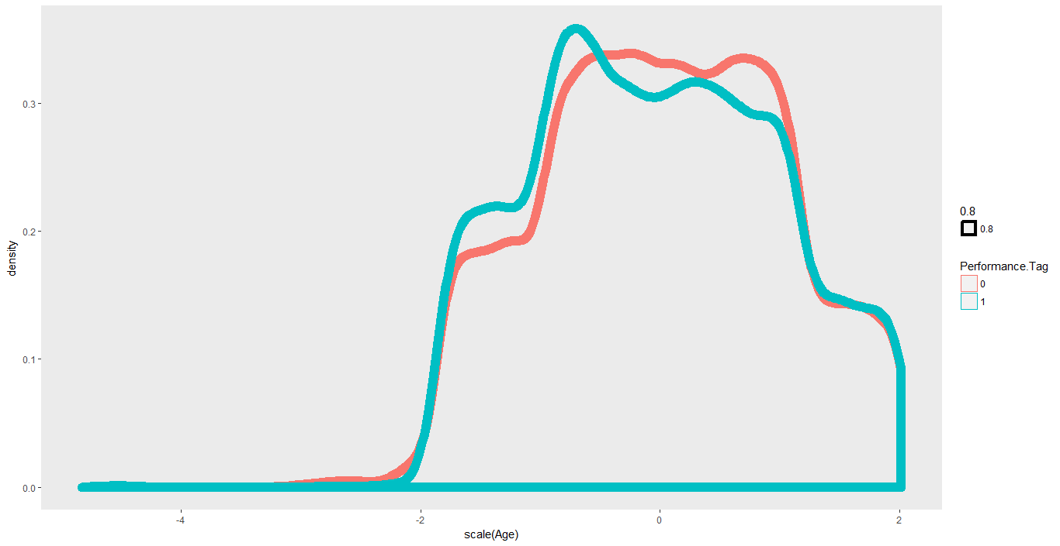
Analysis of numeric variables for outliers - Age
Age density plot against performance
Age Box plot (Outliers are removed)

Slide 9
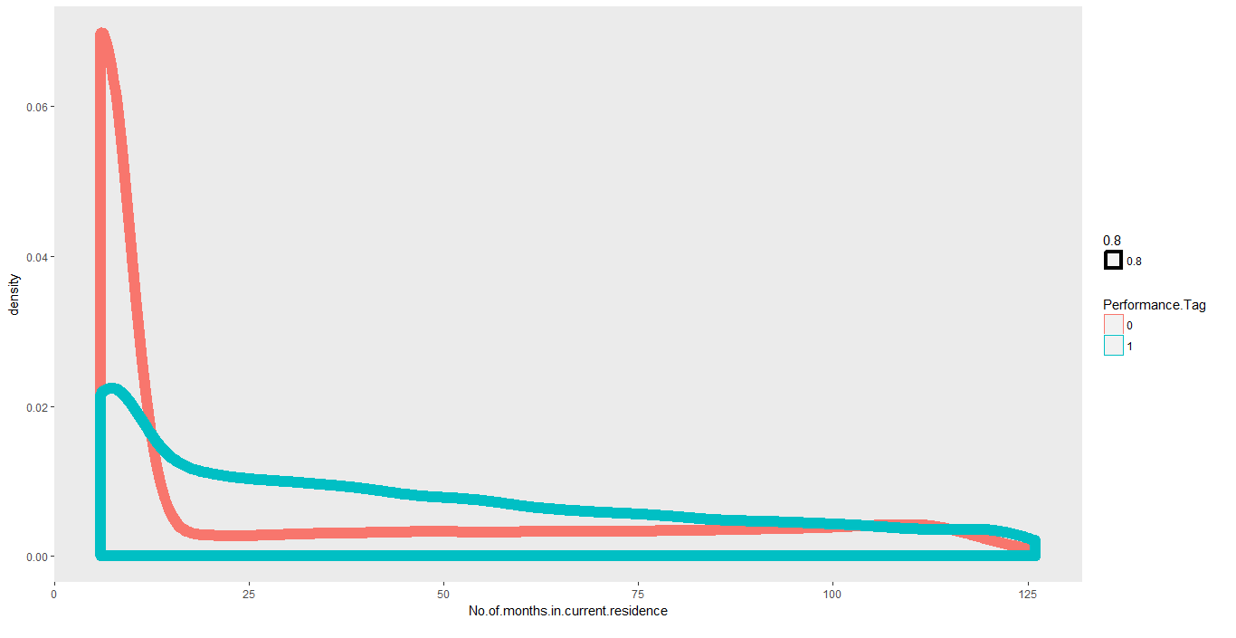
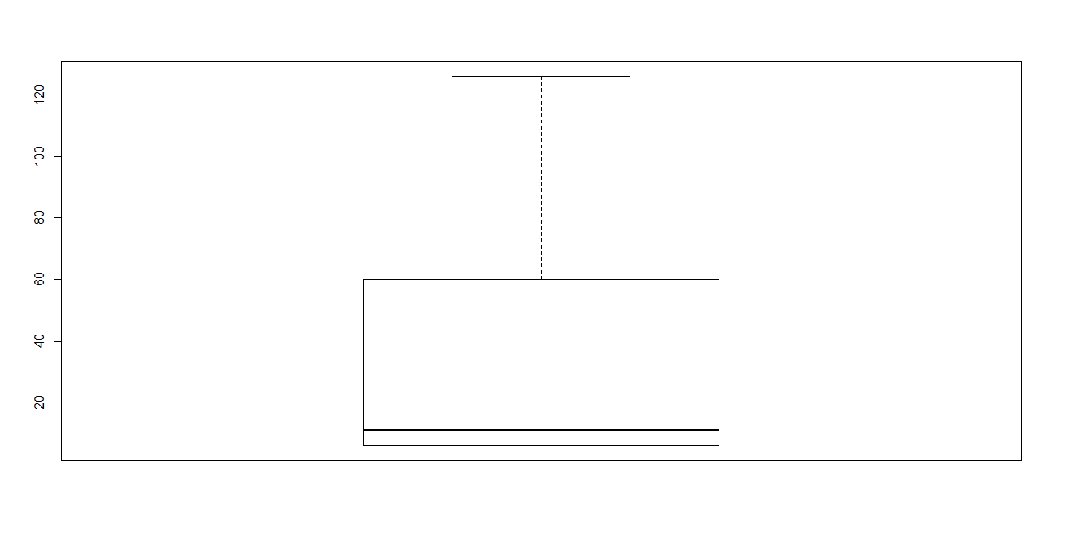
Analysis of numeric variables for outliers – No of months in current residence
No of Months density plot)
No of Months Box plot (No outliers)
People who have not defaulted seem to have stayed lesser in current residence

Slide 10
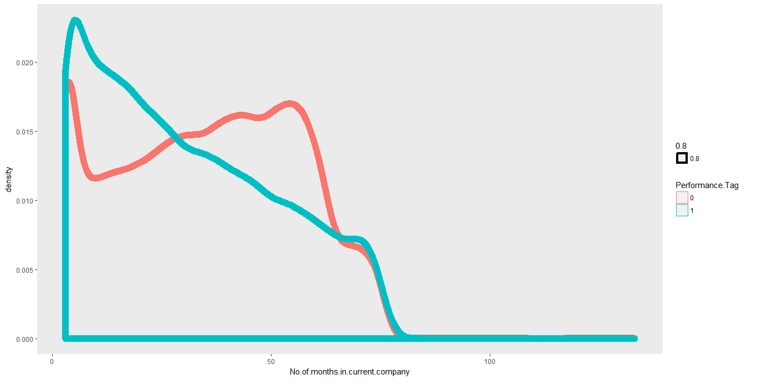
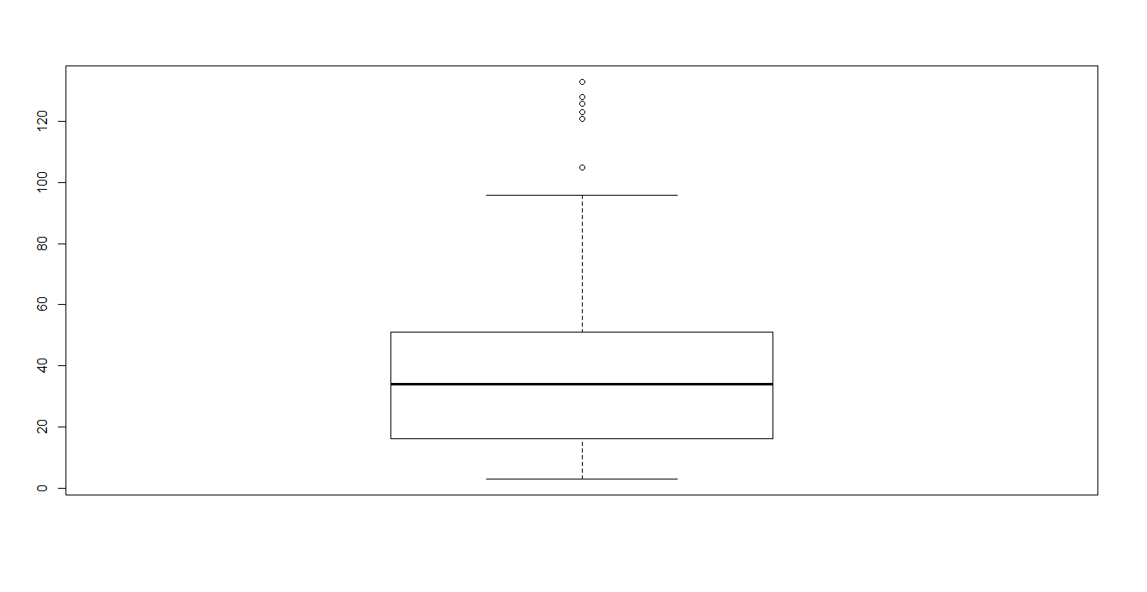
Analysis of numeric variables for outliers – No of months in current company
No of Months in a company density plot
No of Months Box plot (Outliers removed)
People who have not defaulted seem to have stayed longer in current company

Slide 11
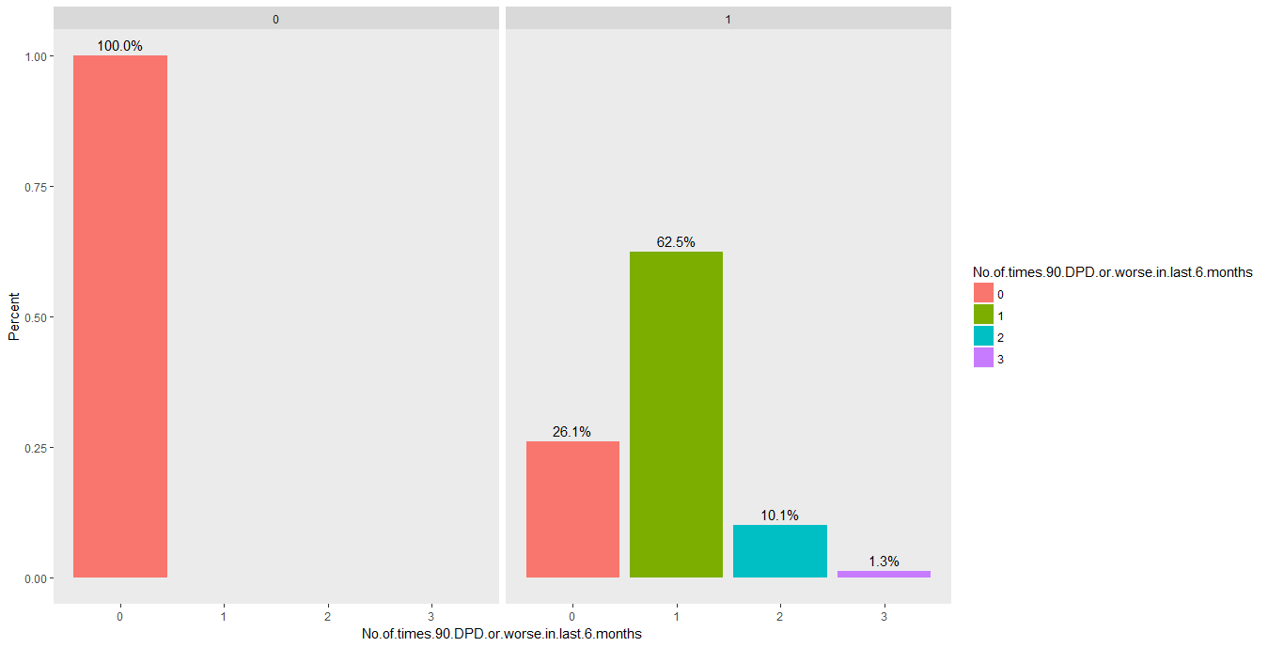
Analysis of numeric variables – 90 DPD in 6 months
People who have not defaulted are seen to have not defaulted 90 DPD 6 months

Slide 12
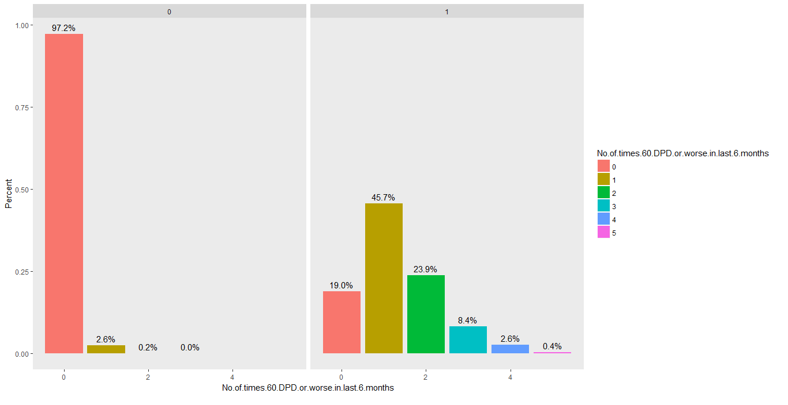
Analysis of numeric variables– 60 DPD in 6 months
People who have not defaulted are seen to have not defaulted 60 DPD 6 months

Slide 13
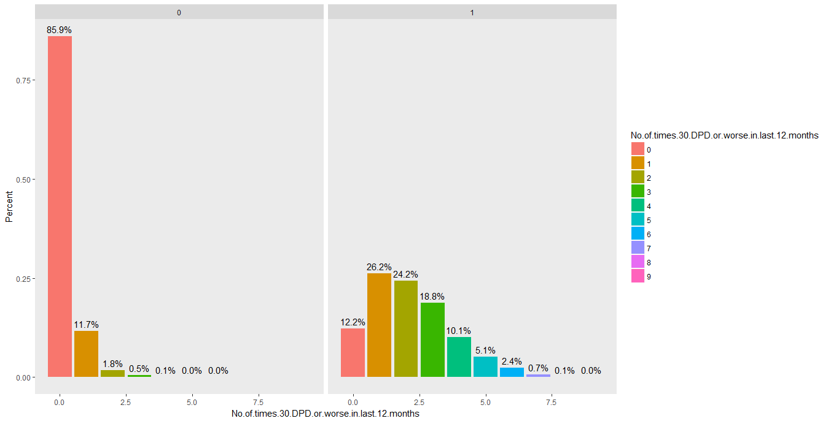
Analysis of numeric variables– 30 DPD in 6 months
Most people who have not defaulted are seen to have not defaulted 30 DPD 6 months

Slide 14
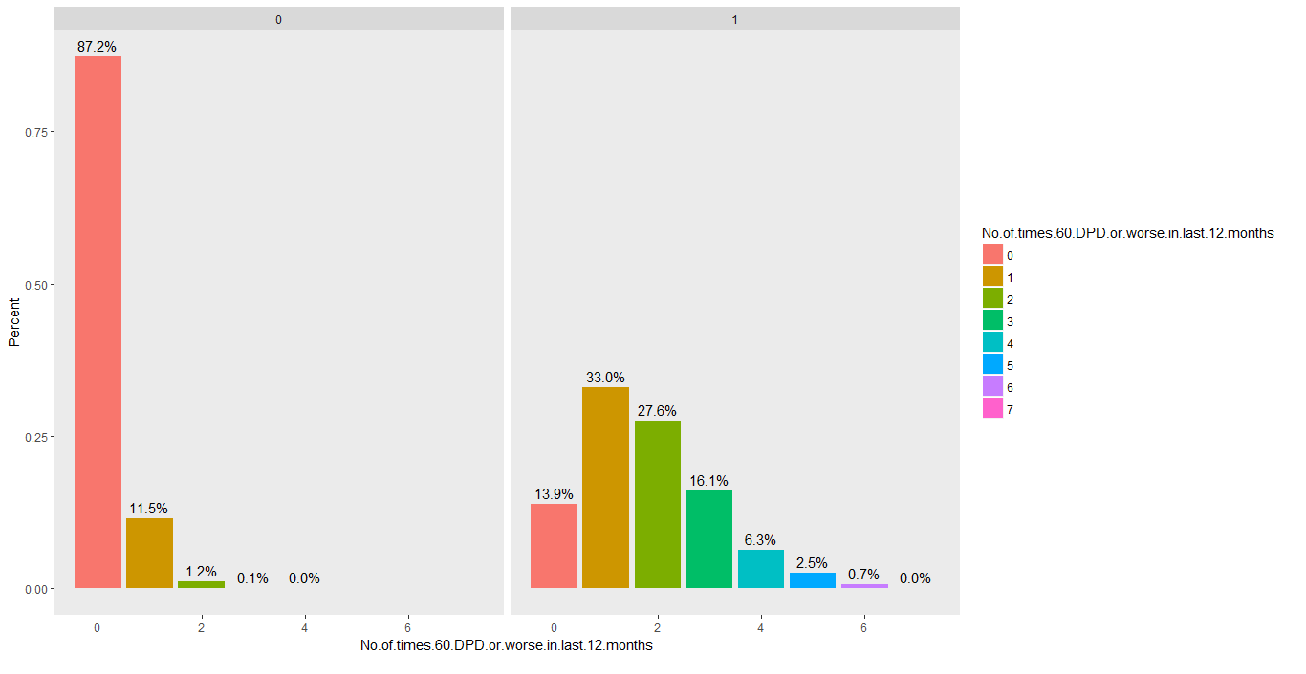
Analysis of numeric variables – 60 DPD in 12 months
Most people who have not defaulted are seen to have not defaulted 60 DPD in 12 months

Slide 15
Analysis of numeric variables for outliers – 30 DPD in 12 months
Most people who have not defaulted are seen to have not defaulted 30 DPD in 12 months

Slide 16
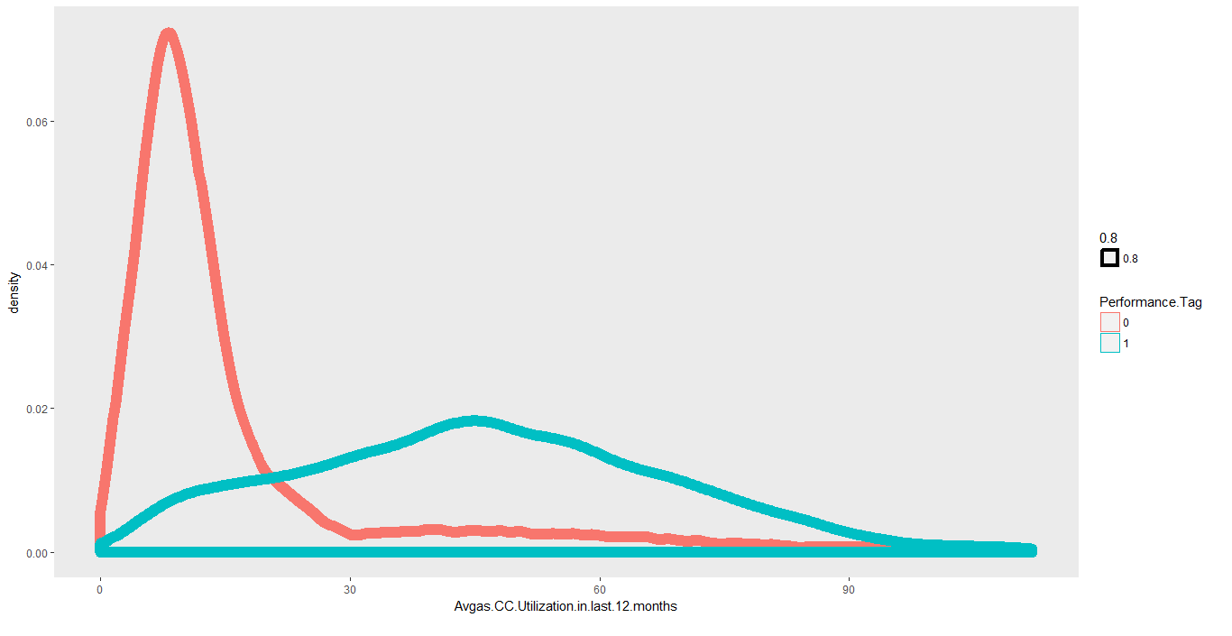
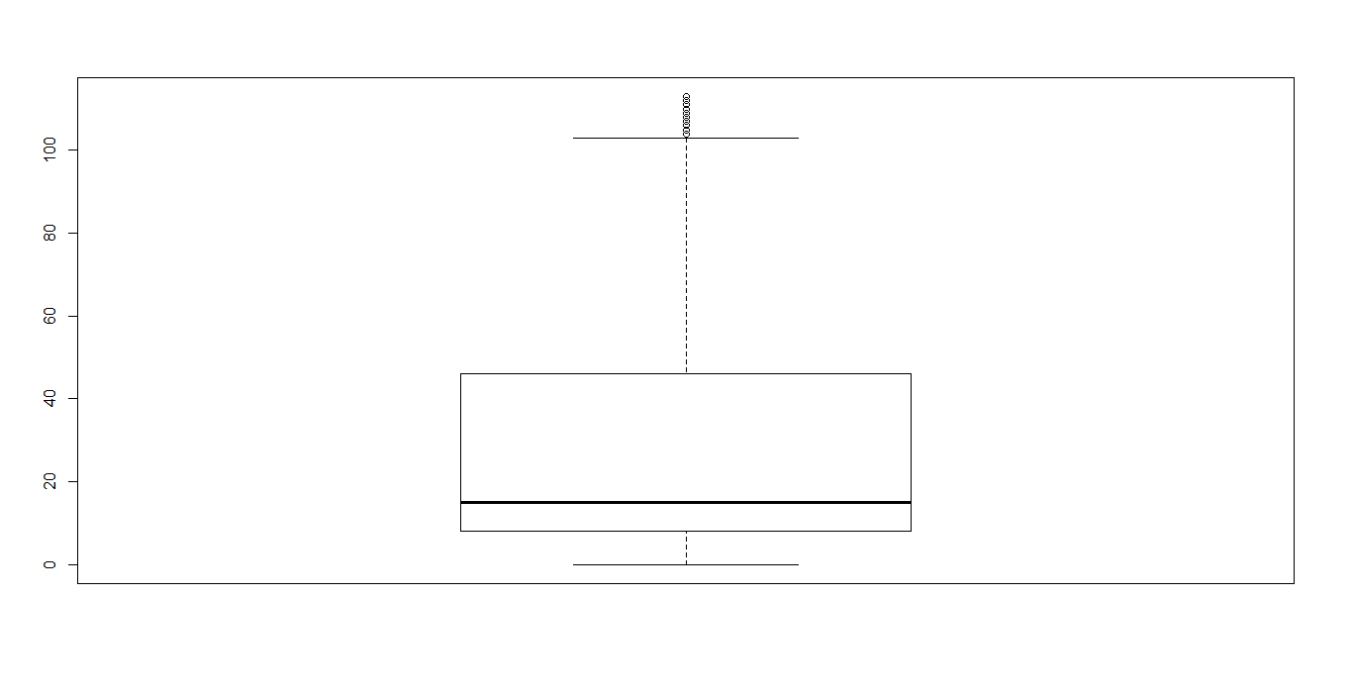
Analysis of numeric variables for outliers – Avg CC utilization in 12 months
Avg CC utilization density plot
Deleted outliers at the extreme right due to unnatural spike
People who have not defaulted are seen to low CC utilization in 12 months

Slide 17
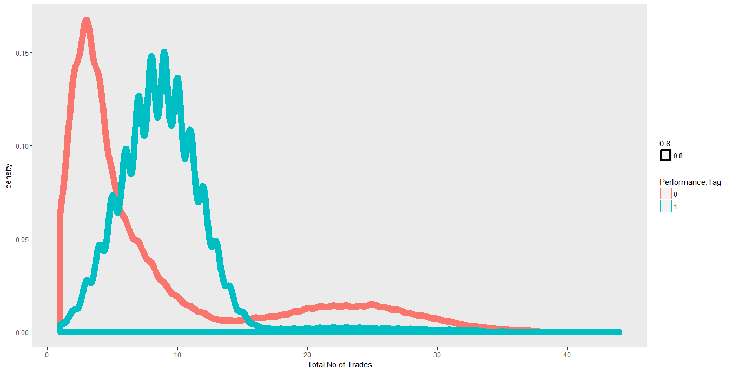
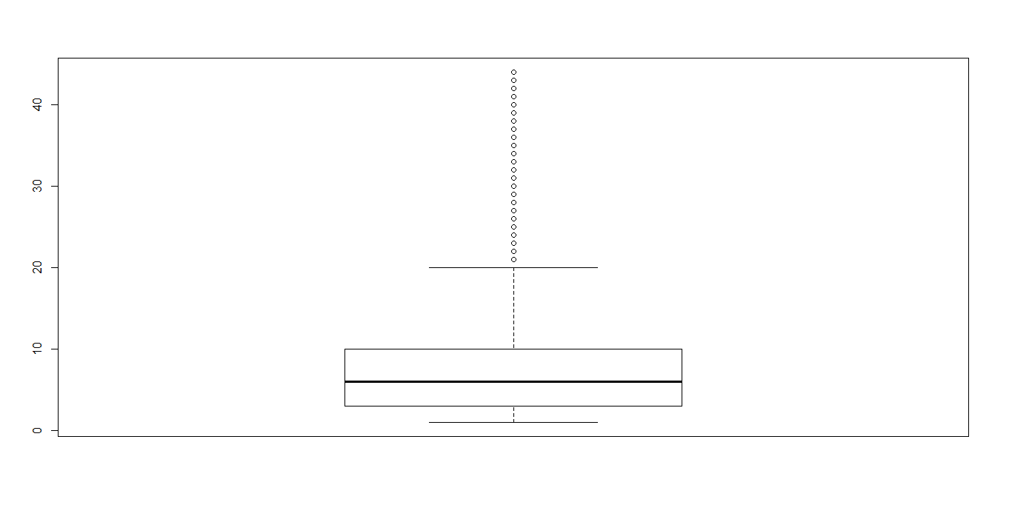
Analysis of numeric variables for outliers – No of trades opened in 12 months
Number of trades density plot
No outliers
People who have not defaulted are seen to have less trades in 6 months

Slide 18
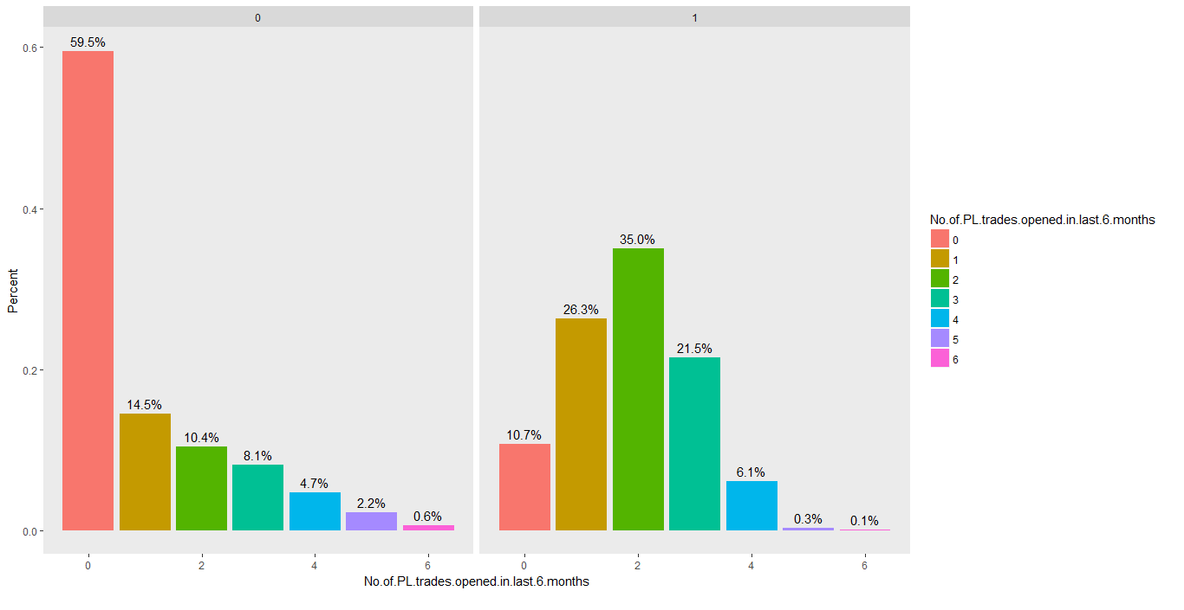
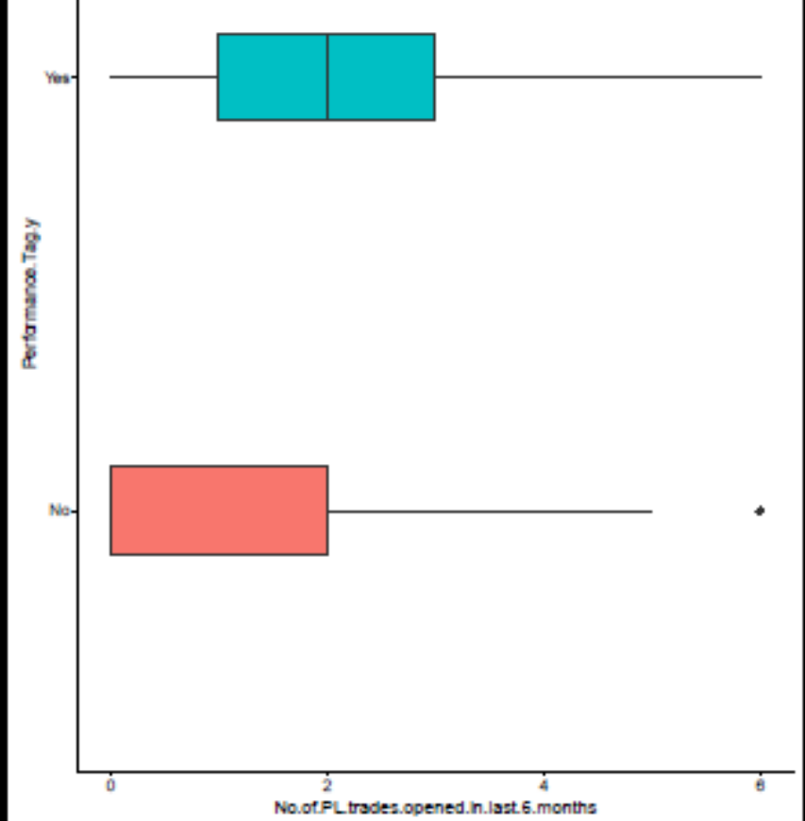
Analysis of numeric variables for outliers – No of PL trades opened in 6 months
People who have not defaulted are seen to have low no of PL trades in 6 months

Slide 19
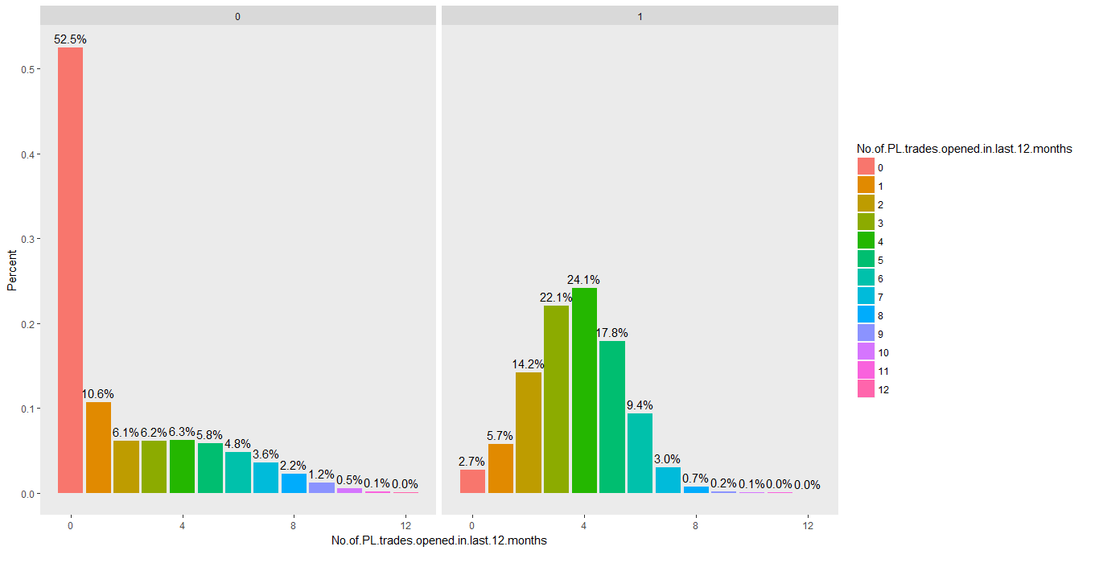
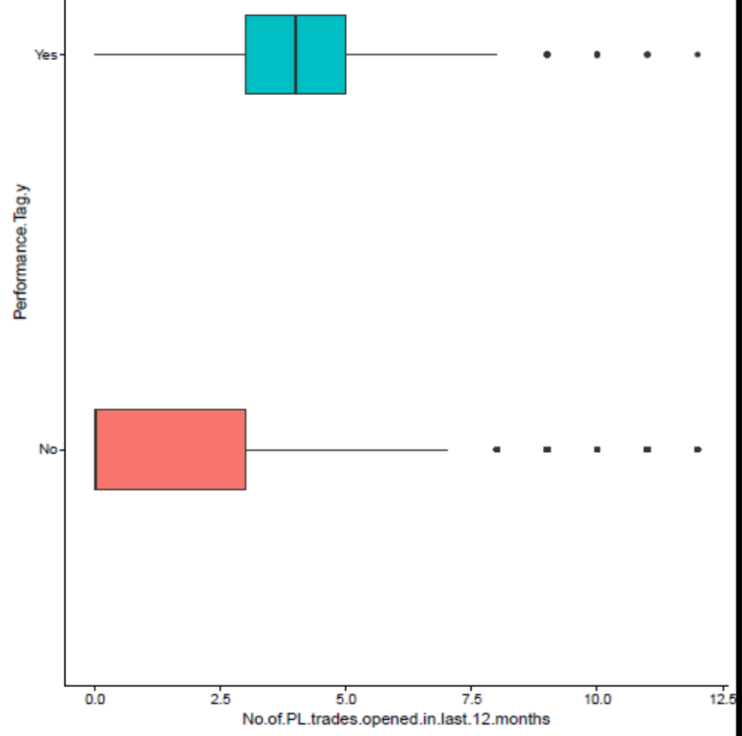
Analysis of numeric variables for outliers – No of PL trades opened in 12 months
People who have not defaulted are seen to have low no of PL trades in 12 months

Slide 20
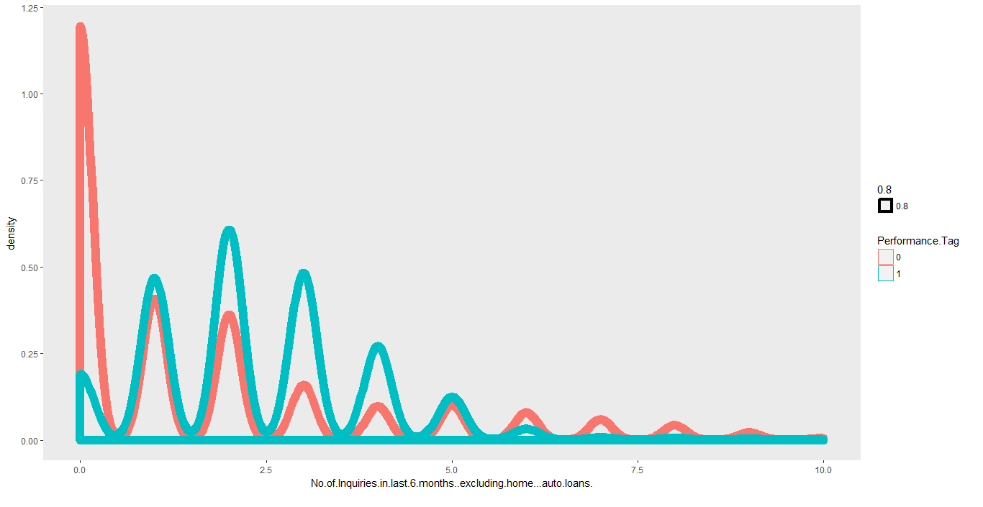
Analysis of numeric variables– No of inquiries in the last 6 months excluding home/auto loans
Number of trades density plot
People who have not defaulted are seen to have low no of inquiries excluding home and auto loans in the last 6 months

Slide 21

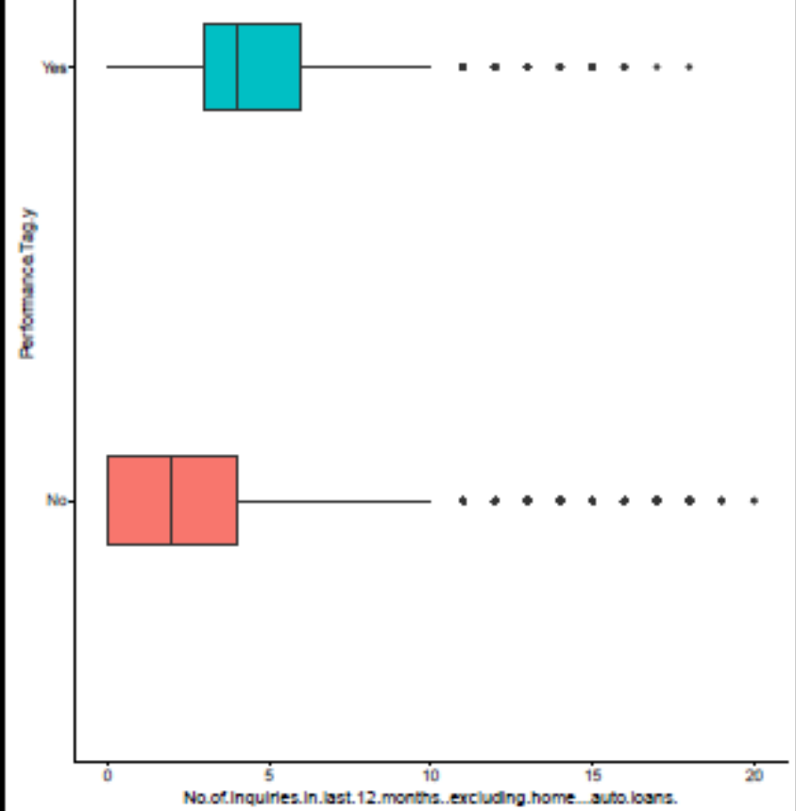
Analysis of numeric variables– No of inquiries in the last 12 months excluding home/auto loans
People who have not defaulted are seen to have low no of inquiries excluding home and auto loans in the last 12 months

Slide 22
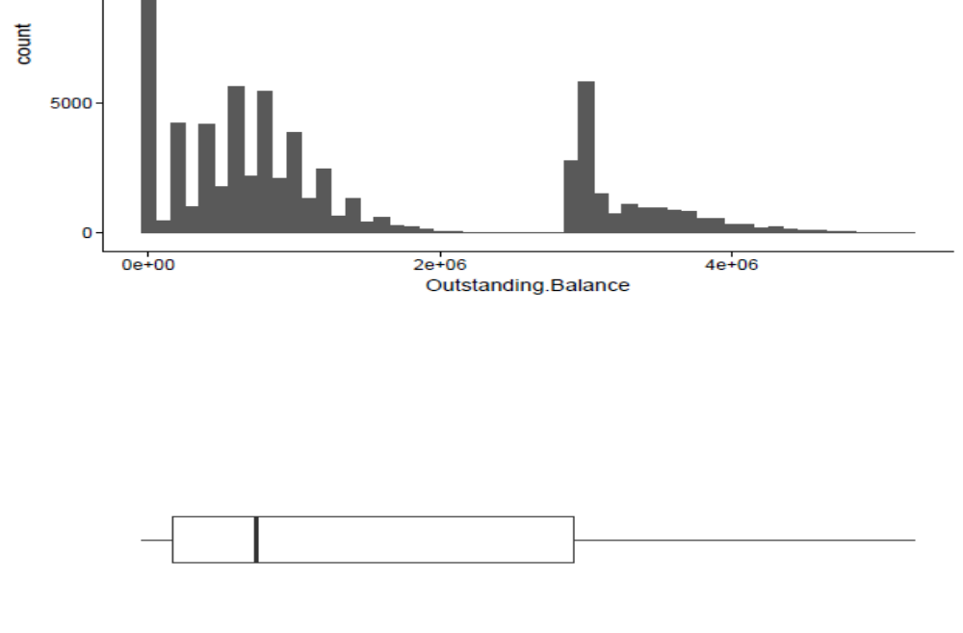
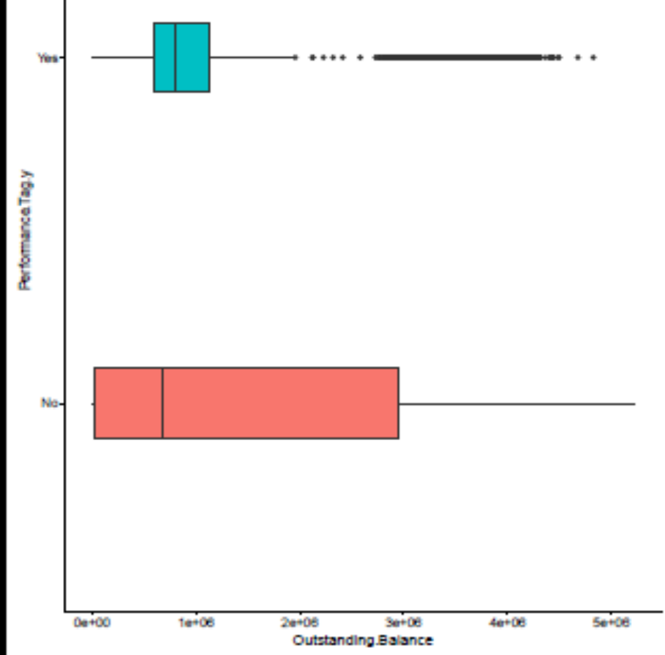
Analysis of numeric variables for – Outstanding Balance
Break in outstanding balance but probably some good reason because there are a number of records before and after the break, so did not delete any records
Outstanding balance doesn’t seem to correlate well with the outcome variable

Slide 23

Analysis of numeric variables for– Total no of trades
People who have not defaulted are likely to have a low total number of trades

Slide 24
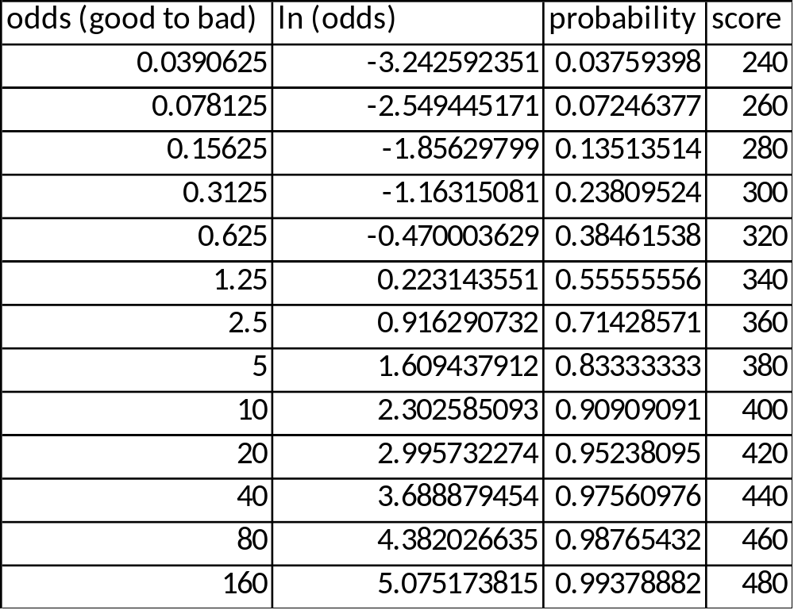
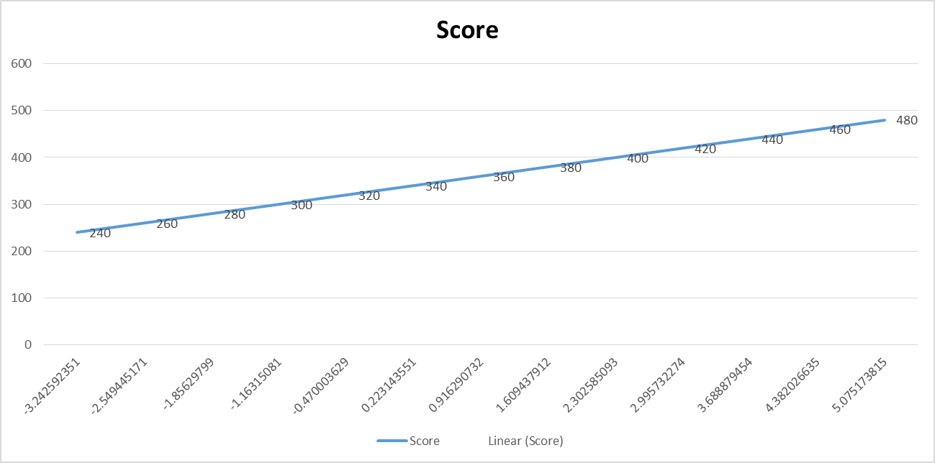
Scorecard building
Score vs Ln Odds

Slide 25
Model Building
Scaled the continuous variables
Checked the number of people defaulted (“bads” = 31%
Created a data frame of categorical features to make dummy variables
Merged dummy variables data frame with the continuous variables dataframe
Certain dummy variables were not created one less than the total varieties and therefore one column among them deleted
Model With Demographic Data
Model Name | Accuracy | Sensitivity | Specificity
Logistic regression | 72.37 | 22.3 | 93.1
Random Forest | 60.54 | 90.52 | 43.84
Decision Tree | 67.8 | 88.25 | 49.39
Model With Demographic and Credit Bureau data
Model Name | Accuracy | Sensitivity | Specificity
Logistic regression | 92.38 | 86.41 | 96.7
Random Forest | 97.34 | 93.31 | 99.3
Decision Tree | 97.43 | 96.9 | 99.1

Slide 26
Model Building – Key Indicators
Model Name | Key Indicators
Logistic regression | Income,No.of.months.in.current.company,No.of.times.30.DPD.or.worse.in.last.6.months,No.of.times.30.DPD.or.worse.in.last.12.months No.of.PL.trades.opened.in.last.12.months,Type.of.residence.xOthers,No.of.months.in.current.residence No.of.times.60.DPD.or.worse.in.last.6.months,No.of.times.60.DPD.or.worse.in.last.12.months,Avgas.CC.Utilization.in.last.12.months No.of.PL.trades.opened.in.last.6.months,No.of.Inquiries.in.last.12.months..excluding.home...auto.loans.,Total.No.of.Trades Presence.of.open.home.loan
Random Forest | No.of.times.90.DPD.or.worse.in.last.12.months,No.of.times.60.DPD.or.worse.in.last.6.months ,No.of.times.90.DPD.or.worse.in.last.6.months No.of.times.30.DPD.or.worse.in.last.6.months,No.of.times.60.DPD.or.worse.in.last.12.months,No.of.times.30.DPD.or.worse.in.last.12.months Avgas.CC.Utilization.in.last.12.months,Outstanding.BalanceNo.of.PL.trades.opened.in.last.12.months No.of.months.in.current.company,Income
Decision Tree | Income,No.of.months.in.current.company,No.of.times.30.DPD.or.worse.in.last.6.months,No.of.times.30.DPD.or.worse.in.last.12.months No.of.PL.trades.opened.in.last.12.months,Type.of.residence.xOthers,No.of.months.in.current.residence No.of.times.60.DPD.or.worse.in.last.6.months,No.of.times.60.DPD.or.worse.in.last.12.months,Avgas.CC.Utilization.in.last.12.months No.of.PL.trades.opened.in.last.6.months,No.of.Inquiries.in.last.12.months..excluding.home...auto.loans.,Total.No.of.Trades Presence.of.open.home.loan

Slide 27
Financial Analysis
Probability cutoff for “bad” should depend on what value generates max profit
For each probability cutoff value from 0 to 1 in steps of 0.05, profitability was calculated as follows
  Benefit of model
    No of customers rejected by model for that cutoff and who actually defaulted
    Sum of Outstanding balance saved for these people since that is the total loss to the bank
  Loss due to model
    No of customers rejected by the model for that cutoff but did not default
    Sum of outstanding balance of this population
    Assuming 18% interest on outstanding balance lost by bank
  Profit = Benefit of model – Loss due to model

Slide 28
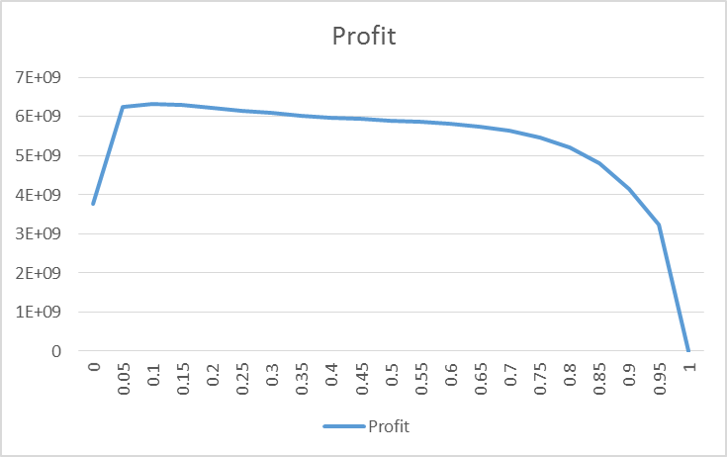
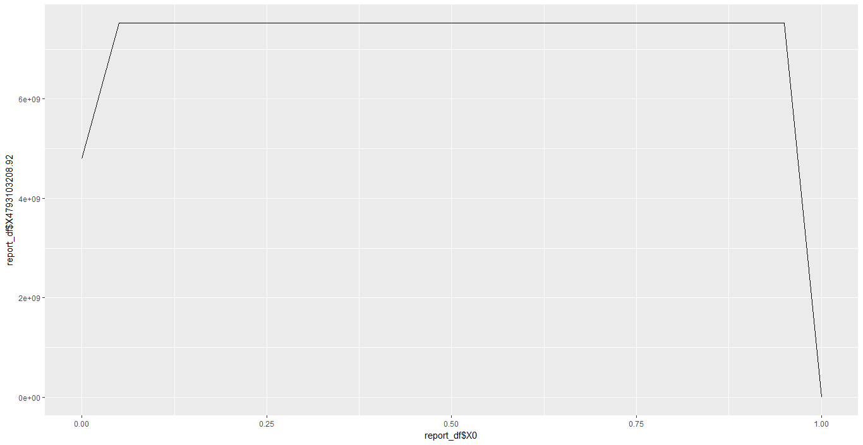
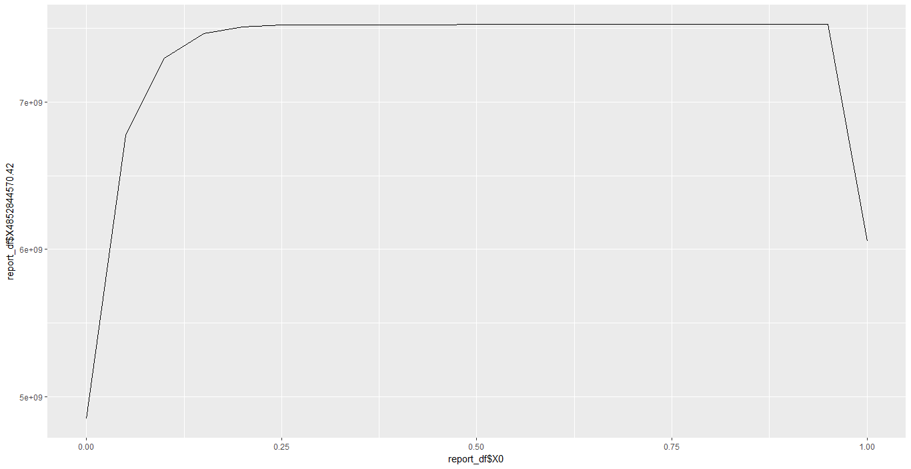
Financial Analysis
Model Name | Profit plot for different cutoff | Maximum Profit | Cutoff
Logistic regression |  | 6325129996 | 0.1
Random Forest |  | 6574889948 | 0.2
Decision Tree |  | 7100809034 | 0.1

Slide 29
Conclusion
All the three models Logistic Regression, Random Forest and Decision Tree provides comparable prediction.
  Seen to peak at 0.1 probability cutoff
  From scorecard, 0.1 cutoff corresponds to a score of ~270
  Plug in a new customer attributes into the model, calculate probability and from the table of probability vs score find the score and reject credit card if score < 270.

