Slide 1
Install Aspen & Aspen HYSYS – Python interface
10/23/2019
Jonggeol Na

Slide 2
Install Aspen

Slide 3
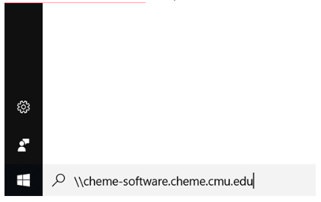
Accessing Software Share in CMU ChmE
1. Click Start and then type \\cheme-software.cheme.cmu.edu and press

Slide 4
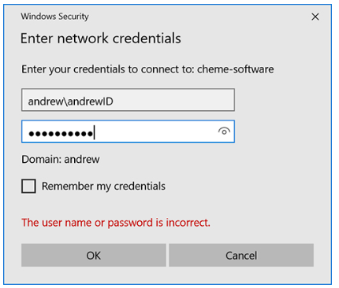
Accessing Software Share in CMU ChmE
2. You will be prompted with a box titled Enter Network Password as shown below:
In the Username field, type andrew\AndrewId, where AndrewId is your given Andrew ID from the university. In the Password field, type in your Andrew password.

Slide 5
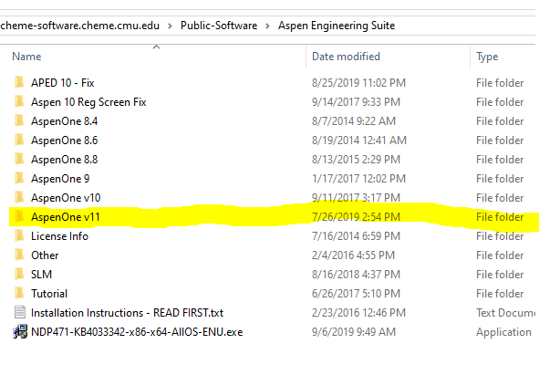
Copy AspenOne V11 folder
3. If you have done this correctly, a window titled cheme-software will open, and you have successfully connected to the server.
4. Double-click on the Public-Software folder.
5. Copy AspenOne v11 (~11 Gb) in your local Computer

Slide 6
Installation Instructions
Deatiled Installation Instructions are located here:
https://www.cmu.edu/cheme/computing/software/licensed-software-list/aspen-engineering-suite.html

Slide 7
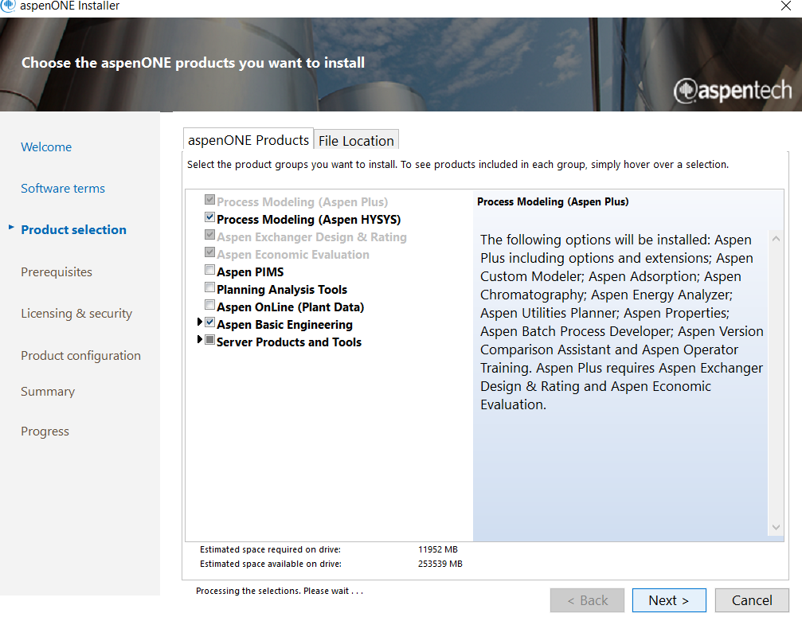
Installation Instructions
Run Setup.exe in ../aspenONE_V11_ENG
Please add Process Modeling (Aspen HYSYS)

Slide 8
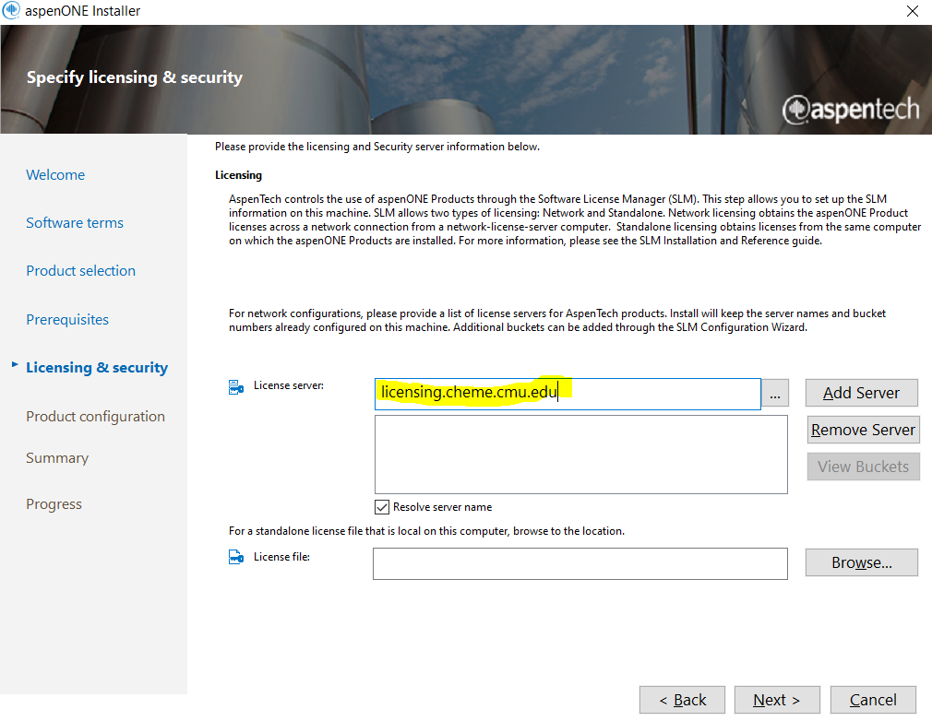
Installation Instructions
License Server: licensing.cheme.cmu.edu
Confgure Buckets: Default
Click add Server before click Next

Slide 9
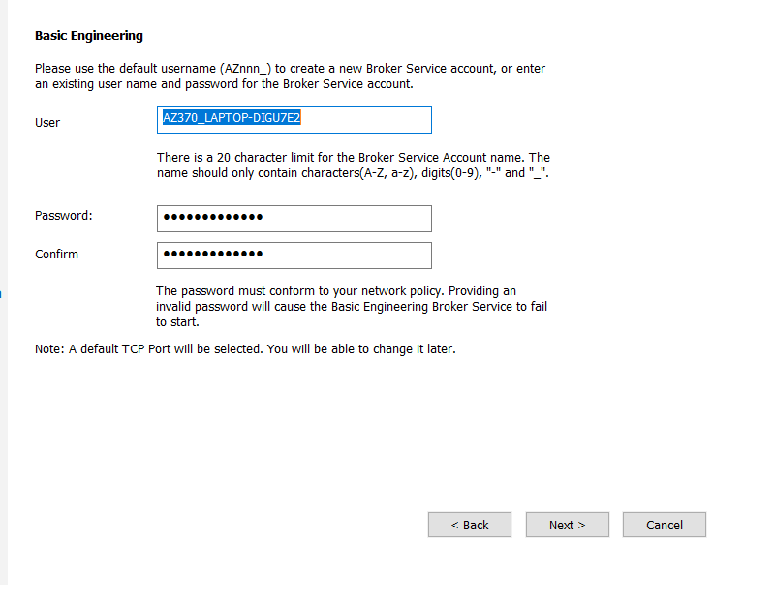
Installation Instructions
Type password you like

Slide 10
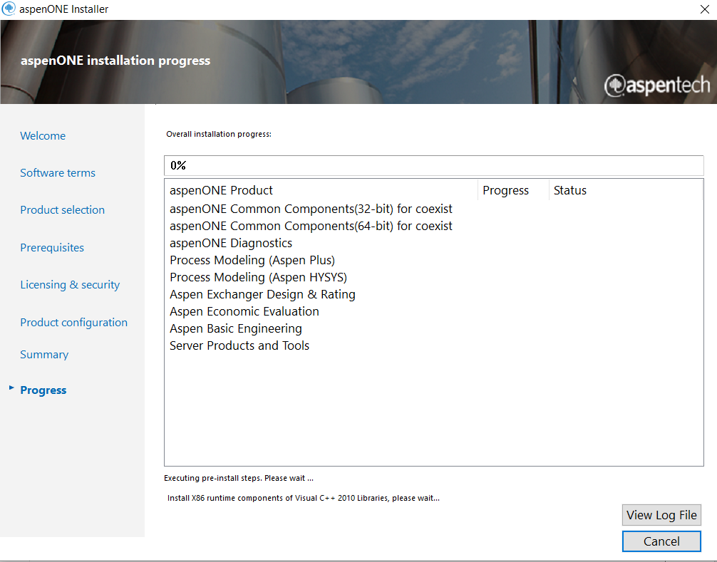
Installation Instructions
Wait for installation

Slide 11
Aspen HYSYS – Python interface

Slide 12
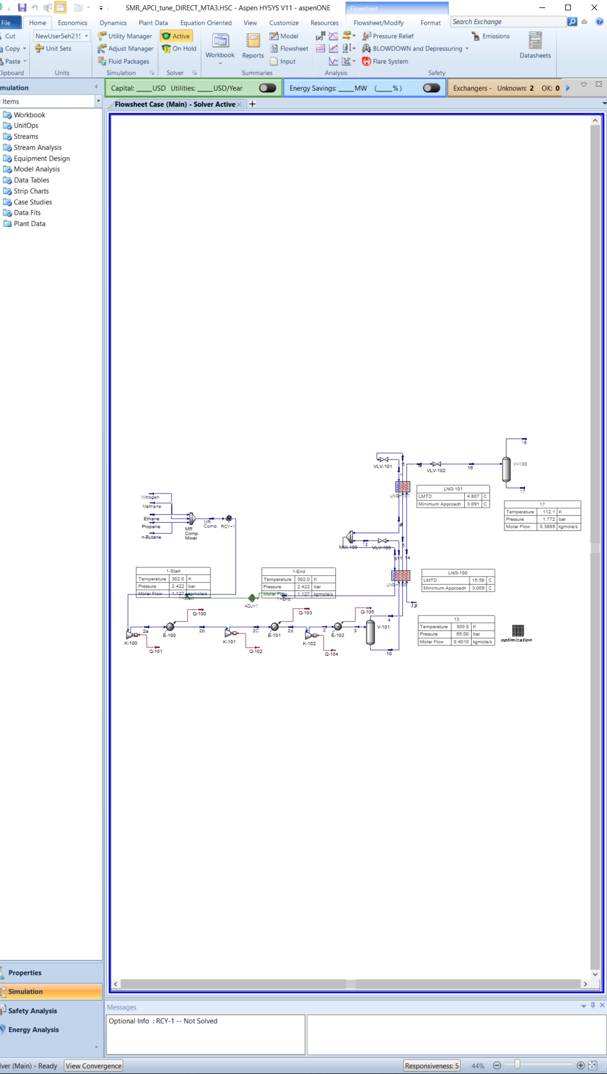
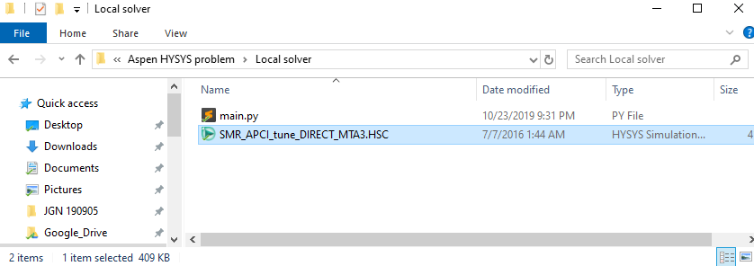
Aspen HYSYS
Run Hysys file “SMR_APCI.HSC”
T
To understand the process, please refer to
Na, J., Lim, Y., & Han, C. (2017). A modified DIRECT algorithm for hidden constraints in an LNG process optimization. Energy, 126, 488-500.

Slide 13
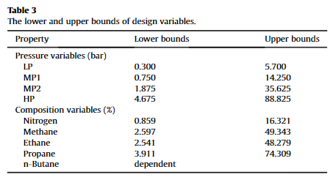

Run main.py
Just run main.py then you can get: $y=f_{HYSYS}(x)$
where y is objective function to be minimized (Total Energy Consumption / LNG Production(Ton per day)) and $x∈ℝ^{1×8}$ is input vector.

Slide 14
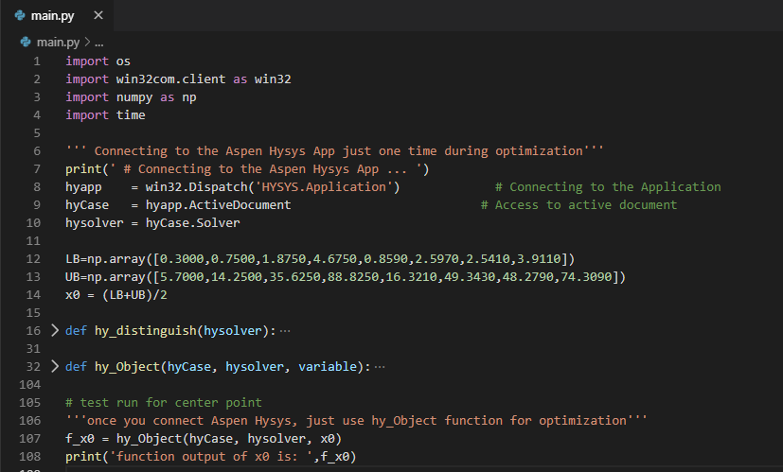
main.py
Just change x0 to your variable

