Slide 1

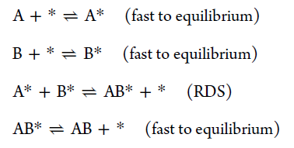
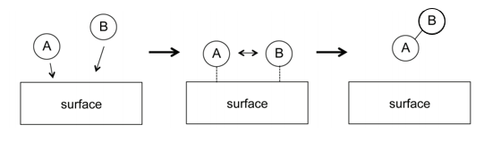
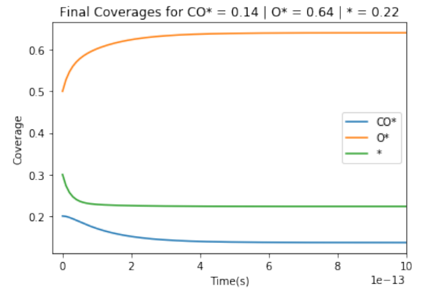
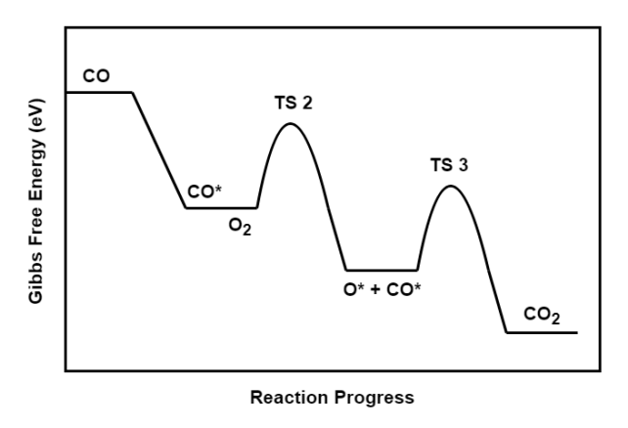
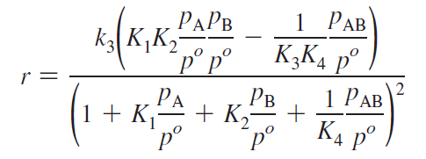
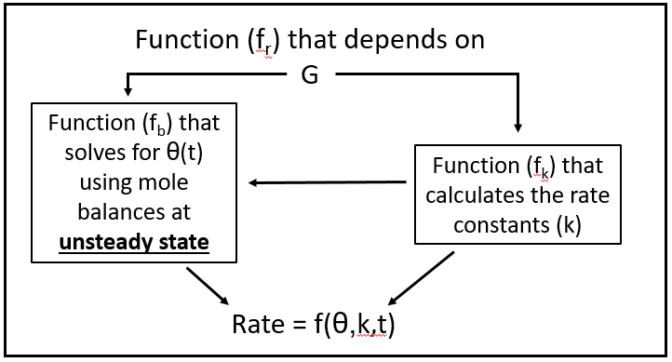

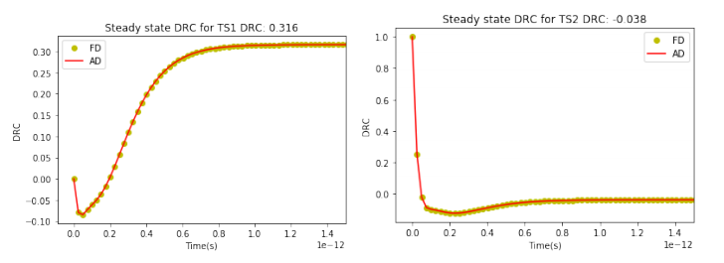
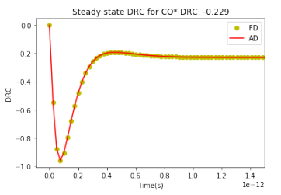
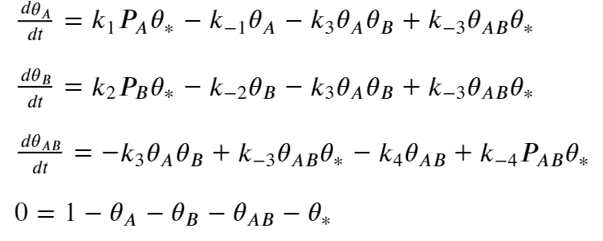

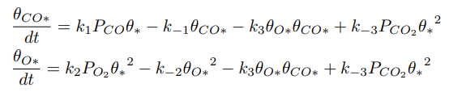
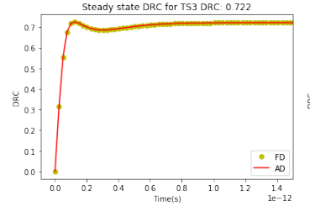
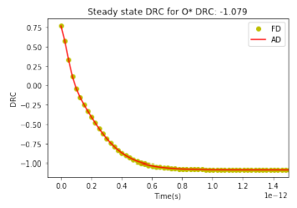
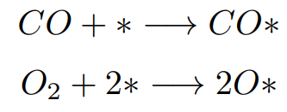



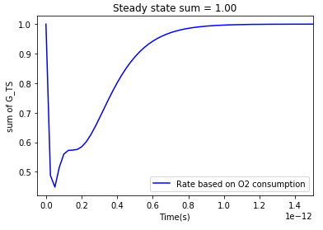
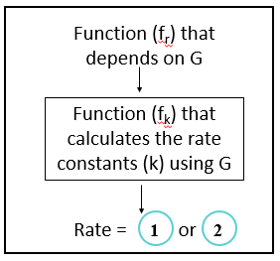


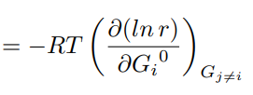
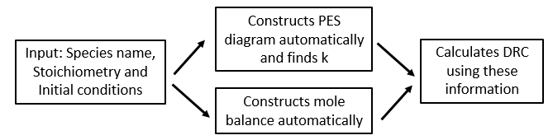
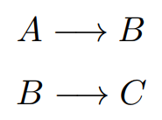


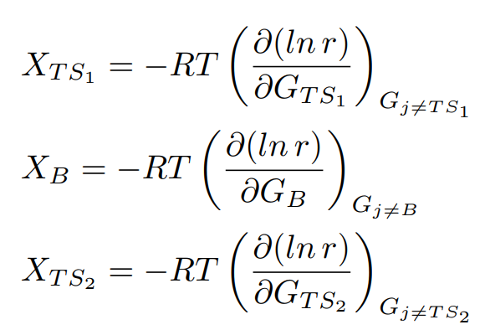

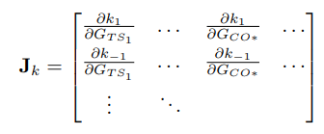
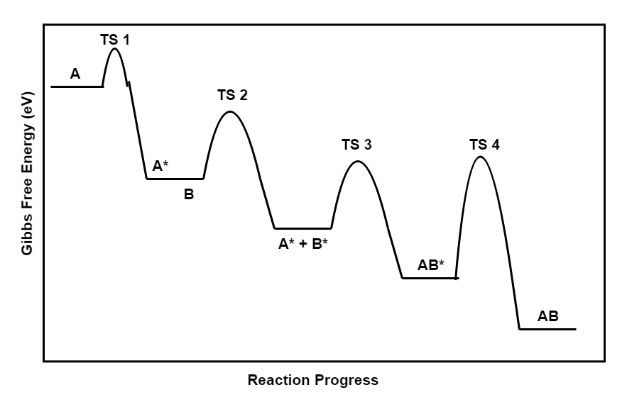
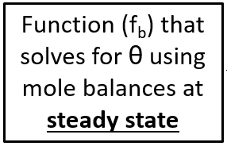
Calculation of Degree of Rate control for multistep reactions at steady and unsteady state
Siddarth Achar and John R. Kitchin
Department of Chemical Engineering
Carnegie Mellon University
Pittsburgh, PA 15213, U.S.A.
Abstract
Reactions used to demonstrate DRC
Transient State DRC using AD (CO oxidation reaction)
Degree of Rate Control (DRC) is a mathematical metric used to determine the rate-determining step of a multi-step catalysis reaction. DRC is a dimensionless quantity calculated by using the rate of the reaction and the energies of each transition state and intermediate state. Computing the DRC requires derivatives of the rate law with respect to energies of the intermediates and transition states, which has previously limited its application to systems where analytical rate laws exist, or where finite differences can be used to approximate the derivatives. This project makes use of automatic differentiation (AD) to compute necessary derivatives over finite differences (FD). A simple reaction like CO oxidation through Langmuir-Hinshelwood is used as an example to demonstrate the calculations of DRC using AD on Python (a package named autograd) and the results are compared with those from FD. There are two parts to computing the DRC, the first one is for steady state systems and the second one is for transient systems. Steady state DRCs are calculated in four different ways: (1) Using the simplified definition of the rate law (2) Using the expanded definition of the rate law (3) Using non-linear solvers to solve the mole balance (4) Using ordinary differential equation integrators to solve for the mole balance for the steady state rate. The results found from these methods are compared to those found in literature. Transient DRC values (time dependent) are computed using Method 4. Several observations like the deviation of the summation rule for the DRCs of all Transition States from 1 are a few things that are interesting findings. Overall, the approaches using automatic differentiation have some advantages over analytical rate laws and finite difference methods. We show that it is not necessary to derive analytical rate laws for overall reactivity, thus avoiding a potentially difficult and tedious task. Automatic differentiation is also not an approximation to the derivatives as finite differences are, thus avoiding some issues with numerical stability. Finally, if the correlations between the rate constants and equilibrium constants are properly constructed, automatic differentiation automatically accounts for them, simplifying the analysis of the DRC compared to finite differences.
The concept of DRC is tested on the Langmuir Hinshelwood reaction. The reaction can be represented as:
Input
- O₂ consumption is considered as the reaction that determines the rate.
- The function f_{b} solves for coverages using odeint. The derivative of the final rate (O₂ consumption) found using AD and compared with results from FD.
- Part in green shows the transient DRC.
2
1
Simplified expression for rate
Complete expression for rate →
3
5
4
6
Uses eq
7,8 and 9
For unsteady state systems, an actual example of Langmuir Hinshelwood is used when CO oxidizes to form CO₂ :
7
8
9
Steady State DRC using AD
The rate that we choose that determines the rate the reactions matters when transient systems are considered. So, these plots would be different when R1 or R2 are considered. All the rates are equal only at steady state.
Part 1: Using Simple and Complete expression for rate
Summation Rule:
What is Degree of Rate Control (DRC)?
AD
autograd on
FD
Proof exists for steady state and is verified with current results for steady state.
But there is a deviation when a transient system is considered
Output:
DRC_{TS1} = 0.0000
DRC_{TS2} = 0.0000
DRC_{TS3} = 1.0000
DRC_{TS4} = 0.0000
DRC_{A*} = -2.0000
DRC_{B*} = 0.0000
DRC_{AB*} = 0.0000
Output:
DRC_{TS1} = 0.0000
DRC_{TS2} = 0.0000
DRC_{TS3} = 1.0000
DRC_{TS4} = 0.0000
DRC_{A*} = -2.0000
DRC_{B*} = 0.0000
DRC_{AB*} = 0.0000
It is a generalized expression to measure the sensitivity of the rate with respect to the free energies of both the intermediates as well as the transition states can be calculated by a single generalized expression.
User Interface to compute DRC for any reaction
Simple (1) and Complete rate expression (2)
G_{TS1}
Part 2: Solving Mole Balances to get steady state rate
3
4
5
6
Example:
- Coverages at steady state are calculated by equations , , and
G_{TS2}
r = k₄ θ_{AB}
requires
DRC:
Jacobians from autograd
and
G_{B}
Conclusions
Input
Output:
DRC_{TS1} = 0.0000
DRC_{TS2} = 0.0000
DRC_{TS3} = 1.0000
DRC_{TS4} = 0.0000
DRC_{A*} = -2.0000
DRC_{B*} = 0.0000
DRC_{AB*} = 0.0000
Degree of Rate control can be used to see what parameters have to be tuned to increase the rate of a reaction by typing just few lines of code and takes less time to compute as well.
Calculating the gradients using AD eliminates approximation errors in finite differences and is more accurate.
A lot can be understood about the kinetics of the reaction when DRC is computed for transient systems.
The user-interface to find the DRC can reduce human errors while mole balances and written.
This is a very powerful aid to microkinetic models as it finds important transition states and intermediates.
If DRC_{x} > 1, Decreasing G_{x} increases the rate of the reaction
If DRC_{x} < 1, Decreasing G_{x} decreases the rate of the reaction
If DRC_{x} = 0, Changing G_{x} does not affect the rate of the reaction
Gibbs Free Energy is like a tunable parameter which is adjusted to increase the total rate of the reaction.
DRC is also a powerful aid to the development of more accurate microkinetic models as it identifies which intermediates and transition states are most important.

