Slide 1

Project: Peter
Kanishk Mair
Siddarth Achar
Swapnil Agrawal
Tanmay Raj

Slide 2
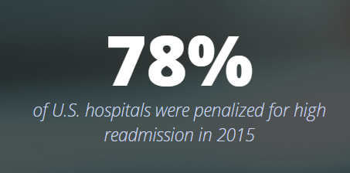
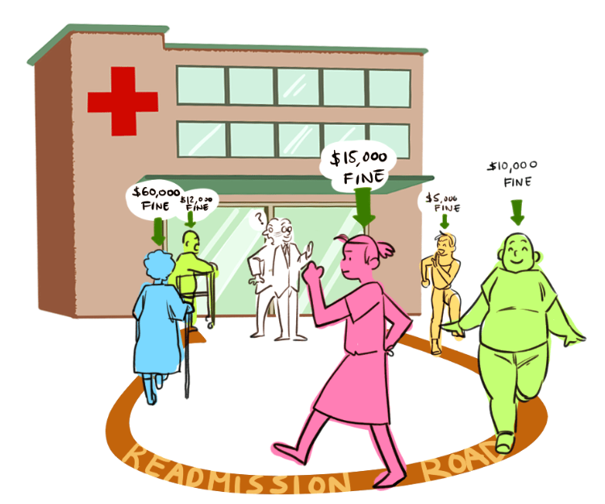
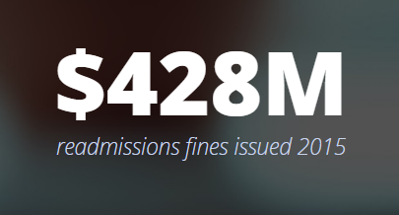
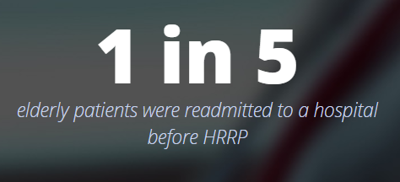
Problem Statement
Reducing preventable readmission of patients to hospitals by using predictive diagnosis to provide personalized healthcare
1

Slide 3

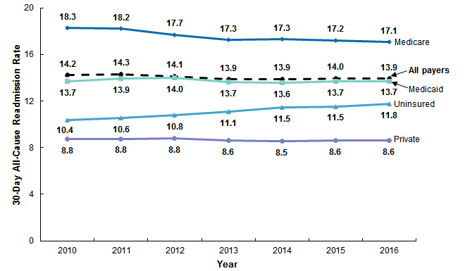
A $17 Billion Problem!
Readmission rates were highest for patients with Insurance
Non-maternal patients aged 1-20 years had the largest increase in readmission rate
2
https://revcycleintelligence.com/news/preventable-readmissions-cost-cms-17-billion
2
https://hcup-us.ahrq.gov/reports/statbriefs/sb248-Hospital-Readmissions-2010-2016.jsp#targetText=Hospital%20readmissions%20serve%20as%20a,focused%20on%20decreasing%20preventable%20readmissions.
Notes:
Team came up with a very robust solution.
We Filtered tons of data to find correlations between the alarm data and downtime coding.

Slide 4

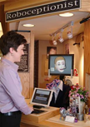
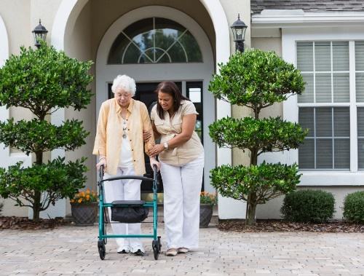
Technology Flow Sheet
Patient UID
Symptoms
Patient Database
Helps doctor to understand patients needs better
1
Frequency of visit
AI aided prescription
Medical history…
ML algorithm to check if previous medication has helped patient
2
Diagnosis
Personal Info
Insurance Type
Age
ML algorithm to evaluate risk factor
3
Can be used by hospital to reduce readmission penalty
Patient Engagement
Technology
3

Slide 5
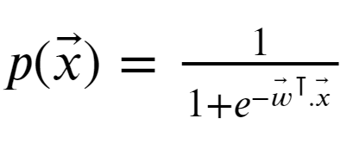


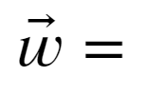



logistic regression as the classifier
Behind the Model
M
M
[ ]
N
.
.
.
Probability of the patient coming back within 30 days
After feature engineering, Age, Insurance, Patient History and Disease are the features used for calculating risk factor
< 0
else
Risk Factor : low
Index = 0
Risk Factor : High
Index = 1
4

Slide 6
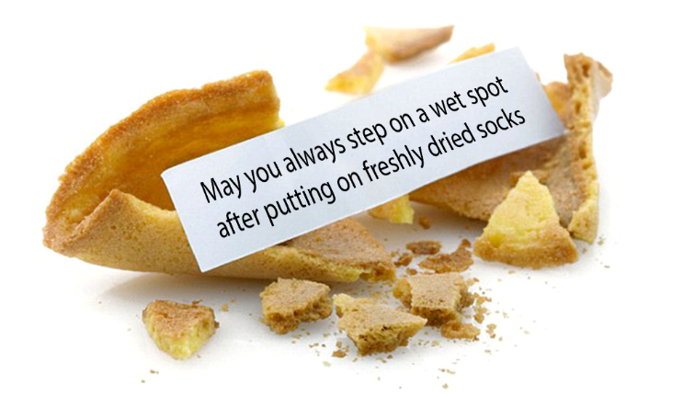
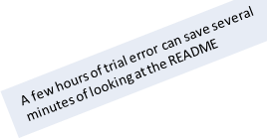
Solution? Peter
A concerned bot that utilizes RPA and Machine Learning to help both doctors and patients to engage more effectively
UiPath
Google.Cloud.Speech.V1 = 1.2.0
Twilio.Activities = 3.0.0
Python 3.7.4
Installation process Download the .zip folder and run the .xaml file! Rest is all automated :)
Pandas
Scikit-learn
Package name: Peter
Dataset: Sample data for diabetic patients synthetically generated
Instance: A simulated run for a returning patient
Setup: Download the Peter. zip folder and run the .xaml file! Rest is all automated :)
5
Notes:
Results in nice big fonts! ☺
Or how we did it with ML details

Slide 7
Demo
Major challenge : Insufficient Data
Solution - Use UI path to make dataset and using attributes from statistics
Assumptions:
Using data from diabetes to make a general model for predicting risk factor for all diseases
All the patient cases are of readmission
Demo
6
Notes:
Approach:
We built a logistic linear regression model. Technical aspects of ML

Slide 8
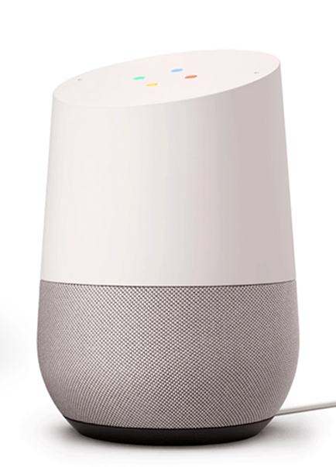

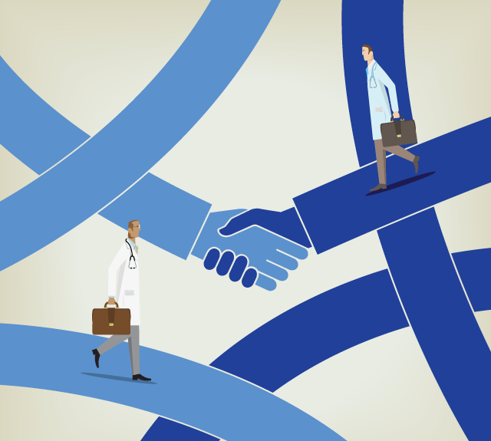
Future Work
Incorporate Smart Voice Device
to enhance user experience
Patient Education using mobile
Application and increased
Involvement of hospitals for
after-care
Increase hospital collaboration
to improve patient database
7

Slide 9

Thank You!
Q & A

