Slide 1
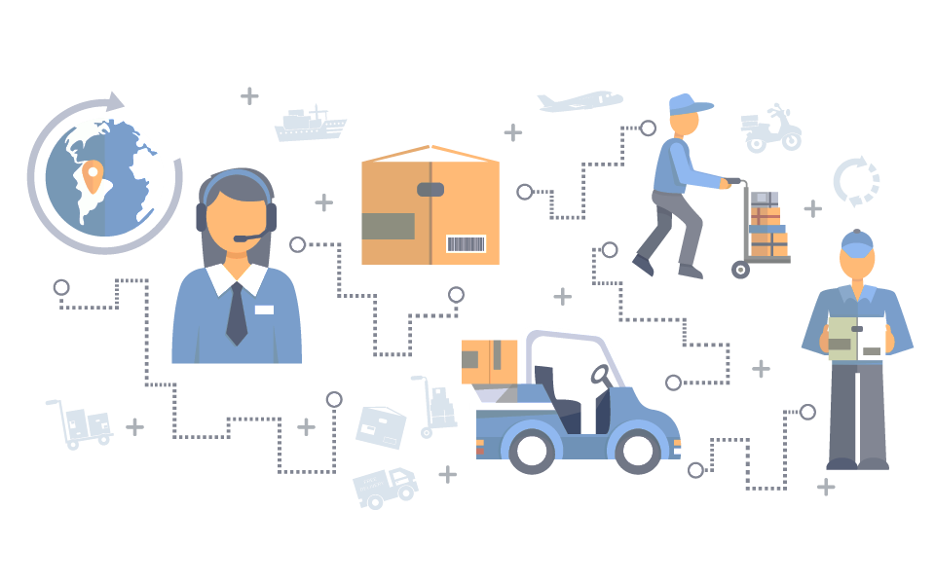
Designing an MINLP Model for Optimal Scheduling of Supply Chain Network
Team1: Dechuan Du, Isaac Mills, Kanishk Mair, Qiong Wang

Slide 2
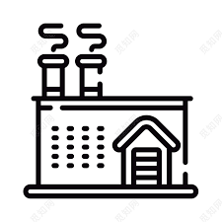



Why is this problem important?
High costs and wait times involved in supply chain network
For instance, There’s a total loss of $1.98 billion annually owing to inefficiencies in supply chains in United Kingdom alone with an average delay of about 3 hours for every shipment.
Globally, supply chains have $225 billion worth of inventory, yet 70% of production time isn’t efficiently utilized.
Suppliers
Plants
Warehouses
Customers
*Source: Lewandowska Justyna. “Causes of Losses in Supply Chains”. International Conference on Management, Enterprise and Benchmarking 31 May - 1 June, 2013, Budapest, Hungary
Introduction | Problem Statement | Methods | Results and Conclusions | Future Work
Notes:
Supply chain management is concerned with the efficient integration of suppliers, factories, warehouses and stores so that merchandise is produced and distributed in the right quantities, to the right locations and at the right time.
So optimal design of supply chain networks can significantly reduce the high system cost and wait time involved. But with consideration of several layers and logistical components of the network, the optimization problem is always a non-linear hard problem which is hard to solve. So it is important to model a way to find the optimal solution to multi-layer supply chain to to aid the decision makers with the task of planning single-horizon logistics in supply chain networks.

Slide 3
Formulating the model.
Considerations for the Logistic network
Location of plants & warehouses
Levels of production and inventory
Transportation modes
Stochastic demands
Modelling network of:
3 Suppliers
2 Plants
4 Warehouses
5 Customers
Problem type
Software used
Solver Selected
MINLP
GAMS
BARON
Introduction | Problem Statement | Methods | Results and Conclusions | Future Work
Notes:
Here we propose a three layers supply chain network with stochastic demands based on a Brazil drug industry. The model will integrate decisions on the location of plants and warehouses, levels of production and inventory, and on transportation modes.
As it is a non-linear optimization problem, we use the solver BARON in GAMS, a software for optimization problem.

Slide 4
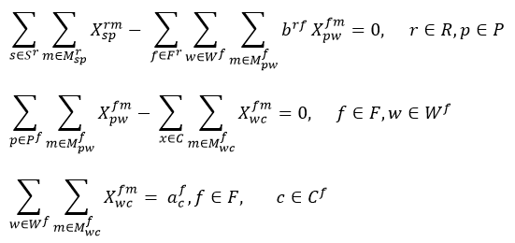
Model Constraints
I. Demand Constraints
Supplier to Plant
Plant to Warehouse
Warehouse to Customer
Introduction | Problem Statement | Methods | Results and Conclusions | Future Work

Slide 5
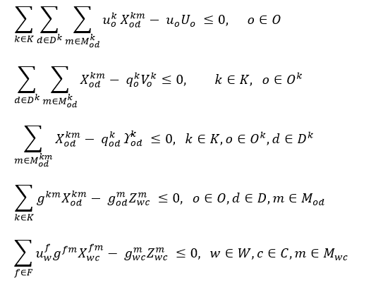
Model Constraints
II. Capacity Constraints
Global Capacity Limits
Limit of each commodity that can be used from a node
Transport guarantee on node selection
Capacity limit for different transportation modes
Capacity limit at warehouses for SKU
Introduction | Problem Statement | Methods | Results and Conclusions | Future Work

Slide 6
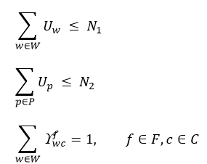
Model Constraints
III. Conveyance Constraints
Limiting number of Warehouse
Limiting number of Plants
Single Warehouse for each Customer
Introduction | Problem Statement | Methods | Results and Conclusions | Future Work

Slide 7
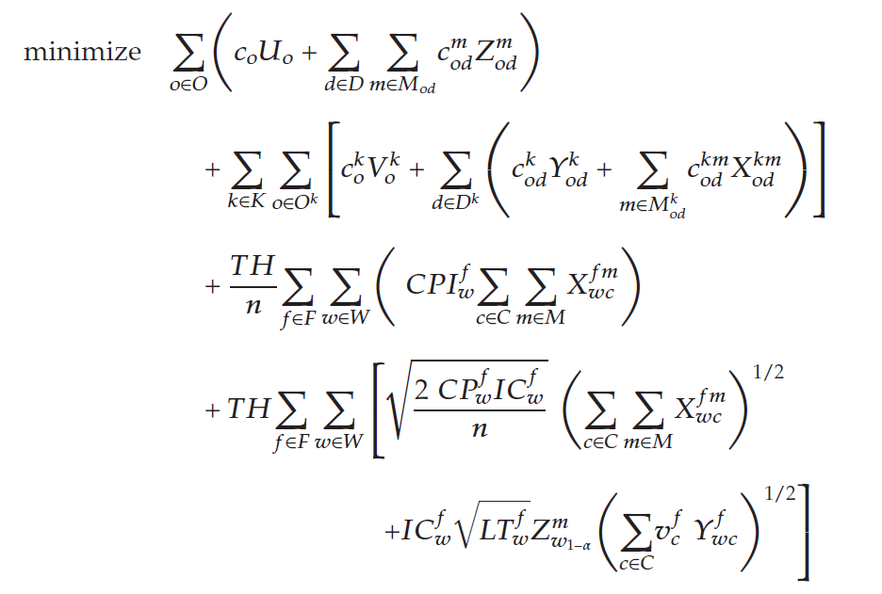
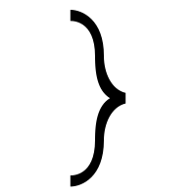
Objective Function
Fixed Cost
Variable Costs
Location & Allocation
Fixed Cost
Variable Costs
Inventory Levels
Introduction | Problem Statement | Methods | Results and Conclusions | Future Work

Slide 8
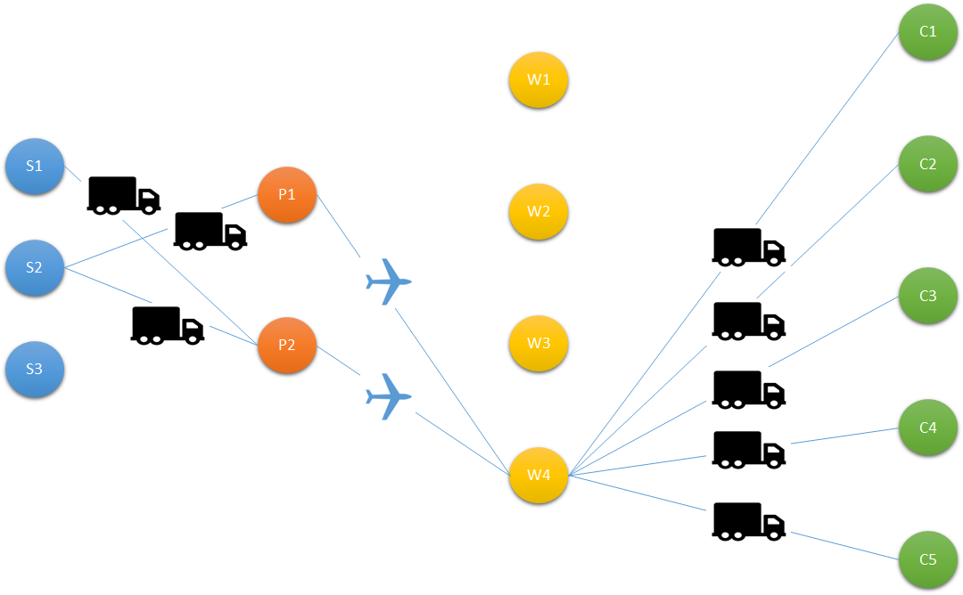
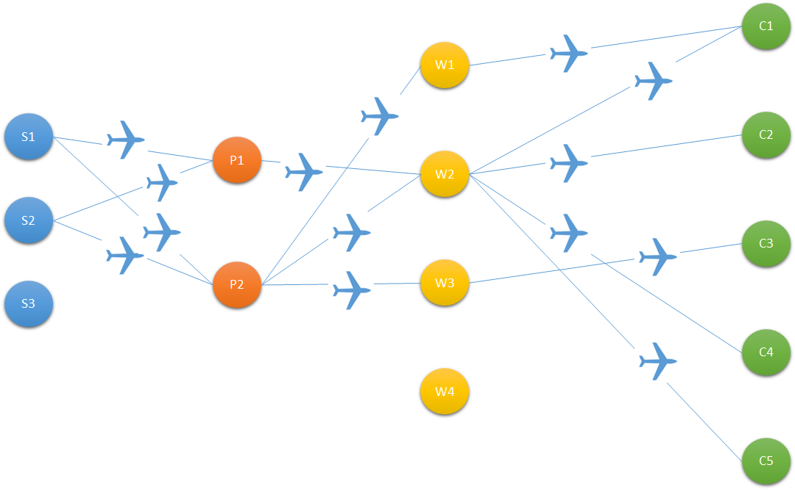
We got the comparison between optimization results of different objectives.
The solution of minimizing the total cost.
The total cost is $55.795 million.
The execution takes 272 days.
The solution of Minimizing the time.
The total cost is $107.562 million.
The execution takes 37.3 days.
Introduction | Problem Statement | Methods | Results and Conclusions | Future Work
7
Notes:
It’s observed that transportation of the commodity was carried out mostly by trucks instead of using the costlier option of transporting via an airplane. Also, it’s observed that the finished product is only shipped to Warehouse W4 because it has the least storage cost. The total optimized cost was found to be $55.795 million, however, the execution takes about 272 days.
we minimize the total time required to transport all the commodities in the entire network. The above figure is expected since we are minimizing time and hence airplane is used as the transportation mode for all shipping. Also, most of the nodes are used in order to minimize the total time. It only takes 37.3 days, but total cost is 107.562 million.

Slide 9
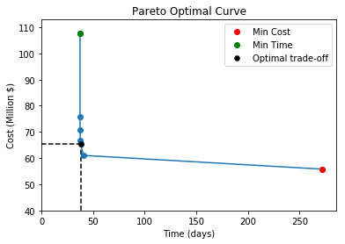
From the Pareto optimal curve we can get the relationship between optimal cost and time.
Cost (Million $) | Time(days)
55.795 | 272
61.042 | 40.645
65.495 | 37.822
66.739 | 37.533
70.925 | 37.353
76.776 | 37.3
107.526 | 37.3
Introduction | Problem Statement | Methods | Results and Conclusions | Future Work
Notes:
For this multi-objective optimization problem, the solution to these conflicting objectives can be modeled with Pareto Curves which can give us optimal trade-off in our model.(the left table is the different cost and time correspond with the curve).from the curve we can see the cost decrease sharply in a very small time spend horizon. Because if we only use the trucks, the cost will be extremely high. If we only use air line, the cost will much lower. However, the cost will still decrease much more by optimize the nodes of the transportation.

Slide 10
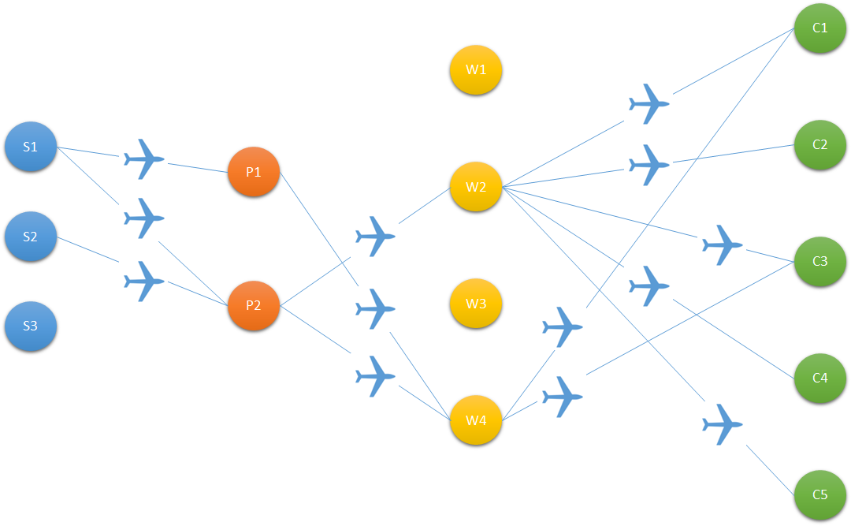
Optimal Solution which has a minimum cost of $65.495 million and takes 37.822 days.
Introduction | Problem Statement | Methods | Results and Conclusions | Future Work

Slide 11
We selected the results returned by BARON solver.
S. N. | Solver | Results Comparison
1 | BARON | Gives us the above discussed curve.
2 | ANTIGONE | Returns optimal values which aren’t as good as those returned by BARON.
3 | ALPHAECP | Not suitable for the model since it returns singularity while solving as the variable values decrease.
4 | DICOPT | Returns accurate values for individual objectives but returns relaxed solution for multi-objective function. Hence, it can’t be used to produce the optimal curve.
5 | OQNLP | Cannot solve the model used.
6 | SBB | Produces correct solution to minimize time but not the cost. Hence, it produces inaccurate curve.
Introduction | Problem Statement | Methods | Results and Conclusions | Future Work

Slide 12
Future work will focus on making the model more realistic.
Current Work
Future Work
Network designed for a Single Planning horizon (with stochastic future demand)
Objective of Time only considers transportation and lead times. Additional constraints needed too
Modelled on a randomly generated data
Convert the model into Long-term planning using Rolling horizon method
To make time objective more realistic, we must include delays, changeovers, etc.
Validation of updated model using real data
Introduction | Problem Statement | Methods | Results and Conclusions | Future Work
Notes:
The old plan just consider about fixed requirement of customers, instead, we can consider about the stochastic demand of these customers (say a customer buy 100 products but wants to return after a week ).we can solve this problem by employing Rolling Horizon Method to reorganize the Supply Chain decisions after specific time periods and the continuous planning horizon would have to be discretized (say monthly). Due to the stochastic nature of customer demands, after the end of each month, renewed demands of the customer can be used to update the model to provide us with continuous updating of the amounts to be transported.
For instance, time for production can be proportional to the amount used. Additionally, we can modify the model to allow the Supply Chain to have backlogs with respect to the given commodity having certain penalties.in the case of multi-products, we can constrain certain order of production to be allowed (for example, product C cannot be produced following product A).

Slide 13
Thank You

