Slide 1
Perth09 HA Mutant Validation with Vietnam Serum
Rachel Eguia
27Feb20-

Slide 2
10Mar20: Perform MOI test on F193F, F193D, F159G, and L157D GFP viruses
I will set up an MOI test to find the appropriate MOI for future neutralization assays. I will make two-fold serial dilutions of virus to test an MOI of 0.5 to 0.0039.
Plate setup: (doing 2 replicates for each virus)
IP/well | MOI | Row
20000 | 0.5 | A
10000 | 0.25 | B
5000 | 0.125 | C
2500 | 0.0625 | D
1250 | 0.03125 | E
625 | 0.015625 | F
312.5 | 0.0078125 | G
156.5 | 0.00390625 | H
1 | 2 | 3 | 4 | 5 | 6 | 7 | 8 | 9 | 10 | 11
empty | virus + cells | virus only | virus + cells | virus only | virus + cells | virus only | virus + cells | virus only | cells only | empty
1 | 2 | 3 | 4 | 5 | 6 | 7 | 8 | 9 | 10 | 11
empty | virus + cells | virus only | virus + cells | virus only | virus + cells | virus only | virus + cells | virus only | cells only | empty
Virus | IP/uL | Target IP/uL | Target vol (uL) | vol virus (uL) | vol NAM (uL)
F159G | 2132.72 | 500 | 500 | 117 | 383
F193D | 4309.27 | 500 | 500 | 58 | 442
F193F | 6186.81 | 500 | 500 | 40 | 460
L157D | 6538.66 | 500 | 500 | 38 | 462
Protocol:
Added 80 uL NAM to all wells, and 160 uL NAM to empty wells
Added 40000 IP of GFP virus in row A of columns 2-5
Diluted virus to 500 IP/ uL by adding the specified volumes of virus and NAM (in above table) to 1.5 mL epi, then added 80 uL of each to row A).
Made serial two-fold dilutions down rows by transferring 80 uL down to each row, removing 80 uL from the final row (changed tips between each row)
Incubated plate for ~1 hr while splitting MDCK-SIAT1-PB1 cells. Resuspended cells in NAM
Made a 10 mL master mix of cells at 5e5 cells/mL in NAM (ended up seeding 4e5 cells/mL instead)
Added 80 uL of cells to columns 2/4/6/8/10, and 80 uL NAM to columns 3/5/7/9 in both plates
Incubated plate at 37°C (START: 5 PM)
Read plate on plate reader at 11 AM (~18 hpi)

Slide 3
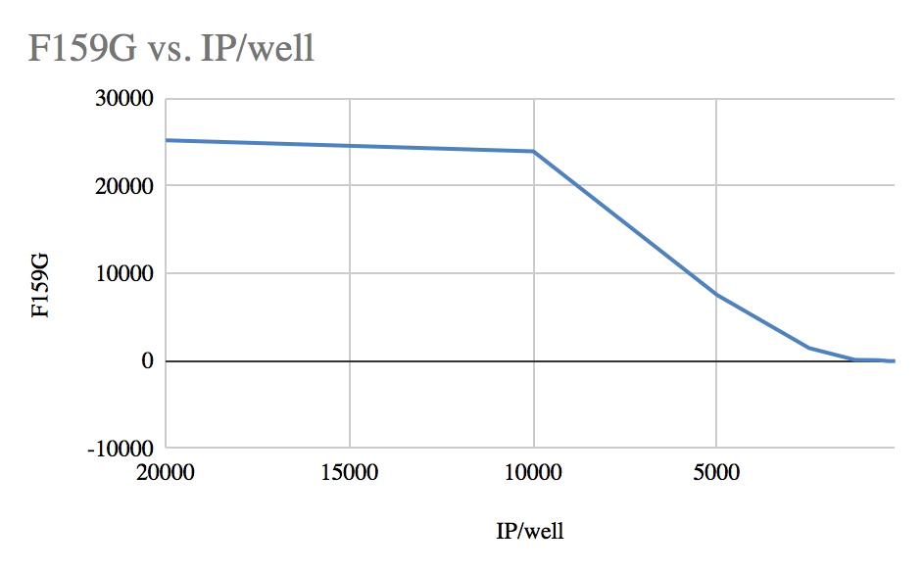
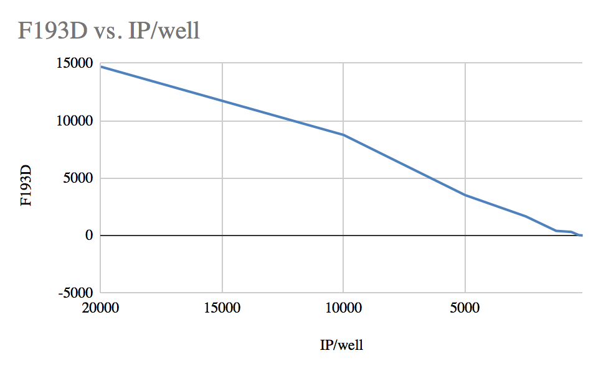
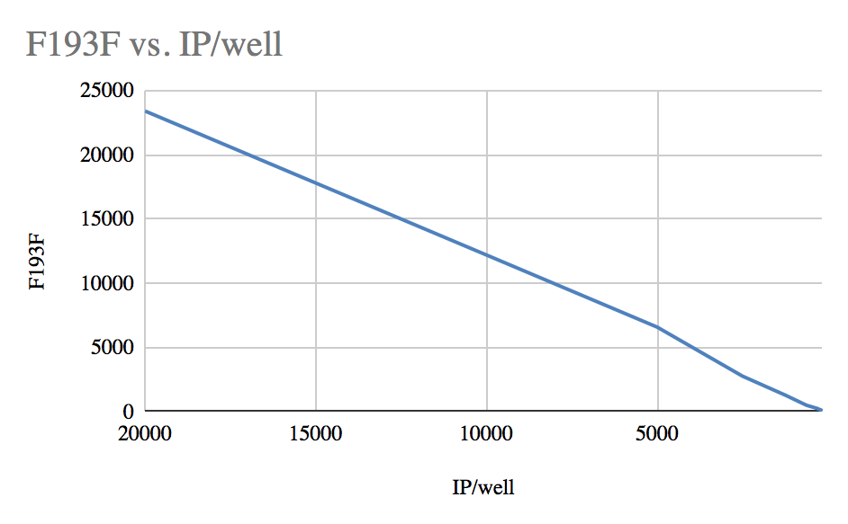
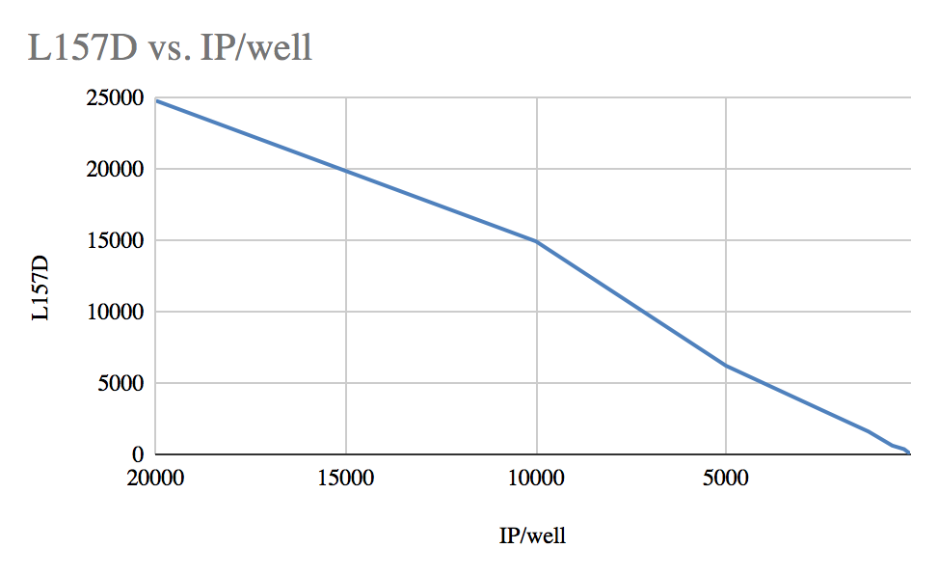
11Mar20: MOI test results
Based on the curves, I will use an IP/well of 5,000 for F159G and an IP/well of 7,500 for the L157D, F193F and F193D mutants . I’ll compile all of my IP/well findings in a table on the next slide.
IP/well | F159G |  | IP/well | F193D |  | IP/well | F193F |  | IP/well | L157D
20000 | 25225 |  | 20000 | 14698.5 |  | 20000 | 23393 |  | 20000 | 24821
10000 | 23961 |  | 10000 | 8750 |  | 10000 | 12186 |  | 10000 | 14955.5
5000 | 7532.5 |  | 5000 | 3512.5 |  | 5000 | 6571.5 |  | 5000 | 6230.5
2500 | 1472.5 |  | 2500 | 1656 |  | 2500 | 2752.5 |  | 2500 | 3147
1250 | 122 |  | 1250 | 394.5 |  | 1250 | 1278.5 |  | 1250 | 1615
625 | 91 |  | 625 | 304 |  | 625 | 486.5 |  | 625 | 631
312.5 | -22.5 |  | 312.5 | 21.5 |  | 312.5 | 240 |  | 312.5 | 379.5
156.5 | -10.5 |  | 156.5 | -6 |  | 156.5 | 60 |  | 156.5 | 60

Slide 4
19Mar20: Neutralization assays Perth09 WT and mutant viruses with Vietnam samples
I will make 12 serial dilutions of serum in triplicate in a 96-well plate, and test neutralization against the WT, F193F, F159G, and F193D viruses.
First, I will make 1:15 dilution of the HC070021 and HC150044 samples and a 1:6 dilution of the HC080043
To do this I will dilute 66.67 uL of each serum sample in 933.33 uL NAM and 166.67 uL of HC080043 in 833.33 uL NAM for 1000 uL total volume. I will use this diluted serum for the top row of the serial serum dilutions.
I will then serially dilute the serum 2-fold by transferring 80 uL across wells.
Serum samples:
HC070021 and HC150044
 |  |  | After adding 40 uL of virus
Row | Dil. factor (2-fold dil.) | Diliution into NAM | Serum dil. (RDE-treated) | Serum dil. (Original)
12 | 30 | 0.03333333333 | 0.02222222222 | 0.005555555556
11 | 60 | 0.01666666667 | 0.01111111111 | 0.002777777778
10 | 120 | 0.008333333333 | 0.005555555556 | 0.001388888889
9 | 240 | 0.004166666667 | 0.002777777778 | 0.0006944444444
8 | 480 | 0.002083333333 | 0.001388888889 | 0.0003472222222
7 | 960 | 0.001041666667 | 0.0006944444444 | 0.0001736111111
6 | 1920 | 0.0005208333333 | 0.0003472222222 | 0.00008680555556
5 | 3840 | 0.0002604166667 | 0.0001736111111 | 0.00004340277778
4 | 7680 | 0.0001302083333 | 0.00008680555556 | 0.00002170138889
3 | 15360 | 0.00006510416667 | 0.00004340277778 | 0.00001085069444
2 | 30720 | 0.00003255208333 | 0.00002170138889 | 0.000005425347222
1 | 61440 | 0.00001627604167 | 0.00001085069444 | 0.000002712673611
HC080043
 |  |  | After adding 40 uL of virus
Row | Dil. factor (2-fold dil.) | Diliution into NAM | Serum dil. (RDE-treated) | Serum dil. (Original)
12 | 12 | 0.08333333333 | 0.05555555556 | 0.01388888889
11 | 24 | 0.04166666667 | 0.02777777778 | 0.006944444444
10 | 48 | 0.02083333333 | 0.01388888889 | 0.003472222222
9 | 96 | 0.01041666667 | 0.006944444444 | 0.001736111111
8 | 192 | 0.005208333333 | 0.003472222222 | 0.0008680555556
7 | 384 | 0.002604166667 | 0.001736111111 | 0.0004340277778
6 | 768 | 0.001302083333 | 0.0008680555556 | 0.0002170138889
5 | 1536 | 0.0006510416667 | 0.0004340277778 | 0.0001085069444
4 | 3072 | 0.0003255208333 | 0.0002170138889 | 0.00005425347222
3 | 6144 | 0.0001627604167 | 0.0001085069444 | 0.00002712673611
2 | 12288 | 0.00008138020833 | 0.00005425347222 | 0.00001356336806
1 | 24576 | 0.00004069010417 | 0.00002712673611 | 0.000006781684028

Slide 5
19Mar20: Neutralization assays againstPerth09 WT and mutant viruses with Vietnam samples
“A-H” will be referred to as columns, and “1-12” as rows. I had the plate with column A-H going left to right, and rows 12-1 from top to bottom.
Made the following dilutions of virus:
For multichannel, used Fisher brand blue box/green wafer tips, #02-707-431
Thawed sera and made dilutions to working stock solutions using NAM. START: 1:50 PM
Added 80 uL NAM to all wells of all 12 plates. Also began thawing viruses
Added 80 uL of the diluted serum to the top row (row 12) of the plate for columns D, E, and F. Did this for each plate
Using the multichannel with three tips attached, mixed the top row D/E/F and transferred 80 uL the second row, mixed, etc. Removed 80 uL from the last row. Did not change tips in between rows (not necessary here)
Added 40 uL NAM to column B of all plates (virus only column) to make up for no cells being added to these columns.
Prepared virus inoculum according to volumes in table above (~3.5 mL per plate).
Using a reservoir and multichannel added 40 uL of virus to columns B-G. Used new tips for each row (no need to mix). Incubated at 37°C. START: 3:30 PM
While virus + antibody mixtures were incubating, started preparing cells by trypsinizing MDCK-SIAT1-PB1 cells, neutralizing with D10, spinning at 1200 rpm for 4 min, then resuspending in 20 mL NAM
Made a master mix of cells at 1e6 cells/mL, making a 35 mL master mix (~3.5 mL per plate)
Counted 2.605e6 cells/mL
After ~1.5 hr of virus + Ab incubation, took each plate out of the incubator in order, and added 40 uL cells to columns C-G, using fresh tips for each row. Used a fresh reservoir for each plate, re-mixed cell suspension before adding to reservoir. START: 5:00 PM
At ~18 hpi ( 11:00 AM on 20Mar20), read on plate reader with “Neutralization assay 96 well” program.
 | COLUMN
ROW | A | B | C | D | E | F | G | H
1 | NAM only | virus only | virus + cells only | serum dilution | serum dilution | serum dilution | virus + cells only | NAM only
Mutant | Plates | IP/ul | Titer | Vol virus (ul) | Vol NAM (ul)
WT | 3 | 187.5 | 6327 | 311 | 10189
F193F | 3 | 250 | 6187 | 424 | 10076
F159G | 3 | 187.5 | 2133 | 923 | 9577
F193D | 3 | 250 | 4309 | 609 | 9891

