Slide 1
Web Technology
Part 3:
Introduction to JavaScript Language

Slide 2
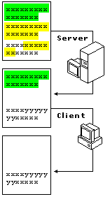
Client and Server-side scripts
Back End
server-side script
php, asp, aspx, nodeJS
Front End
client-side script
vbs, js
HTML
https://www.w3schools.com/whatis/whatis_fullstack.asp

Slide 3
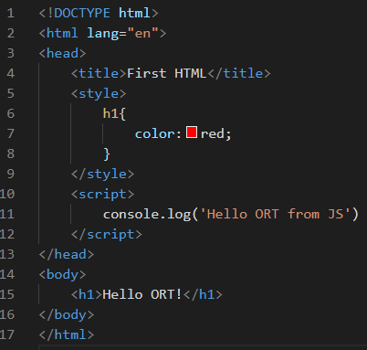
HTML example 1
1.html
Style segment
Script segment

Slide 4
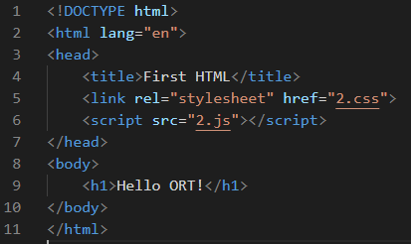

HTML example 2
2.html
2.css
2.js

Slide 5
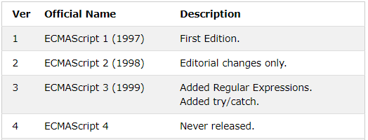
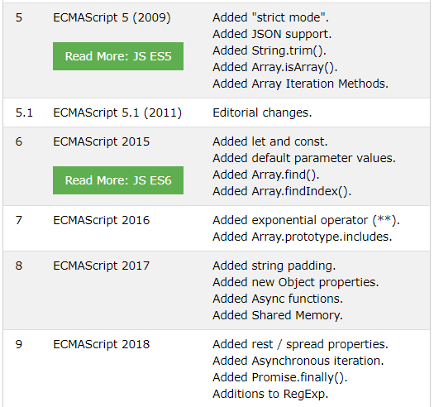
JavaScript – History and Versions
Developed in 10 days in May 1995 by Brendan Eich
ECMA standard – 1997
Ryan Dahl – NodeJS, 2010
Web browser
ES5
Web server
Desktop app
ES6
Mobile app
European Computers Manufacturers Association
https://www.w3schools.com/js/js_versions.asp

Slide 6
Lexical Structure and Variables
Case Sensitivity
Comments
  // 1-line comments
  /* multiline comments */
Literals
  12
  1.2
  “Hello”
  true, false
  null
  [1,2,3]
Identifiers
  ASCII characters – Yes
  Unicode (like Hebrew) - No
Variables ES5
var x = 12
Variables ES6
const x = true
let x = ‘ORT’

Slide 7
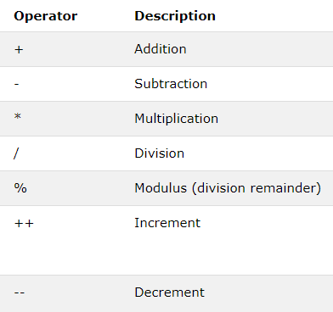
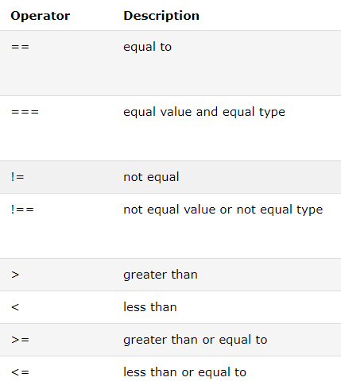
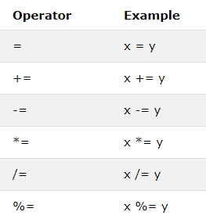
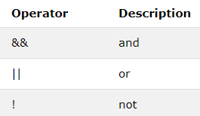
Basic Operators
Arithmetic
Comparison
Assignment
Bitwise
https://developer.mozilla.org/en-US/docs/Web/JavaScript/Guide/Expressions_and_Operators
https://www.w3schools.com/jsref/jsref_operators.asp

Slide 8

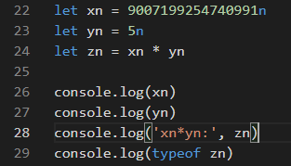
Data Types: Numbers
Numbers
  Integer from (– 2)**53 to 2**53
  Octal and Hexadecimal
    026 (8-based, from 0…)
    0xC9A (16-based, from 0x…)
  Floating-point
    3.14
    .3333
    1.12e+23
  Big numbers
Mutation
Conversion to string
    let x = 33
    let y = x.toString(16)
Working with numbers
  sin_of_x = Math.sin(x)
  hypot = Math.sqrt(x*x + y*y)
2 - binary value
8 - octal value
16 - hexadecimal value

Slide 9
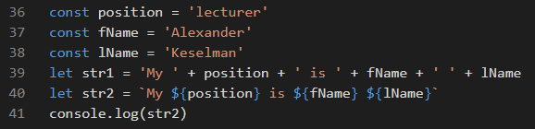
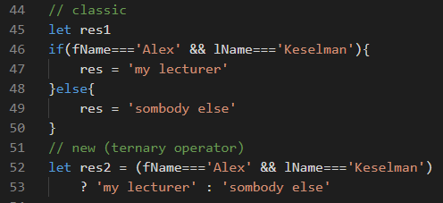
Data Types: Strings and Boolean
String
  ‘string 1’, “str 2”
  ‘name=“Alex”’
  <a href=“#” onClick=“alert(‘OK’)”>Click Me</a>
  ‘I can\’t’
  “static_part” + dynamic_part
  ***********************************
  s.length
  last_char = s.charAt(s.length – 1)
  i = s.indexOf(‘a’)
Boolean
  true, false
  var a = true
  if (x===1) {
  console.log(‘correct number’)
  }
  else {
  console.log(‘wrong number’)
  }

Slide 10
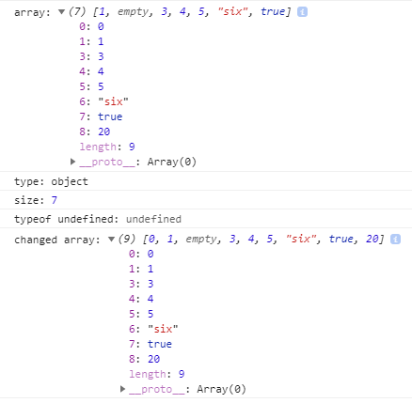
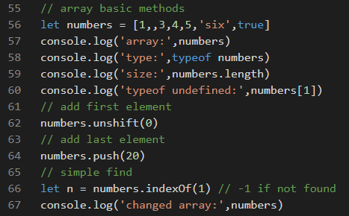
Data Type: Array 1
Creating Arrays
  const a = new Array() or a = [ ]
  a[0] = 1.2
  a[1] = “string”;
  a[2] = true
  a[3] = [1,2,3]

Slide 11
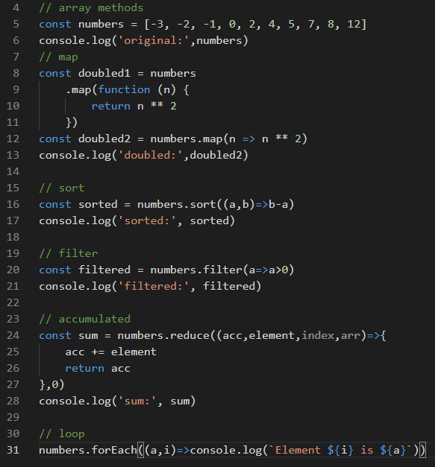
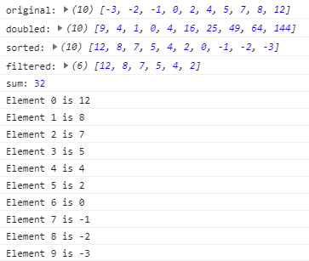

Data Type: Array 2
Enumeration

Slide 12
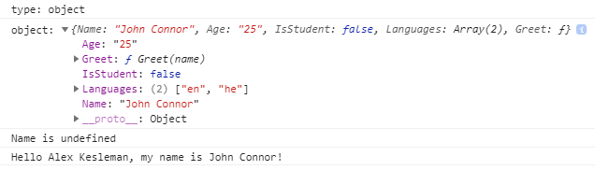
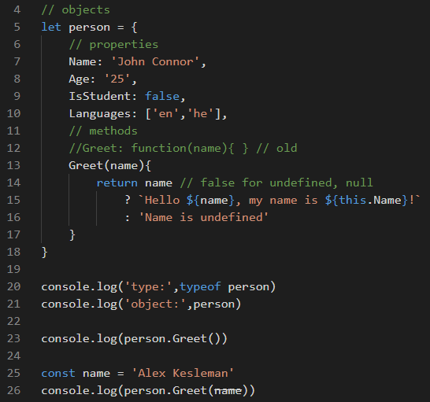
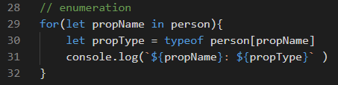
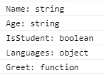
Data Type: Object 1
Enumeration

Slide 13
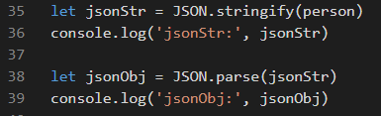
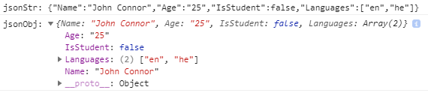

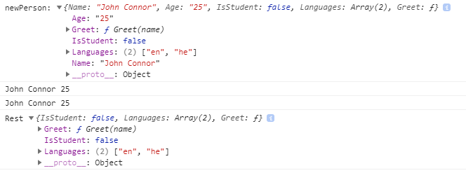
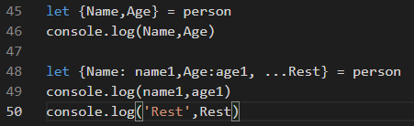
Data Type: Object 2
JSON JavaScript Object Notation
Clone spread operator
Destructuring

Slide 14
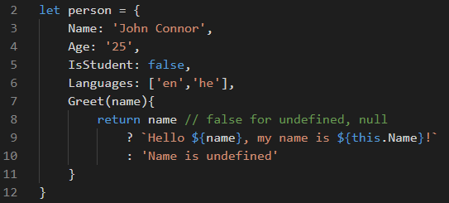
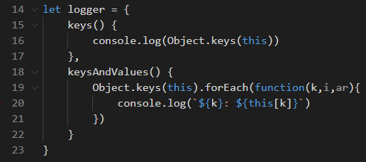
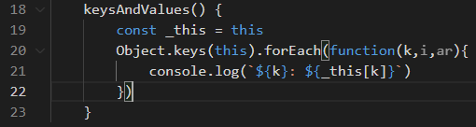
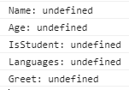
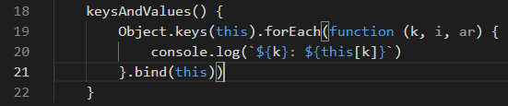
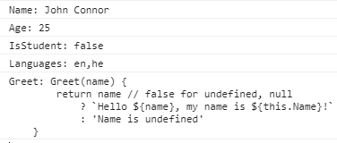
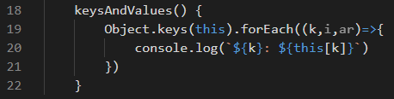
Data Type: Object 3
Context problem
Not working
Solution 1 - _this
Solution 2 – bind(this)
Solution 3 – arrow function

Slide 15
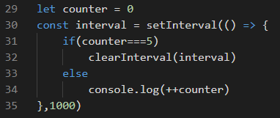

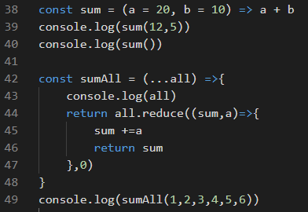

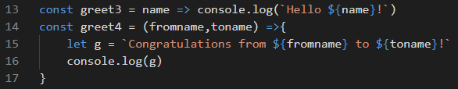

Functions
Anonymous functions ES5-ES6
Function declaration ES5
Default and all arguments ES6
Function expression ES6
Arrow functions ES6

Slide 16

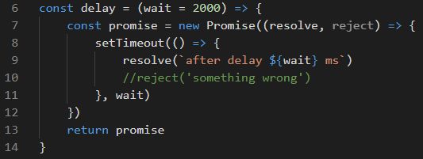
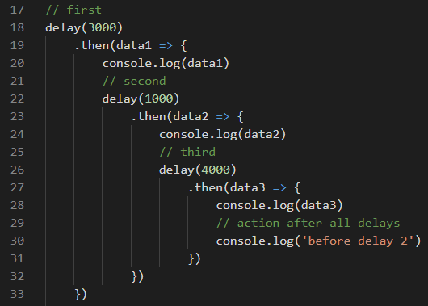
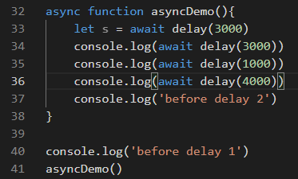
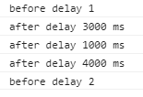
Asynchrony
origin with callback
wrapped in a promise
then-catch model
await model

Slide 17
JS and DOM: Basics
Control Document Appearance
Control Document Content
Control the Browser
Interact with HTML forms
Interact with User
Client State – cookies, sessionStorage, localStorage
Native JSON support
Object oriented approach
ES5
Dynamic features in web pages (frontend only)
ES6
Web pages (frontend) fully generated by JS with JS based server (backend)

Slide 18
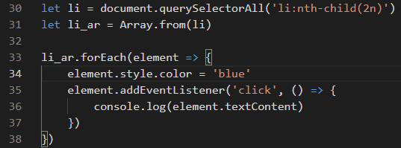
JS and DOM: Select
Global HTML DOM objects
  document
  window
  navigator
Select DOM elements
element.querySelector(selector)
element.querySelectorAll(selector)
element.getElementById(id)
element.getElementByName(name)
element.getElementByTagName(tagname)
element.getElementByClassName(classname)
Basic Selectors
  #id
  .class
  tag
Advanced Selectors
  Grouped: p, div, span
  Combined: div .cl1
  Pseudo-class: :hover
  Attribute: a[target=“_blank”]
https://www.w3schools.com/css/css_selectors.asp
https://www.w3schools.com/jsref/dom_obj_document.asp

Slide 19
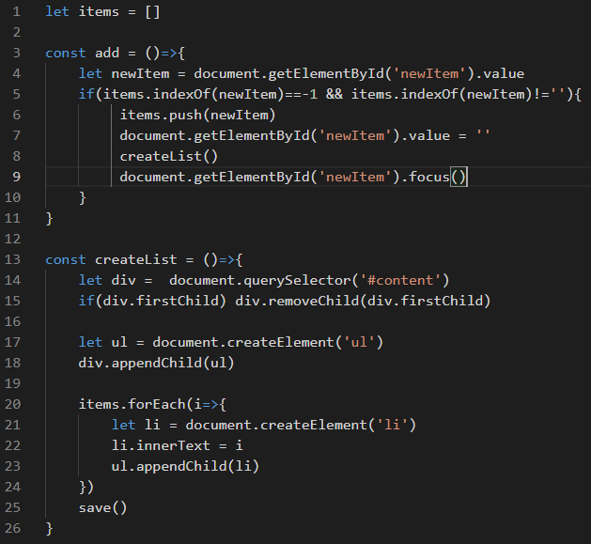
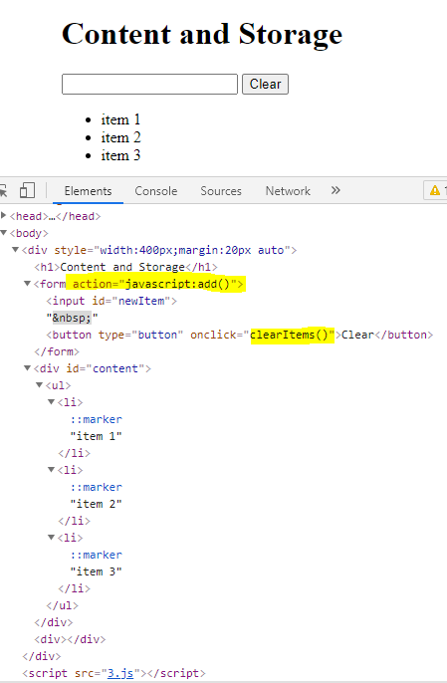
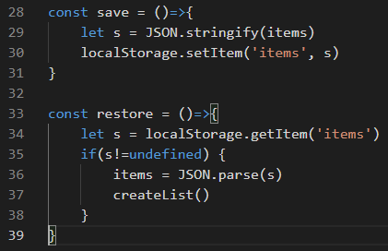
JS and DOM: Content, Storage
3.html, 3.js

