Slide 1
JavaScript and HTML
an example of dynamic HTML page generated with JavaScript

Slide 2
About the presentation
it’s a brief introduction to the JS based front-end development approach
It includes the essential components of programming in JavaScript (ES6)
The slides are intended to be a summary of the demo project shown in VS Code
  Objects
  Functions
  Classes
  HTML DOM
  NodeJS
  ParcelJS
The full source code of the demo project is available on GitHub: https://github.com/alexvirtech/js-html-1
The demo project is an example of HTML page generated with JavaScript.
It's created for educational purposes in the Web technologies course of ORT Braude college.
I thank Vladilen Minin for the ideas used in this project.

Slide 3
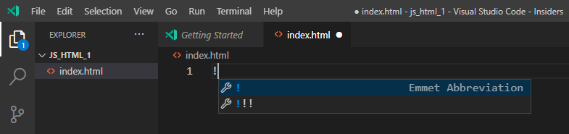
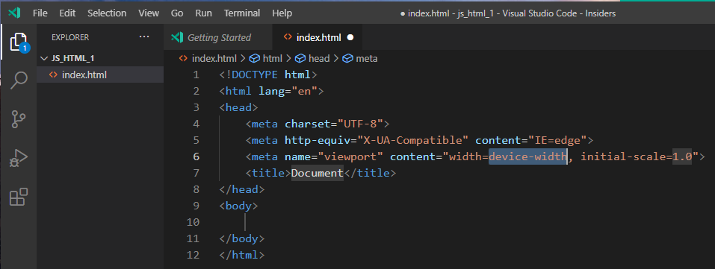
Starting HTML

Slide 4
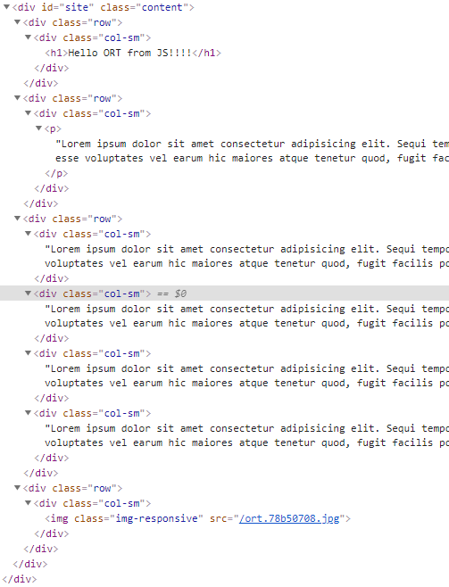
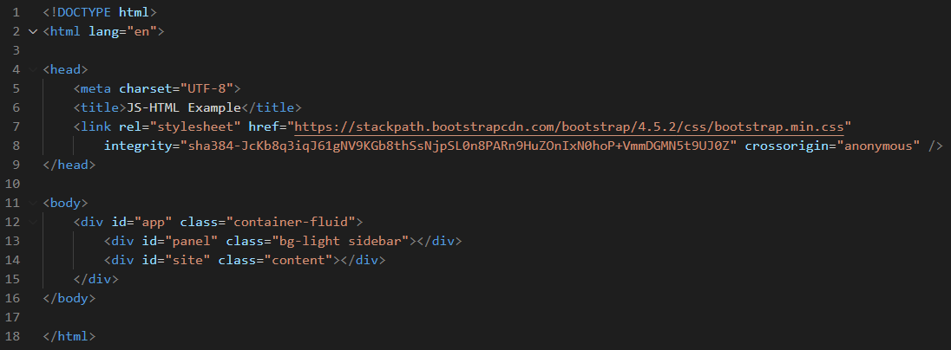
Pure HTML version

Slide 5
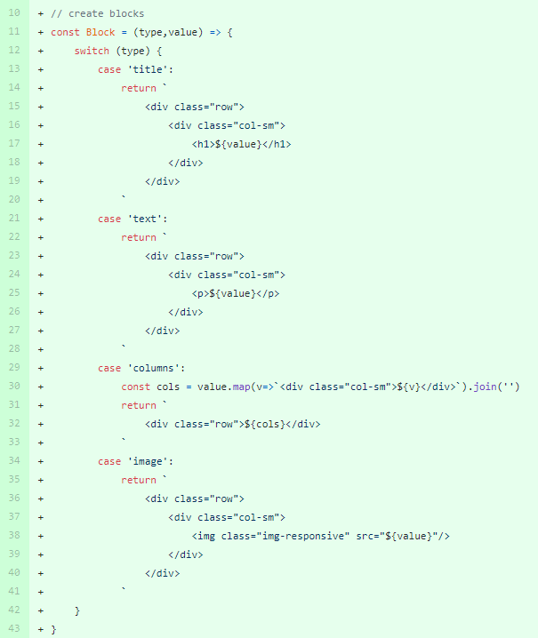
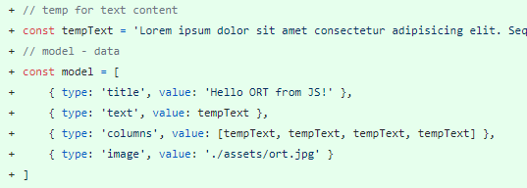
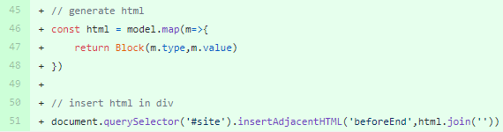
Basic JS-to-HTML Approach
2. Function, creating blocks
1. Create model (data input)
3. Create html and insert in placeholder (div)

Slide 6


VS Code - server environment
package.json
Init NodeJS project
  npm init
Install Parcel
  npm i parcel-bundler –save-dev
https://parceljs.org/getting_started.html
npm run go

Slide 7
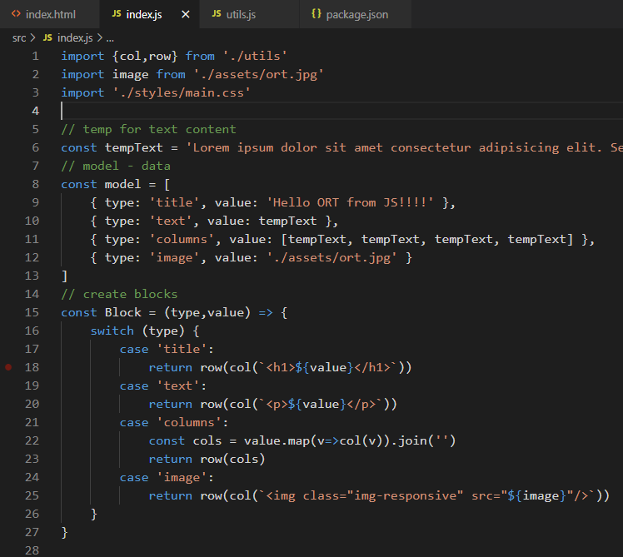
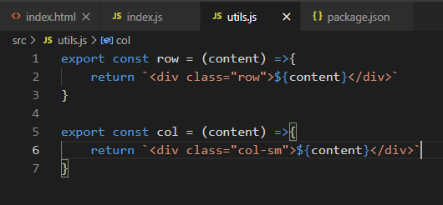
Import, Export in JS
utils.js

Slide 8
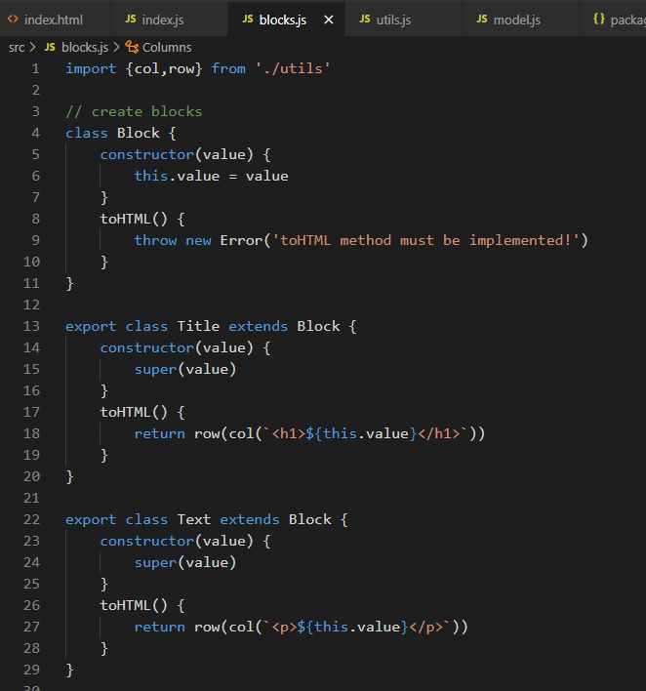
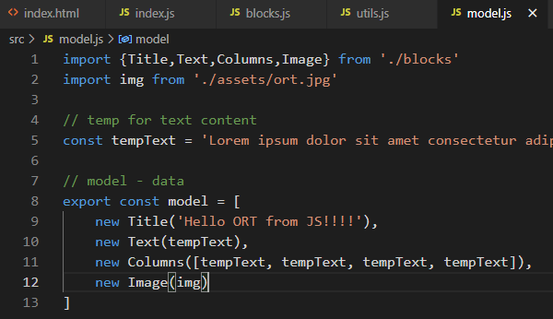
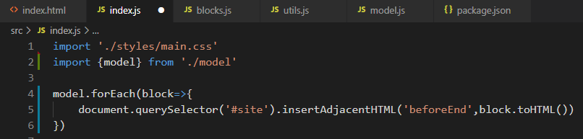
JS Classes and inheritance
Classes for block rendering
Model with classes
HTML content creation

Slide 9
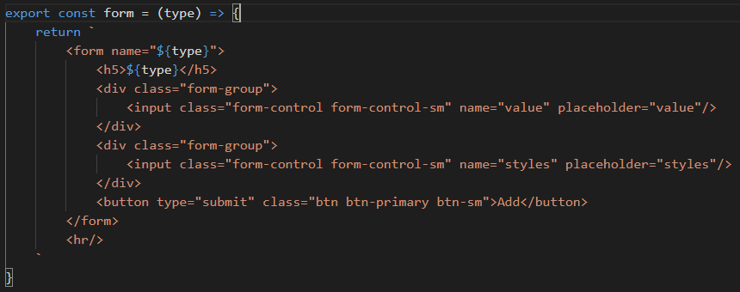
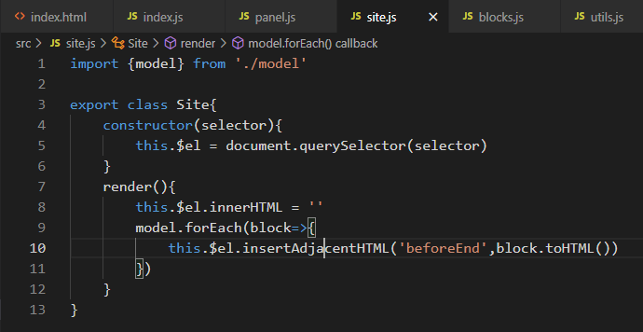
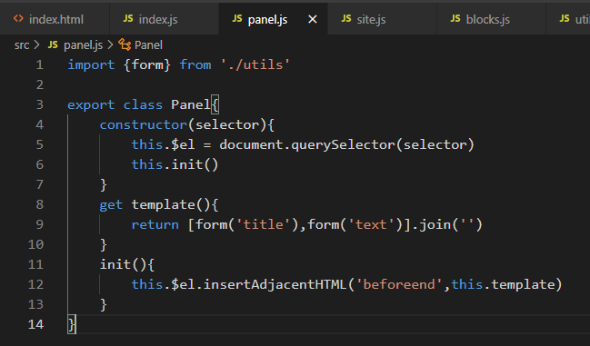
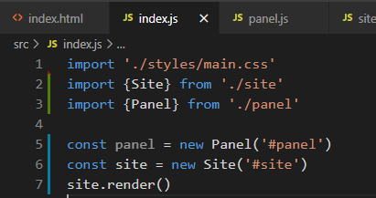
Optimization
utils.js
site.js
panel.js
index.js

Slide 10
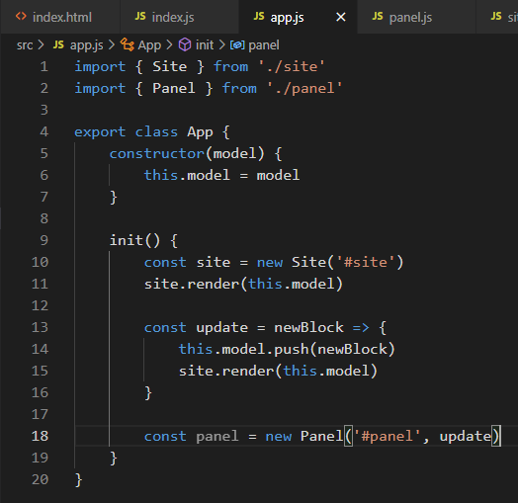
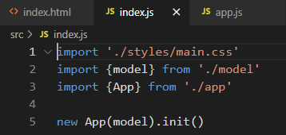
Final Structure
app.js
index.js

Slide 11
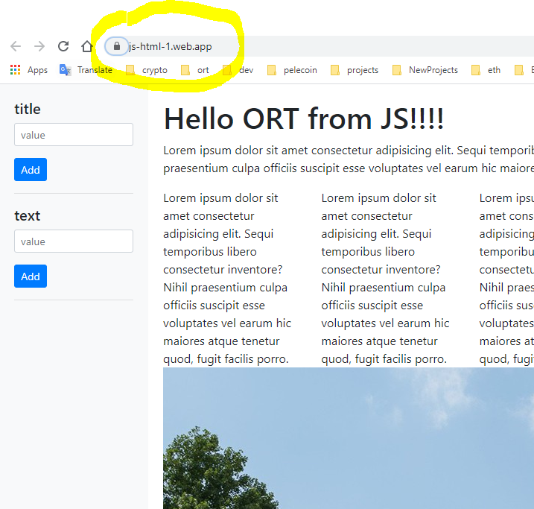
Deployment at Google Firebase
Create account in https://firebase.google.com/
create new project
npm install -g firebase-tools*
firebase login
firebase init
firebase deploy
*onerror use the following command (in console):
Set-ExecutionPolicy -Scope Process -ExecutionPolicy Bypass

