Slide 1
Web Technology
Part 1:
Introduction

Slide 2
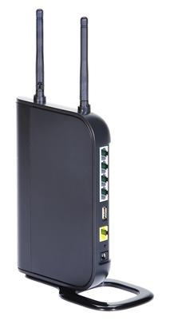
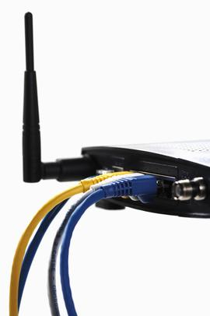
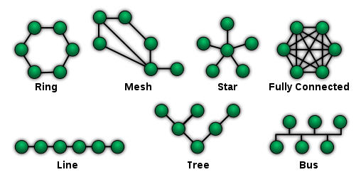
Local-Area Network 1
Goal:
  to cover a small geographical area.
Topologies:
  multi-access bus, ring, star …
Technologies:
    Ethernet – star + protocol (1980)
Connectivity:
  Cables, Wireless
  Hub, access point

Slide 3
Local-Area Network 2
LAN 2
gateway
LAN 1

Slide 4
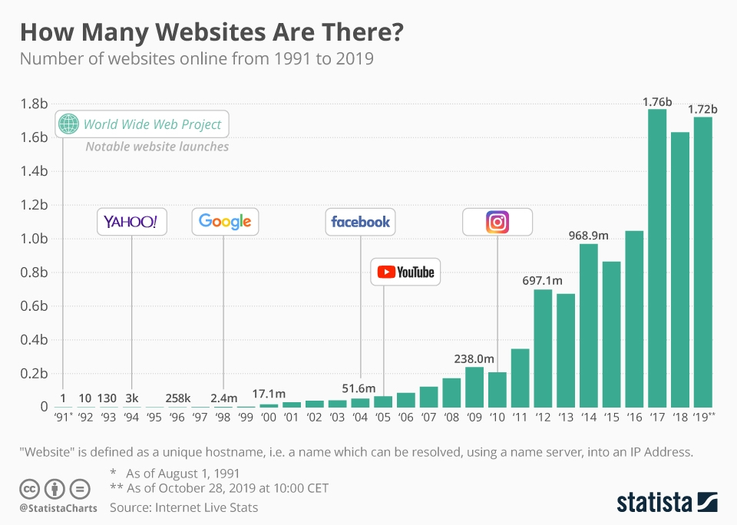
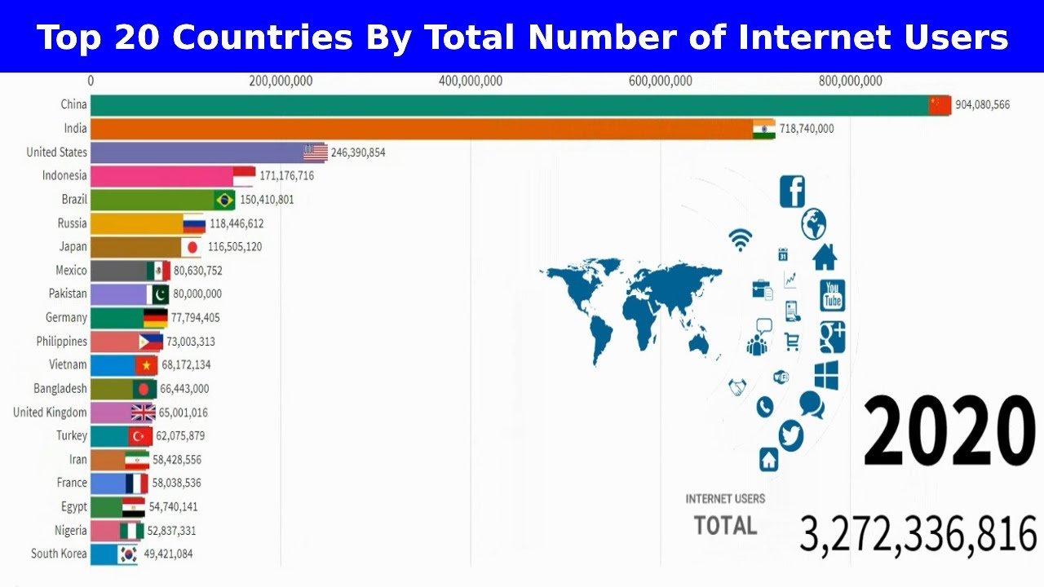
Wide-Area Network 1
WAN emerged in the late 1960 as an academic research project.
Evolution - from 4 sites (Arpanet, 1968) to World Wide Web (3.2 B users, 1.8 B web sites in 2020).
Communication speeds - from 1200 bits/s to more then 1000 Mbit/s.
Structure - Network of networks.
http://www.internetlivestats.com/total-number-of-websites/
http://techcrunch.com/2011/03/30/the-history-of-internet-usage-and-speeds-infographic/

Slide 5
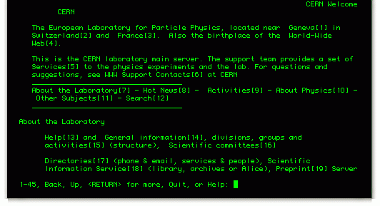
First Web Site
The website, created by Tim Berners-Lee at CERN, was a basic text page with hyperlinks and went live on August 6, 1991.
https://alexloth.com/cern-the-worlds-first-website-went-online-20-years-ago-today/

Slide 6
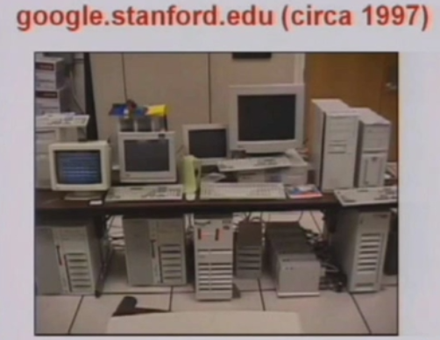
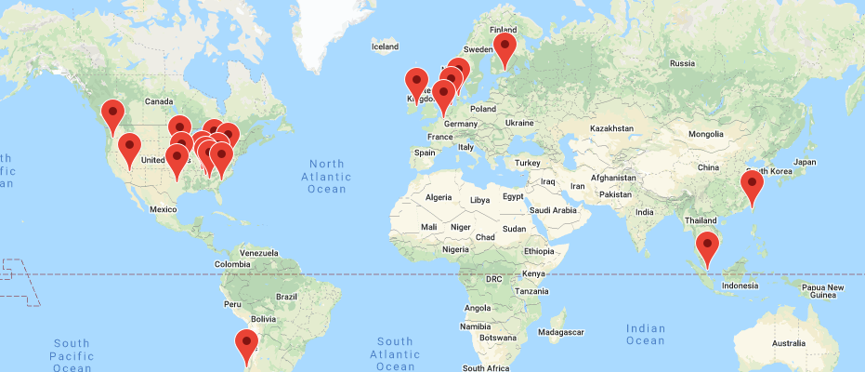
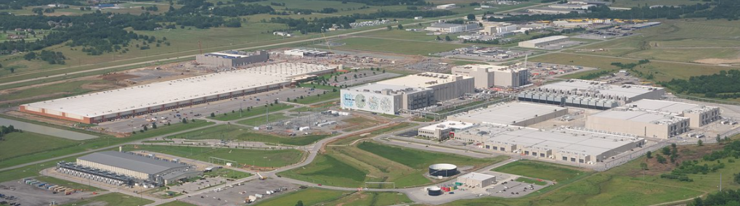
Wide-Area Network 2
2020
5.6 billion searches per day
More than 2,500,000 servers worldwide

Slide 7
Wide-Area Network 3
Network Host
users
Host operating system
Communication
Processor
Network Host
users
Host operating system
Communication Subsystem

Slide 8
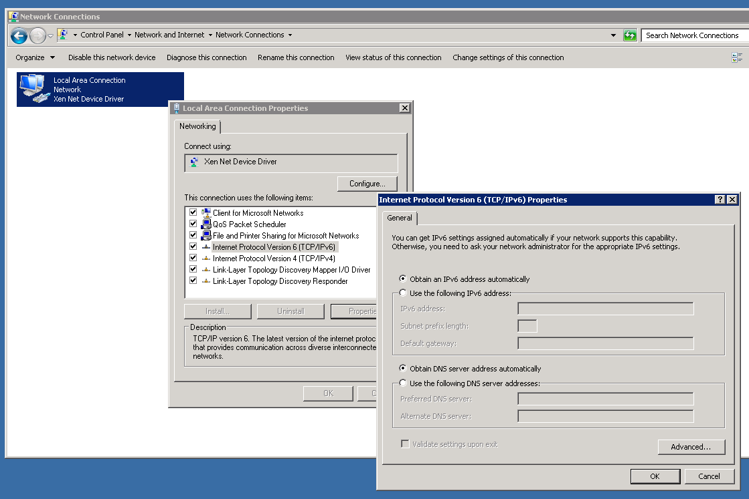
TCP/IP
Transmission Control Protocol/Internet Protocol (TCP/IP)
  A protocol developed by the Department of Defense for communications between computers. It is built into the UNIX system and has become the de facto standard for data transmission over networks, including the Internet. TCP and IP are transport and address protocols; TCP is used to establish a connection for data transmission, and IP defines the method for sending the data in packets.

Slide 9
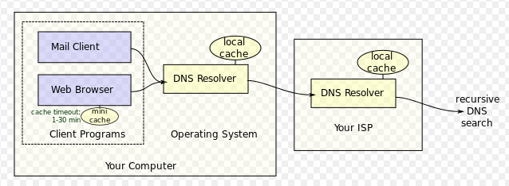
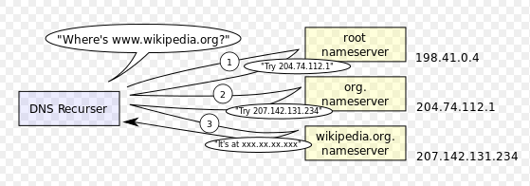
Domain Name Service
Goal: to communicate each computer must have a unique and resolvable ID.
Name Structure: each computer is identified by pair <host name (an unique name within the network), identifier (an unique id within the host)>
Step 1: accepting a host name and returning the address of name server responsible on that name (DN Server).
Step 2: contacting the server responsible on that name and returning the host-id.
Reason: distributed responsibility and updating.
Example: rita.vms.co.il - 212.25.69.210
https://ip-api.com/
Ipconfig
tracert <domain>
hosts

Slide 10
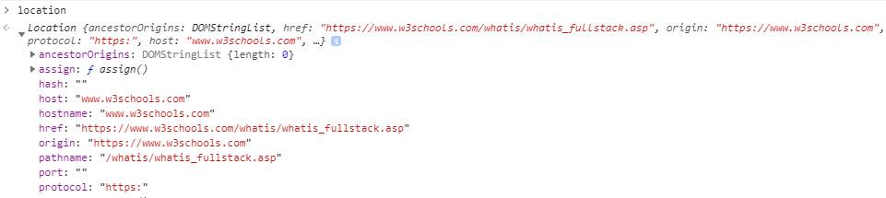
Uniform Resource Locator
protocol
host name
local info
query string
http://
www.keselman.com
/nnt/index.asp
?
user=alex
virtual directory + file name
Uniform Resource Locator (URL)
  The address of a resource on the Internet. URL syntax is in the form protocol://host/localinfo, where protocol specifies the means of returning the object, such as Hypertext Transfer Protocol (HTTP) or File Transfer Protocol (FTP).

Slide 11
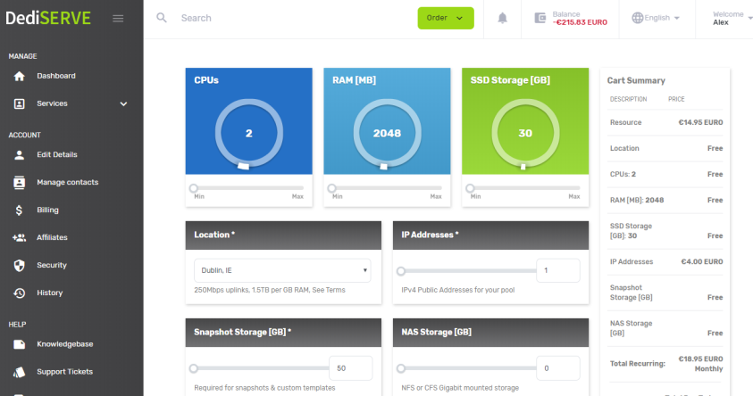
Web Server – Cloud Services
Dediserve Example

Slide 12
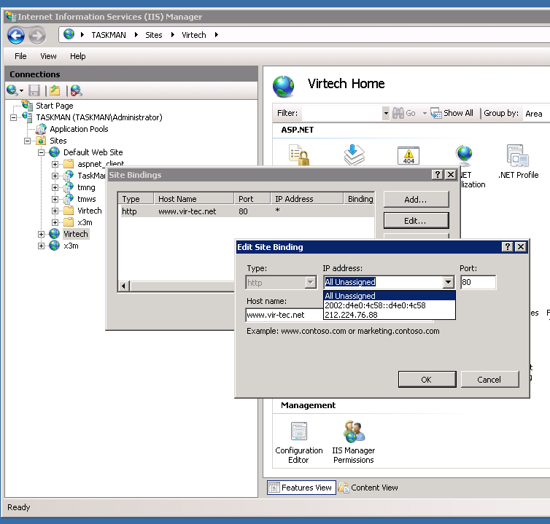
MS Internet Information Server

Slide 13
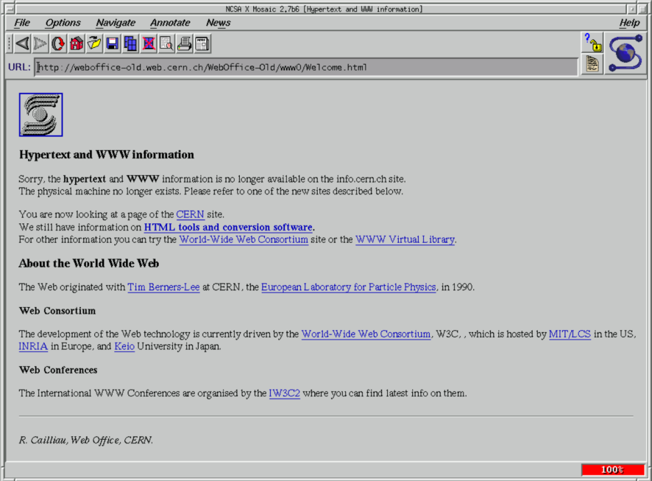
Hypertext & Visual Browser
hypertext
  A collection of documents containing cross-reference links that can be used
  interactively by a user to move immediately from one topic to another.
Page 1
Page 3
Page 3
Page 1
Page 2
Page 2
Tim Berners-Lee, 1989
Page 2
Page 1
Page 3
First graphic web-browser (MOSAIC) and “mouse click” based hyperlinks
  Marc Andreessen, 1993

Slide 14
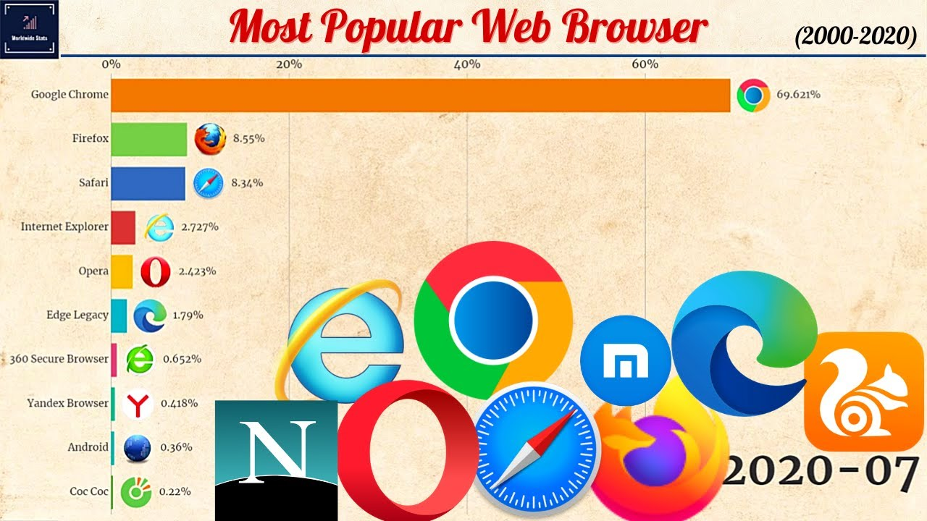
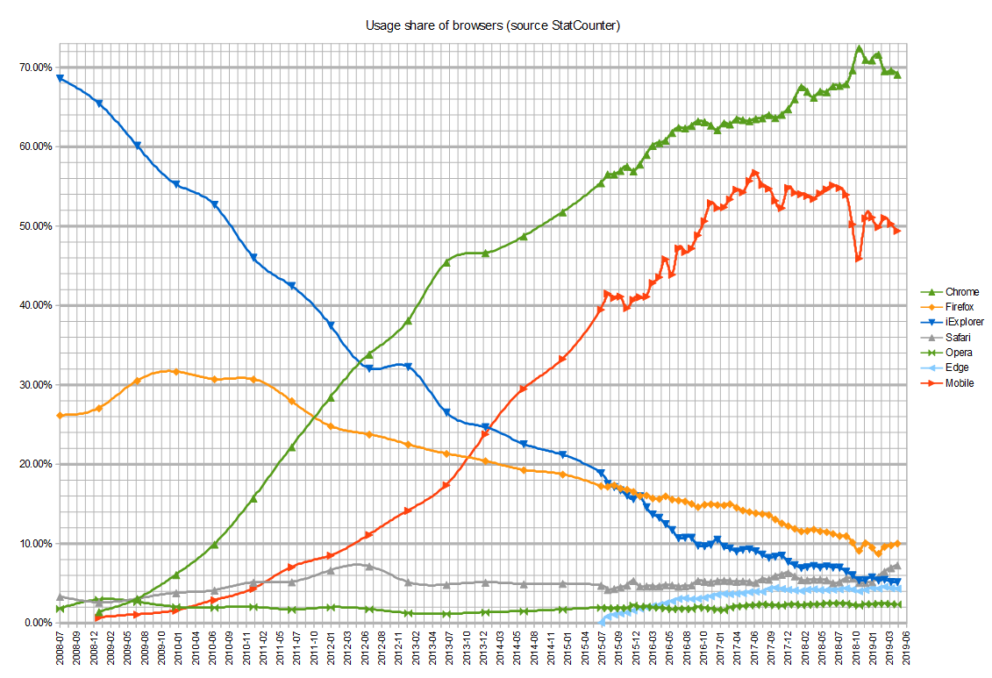
Web Browsers Wars

Slide 15
Examples
Development environment
  VS Studio
  VS Code
    Plugins:
      Live Server
      Auto Rename Tag
      htmltagwrap
Simple HTML examples
  html, css, js
  CSI, CDN

