Slide 1
Web Technology
Part 2:
Introduction to front-end development

Slide 2
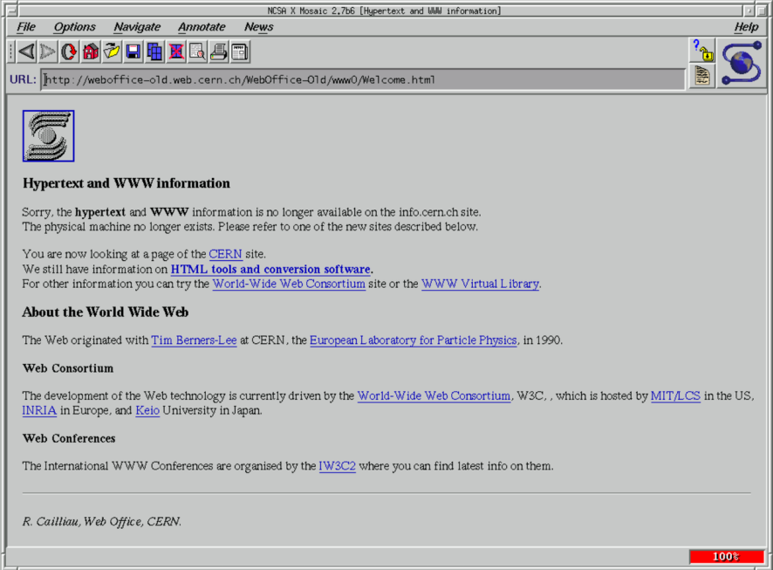
Hypertext & Visual Browser
hypertext
  A collection of documents containing cross-reference links that can be used
  interactively by a user to move immediately from one topic to another.
Page 1
Page 3
Page 3
Page 1
Page 2
Page 2
Tim Berners-Lee, 1989
Page 2
Page 1
Page 3
First graphic web-browser (MOSAIC) and “mouse click” based hyperlinks
  Marc Andreessen, 1993

Slide 3
Hypertext Transfer Protocol
The Hypertext Transfer Protocol
    (HTTP) is an application-level protocol for hypermedia information systems.
    http://www.w3.org/pub/WWW/Protocols/
HTTP header
HTTP return codes
CONTENT-ENCODING (29)
  Any additional content coding that have been applied to the entire resource.
CONTENT-LENGTH (5)
  Size of the resource, in bytes.
CONTENT-TRANSFER_ENCODING (2)
  Additional content coding that has been applied to the resource.
CONTENT-TYPE (1)
  Content type of the resource (such as text/html).
REQUEST-METHOD (45)
  Verb that is used in the request, typically GET or POST.
STATUS-CODE (19)
  Status code returned by the server
200 | URL located, transmission follows
400 | Unintelligible request
404 | Requested URL not found
405 | Server does not support requested method
500 | Unknown server error
503 | Service unavailable

Slide 4
HTML, DHTML, CSS
Hypertext Markup Language (HTML)
  A markup language derived from the Standard Generalized Markup Language (SGML). Used to create a text document with formatting specifications that tells a software browser how to display the page or pages included in the document.
DHTML - Dynamic HTML
Cascading style sheet
  A separate HTML file that keeps track of design and format information such as the colors, fonts, font sizes, and margins you use in your help files or Web pages.

Slide 5
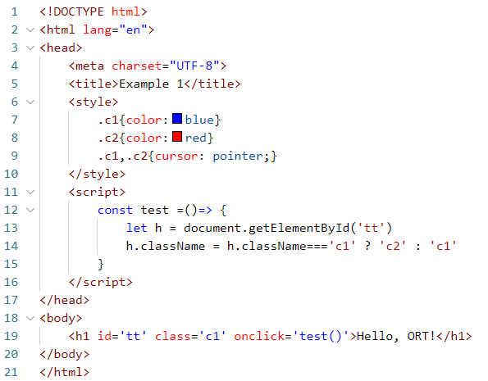
HTML example 1
1.html
CSS segment
JS segment

Slide 6
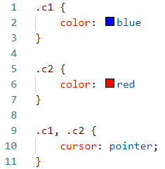
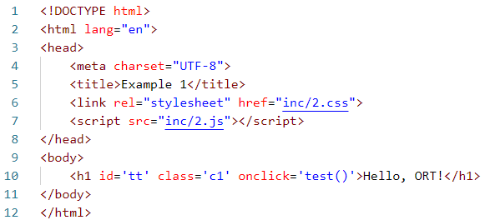

HTML example 2
2.css
2.html
CSS segment
JS segment
2.js

Slide 7
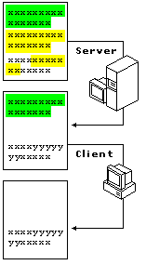
Client and Server side scripts
server side script
asp, aspx, php
client side script
js, vbs
HTML

Slide 8
JavaScript and VBScript examples
<html>
<head>
<SCRIPT LANGUAGE=“javascript”>
<!--
function Press_OnClick ()
{
alert("Hello, ORT !");
}
//-->
</SCRIPT>
</head>
<body>
<FORM Name="Form1">
<INPUT TYPE=“BUTTON”
VALUE="Click me"
NAME="BtnHello"
OnClick="Press_OnClick()“/>
</FORM>
</body>
<html>
<HTML>
<HEAD>
<SCRIPT LANGUAGE="VBScript">
<!--
Sub Button1_OnClick
MsgBox "Hello, ORT !"
End Sub
-->
</SCRIPT>
</HEAD>
<BODY>
<FORM>
<INPUT NAME="Button1“
TYPE="BUTTON"
VALUE="Hello Button">
</FORM>
</BODY>
</HTML>

Slide 9
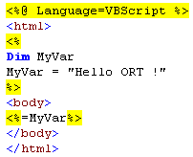
ASP example
Active Server Pages (ASP)
  scripting technology is written for and performed by the server side of the Web site. It allows to do many of the same functions that VBScript and Jscript can do on the client side, including determine user browsers, manipulate ActiveX and Java components, and build many different kinds of function
<html>
<body>
Hello ORT !
</body>
</html>

Slide 10
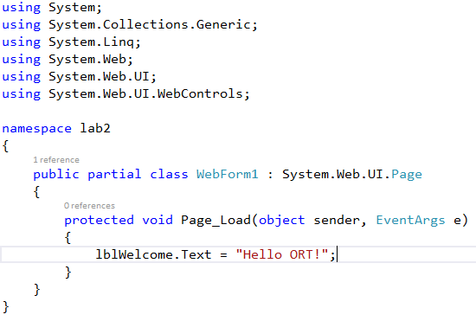
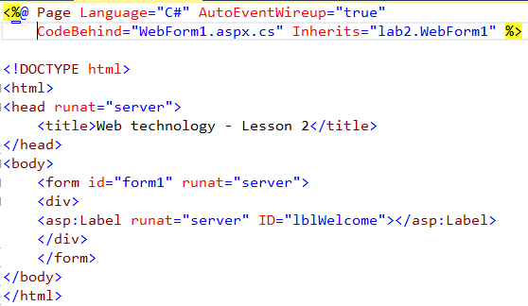
ASPX example
ASP.NET
  is an open-source server-side Web application framework designed for Web development to produce dynamic Web pages. It was developed by Microsoft to allow programmers to build dynamic web sites, web applications and web services.

Slide 11
HTML – basic elements
Every element has name
Start tag
End tag
Most element s have content
Some elements have no content
Some elements have no end tags
<body ..
<table ..
<p ..
< ..
</ ..
<H1>Hello !</H1>
<table><tr><td>Hello !</td></tr></table>
<img src=“tt.jpg”/>

Slide 12
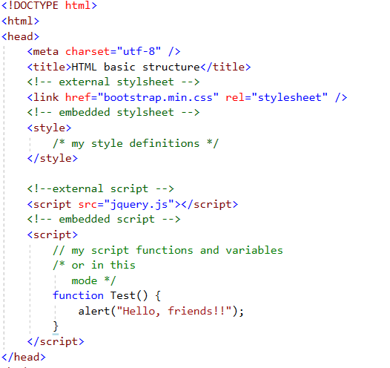
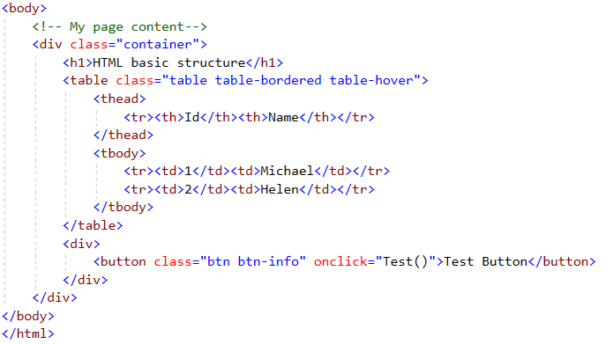
HTML – basic structure

Slide 13
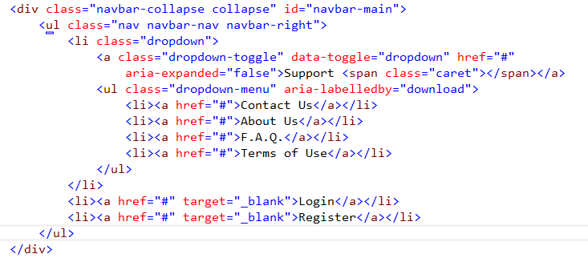
Tag Attributes
Specific for element
Have value
Must be closed “attr”
Can be from a list, a number, a percentage or created

Slide 14
Formatting Text
Alignment
  Default
  Left
  Right
  Center
  Justify *
Special tags
  <SMALL>…</SMALL>
  <BIG>…</BIG>
  <SUP>…</SUP>
  <SUB>…</SUB>
  <STRIKE>…</STRIKE>
List types
  <UL>
  <DIR>
  <MENU>
  <OL>
Formatting Elements
  Header <H1>…</H1> - <H6>…</H6>
  Break <BR/>
  Paragraph <P>…</P>
  Preformatted <PRE>…</PRE>
  No break <NOBR>…</NOBR>
  Bold <B>…</B>
  Italics <I>…</I>
  Underline <U>…</U>
  Tab <BLOCKQUOTE>…<BLOCKQUOTE>
Advanced containers
  <SPAN>…</SPAN>
  <DIV>…</DIV>
<P> = 2 * <BR/>

Slide 15
Linking Pages
HREF - applied to
  Link <LINK REL=“stylesheet” HREF="styles.css">
  Text <a href=“stam.htm”>stam text</a>
  Area
  Image
HREF types
  http “http://www.hp.com”
  ftp “ftp://www.hp.com”
  mailto “mailto:alex@keselman.com”
  javascript “lavascript:myfunc()”
Target
  blank

Slide 16
Document Object Model
The Document Object model is the mechanism that makes HTML programmable
Parent Object
Previous Object
Active Object
Child Object (1)
Child Object (2)
Next Object

Slide 17
Cascading Style Sheets
<LINK REL=“stylesheet” HREF="styles.css">
What Style Sheets can do
  Grouping elements
  Instant change of the Web Site design
  Team cooperation in web development

Slide 18
Using Styles in HTML
External Style Sheet
Embedded - within the HEAD
Inline Styles
<LINK REL=“stylesheet” HREF="styles.css">
<STYLE>
A {color: red;}
A:hover {color: navy;}
</STYLE>
<body style=“cursor: hand;color: navy;”>

Slide 19
Rules and Properties
Two rules example
CSS Model
BODY
{
CURSOR: hand;
COLOR: navy;
FONT-FAMILY: Verdana;
BACKGROUND-COLOR: paleturquoise
}
.test
{
BORDER-RIGHT: red double;
BORDER-TOP: red double;
BORDER-LEFT: red double;
WIDTH: 200pt;
BORDER-BOTTOM: red double;
FONT-FAMILY: 'MS Sans Serif';
HEIGHT: 100pt;
TEXT-ALIGN: center
}
SELECTOR-NAME {
  property: value; /* comments */
  property: value;
  property: value;
  property: value;
}

Slide 20
Grouping Properties
H1 {
  font-family: Helvetica, Arial;
}
H2 {
  font-family: Helvetica, Arial;
}
H3 {
  font-family: Helvetica, Arial;
}
H1, H2, H3 {
  font-family: Helvetica, Arial;
}

Slide 21
Classes
P.first {
  font: bold 14pt “Arial”;
}
P.second {
  font: normal 10pt “Arial”;
}
.general {
  font: bold 18pt “Tahoma”;
}
<p class=“first”>First class paragraph</p>
<p class=“second”>Second class paragraph</p>
<span class=“general”>This class is defined for all tags</span>

Slide 22
Pseudo-Classes
A: link {
  color: red;
  text-decoration: none;
}
A: visited {
  color: navy;
}
A: active {
  color: blue;
}
A: hover {
  text-decoration: underline;
}
A.special: link{
  color: black;
}
#myTable tr: first-child {
  color: red;
}
input:focus {
background-color: yellow;
}
p:nth-child(2) {
background: red;
}
p:nth-child(odd) {
background: red;
}
p:nth-child(even) {
background: blue;
}

Slide 23
CSS Box Model
Padding:
  padding-top
  padding-right
  padding-bottom
  padding-left
  padding
element
Margin:
  margin-top
  margin-right
  margin-bottom
  margin-left
  margin
padding
border
margin

Slide 24
Examples and exercises
Planning and dividing page
Formatting and styles
Bootswatch
Gallery example

