Slide 1
DISCOURSE COMMUNITIES
S H O W B U S I N E S S - F I L M I N D U S T R Y (F O L O C A L)

Slide 2
What makes a discourse community?
DISCOURSE COMMUNITIES ARE GROUPS OF PEOPLE THAT OFTEN SHARE SIMILAR OR IDENTICAL VALUES, ASSUMPTIONS AND EXPERIENCES.
MEMBERS OF A DISCOURSE COMMUNITY MIGHT HAVE CERTAIN SPECIFIC VOCABULARY OR SEMANTICS THAT ARE USED ALMOST EXCLUSIVELY WITHIN THAT GROUP.
THEY ALSO TEND TO HAVE COMMON GOALS, AND SIMILAR PERSPECTIVES IN REGARD TO THE PROCESSES AND METHODS OF ACHIEVING SAID GOALS.

Slide 3

FILM INDUSTRY
IT COULD BE ARGUED THAT THE FILM INDUSTRY WAS ONCE AMONG THE MOST IMPERMIABLE OF DISCOURSE COMMUNITIES, BECAUSE IT WAS FAR MORE DIFFICULT TO BREAK INTO THE BUSINESS.
A MASSIVE SHIFT HAS OCURRED IN RECENT YEARS WITH THE ADVENTS OF DIGITAL TECHNOLOGIES. THESE DAYS, THE AMOUNT OF PEOPLE ABLE TO BECOME PART OF THIS COMMUNITY HAS EXPLODED.
IT IS POSSIBLE THAT CERTAIN MEMBERS FROM DIFFERENT RANKS WITHIN A FILM CREW WILL OFTEN FORM MICRO DISCOURSE COMMUNITIES WITHIN THE LARGER STRUCTURE. THIS IS MORE COMMON WITHIN LARGER, BIG BUDGET PRODUCTIONS.

Slide 4
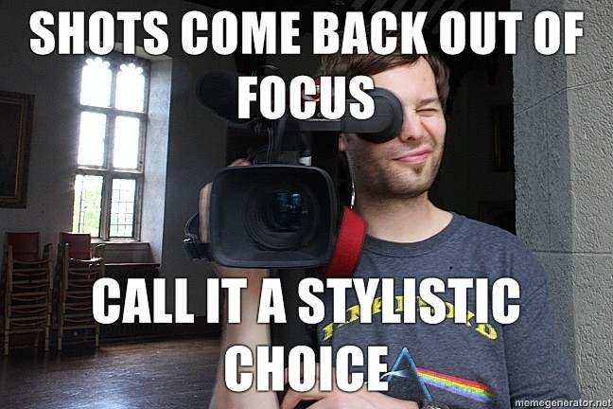

CAMERA DEPARTMENTS
CINEMATOGRAPHERS AND THE CAMERA DEPARTMENT TEND TO STICK TOGETHER VERY OFTEN, AS IT’S THE PART OF THE JOB THAT HAS TO DO WITH ALL THE TECHNICAL ASPECTS.
CAMERA DEPARTMENTS ALSO HAVE VERY SPECIFIC LINGO AND RULES FOR SET ETIQUETTE.

Slide 5
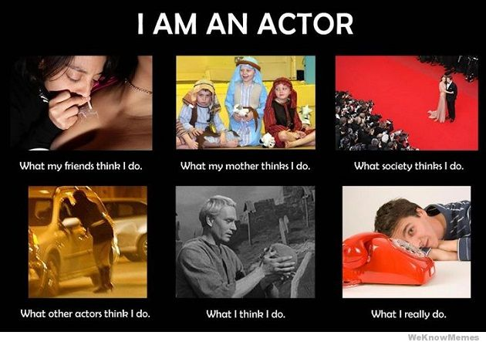

talent
ACTORS WILL LIKELY STICK TOGETHER, AS THEIR LIFE HARDSHIPS AND EXPERIENCES ARE VERY SIMILAR.

Slide 6
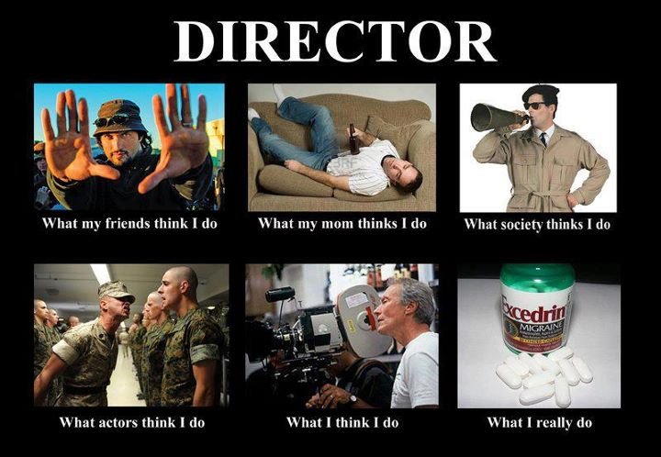
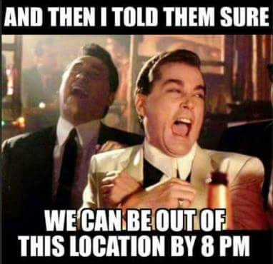
EXECUTIVES
IT IS WELL KNOWN IN THE FILM INDUSTRY THAT THINGS TAKE MUCH LONGER THAN ANTICIPATED. (ESPECIALLY IN INDEPENDENT PRODUCTIONS).

Slide 7




THE FILM INDUSTRY IS FOLOCAL
THE FILM INDUSTRY IS A FOLOCAL DISCOURSE COMMUNITY BECAUSE IT IS:
CONCENTRATED IN LOCAL COMMUNITIES (SUCH AS HOLLYWOOD, ALBUQUERQUE, AND NEW YORK).
ALSO PROMINENT ACROSS THE WORLD IN MOST COUNTRIES.
ALTHOUGH THIS IS A FOLOCAL DISCOURSE COMMUNITY, THE FILM INDUSTRY COMES TOGETHER AS ONE IN A VARIETY OF INTERNATIONAL FILM FESTIVALS:

