Slide 1
Unhealthy public school lunch
Ken M. Amamori
RWS1301
MW 1:30 – 2:50 PM

Slide 2
benefit of healthier lunch
Better academic performance
Less behavior problem
Prevent obesity

Slide 3
1. Better academic performance
A study showed with a lunch with better quality, test score increased about 40%
burgers, chicken nuggets, and French fries contains are loaded with high levels of saturated fats → impair learning and memorizing skills of kids

Slide 4
2. Better behavior
Served food with quality(remove chemical additives, processed food, and less sugar) and there were positive impact
Violence declined by 33%
Theft dropped by 77%
Bad behavior reduced by 44%
44% decrease in suicide attempts

Slide 5
3. Prevent obesity
Obesity is major problem in U.S., which the rate of obesity tripled in the last 30 years causing serious healthiness issue
A study showed an adolescent age determines future habits → tends to eat unhealthy food for years

Slide 6

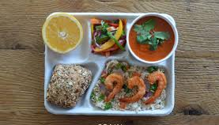

Example of good lunch
Italy Spain Japan

Slide 7
conclusion
Government must act on this situation to improve the school lunch system
Healthier food have many benefit from physical perspective to mental point of view

