Slide 1





Matched Outcomes, Divergent Gaze: How Foveated MLLMs Search Compared to Humans
MOHAMED AMINE KERKOURI, F-Initiatives/NeoPhi.ai, France
MAROUANE TLIBA, USPN, France
ALADINE CHETOUANI, USPN, France
ULAS BAGCI, Radiology, Northwestern University, United States
ALESSANDRO BRUNO, IULM, Italy

Slide 2
1. Motivation (MLLMs)
Document and chart understanding
Format transduction.
…
Bulk semantic annotation.
GUI Navigation
MLLMs

Slide 3

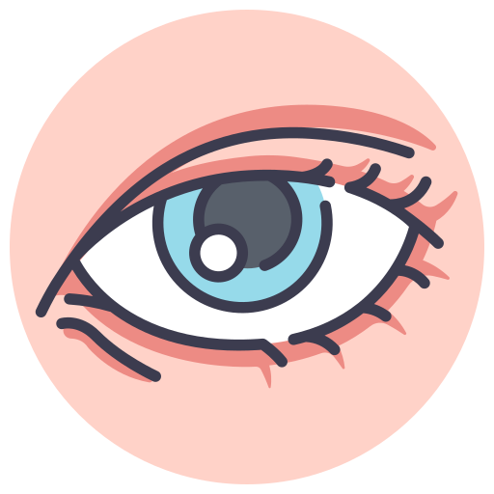
1. Motivation (Visual Behavior)

Slide 4
1. Motivation
When forced to view a scene through the same foveated (acuity-limited) input as a human.
Do MLLMs search the way humans do?

Slide 5
1. Motivation
Decision
Finding
Gaze process
Is the model's present/absent judgment as accurate as a human's?
Does the model's gaze reach the target as efficiently as a human's?
Do the model's eye-movement dynamics (order, amplitude, entropy, consistency) resemble a human's, independent of outcome?
Notes:
Do MLLMs search the way humans do?
- **Decision** — Is the model's present/absent judgment as accurate as a human's?
- **Finding** — Does the model's gaze reach the target as efficiently as a human's?
- **Gaze process** — Do the model's eye-movement *dynamics* (order, amplitude, entropy, consistency) resemble a human's, independent of outcome?

Slide 6
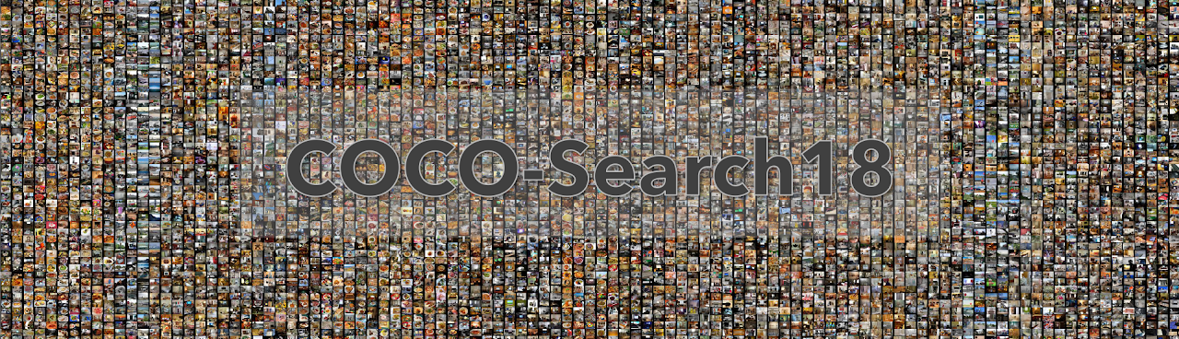
2. Method (Data)
Validation split
285 scenes
1680×1050 px
141 target-present
144 target-absent
10 observers per scene

Slide 7
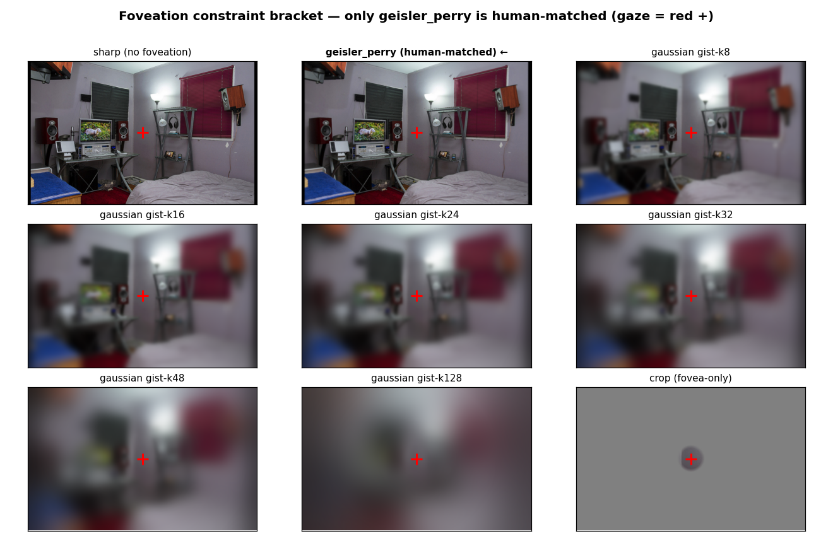
2. Method (Data)

Slide 8
2. Method (Models)
Qwen3.5-35B-A3B
GLM-4.6V-Flash
Gemma-4-E4B
5 Seeds

Slide 9
2. Method (Data)
285 scenes × 5 seeds × 9 conditions × 3 models
38,475
Data points

Slide 10
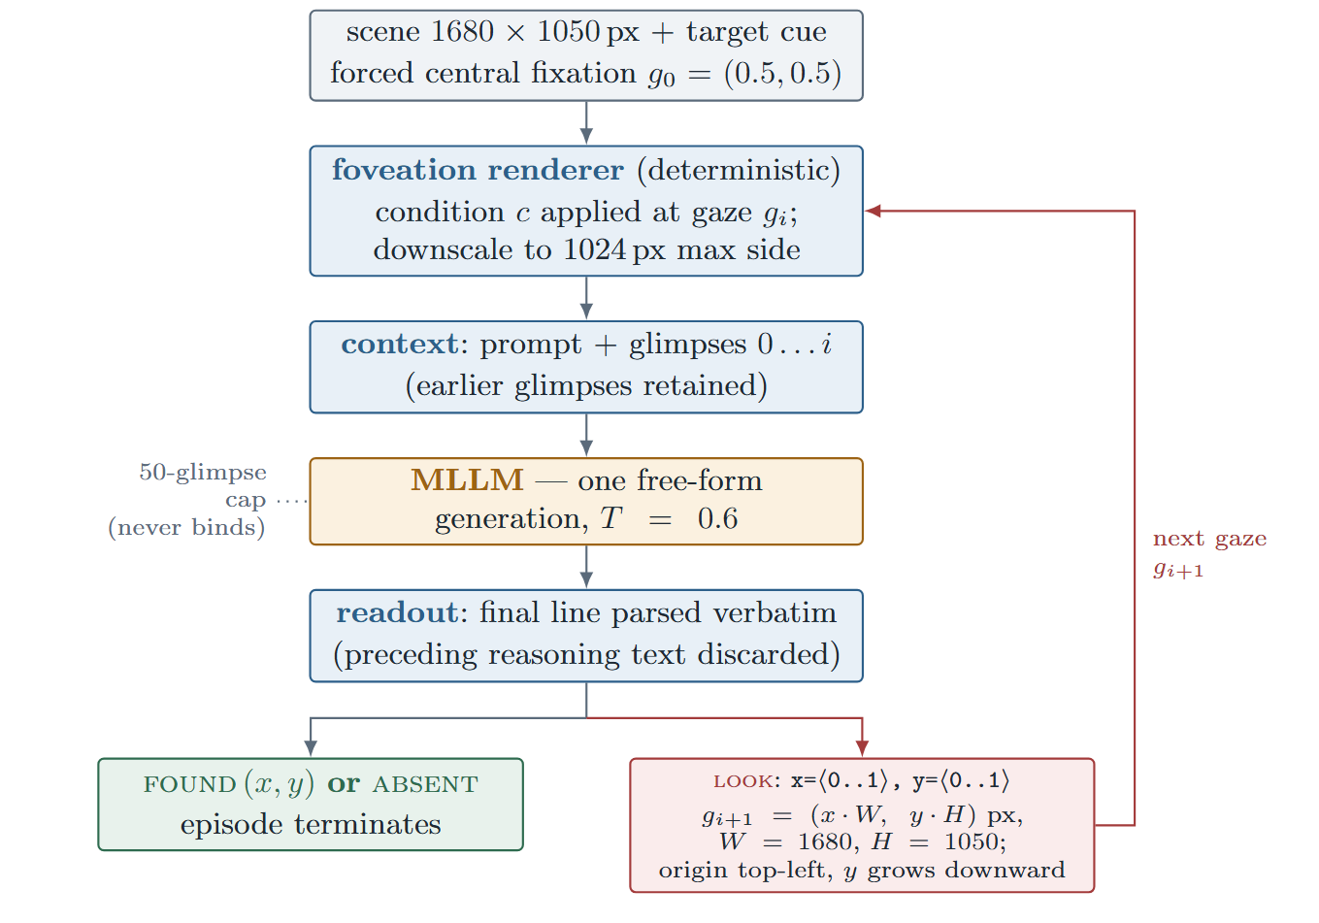
2. Method (Agent)

Slide 11
2. Method (Agent)

Slide 12
2. Method (Agent)

Slide 13
2. Method (Agent)

Slide 14
2. Method

Slide 15
2. Method (Agent)

Slide 16
2. Method (Agent)

Slide 17
2. Method (Agent)

Slide 18
2. Method (Agent)

Slide 19
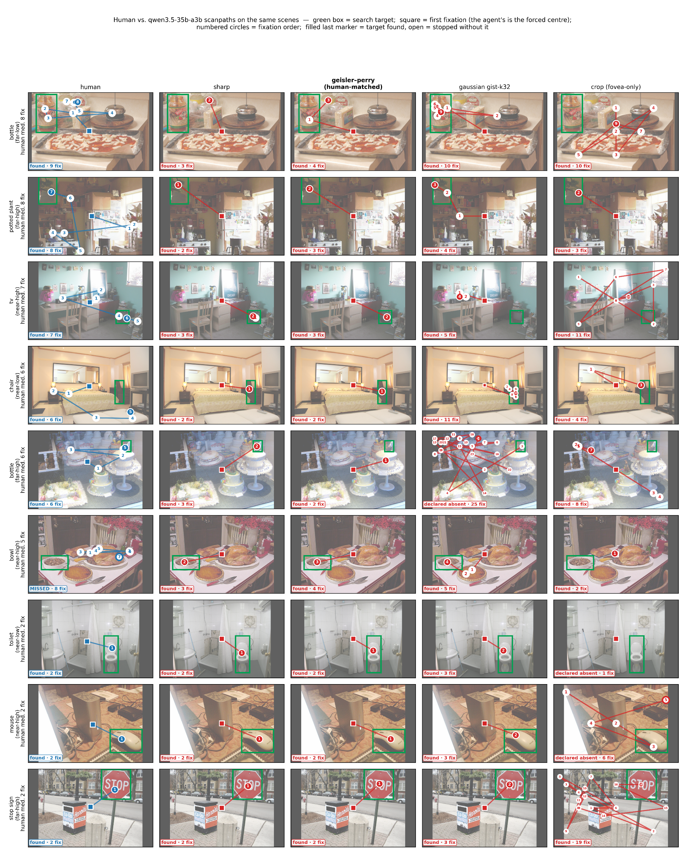
3. Results

Slide 20
3. Results

Slide 21
3. Results

Slide 22
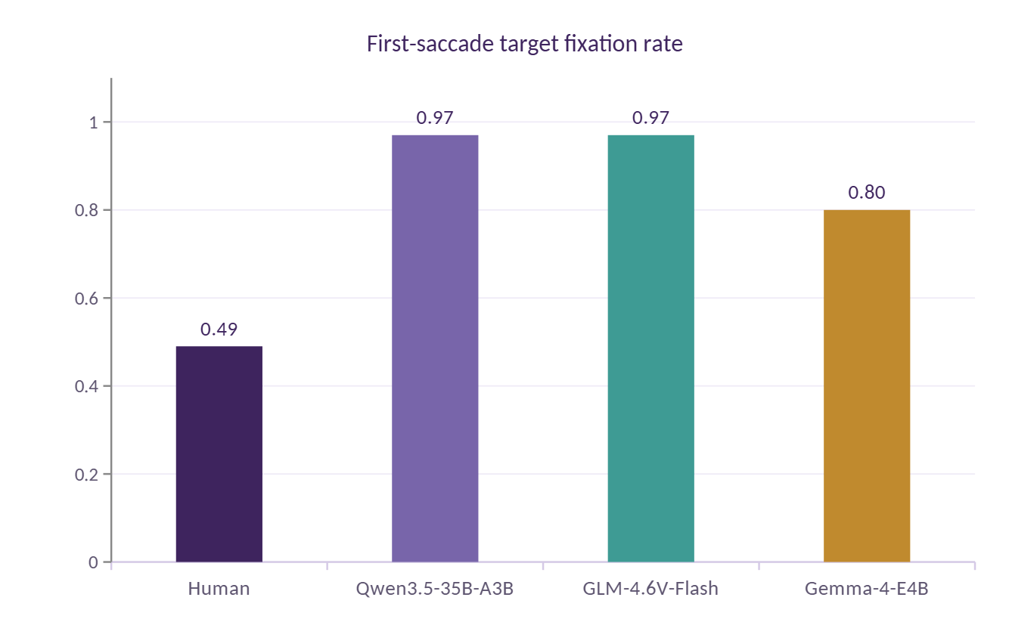
4. Experiments (One-shot in-harness decision accuracy)

Slide 23
4. Experiments (One-shot in-harness decision accuracy)
On raw detection, models perform as good as or mostly better than humans.

Slide 24
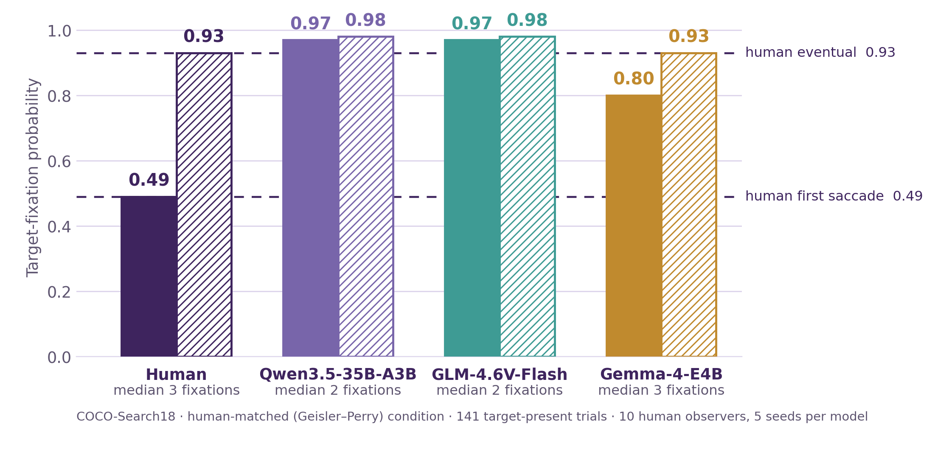
4. Experiments (Finding efficiency)

Slide 25
4. Experiments (Finding efficiency)
Models have an efficiency advantage.

Slide 26
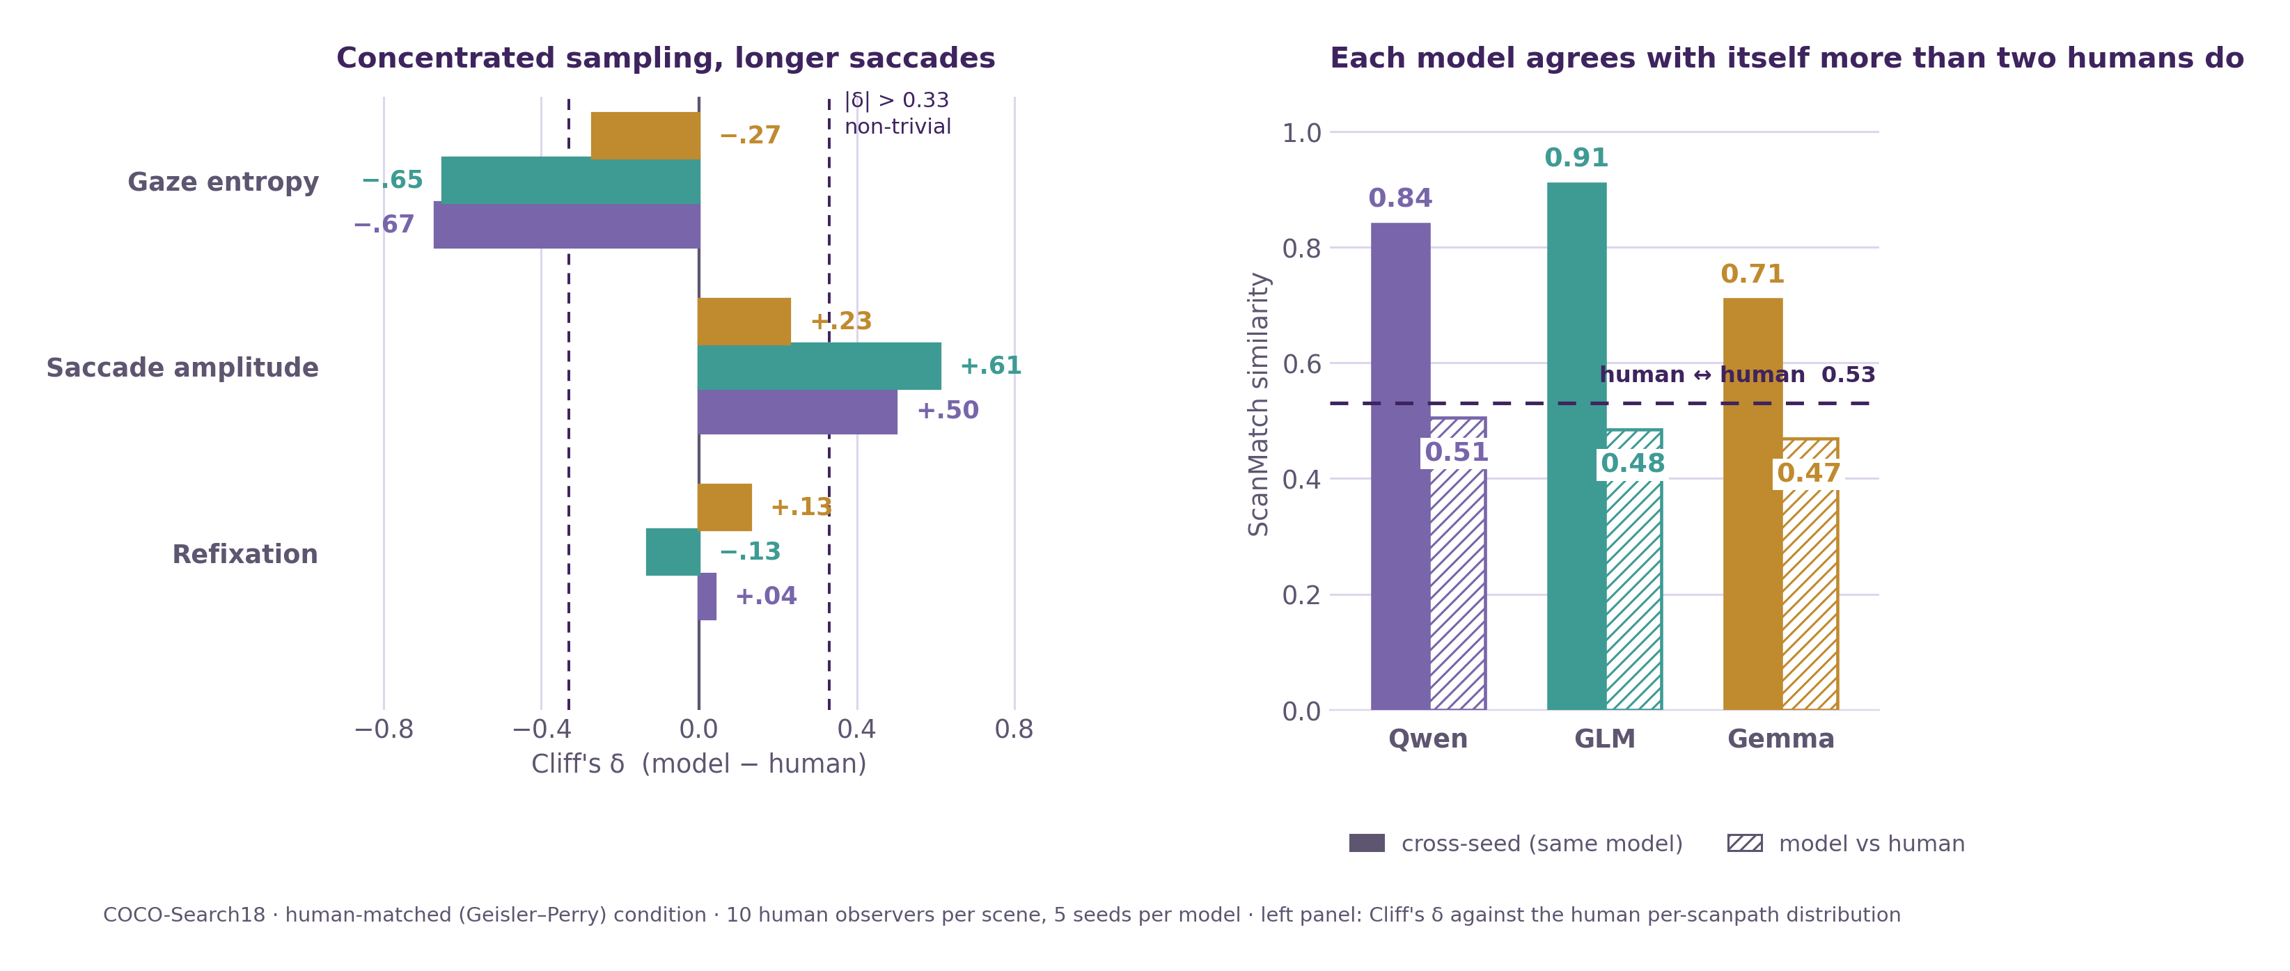
4. Experiments (Gaze dynamics)

Slide 27
4. Experiments (Gaze dynamics)

Slide 28
4. Experiments (Gaze dynamics)
Models agree with themselves more than humans

Slide 29
4. Experiments (Gaze dynamics)

Slide 30
4. Experiments (Gaze dynamics)
The gaze process is not human, even though outcomes are.

Slide 31
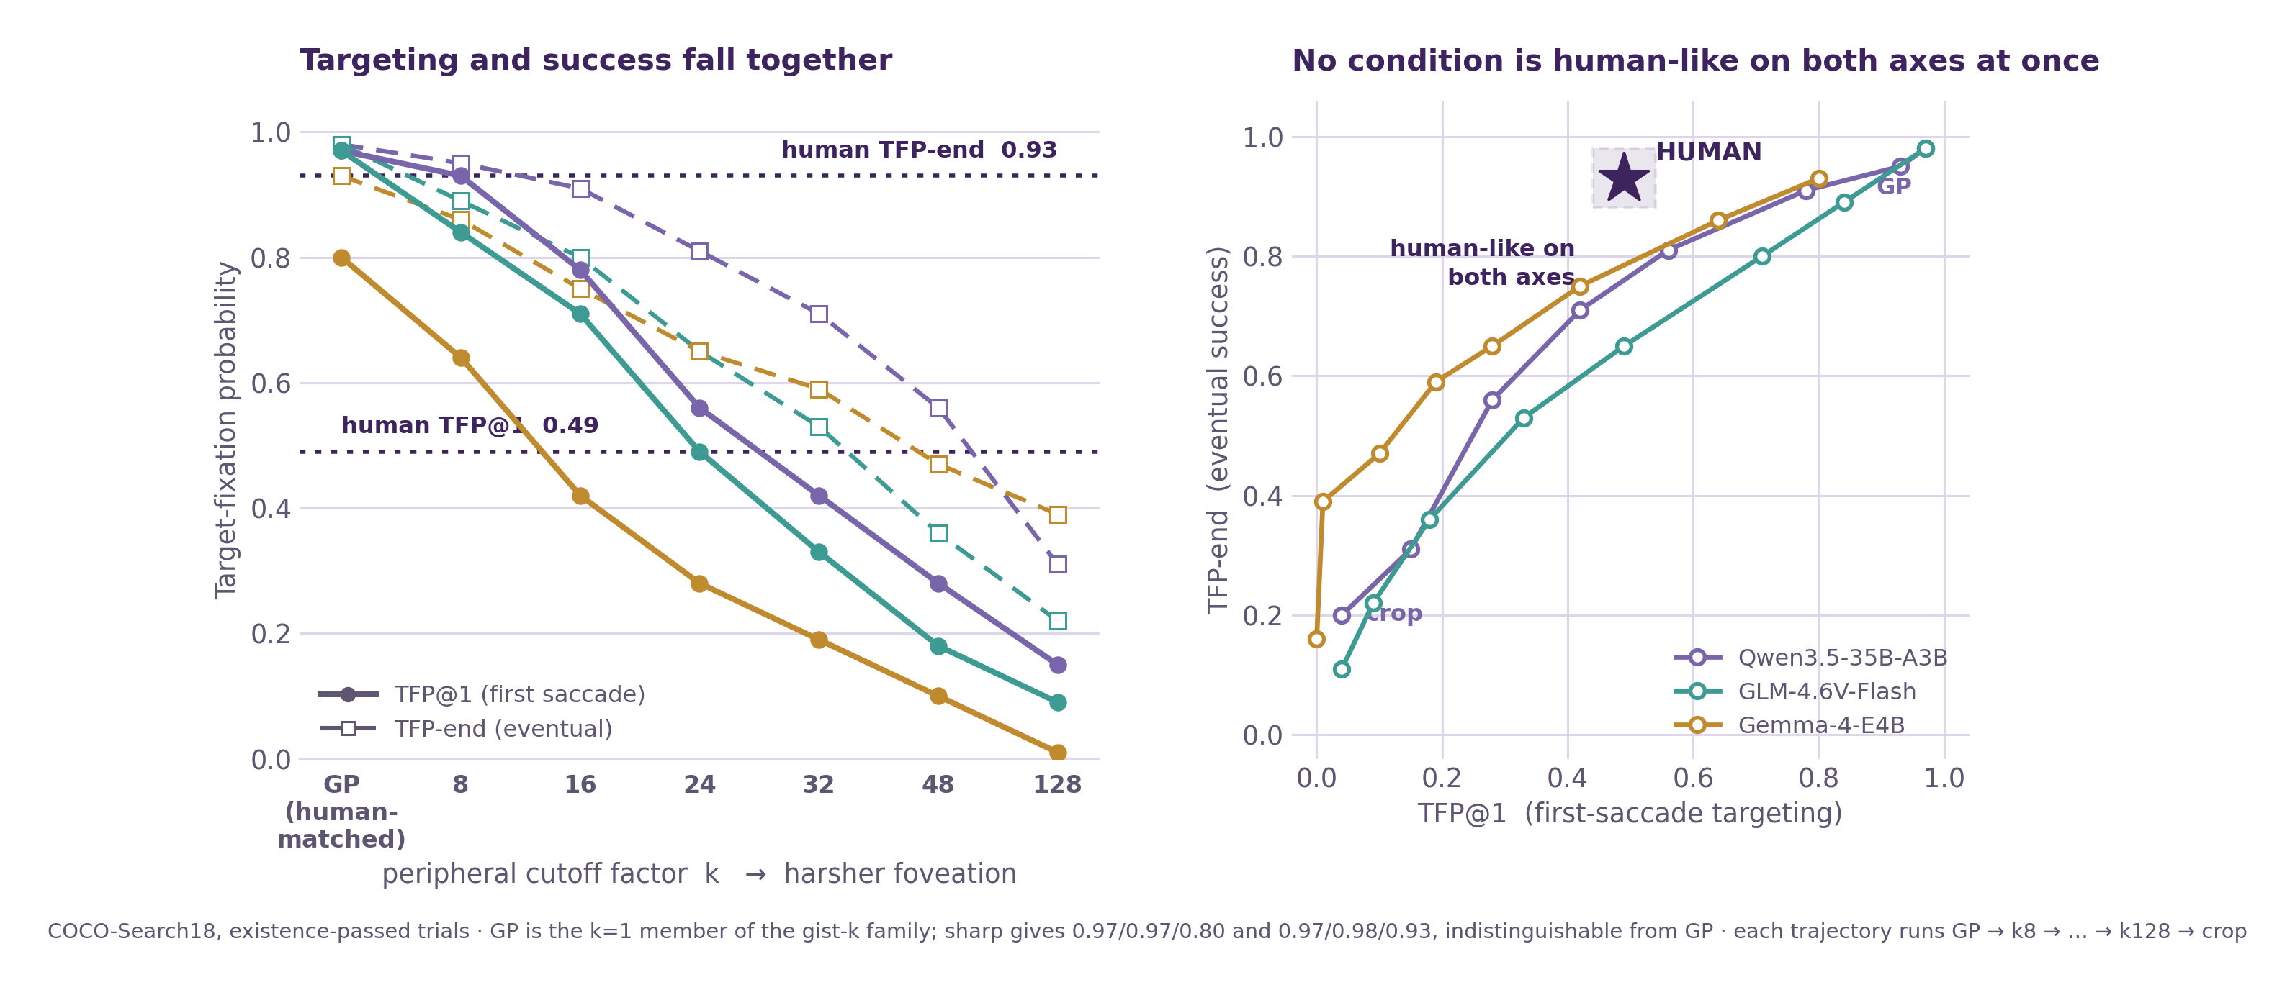
4. Experiments (Degradation sweep)

Slide 32
4. Experiments (Degradation sweep)
No amount of degradation recovers a human-like characteristics of the visual behaviour
Notes:
The divergence isn't caused by acuity mismatch it persists even when acuity is exactly matched, and no amount of degradation recovers a human-like *process*. This points to an **architectural** explanation: single-pass, non-serial processing rather than a serial, fixation-by-fixation searcher.

Slide 33
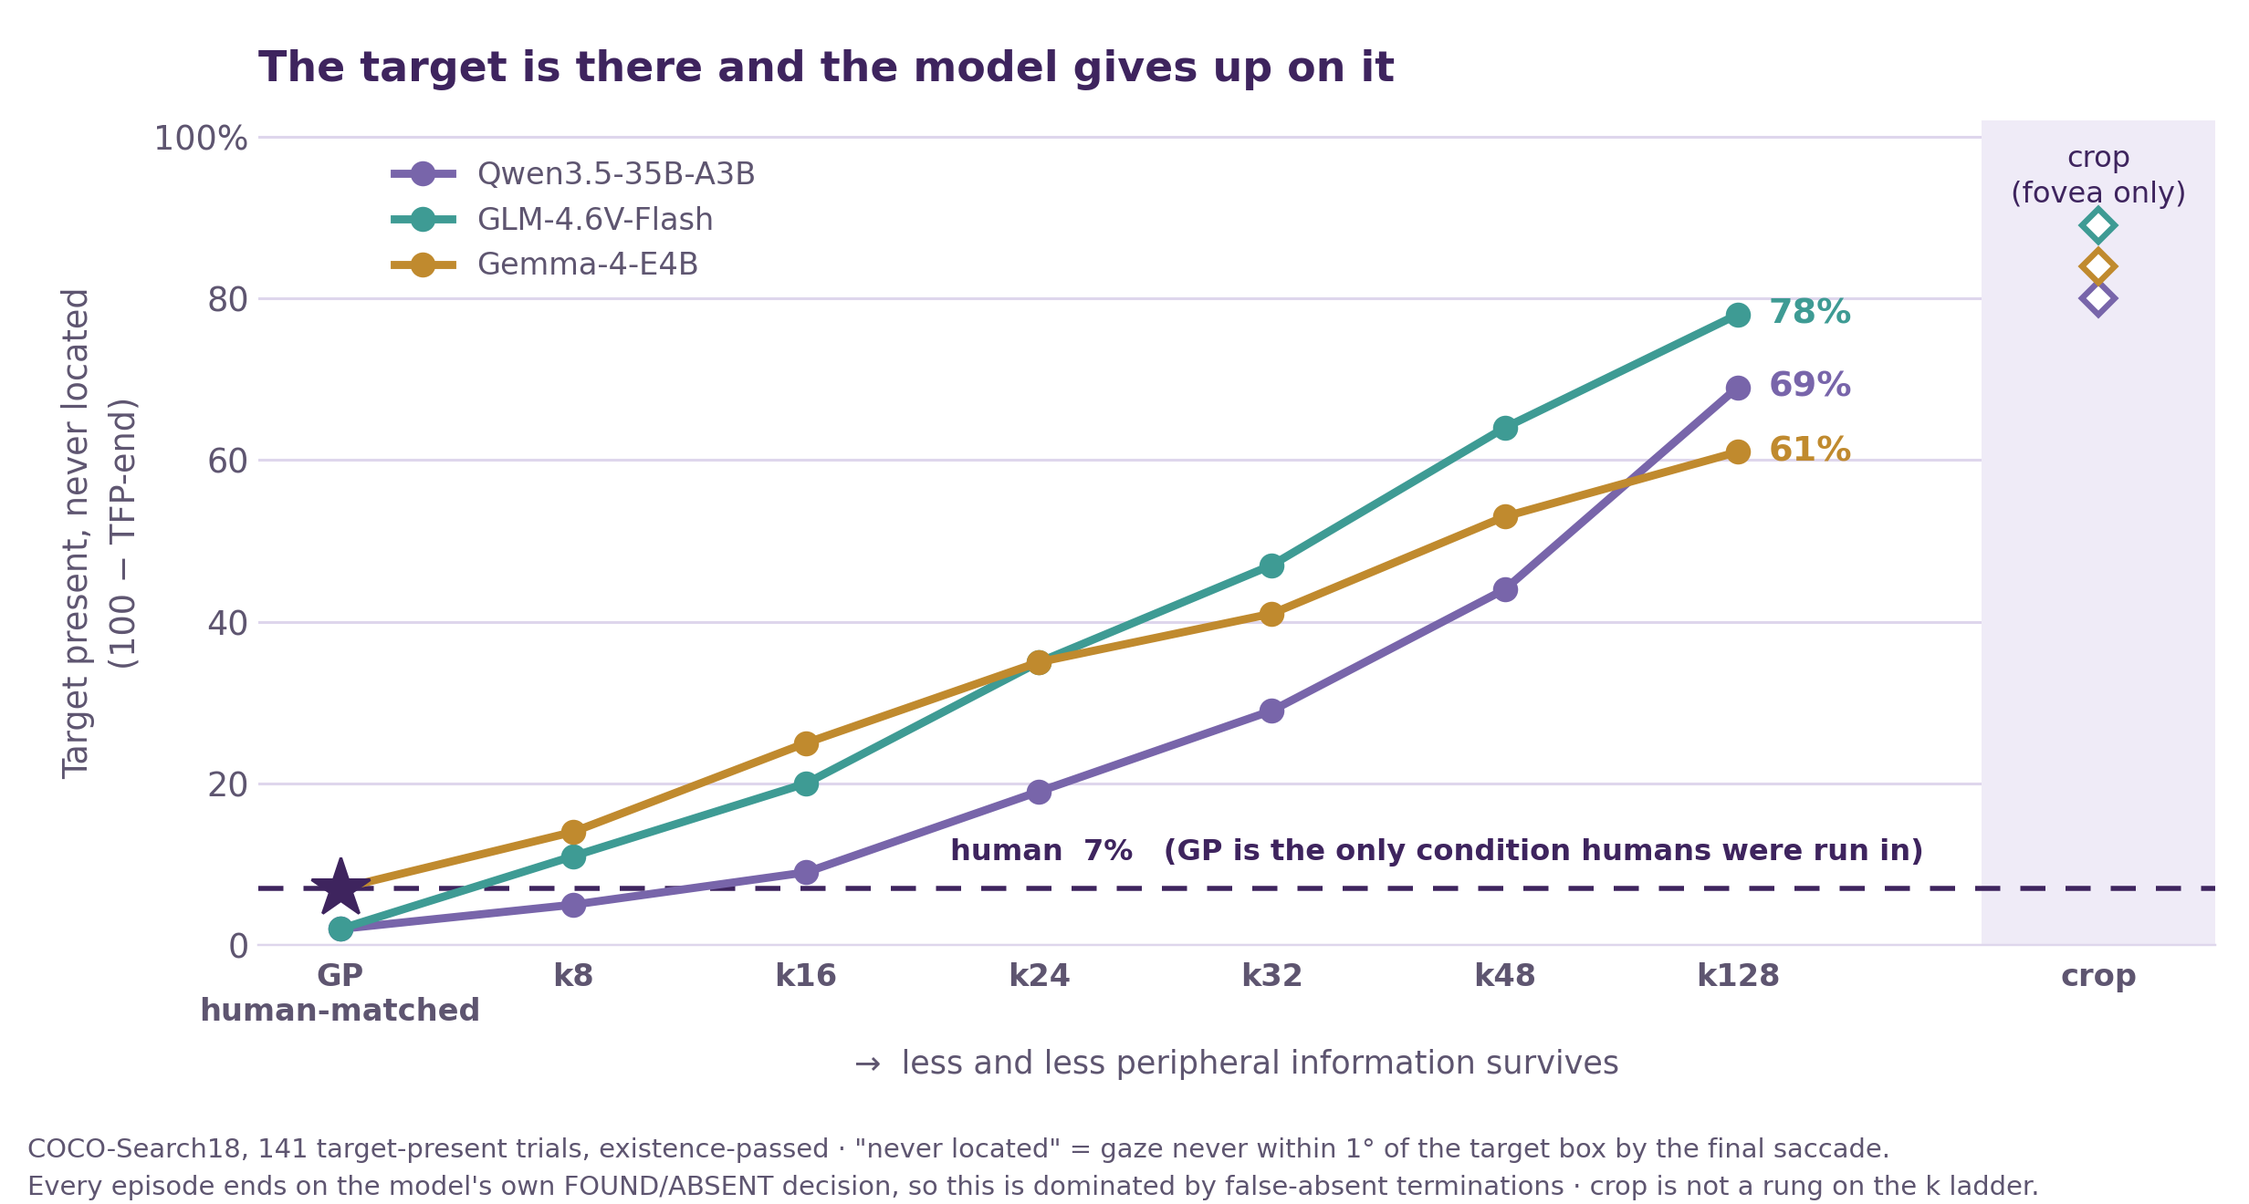
4. Experiments (Failure mode under severe degradation)
Notes:
The divergence isn't caused by acuity mismatch it persists even when acuity is exactly matched, and no amount of degradation recovers a human-like *process*. This points to an **architectural** explanation: single-pass, non-serial processing rather than a serial, fixation-by-fixation searcher.

Slide 34
4. Experiments (Failure mode under severe degradation)
Under vanishing evidence, models don't lengthen search gracefully like humans, they collapse into a default-negative response.
model-internal failure signature
Notes:
Under vanishing evidence, models don't lengthen search gracefully like humans they collapse into a default-negative response, a distinct **model-internal failure signature**

Slide 35
Key findings
Decision
Finding
Gaze process
Model decisions are as good or better than humans under human-like foveation conditions, and only degrade under severe foveation.
The models find the object more efficiently than humans, usually in 1 big saccade, while humans take much more saccades.
Independent of outcome, MLLMs have shown that their visual searching behaviour is different from the humans, and they can not be considered a good simulation alternative.
Notes:
Do MLLMs search the way humans do?
- **Decision** — Is the model's present/absent judgment as accurate as a human's?
- **Finding** — Does the model's gaze reach the target as efficiently as a human's?
- **Gaze process** — Do the model's eye-movement *dynamics* (order, amplitude, entropy, consistency) resemble a human's, independent of outcome?

Slide 36
A high alignment score cannot certify human-like vision
Answer-alignment scores are computed on outcomes; But are blind to the process axis.
Models scored well on exactly those, while diverging on sequential measures.
Certifying process-level correspondence needs sequence-level measurement.
Notes:
The divergence isn't caused by acuity mismatch it persists even when acuity is exactly matched, and no amount of degradation recovers a human-like *process*. This points to an **architectural** explanation: single-pass, non-serial processing rather than a serial, fixation-by-fixation searcher.

Slide 37
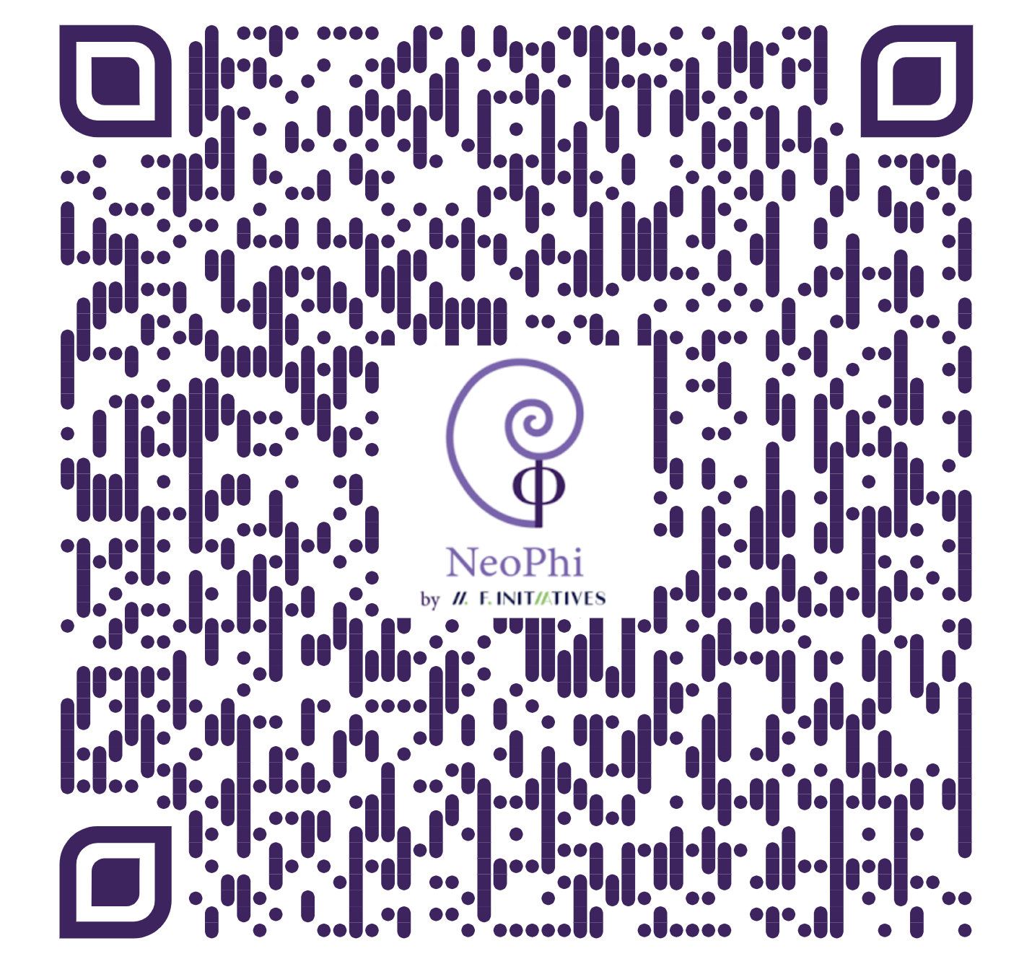

Slide 38

Thank You!
Matched Outcomes, Divergent Gaze:
How foveated MLLMs Search Compared to Humans
https://github.com/kmamine/MODG
Questions?
Notes:
Matched Outcomes, Divergent Gaze: How Foveated MLLMs Search Compared to Humans kmamine/MODG

