Slide 1

Home Insurance Prediction Insurance claims How to F#@*K the customer the most
Classification Project:
Doron T-test & Guy Knn.

Slide 2
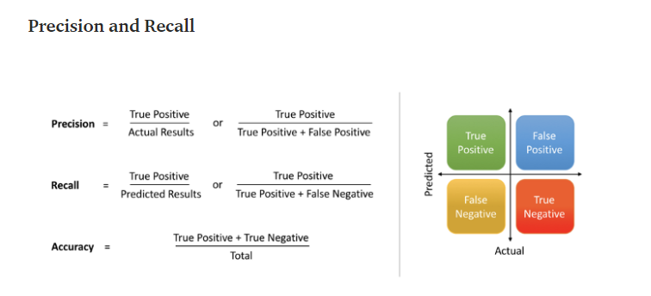
Goal (Prediction purpose)
Each filed claim = $$$$$ Burden cost.
We would like to be able to use the model to estimate the expected burden cost given the existing data.
…A good AI model in this context is inclusive enough to catch 80-100% of all relevant claims (recall) but exclusive enough to avoid returning a high number of false positives (precision)…
Notes:
The threshold for acceptable precision and recall will vary by context. One common use of AI in the legal field is for the classification of responsive documents. A good AI search in this context is inclusive enough to catch 80-100% of all relevant documents (recall) but exclusive enough to avoid returning a high number of false positives (precision). Without high recall, a second review of the total population is necessary to catch enough relevant documents. Without high precision, the documents that the search returned have to be manually reviewed to remove false positives. Either case involves extra man hours and extra cost. While 80% is acceptable for relevance review, a search would need to return nearly perfect (99-100%) recall for situations involving sensitive information like privilege review, personally identifiable and person health information identification, or data breach.

Slide 3
Data Background
The data set contain: 12K record over 17 Columns
Each record: represent an insurance policy
Target class: represents if the policy was Claimed (True) or not (False)

Slide 4
Features preparation
Our key guidelines to deciding which features to keep & which to Drop:
leaks information from the future or Data which is not available when new record arrives
Doesn’t affect the state of the claim (ex: randomly generated ID value)
Features which are formatted poorly
requires more data or a lot of pre-processing to turn into useful a feature
contains redundant information.

Slide 5
Dropped Features
[id] - generated ID value - DROP
[user_id] - generated / user ID value - DROP (Contained Dup. values)
[square_ft] - have very few valid records - DROP
[product] - Highly imbalanced - DROP
[high_risk_dog] - contain only '0' - DROP
[Postal_code] – redundant with state with many categories
Features Cleaning
[portable_electronics] - 407 NULLs - Assuming NULL = 'No portable electronics' - FILLNA (‘0’)
[fire_housing_proximity] - Distance from available fire extinguishing solution. - CLEAN of invalid String values
[card_type] – 52 NULLs - FillNA – ‘Other’.

Slide 6
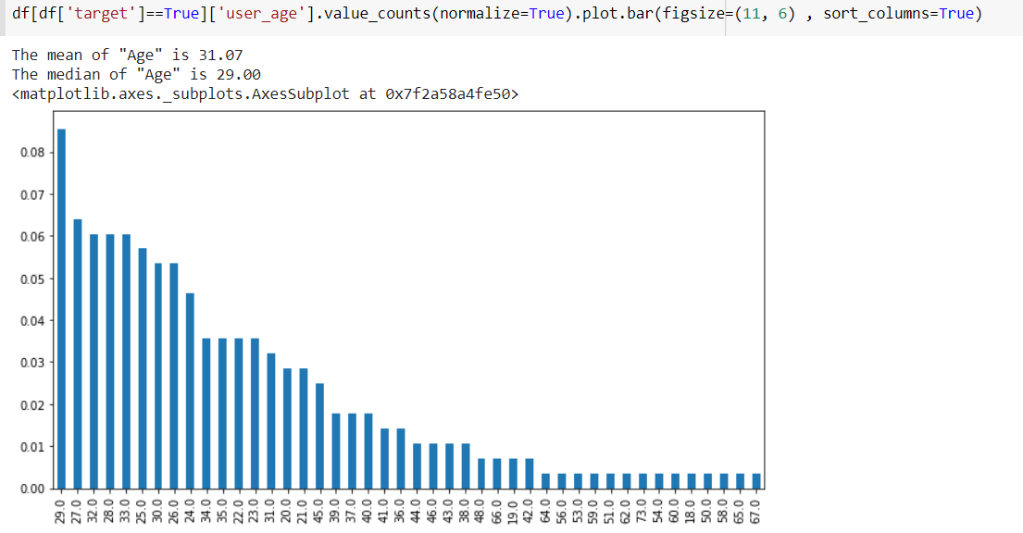
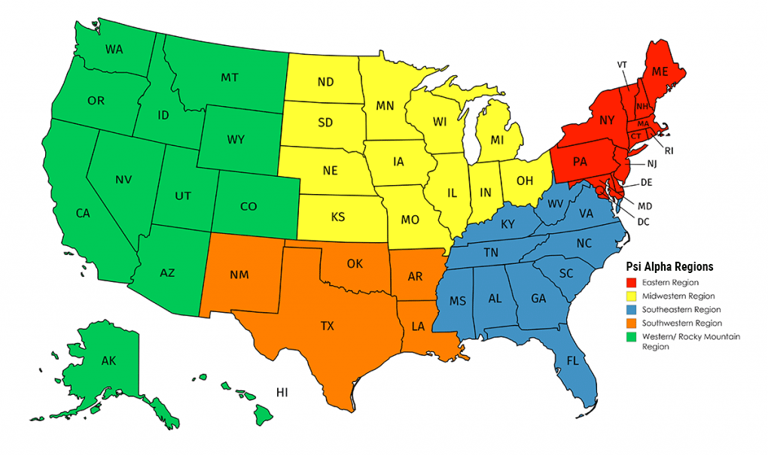
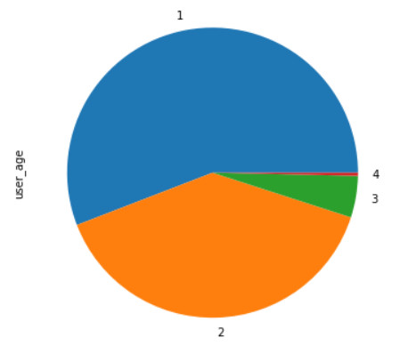
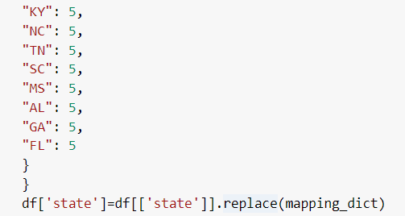
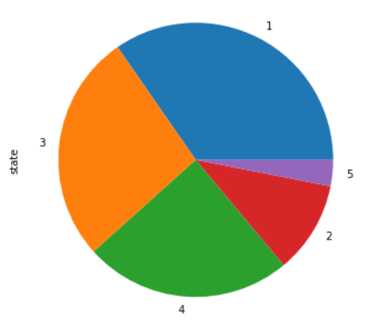
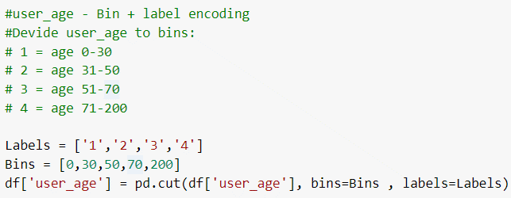
User_age
State
Type Categorical – with 22 categories (states).
Null – 82 NULL values.
Distribution
Null – No NULL values.
Label-Encode to bins
FillNA – .median
Label-Encode to bins

Slide 7
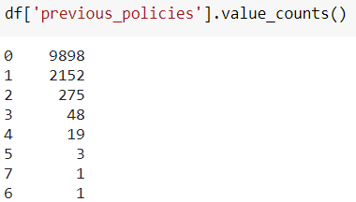
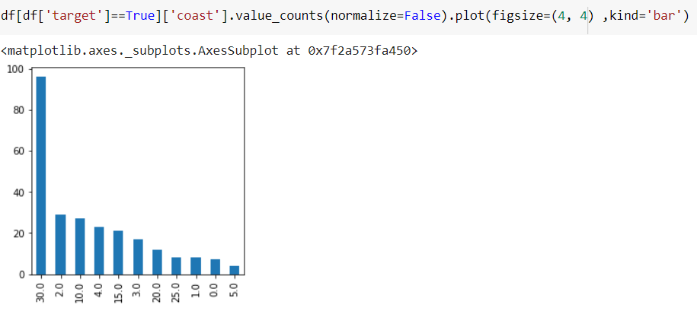
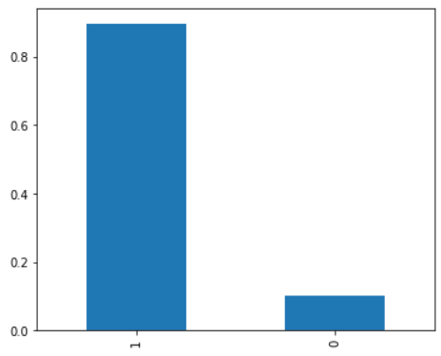
Coast
Prev policies
Null – 1155 NULL values.
True Class distribution
Assumption – NULL Values means “Not close to coast”
New Feature – [is_close_to_coast] (Binary Enc)
Null – 0 NULL values.
Assumption – According to the data our assumption – This feature doesn’t represent customer aging.
Feature conversion – Binary Enc.

Slide 8
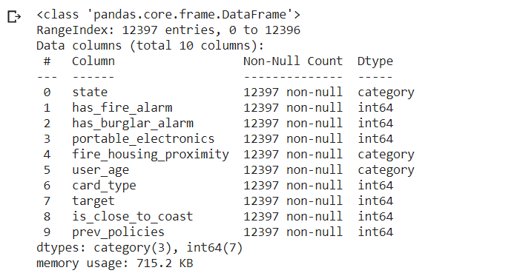
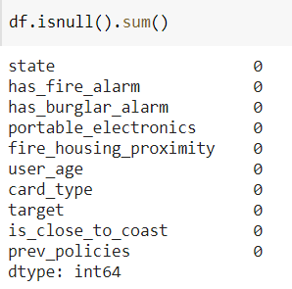
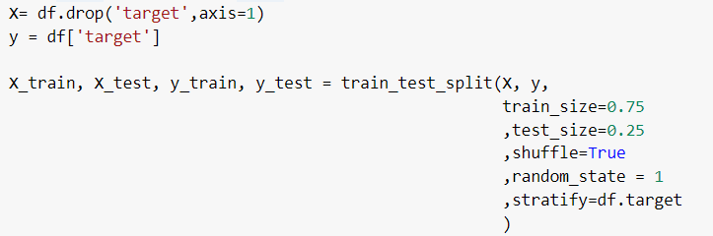
Data After cleaning
Split data
0.75 / 0.25
With Stratify

Slide 9
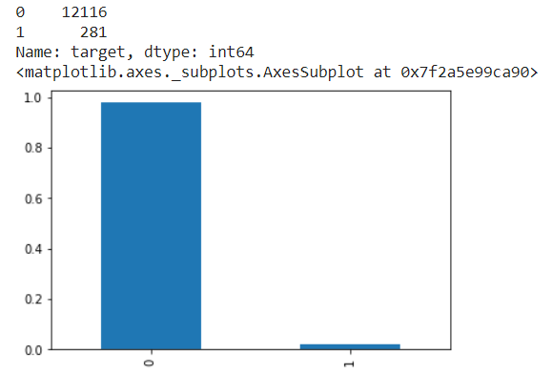


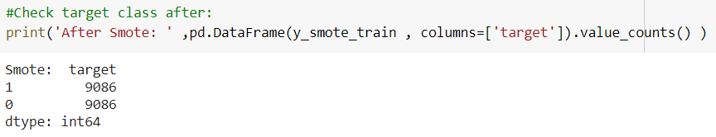
Imbalanced data handling
Data is highly imbalance: T/F Ratio 0.02319247276328821393199075602509
Checked balancing using 2 methods:
SMOTE (Over) SMOTE-Tomek links (Over+Under)
We tested all models without Re-sampling / SMOTE / Tomek. both Resampling methods showed very similar result compared to without up-sampling
Notes:
The Concept: Tomek Links
Tomek Links is one of a modification from Condensed Nearest Neighbors (CNN, not to be confused with Convolutional Neural Network) undersampling technique that is developed by Tomek (1976). Unlike the CNN method that are only randomly select the samples with its k nearest neighbors from the majority class that wants to be removed, the Tomek Links method uses the rule to selects the pair of observation (say, a and b) that are fulfilled these properties:
The observation a’s nearest neighbor is b.
The observation b’s nearest neighbor is a.
Observation a and b belong to a different class. That is, a and b belong to the minority and majority class (or vice versa), respectively.

Slide 10
models
-Logistic Regression
Grid Search for hyper params (10 CV)
Scoring using f1 / ROC_AUC
-Random Forest
Grid Search for hyper params (5 CV)
Scoring using f1 / ROC_AUC
-SVM
Kernels Sigmoid / Linier

Slide 11



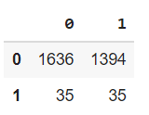
Logistics regression
F1 scoring:
Predict:

Slide 12


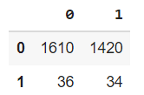
Logistics regression
ROC_AUC scoring:
Predict:

Slide 13


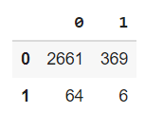
Random-Forest
F1 Scoring:
Predict:

Slide 14

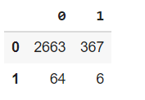
Random-Forest
ROC_AUC Scoring:
Predict:

Slide 15
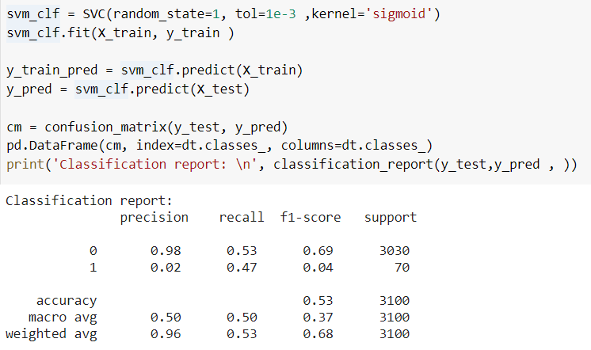
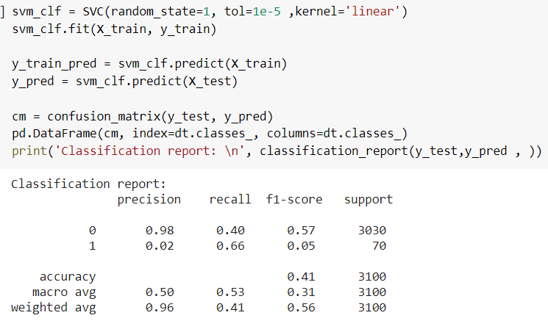
svm

Slide 16
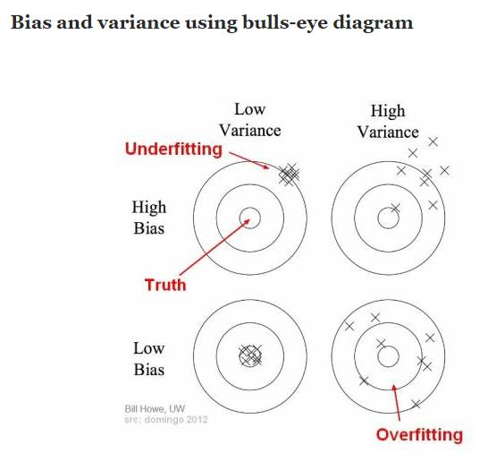
conclusion
Eventually we couldn’t figure-out what leads to poor model performance.
Feature Selection / Preparation improvement?
Explore more GS prams?
Variance / Bias – Our models are very Biased. (Not regularized?)

