Slide 1

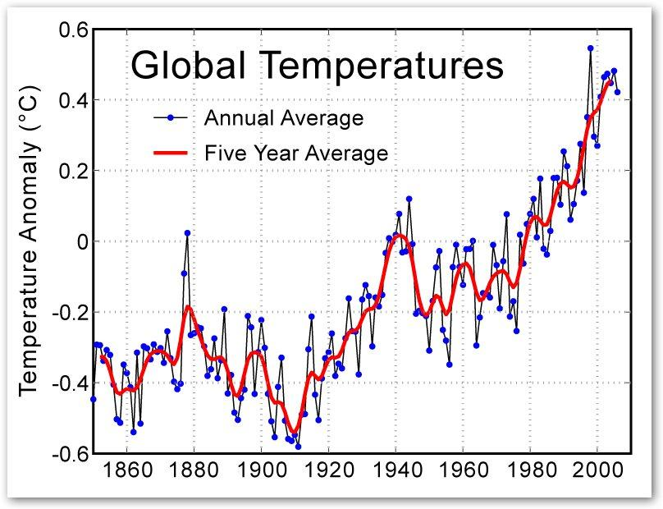
FlashBack……..
Prof. Srinivasan
Chairman, IISC, Bangalore

Slide 2

Bhago!! -Run from nature's fury

Slide 3
Problem
Simulate the future disasters by being very close to reality.
Motivate people to take appropriate actions in the present.

Slide 4
Idea
Build a game simulating Natural Disasters (sea level rising , floods, global warming, etc..) of future.
In this game, a user is placed in a location with a natural disater and the goal is to save his life.
User runs to places and takes various pledges to save himself.
Game makes use of Real Data ( like Elevation, geo locations, geo conditions etc)

Slide 5
How does it help
Educate people about the ill effects of Global Warming
Motivates people to take Green Initiatives.
Closes the loop on the pledges taken.
Leveraging the social platform to spread awareness

Slide 6
Demo

Slide 7
Future Plans
Completion of Android App
IPhone App
Include more simulations for various natural Disasters
Sharing on social communities

Slide 8
Current State
Android Gaming App.
Only natural disaster considered is Sea Level Rising.
Data used from Google Maps Apis for locations.
Data used from http://gpsvisualiser.com for elevations

