Slide 1
Forecast of a Flood Levels in a River
CSE7101- Capstone Project
Review-5
Batch Number: PSCS_6(CSE-133)
Under the Supervision of,
Dr Vijaya Kumar A V
Professor
School of Computer Science and Engineering
Presidency University
Roll Number | Student Name
20221CSE0199 | Karnatakam Manohith
20221CSE0245 | Vaddireddy Sivananda Reddy
20221CSE0221 | Palem Sreedhar Rao
Name of the Program: CSE
Name of the HoD: Dr Asif Mohammed
Name of the Program Project Coordinator: Dr. Jayavadivel Ravi
Name of the School Project Coordinators: Dr. Sampath A K , Dr. Geetha A

Slide 2
Problem Statement Number: PSCS_6
Organization: Presidency University
Category (Hardware / Software / Both) :Hardware
Problem Description:
Design and develop a system to project the extent of river inundation based on forecasted flood levels, integrating topographic and hydrological data for improved disaster preparedness

Slide 3
Content
Abstract
Literature Survey
Objectives
Modules
Architecture Diagram
Working Model
Timeline (Gantt Chart)
References

Slide 4
Abstract:
Riverine flooding continues to be one of the most severe threats to human societies, especially in regions with large, densely populated floodplains. Beyond its direct consequences such as destruction of infrastructure and crop losses, flood events initiate cascading socio-economic and ecological effects that may last for years. Present methods for addressing flooding often focus on stage forecasting—predicting river height—but fail to offer precise, spatially contextualized assessments of flood extent. This creates a gap between data -availability and decision-making utility.
This paper introduces a novel, robust system that integrates real-time IoT-based sensing technologies with advanced GIS-based hydrodynamic modeling frameworks to bridge this critical gap.
By developing an integrated architecture encompassing on-ground sensing, cloud-driven analytics, and user-centric visualization interfaces, the proposed framework transforms raw hydrological forecasts into intelligible, action-oriented maps and alerts. Furthermore, this system is designed for resilience, ensuring uninterrupted operation in adverse conditions via hybrid communication strategies and solar-powered autonomy.

Slide 5
Literature Survey (Overview) :
S.No | PAPER TITLE | METHOD | ADVANTAGES | DIS- ADVANTAGES
1 | Flood mapping based on synthetic aperture radar | Global Thresholding Automated Thresholding (K&I, Otsu) | Simple, fast, easy to implement Data-driven, avoids manual tuning | Over-detection, sensitive to choice of threshold Can fail when histogram is unimodal or noisy
2 | Assessing the impact of river changes on flood regulation capacity using a coupled flood model in an urbanized plain river network region | Event-based approach using a coupled flood model (integrated hydrologic & hydraulic components implied) | Event-specific insights. Captures complex interactions via coupling | Data and computationally intensive. May lack coverage for broader temporal scales. Spatial resolution depends on model sophistication
3 | Application of ANN and HEC-RAS model for flood inundation mapping in lower Baro Akobo River Basin, Ethiopia | ANN for rainfall–runoff modeling → HEC-RAS for hydraulic flood mapping → NDWI for calibration/validation | High accuracy (ANN performance), strong spatial match with NDWI, effective integration of ML and hydraulic modeling, potential flood warning tool | Data-intensive ANN training, modeling complexity, limited generalizability, computational demands, and reliance on NDWI for validation
4 | Flood inundation modeling and hazard assessment in Lower Ping River Basin using MIKE FLOOD | Utilizes MIKE FLOOD (coupled 1D-2D hydraulic modeling) | Covers riverine and overland dynamics Integrated modeling Framework Recognized by agencies, Extensible modules | Steep learning curve High computational demand Requires technical expertise

Slide 6
Objectives
Real-time River Level Monitoring
Deploy IoT-based sensors (ultrasonic, radar, or pressure) to continuously measure river water levels.
Rainfall & Flow Measurement
Integrate rain gauges and river flow meters to capture local hydrological conditions that contribute to flooding
Edge Processing for Faster Alerts
Use microcontrollers (Raspberry Pi, Arduino, or industrial controllers) to process sensor data locally before sending it to the cloud, ensuring quick response.
4. Reliable Communication Network
Enable data transfer from sensors to the server using LoRaWAN, GSM/4G, or satellite modules for uninterrupted connectivity, even during disasters.

Slide 7
Modules:
River Level Monitoring Module
  IoT-based sensors: ultrasonic, radar, pressure sensors.
  Continuous tracking of water levels in real time.
  Data logging of river level fluctuations.
Rainfall & Flow Measurement Module
  Rain gauges for precipitation data.
  River flow meters for discharge measurement.
  Integration with water quality sensors (optional) for complete hydrological context.
Edge Processing & Local Analytics Module
  Microcontrollers (Raspberry Pi, Arduino, Industrial PLCs).
  Local filtering of noise, anomaly detection.
  Quick alert generation at the site before sending to cloud.

Slide 8
Modules:
Communication & Data Transmission Module
  Wireless protocols: LoRaWAN, GSM/4G, Satellite uplinks.
  Redundant channels to ensure connectivity during floods.
  Gateways to aggregate and forward sensor data to central server/cloud.
Central Processing & Storage Module (derived indirectly)
  Cloud platforms for long-term storage (AWS, Azure, GCP).
  Databases for time-series and spatial data.
  Ensures reliability and accessibility for downstream applications.
Visualization & Alerting Module (to act on objectives 1–4)
  Dashboards for monitoring river levels and rainfall trends.
  GIS maps for spatial visualization of flood-prone zones.
  Automated alerts (SMS, mobile apps, sirens) for early warning.

Slide 9
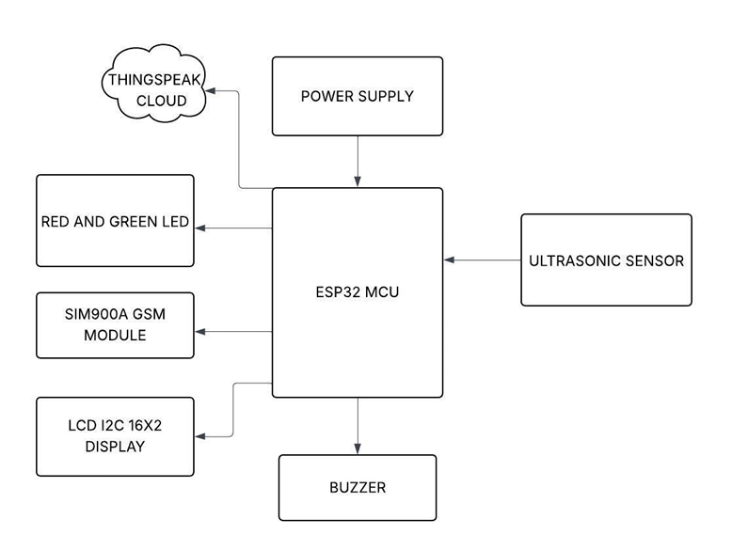
Architecture Diagram

Slide 10
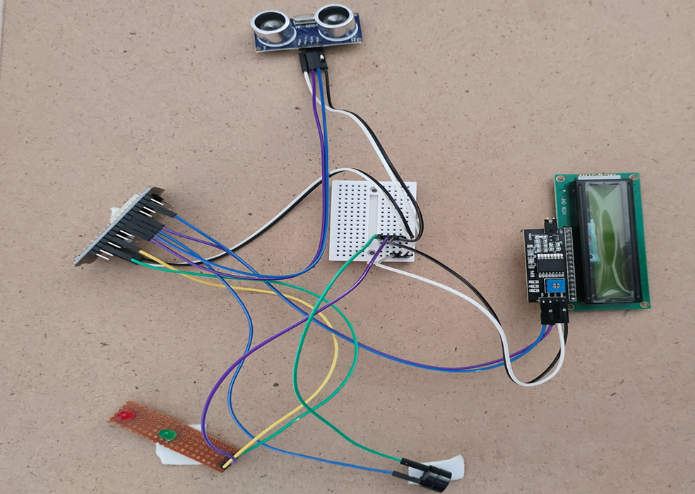
WORKING MODEL:

Slide 11
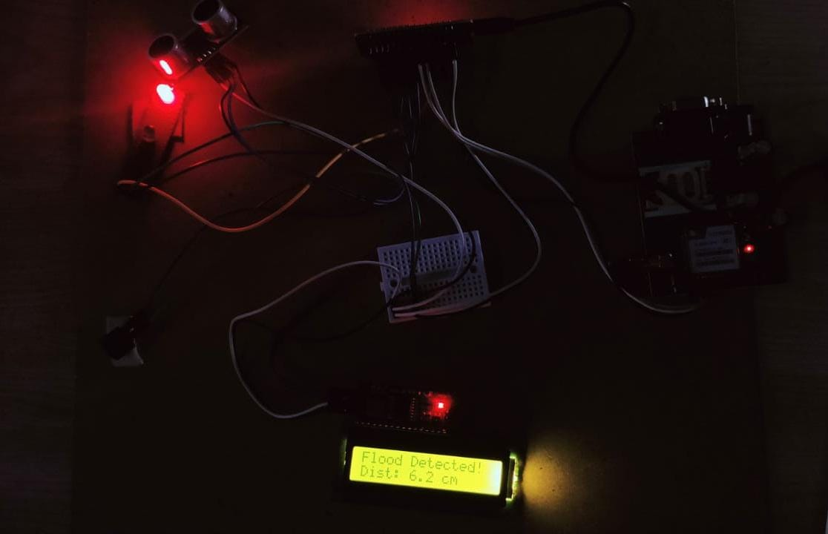
Continue

Slide 12
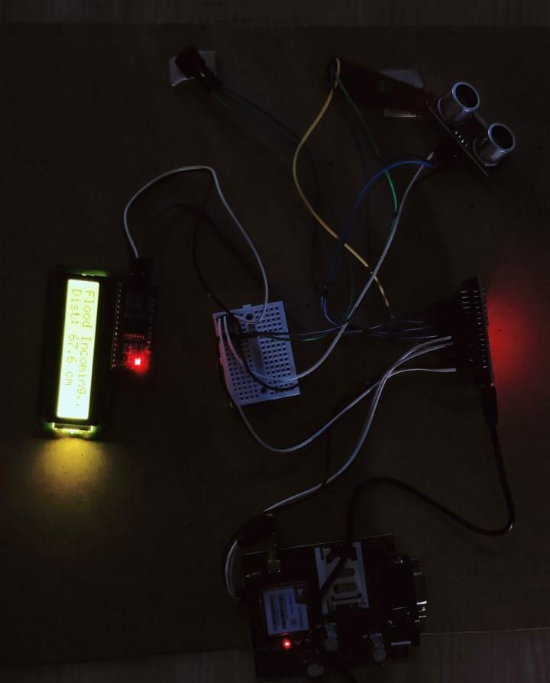
Continue

Slide 13
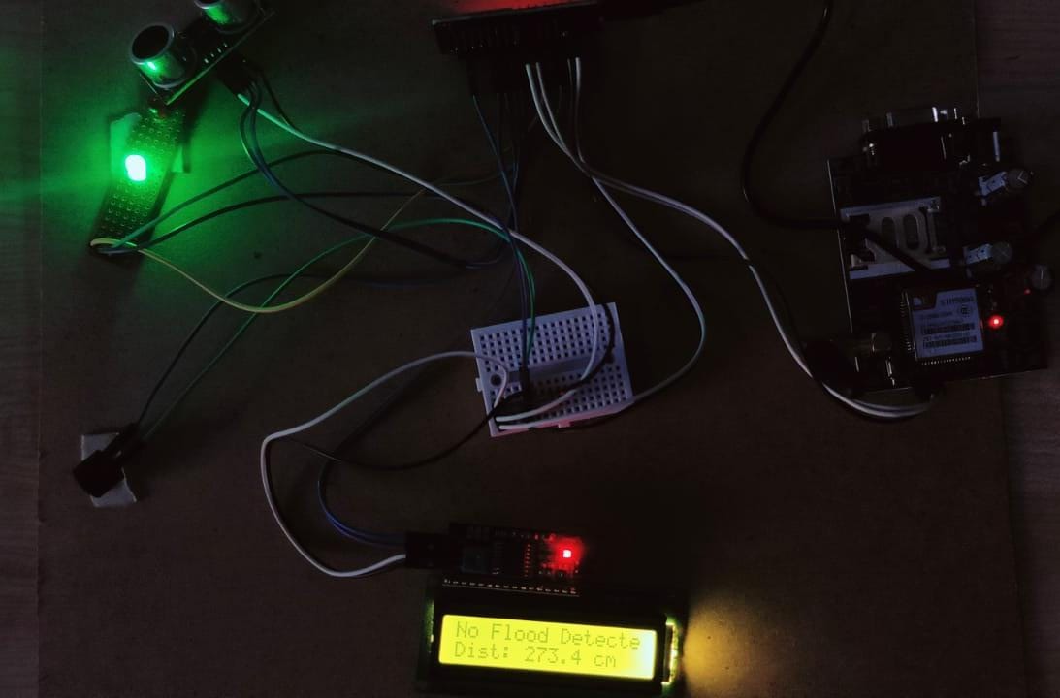
Continue

Slide 14
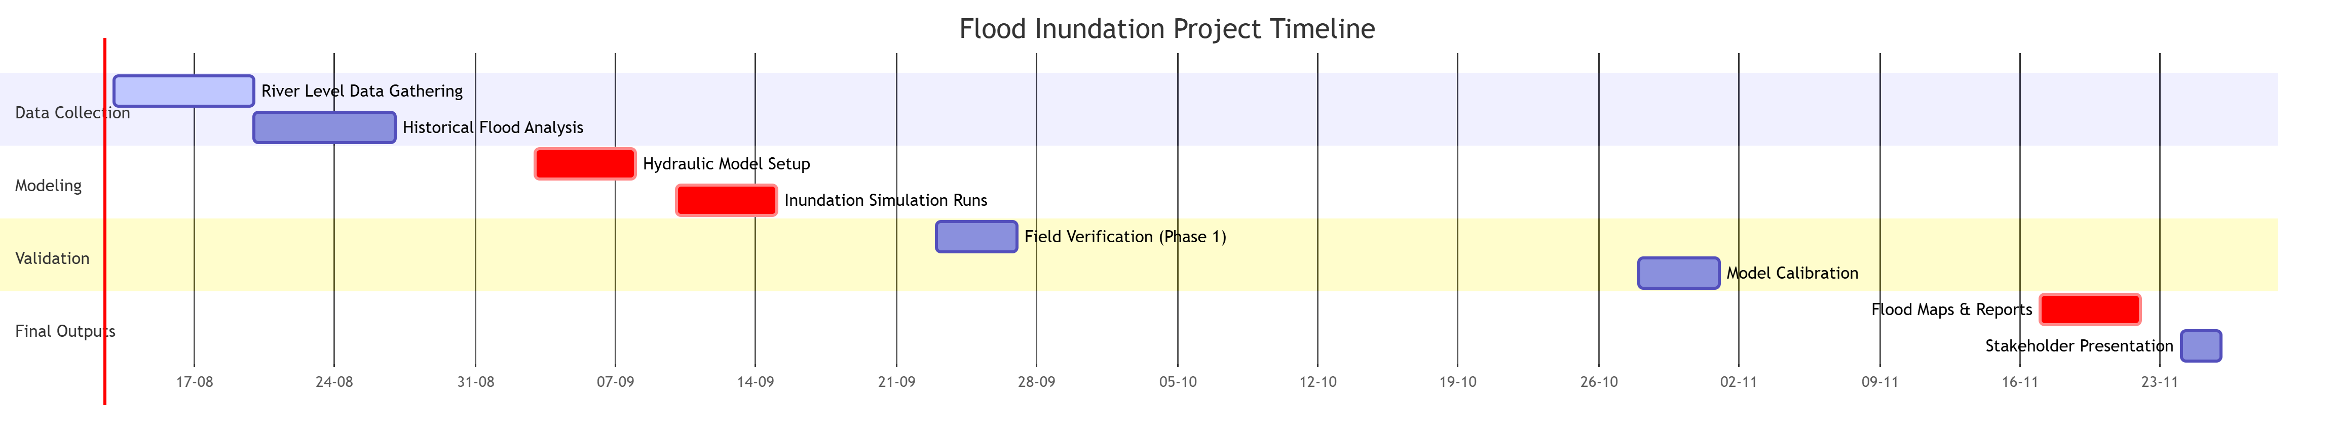
Timeline of the Project (Gantt Chart)

Slide 15
References (IEEE Paper format)
Landuyt, L.; Van Wesemael, A.; Schumann, G.J.P.; Hostache, R.; Verhoest, N.E.C.; Van Coillie, F.M.B. Flood mapping based on synthetic aperture radar: An assessment of established approaches. IEEE Trans. Geosci Remote Sens. 2019, 57, 722–739.
Arcement, G.J.; Verne, R.S. Guide for Selecting Manning’s Roughness Coefficients for Natural Channels and Flood Plains. 1989. Available online: http://dpw.lacounty.gov/lacfcd/wdr/files/WG/041615/Guide%20for%20Selecting%20n-Value.pdf (accessed on 6 September 2021).
Barnes, H.H., Jr. Roughness Characteristics of Natural Streams. US Geological Survey Water Supply Paper. 1849. Available online: https://pubs.usgs.gov/wsp/wsp_1849/pdf/wsp_1849.pdf (accessed on 6 September 2021).
Shustikova, I., Domeneghetti, A., Neal, J. C., Bates, P., & Castellarin, A. (2019). Comparing 2D capabilities of HEC-RAS and LISFLOOD-FP on complex topography. Hydrological Sciences Journal, 64(14), 1769-1782. doi: https://doi.org/10.1080/02626667.201 9.1671982

Slide 16


