Slide 1

OWASP and Python Dan Wojciechowski

Slide 2
What is OWASP?
An open community working towards the development of trusted and secure applications.
Many standards considered industry-accepted
https://www.owasp.org

Slide 3
OWASP Top 10 Project
A list of the top 10 most critical web application security risks. Last approved in 2013; 2017 in development.
Injection (e.g. SQL injection)
Broken Authentication and Session Management
Cross-Site Scripting (XSS)
Insecure Direct Object References
Security Misconfiguration
Sensitive Data Exposure
Missing Function Level Access Control
Cross-Site Request Forgery (CSRF)
Using Known Vulnerable Components
Unvalidated Redirects and Forwards
https://www.owasp.org/index.php/Category:OWASP_Top_Ten_Project#OWASP_Top_10_for_2013

Slide 4
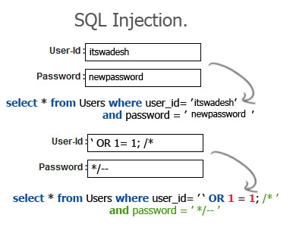
Importance of Web App Security
Industry regulation and general security:
HIPAA, SOX, PCI, GDPR, PII
Data integrity:
Controversial research
Data precision
Stolen to be used somewhere else:
jdoe@microsoft.com:3e20f31d5c665db6489ee25bdbbb6f0e7c66752d
bsaluja@gmail.com:980818ef272f8daa2d36fbfed82bc61055b34f52
mzhou@gmail.com:ae6cd5ce3231a5557136acddf356a4812d21578b
fhuang@yahoo:4c9aa32c780c2bfd7961f6da62e7aaddf7216935
gsmith@uw.edu:61641e17a1be0329f2f249dfb512d83fc18201b1

Slide 5
OWASP and Python
Secure Coding with Python:
Enrico Branca
https://doc.lagout.org/programmation/python/OWASP_Romania_Branca.pdf
Python Security Testing Tools:
SQLMap
https://www.owasp.org/index.php/Automated_Audit_using_SQLMap
WAPITI
https://www.owasp.org/index.php/Automated_Audit_using_WAPITI

Slide 6

OWASP and Python

