Slide 1
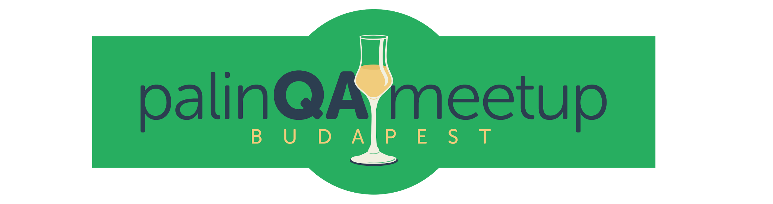
Introduction to Cynefin

Slide 2
/ˈkʌnevɪn/
Notes:
Cynefin is a sense-making framework to help managers, policy makers and others reach the decisions. It was developed in 2000s by IBM.
In Welsh it means habitat - it depicts a rather complex system of what we are as people. We come from different backgrounds, we have certain subjective judgement thoughts and all this affects our choices and decisions in life. The framework is sense making, not really decision making and today we will try to challenge ourselves and our beliefs by an exercise first before we learn more, then learn some theory and once again continue with the exercise. It will be a rather foundation workshop due to time constraints, but I hope you get a certain background and understanding afterwards.

Slide 3
EXERCISE - WORK PROBLEMS
COMPLEX Multiple experts needed (Emerging practice)
COMPLICATED Expert is needed to decide (Good practice)
CHAOTIC Need to act immediately OMG (Novel practice)
SIMPLE Obvious solution (Best practice)
Notes:
sen post-its and then the new member and the group have to decide to which place on the paper each problem should go. 15 min
Review - 10 minutes to see where people put post-its in the end

Slide 4
Retrospective
How many of you felt that you have to put it to a certain group?
Were there different understandings of the issue within the group based on experience?
Did any group split the problem on the post-it?

Slide 5

We have tendency to put things in boxes based on our experience
Notes:
Premature decisions
Data knowledge is very important before jumping to conclusions - ask more
It is hard to say “I don’t know” or break issues to parts rather than dealing with what we have

Slide 6
“Sense-making in a complex and complicated world”
Sense making model, not categorization model
Data precedes framework
Cynefin is dynamic
Helps to rethink
Notes:
Ordered
Complex
Complicated systems
Add disorder and divide ordered system to two: simple and complicated
Simple: C = E cause effect
Complicated - not self-evident -> distinction between best and good is clear, as people may force good practices and piss people off
Complex - without causality. Experiments, new way of doing things
Chaotic - innovation if entered deliberately, if by accident then it is urgent
Disorder - we are there most of the time, we don’t know where we are. We interpret situations in our opinion. If you send in beurocratic way -

Slide 7
Complex
Probe - Sense - Respond
Emergent Practice
Complicated
Sense - Analyse - Respond
Good Practice
Disorder
Chaos
Act - Sense - Respond
Novel Practice
Simple
Sense - Categorise - Respond
Best Practice
Notes:
Complicated: "sense–analyze–respond": assess the facts, analyze, and apply the appropriate good operating practice
Complex: In a complicated context, at least one right answer exists. In a complex context, however, right answers can’t be ferreted out. It's like the difference between, say, a Ferrari and the Brazilian rainforest. Ferraris are complicated machines, but an expert mechanic can take one apart and reassemble it without changing a thing.
Chaos is ideally transitional state - rules don’t work anymore
act to establish order; sense where stability lies; respond to turn the chaotic into the complex.

Slide 8
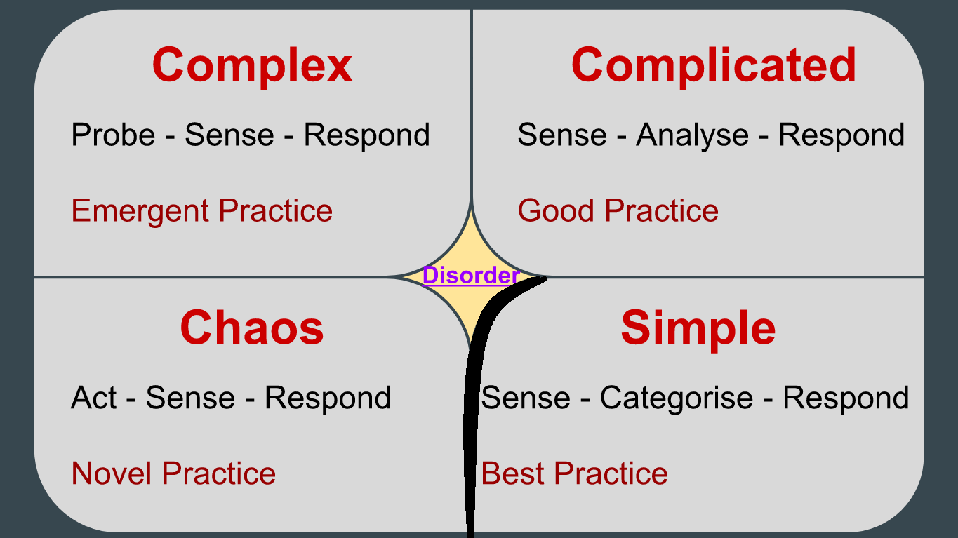
Complex
Probe - Sense - Respond
Emergent Practice
Complicated
Sense - Analyse - Respond
Good Practice
Disorder
Chaos
Act - Sense - Respond
Novel Practice
Simple
Sense - Categorise - Respond
Best Practice
Notes:
Companies are often in obvious or disorder and when scaling they may fall into chaos. They need to rethink.
Example: company had big backlog and didn’t want to touch complex cards. Our tendency is to come back to same approaches that we know, but sometimes we should break down and look at problems more. Cynefin helps to break down problems.
Cynefin is very dynamic - Netflix chaos monkey (Chaos Monkey is responsible for randomly terminating instances in production to ensure that engineers implement their services to be resilient to instance failures.)

Slide 9
How Cynefin can help us in Agile world?
Get out of absolutes - climb out of your expertize borders
Testing is a lot about human aspects and we should learn not to take the easiest known ways, but think again, split, sense, spend time to understand.
Exploratory testing is experimenting
Avoid jumping to conclusions

Slide 10

Questions are indicators: there may be a need to expand discussions. Concerns are important.
Notes:
There may be a silent person in the corner who is not brave enough to beat know-it-alls and they may be right in the end of chaos.

Slide 11
Exercise Part 2: Put issues to Cynefin model
Create disorder part
Don’t be afraid to split post-its into another groups
Discuss how some issues could be split and if you need more information

Slide 12
Complex
Probe - Sense - Respond
Emergent Practice
Complicated
Sense - Analyse - Respond
Good Practice
Disorder
Chaos
Act - Sense - Respond
Novel Practice
Simple
Sense - Categorise - Respond
Best Practice
Notes:
Complicated: "sense–analyze–respond": assess the facts, analyze, and apply the appropriate good operating practice
Complex: In a complicated context, at least one right answer exists. In a complex context, however, right answers can’t be ferreted out. It's like the difference between, say, a Ferrari and the Brazilian rainforest. Ferraris are complicated machines, but an expert mechanic can take one apart and reassemble it without changing a thing.
Chaos is ideally transitional state - rules don’t work anymore
act to establish order; sense where stability lies; respond to turn the chaotic into the complex.

Slide 13

The better you become at something, the more obvious it looks. No second-guessing may lead you to disaster. Stop for a minute. Rethink. Break the default behavior.
Notes:
The things that kill you are the things that you take for granted

Slide 14
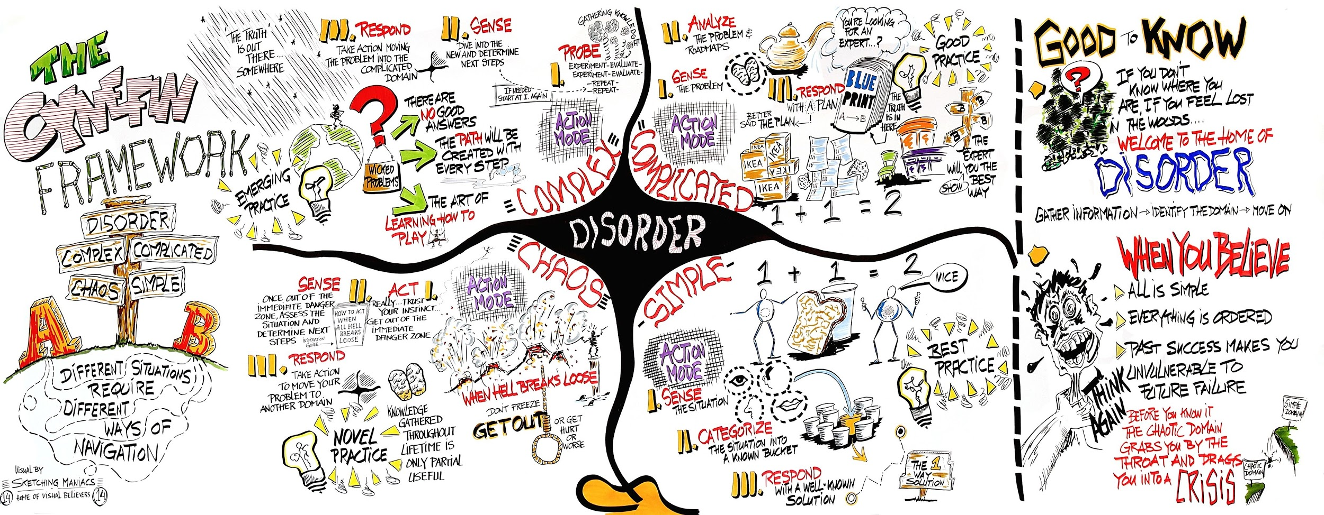

Slide 15
Sources and further readings
Dave Snowden https://www.youtube.com/watch?v=N7oz366X0-8
Liz Keogh https://www.youtube.com/watch?v=G2X_7ojZwtU
London Tester Gathering Workshop on Cynefin by Martin Hyne and Ben Kelly (http://testjutsu.com/2017/03/workshop-an-introduction-to-cynefin-and-complexity-for-software-testers/)
Edwin Stoop’s cartoon (https://upload.wikimedia.org/wikipedia/commons/f/f7/Cynefin_framework_by_Edwin_Stoop.jpg)
Ben Kelly’s blog http://testjutsu.com/2017/08/cynefin-and-software-testing-the-complex-domain/
Cat pictures from Google images

