Slide 1
Inside Innovation

Slide 2
7.5
1 and 5
10 and 5 (XV)
X and V

Slide 3
Approach Angle

Slide 5
Idea Pool

Slide 6
Idea Representation

Slide 7
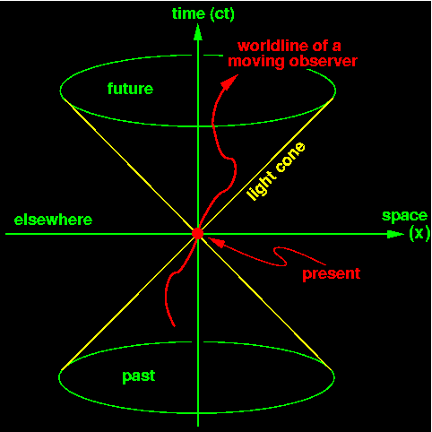

Slide 8
Combine
Schrödinger’s cat

Slide 9
Requirements
Gathering
Force new associations
Improve
Brand
Recognition
Improve
Test
Processes

Slide 10


Paradoxes

Slide 11
Testing means finding bugs
Testing is done by testers
Testing is done once development is completed
Testing does not mean finding bugs
Testing is not done by testers
Testing is not done once development is completed
Testing means preventing bugs
Testing is done by developers
Testing is done throughout the development phase

Slide 12
“IFF – Intelligent Fast Failure”
Dr Jack Matson
DSF – Dumb Slow Failure

Slide 13
References
The International Handbook on Innovation, edited by Larisa V. Shavinina;
Dr Jack Matson, Innovate or Die;
Dr Jack Matson, How to Fail Successfully: A Bold Approach to Meeting Your Goals Through Intelligent Fast Failure;
Michael Michalko, Thinkertoys;
Michael Michalko, Cracking Creativity;
Michael Michalko, Creative Thinkering;
Edward de Bono, How to Have a Beautiful Mind;
Edward de Bono, How to Have Creative Ideas: 62 Games to Develop the Mind;

