Slide 1
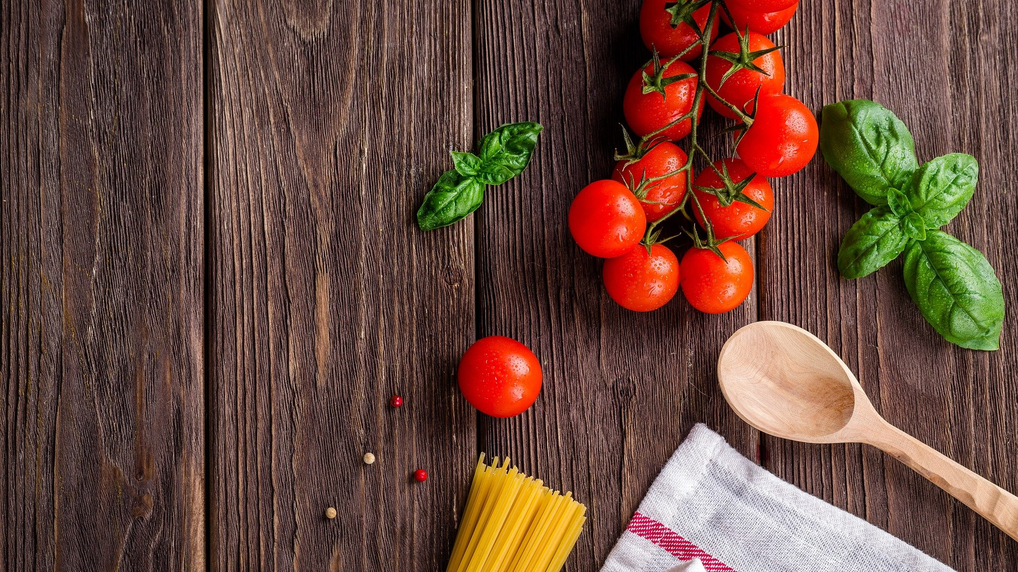
Sinclair Food Pantry Database
Kyle Marler
Database Design Final Project

Slide 2
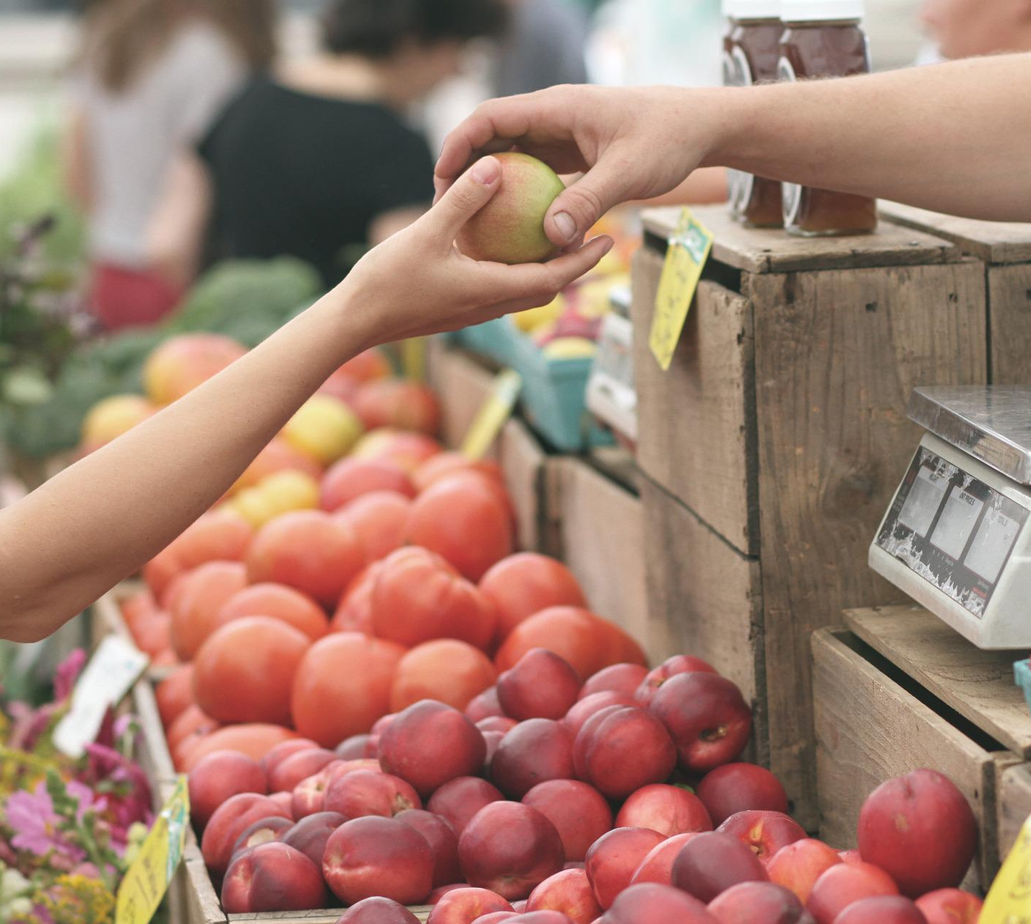
Background
- I approached the Sinclair Food Pantry to see if they needed database assistance.
- It turns out they were keeping track of their data with pen and paper!
- They needed help tracking metrics such as…
How often students visit the pantry.
If they were given a free tote bag.
Whether they are part time or full time.
Family size.

Slide 3
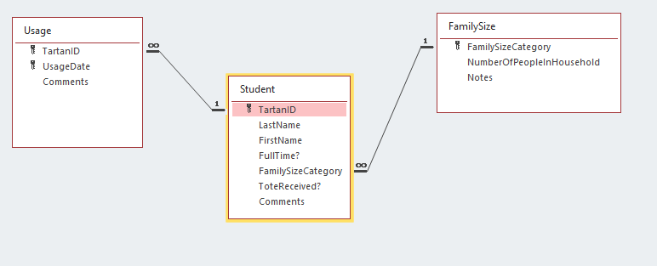
ERD
My design is simple, but fulfills all the requirements of the pantry.
The Student table contains most of the data that is essential to the pantry (as outlined in the previous slide). Notice the FullTime, FamilySizeCategory, and ToteRecieved fields.
The Usage table tracks each student visit.
The FamilySize table serves as a lookup table as there are only 3 valid family sizes.

Slide 4
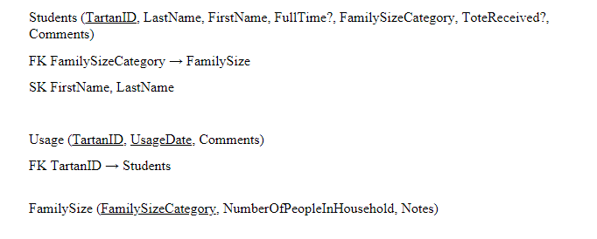
DBDL
For you folks that prefer DBDL over ERD, here is my design in DBDL.
Notice the Students table has a multi-field index on First and Last name. I figured this would be a commonly queried field, hence the index.
The Usage table has a composite primary key to uniquely identify each visit (or usage).

Slide 5
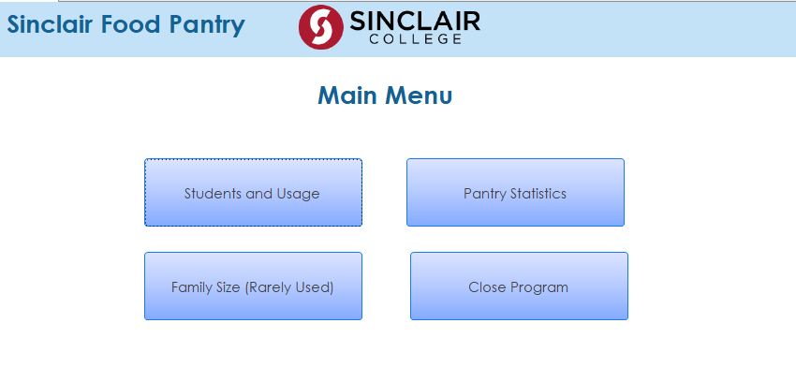
Forms
The forms I created are what I’m most proud of.
The goal was to make an intuitive user interface.
I found a way to open the form you see here automatically upon opening the database so there is no fussing with which form to open from the messy navigation pane.

Slide 6
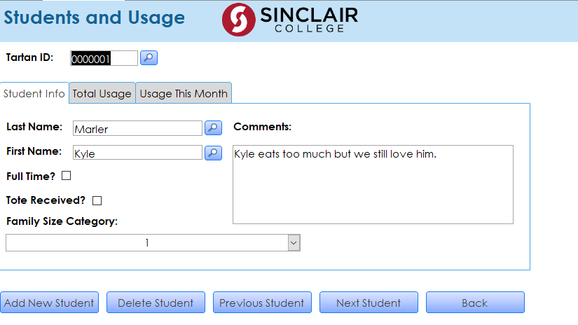
Forms [cont.]
This is the form the user sees when they click the “Students and Usage” button from the previous slide.
Here, they can enter all the student AND usage information by navigating the tab controls.
Shout out to “Computer Learning Zone” on YouTube for their lessons on how to create search buttons on the Tartan ID, Last Name and First Name fields.

Slide 7
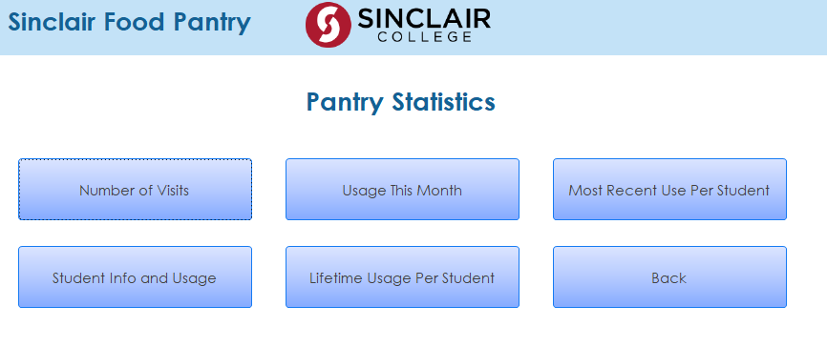
Forms [cont.]
Main Menu
The last form I’ll show you is the Pantry Statistics form.
Recall my main menu form from a couple slides ago (the top image on the right). If you click the Pantry Statistics button you’ll be directed to the form shown on the bottom on the right.
Clicking any one of the buttons seen on this form generates a corresponding report.
Pantry Statistics

Slide 8
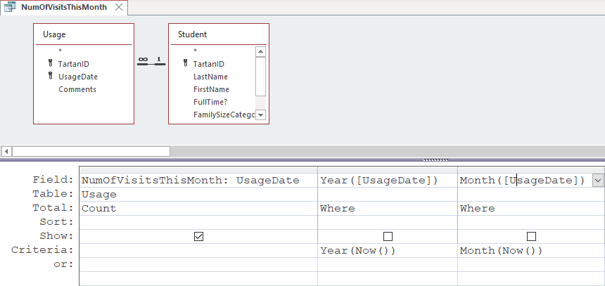
Queries
This is one of the more interesting queries in the database.
I needed to calculate the total number of visits to the pantry for the current month and year.
Hence the use of the Now() Access function as well as the use of the Year() and Month() functions.
Shout out to the Access Help site or else I don’t know if I would have figured out how to do it!

Slide 9
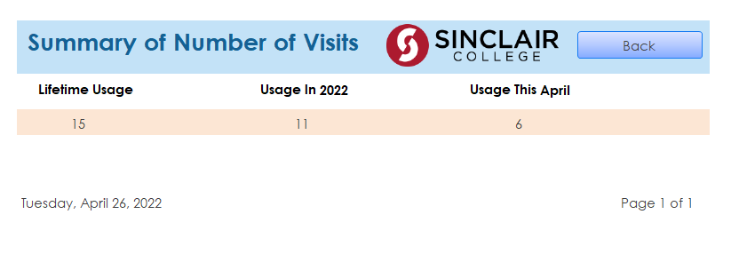
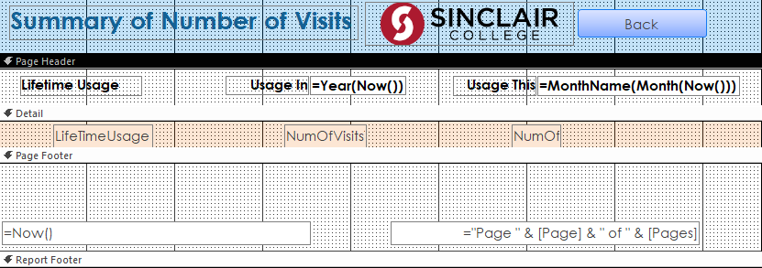
Reports
Report View
While there were certainly more verbose reports in the DB, I was most proud of this humble guy.
The photos to the right are of the same report. The image on top is Report View while the other is Design View.
As you can see in Design View, I created two different calculated text boxes to ensure the report always displays the current year and month. (Clever right?)
Check out the month calculated text box. It has a function within a function within a function! Inception anyone???
Design View

Slide 10
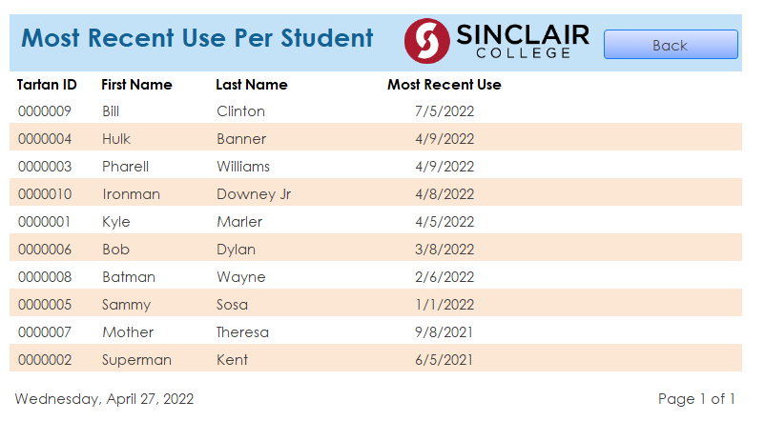
Reports [cont.]
Submenu Form
Recall the Pantry Statistics form from a few slides ago (the image on top). If you select the “Most Recent Use Per Student” button you’ll be directed to the report (the image on bottom).
The pantry workers requested to have a report detailing the most recent use of each student.
I couldn’t help myself and made the test data ridiculous. Hehe :o)
Recent Use Report

Slide 11
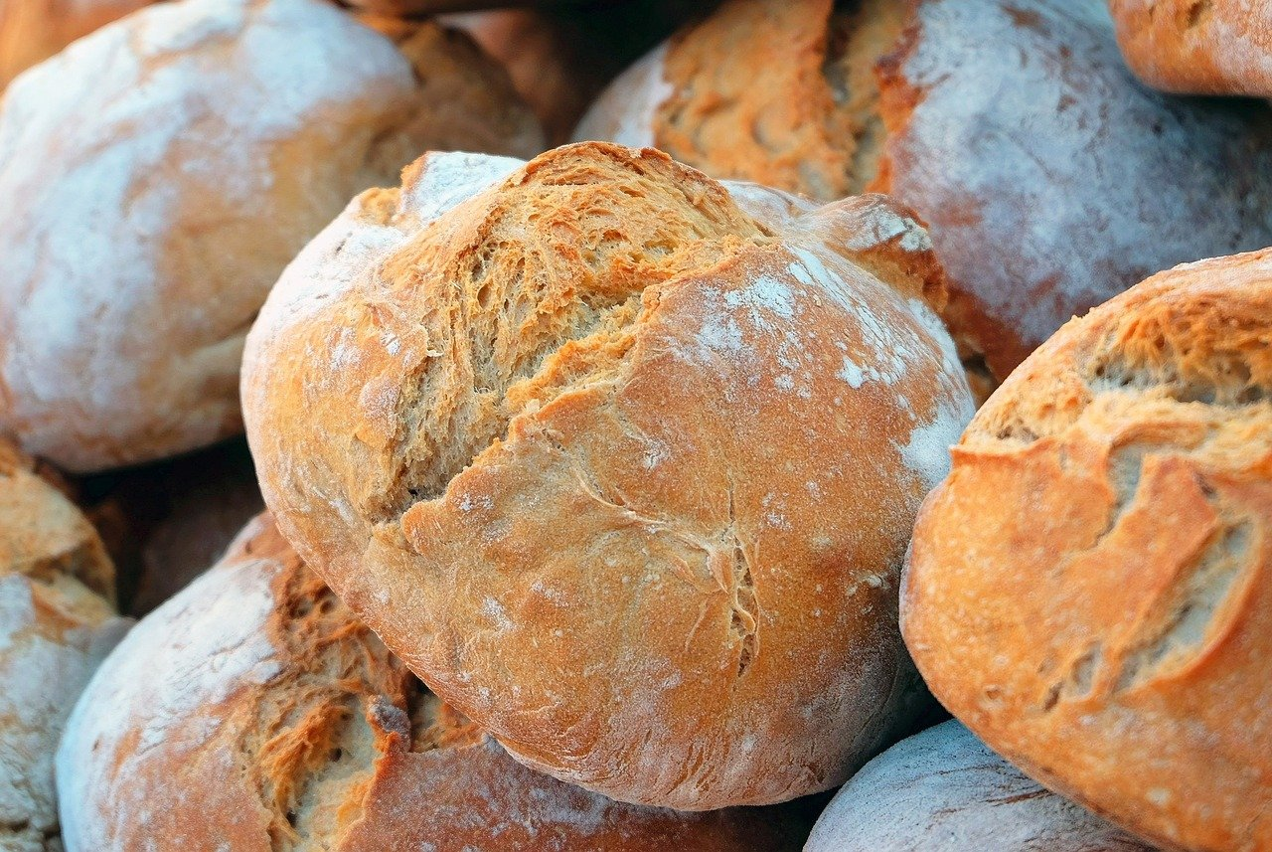
Lessons Learned
The biggest lesson I learned is making sure you have good communication with your end-user, in this case the pantry workers.
It’s no wonder why agile development is such a buzz word these days. Frequent meetings and iterations of the product help keep the customer happy.
Though I spoke with the pantry workers to gather requirements, in a real professional environment, I would have needed much more frequent meetings and deliverables.

Slide 12
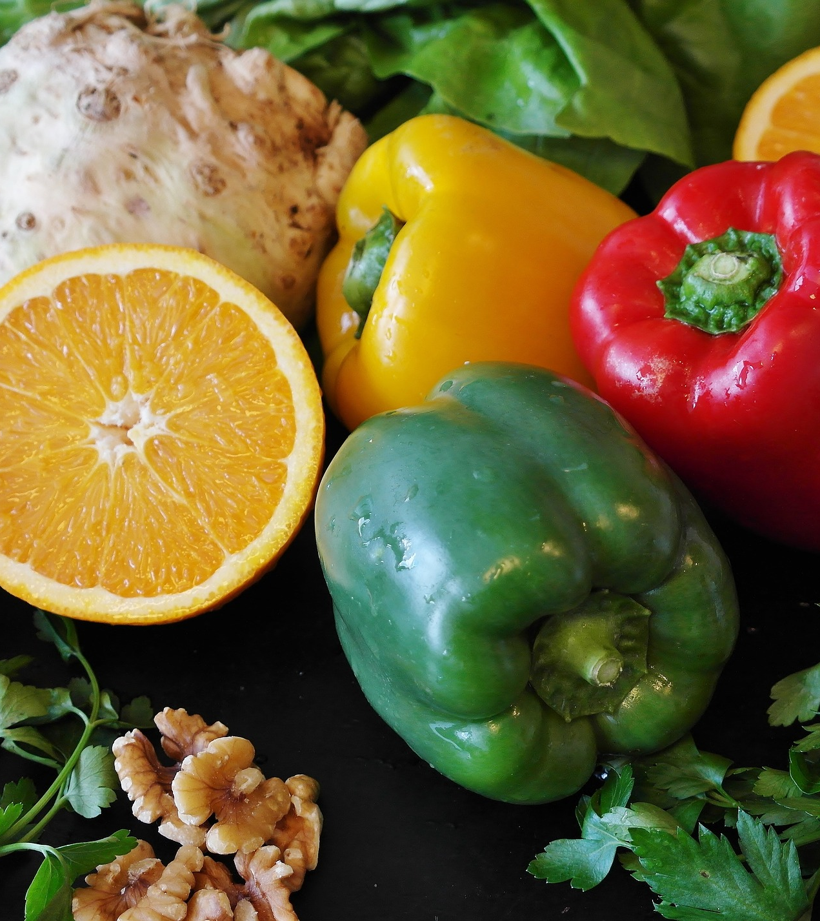
Summary
On day 1 of class I knew literally nothing about databases so to say I’ve learned a lot would be an understatement!
The most difficult concept for me was normalization, in particular, functional dependency, but I think I’ve got a handle on it now!
Shout out to Dr. Massie and Julia Stidham who work with the pantry and helped guide me with the design.
To learn more about the pantry click here.
See you in 2268!

