Slide 1
CSCI 205 Final Project
Team 01 - Kiera Egan, Katy Martinson, Phil Morgan, Doug Russo

Slide 2
Who we are
Kiera Egan - Product Owner
Major: CS
Main Contributions: Space class, Product Backlog, managing gitlab/scrum artifacts
Katy Martinson - Scrum Master
Major: Biology
Main Contributions: Controller and FXML files
Phil Morgan - Developer
Major: CS
Main Contributions: All Piece classes, JUnit tests
Doug Russo - Developer
Major: CS
Main Contributions: Controller, User/Design Manuals, Class diagrams

Slide 3
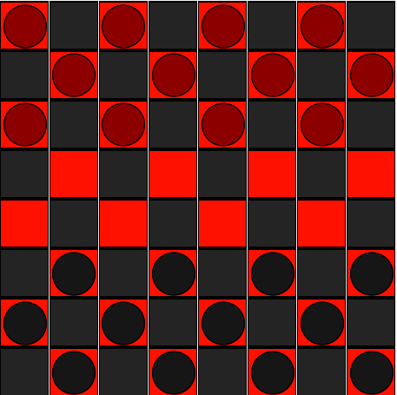
Our Project - Checkers
Basic rules:
Two teams with 12 pieces each
Pieces can only move diagonally on the red squares towards the opposing side
Jumping over an opposing piece requires the space behind it be clear, and takes the piece
Once a piece gets to the opposite side of the board it can move in both directions
The game is over once a player has no more pieces left

Slide 4
User Stories
A checker space should be able to be clicked once in order to select the piece and then the user should be able to click the direction that the piece should go out of a couple of selection options for movement.
Checkers should be able to move to diagonal squares in their given direction. Checkers should also be able to jump over opposing checkers, given that they are not blocked.
Once a Checker gets to the opposite side of the board it will be able to travel backwards (King Piece)
The game will start when the button is clicked and end at the termination of the game

Slide 5
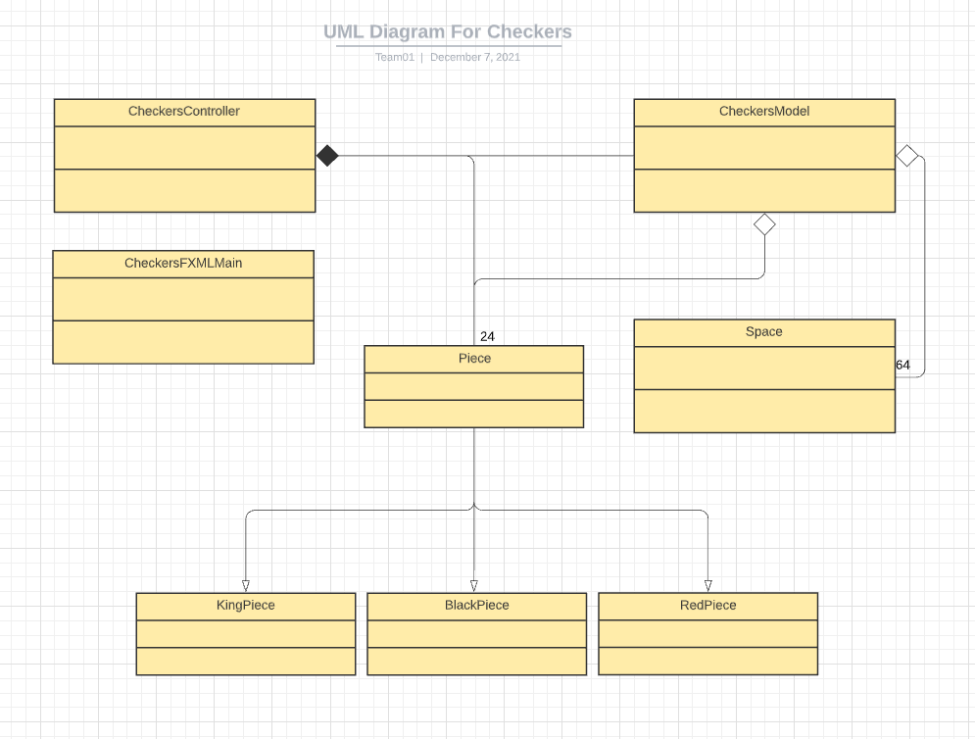
Our Design
CheckersModel
CheckersController
CheckersFXMLMain
Piece
RedPiece
BlackPiece
KingPiece(Not fully implemented)
Space
Notes:
This diagram consists of 8 parts that we introduced into our program: CheckersModel, CheckersController, CheckersFXMLMain, Piece, with RedPiece, BlackPiece, and KingPiece as its subclasses, and the Space class. Our abstractions were as follows: Piece and Space were aggregations of CheckersModel, Piece and CheckersModel had a composition relationship towards CheckersController, and KingPiece BlackPiece, and RedPiece all inherited the Piece class.

Slide 6
Implementation
Two players would play on using one computer, alternating turns
Had a boolean set to true, then once the first player went, it switched to false.
Moving
Type in which space on the grid you would like to go to
Click on checker you want to move to that location
If checker can move there, it will, otherwise, an error will occur
Jumping
If you are able to jump an opposing checker, type the location that you would end up in after the jump and the checker will go there and the opposing checker will be removed
Handling whether a piece has a checker
In the space class, we set up a hasPiece boolean that, with many helper methods, would check to see if a checker was in the location that is wanted

Slide 7
DEMO

Slide 8
Scrum
Strengths:
Helped keep us organized with who does what
Started each day with the Daily Scrum and kept it up to date
Kept accurate time logs of tasks
Helped to know which tasks were currently not started, in progress, or done
Challenges:
Remembering to input time estimates before a task was started
Remembering to input time spent after doing work on a task

Slide 9
Experience
Successes:
Functioning game
Worked well together
Able to bounce ideas off each other
Worked through other items throughout the project, as opposed to last minute.
User Manual/Design Manual/Product Backlog/etc.
Stuck to time estimates relatively well
Challenges:
Merging into the repository
Deciding who would do which work
Whether more than one should work on one thing/etc.

Slide 10
Conclusion
Accomplishments:
Working Basic Checkers
Moving
Jumping
Great GUI
Easy to read and understand code/organized
Version 2.0:
Working King Piece
Fix some bugs with jumping
Checker Counter
Winner/Loser

