Slide 1
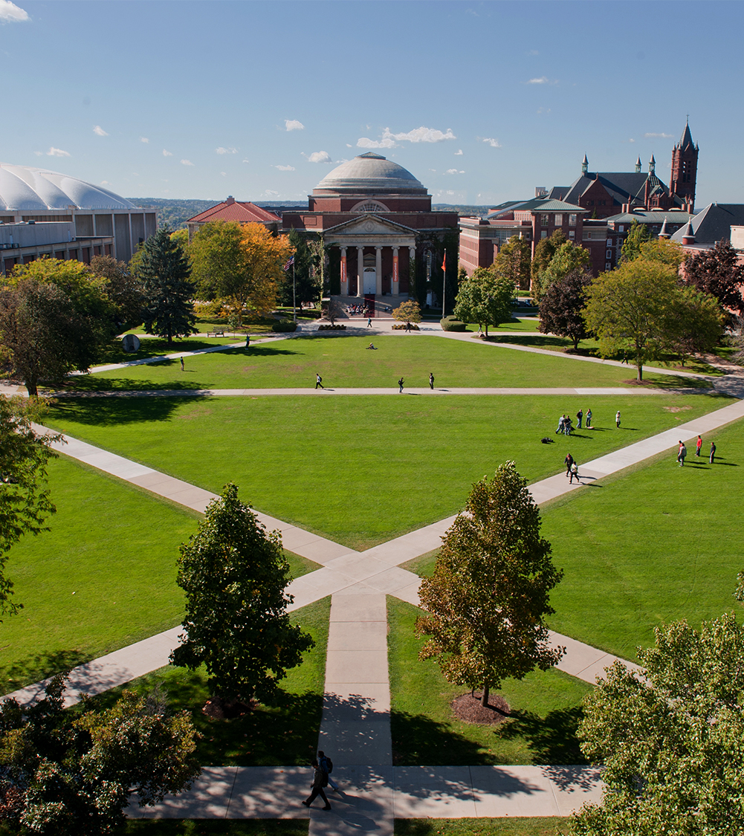
Sobriety Classification Using Gait and Other Biometrics
Department of Electrical Engineering and Computer Science
Kevin Martin & Ravjot Sachdev
9/9/2020

Slide 2
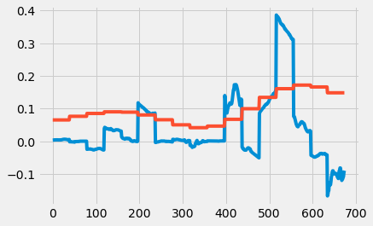
Sobriety Detection Using Machine Learning
Two-step biometric system to detect sobriety levels
First step involves gait-measurement as recorded by phone telemetry data
Data is processed via machine learning algorithms
Data is collected via passive methods
Second step involves iris scanning to confirm sobriety levels
Data would be collected through active methods
Rolling average of x axis vs. TAC reading
Department of Electrical Engineering and Computer Science

Slide 3
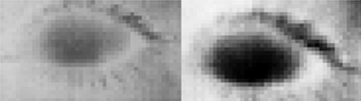
Background/Previous Works
Manual testing
SFSTs (walk-and-turn, one leg stand)
Breathalyzers
Gait
Measurements: 3-axis accelerometer, gyroscope, magnetometer
Features: Mean, standard deviation, correlation, energy
Ascending limb vs descending limb
Optical flow analysis using video
Eye thermal imaging
Features: Ratio of mean value of iris pixels to mean value of sclera pixels
Eye thermal imaging
Left: sober, Right: drunk
Department of Electrical Engineering and Computer Science

Slide 4
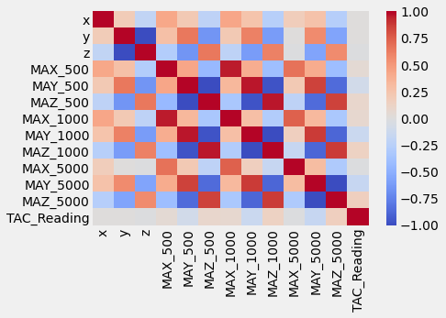
Overview of experiment design
Feature Extraction:
TAC readings measured every half hour, telemetry readings measured every millisecond
Used three sets of moving averages (500, 1000, 5000) for all three axes (x, y, and z)
Matched rolling averages to TAC readings, leaving over 5,000 records to test
Department of Electrical Engineering and Computer Science

Slide 5
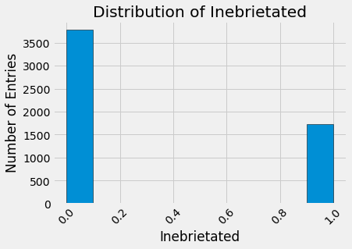
Overview of experiment design - continued
Methodology:
Split TAC readings into binary groups: >=.08 inebriated, <.08 sober
Tested multiple machine learning algorithms to determine the most effective: naïve Bayes, decision tree, grid search, and XGBoost
Utilized scikit-learn API in Python with a 70/30 train test split
Created a “driver” function to test each model on the same x and y data each time
Department of Electrical Engineering and Computer Science

Slide 6
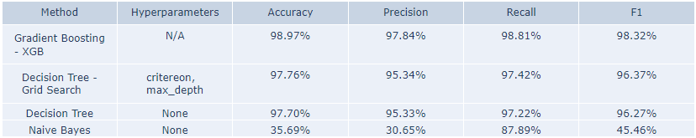
Results
Focused on accuracy, with a secondary emphasis on precision and recall
XGBoost performed the best, with almost 99% accuracy
Grid search was second best, but required much more setup/tuning
Costs outweighed the benefits, especially when considering how well XGBoost works “out of the box”
Department of Electrical Engineering and Computer Science

Slide 7
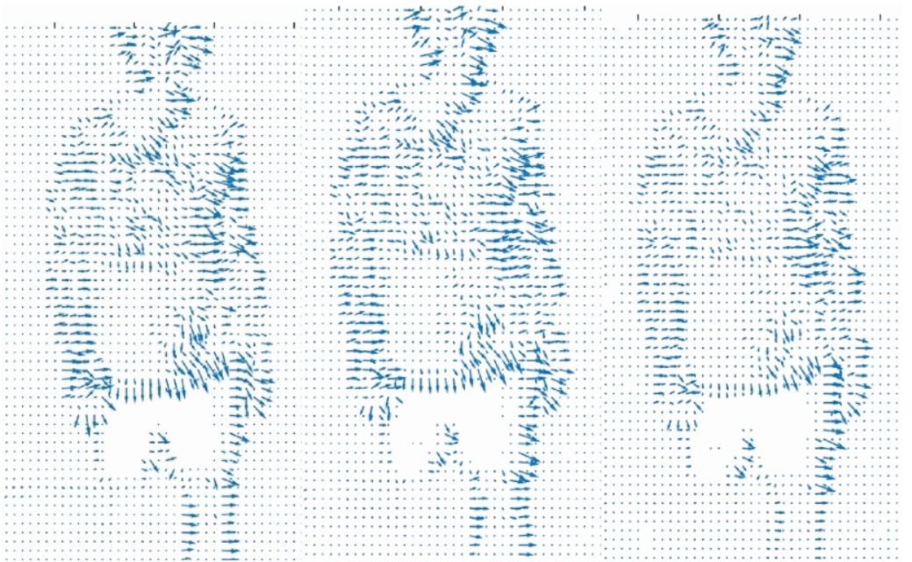
Results Comparisons
Facial thermal imaging
87% accuracy
Bayesian classifier
Eye thermal imaging
“99% confidence”
Undetermined for 5 of 41 participants
Supervised learning - Support Vector Machine (SVM)
Gait
Accelerometer – Different training data for ascending/descending limb
Bayesian Regularized Neural Network and Fast Fourier Transformation
Video – near 100% accuracy
Optical flow frames
Department of Electrical Engineering and Computer Science

Slide 8
Conclusion/Future Work
We would like to implement the second step of our system and use iris scanning to help confirm the results of the telemetry models
Would require extra hardware for thermal imaging
We would also like to extend the initial step by including more test subjects and control for external variables
Overall, we are pleased with the results from the first step and believe we have demonstrated it is possible to accurately determine sobriety levels from biometric data
Department of Electrical Engineering and Computer Science

Slide 9
Questions/Comments
Department of Electrical Engineering and Computer Science

