Slide 1


Historical Data on the Trading of Cryptocurrencies
Kevin Martin
Syracuse University
CIS700 – Monday @ 8:00pm EST

Slide 2
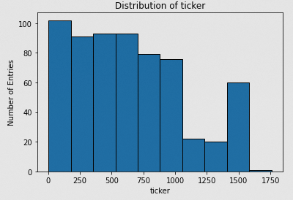
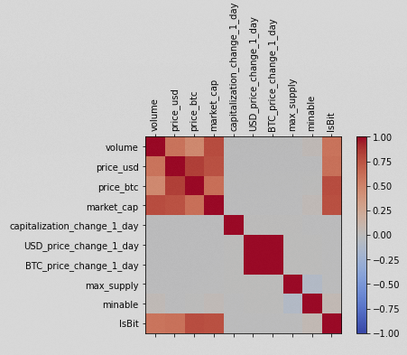
Historical Prices - Overview
Over 2,000 unique currencies available
Almost 1,600 days of transactions for more highly traded ones
17 columns of data, exhibiting both categorical and numerical attirbutes
Only about 5 columns are relevant and/or not redundant
Previous kernel using LSTM approach

Slide 3
Research Goals
Which features of cryptocurrency trading will best predict future price movements, and can we we further predict the magnitude of such movement?
Given the variety of features across time, can we find an optimal combination to predict the future price movement?

Slide 4
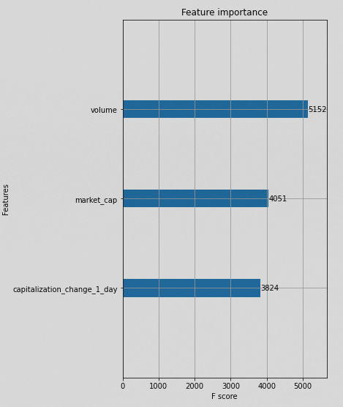
Feature Selection
Focusing on Bitcoin transactions only for the time being
Apply XGBoost to expedite hyper parameter tuning, further expedited by Dmatrix function
Top three features chosen based on F1 Scores, which consider both precision and recall

Slide 5
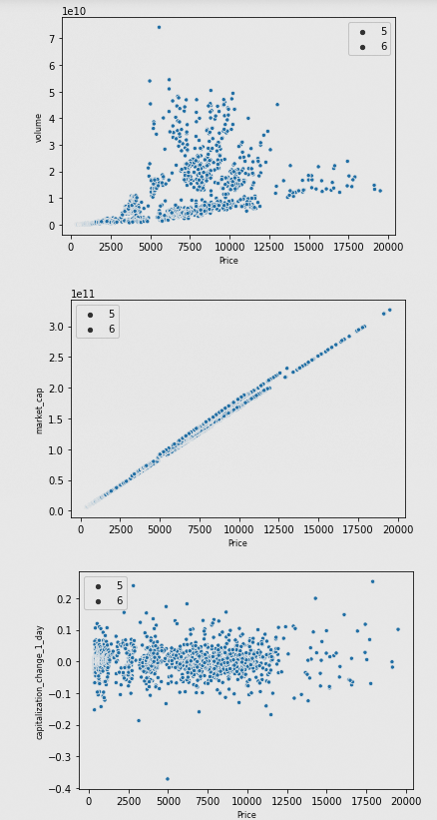
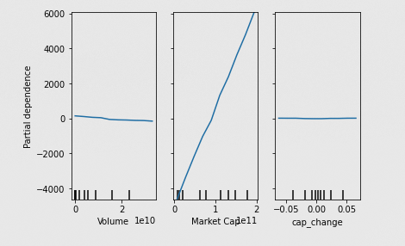
Feature Selection - Continued
Scatterplot vs. partial dependencies
Market Cap (total dollar value of outstanding coins) is clearly the strogest

Slide 6
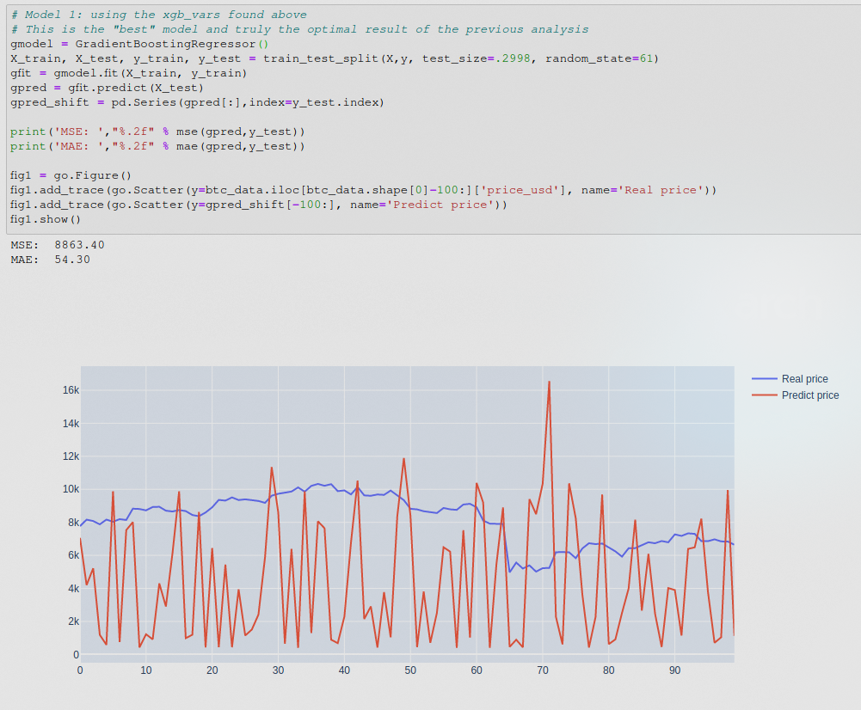
Feature Selection - Continued

Slide 7
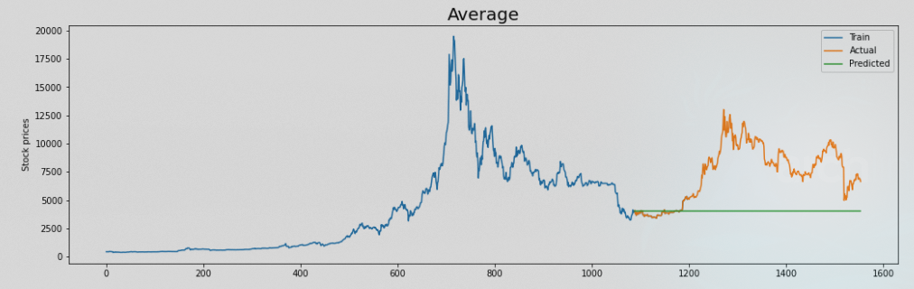
Time Series Analysis - Introduction
Sequential Neural Network to predict price with 70/30 train/test split
Using the mean squared error (MSE) as accuracy measure
Compare to both average and moving average

Slide 8
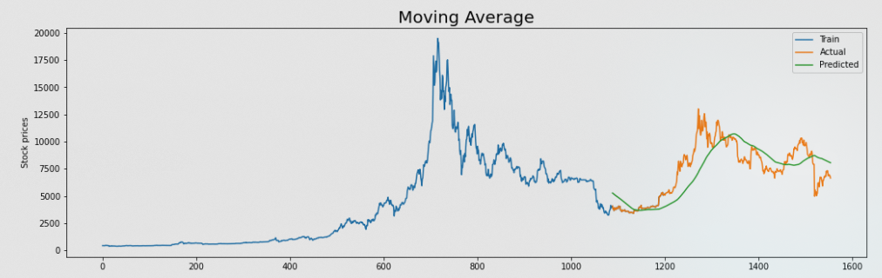
Time Series Analysis – Moving Average
Moving average closer than initially anticipated
Helped validate train/test split

Slide 9
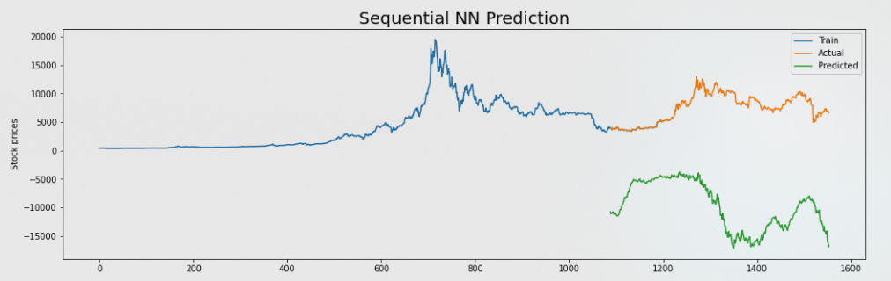
Time Series Analysis - Epochs
You must run neural networks more than once

Slide 10
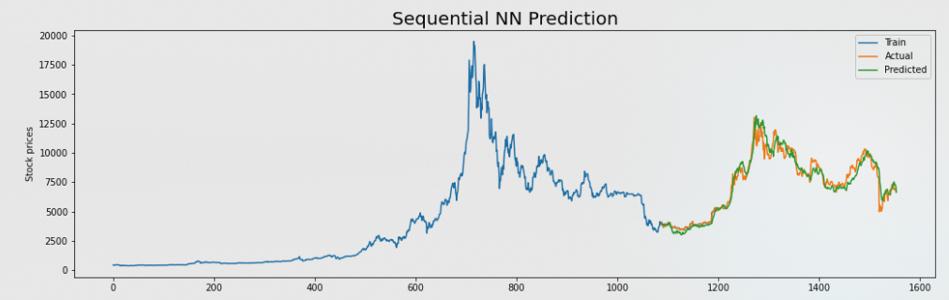
Time Series Analysis - SNN
250 epochs of the SNN approach yielded substantially better results
Not (relatively) computationally intensive, allowed for more tuning and experimentation
Over five times better than moving average (via MSE)

Slide 11
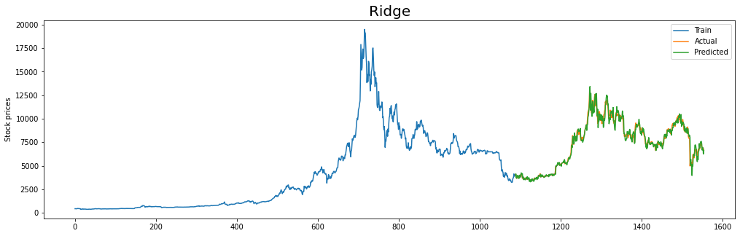
Linear Regression Approaches
All three algorithms outpeformed SNN
Even less computationally demanding
Best example was Ridge Regression, which was about 3 times better than best SNN (via MSE)

Slide 12
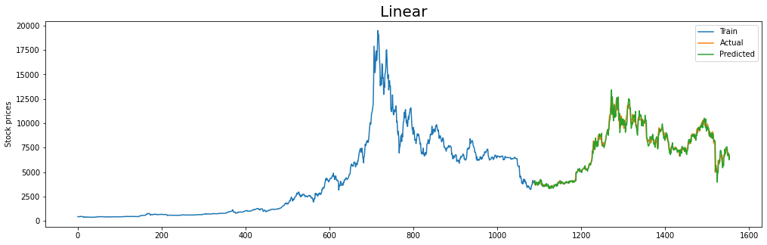
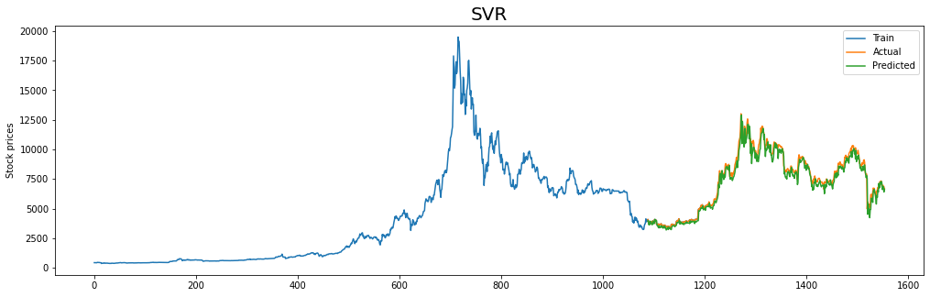
Linear Regression Approaches
Both outpeformed SNN by similar margins

Slide 13
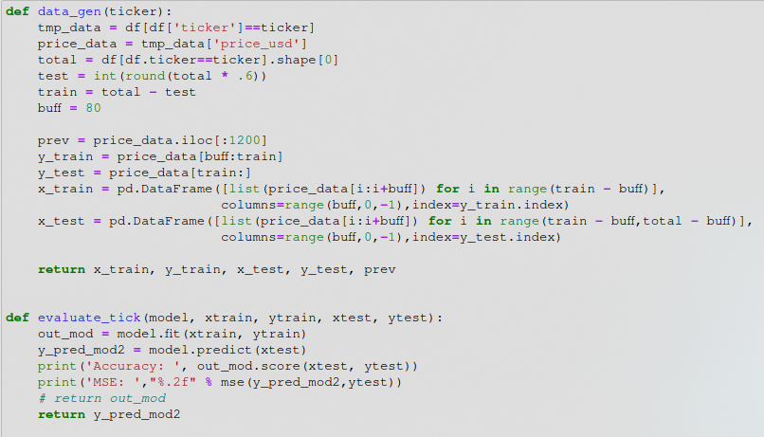
Multiple Currencies - Driver

Slide 14
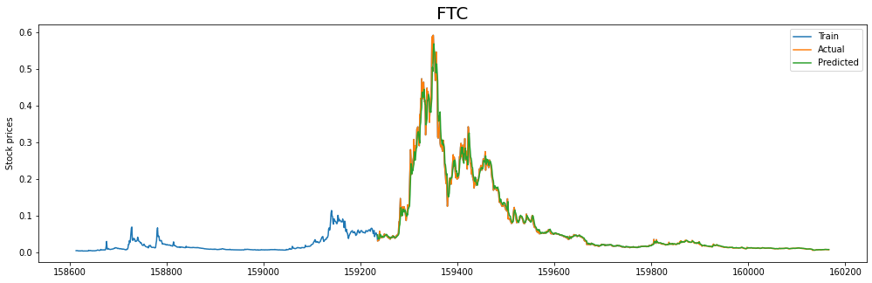
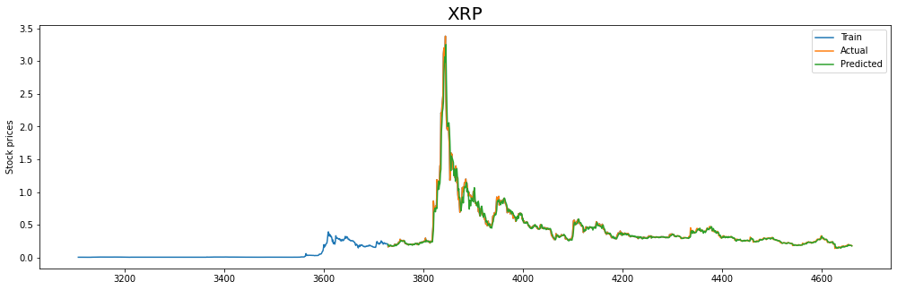
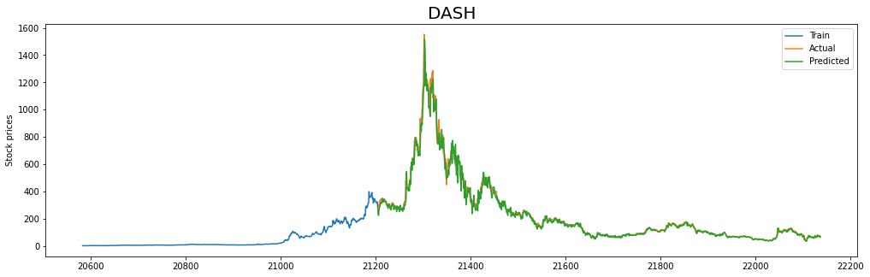
Multiple Currencies - Results
Accuracy: 0.9796069942272243
MSE: 0.00
Accuracy: 0.9593687742782361
MSE: 0.01
Accuracy: 0.9817206573287891
MSE: 1132.63

Slide 15
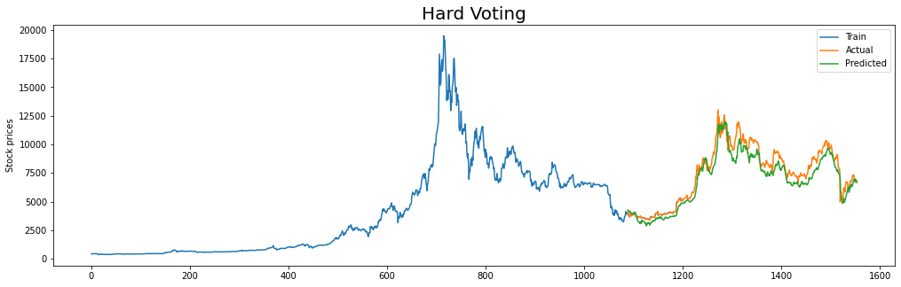
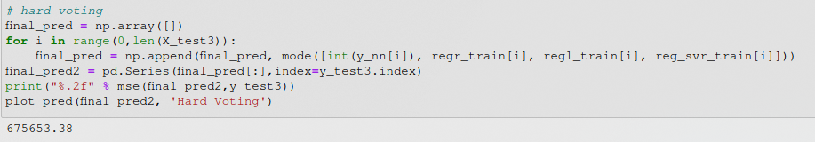
Ensemble Method – Hard Voting

Slide 16
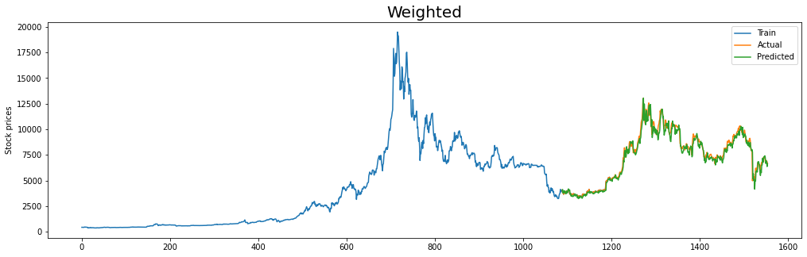
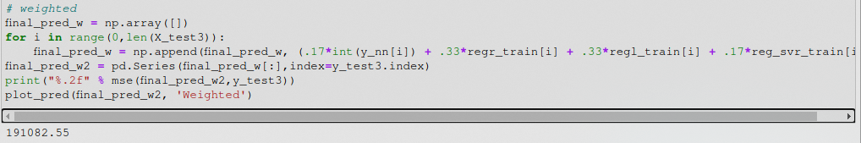
Ensemble Method – Weighted

Slide 17
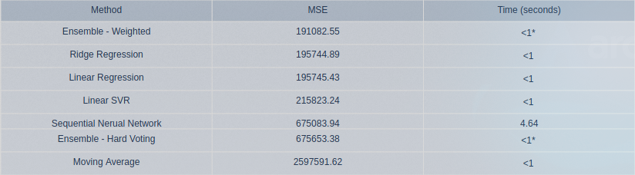
Method Summary

Slide 18
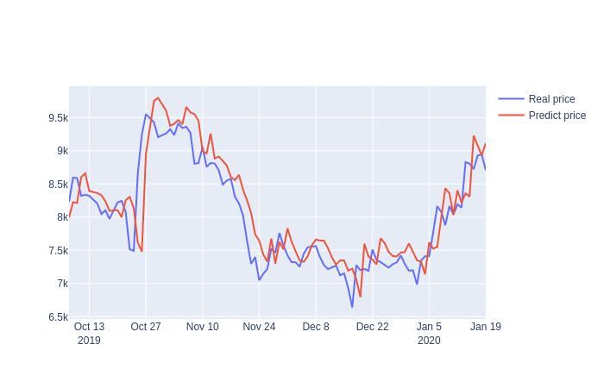
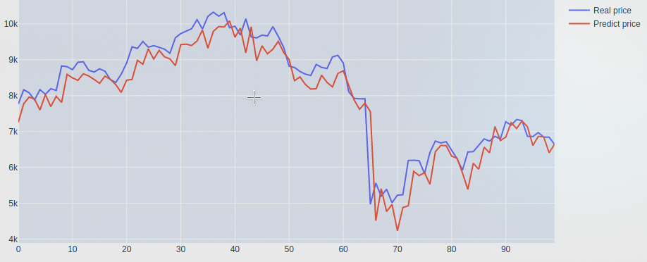
Kaggle Comparison
MAE for Kaggle (LSTM): 273
MAE for mine: 306
Dataset gets updgated regularly, so time period shifted

Slide 19
Conclusions
-Successful price prediction
-Feature extraction and understanding
-Close to other Kernel
-Career change

Slide 20

Questions?

