Slide 1
Azure Facial Recognition

Slide 2
Face service
Belongs to Azure Cognitive Services
Provides AI algorithms that detect, recognize, and analyze human faces in images
Provides several different facial analysis functions:
Face detection
Face verification
Face identification
Find similar faces
Face grouping

Slide 3
Face detection
Returns the rectangle coordinates of human faces locations
Optionally, can extract few more attributes, such as pose, gender, age, emotion, facial hair and glasses.
For example:
"faceAttributes": {
"smile": 0,
"headPose": {
"pitch": 0,
"roll": 0.1,
"yaw": -32.9
},
"gender": "female",
"age": 22.9,
"facialHair": {
"moustache": 0,
"beard": 0,
"sideburns": 0
},
"glasses": "NoGlasses",
"emotion": {
"anger": 0,
"contempt": 0,
"disgust": 0,
"fear": 0,
"happiness": 0,
"neutral": 0.986,
"sadness": 0.009,
"surprise": 0.005
},

Slide 4
Face verification
Builds on Detection and addresses the question, “Are these two images the same person?”
Can be used in identity verification or access control scenarios

Slide 5
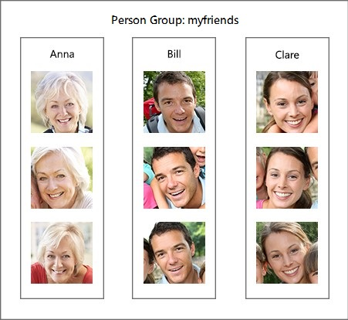
Face identification
Starts with Detection and answers the question, “Can this detected face be matched to any enrolled face in a database?”
Candidates matches are returned based on how closely the probe matches each of the enrolled templates

Slide 6
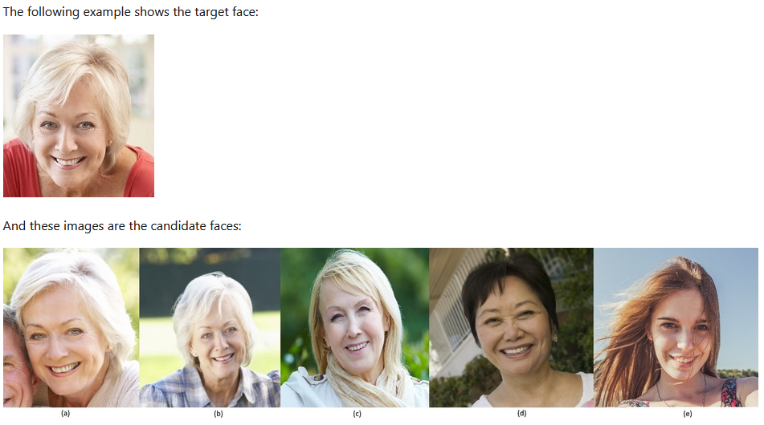
Find similar faces
Face matching between target and set of candidate faces, finding a smaller set of faces that look similar to the target
Useful for doing a face search by image
Two working modes:
matchPerson – returns similar faces after filtering for the same person
matchFace – ignores the same-person filter and returns a list of similar candidate faces, that may or not belong to the same person (percentage probability)

Slide 7
Face grouping
Divides a set of unknown faces into several groups based on similarity
All of the faces in a group are likely to belong to the same person
The groups are differentiated by another factor, such as expression for example

Slide 8
Our service
Azure Face REST API (Azure Face service resource)
Find similar faces
Interactive app
in-memory database
Recognize a person from a photo
If not recognized, teach me who it is!

Slide 9
Useful links
Facial Recognition overview
Azure Face service overview
Face service documentation
REST API quickstart
GitHub REST API samples
GitHub "Face Recognition" repository

Slide 10
Thank you!

