Slide 1
Analyze NYC Taxi Data using Hive
and Machine Learning
Bayan Alghuraybi
Krishna Marvaniya
Guojun Xia
SUMITTED TO : Dr. Jongwook Woo

Slide 2
Table of Content
1. The Azure Machine Learning
2. Ingest data
3. Prepare Data: Hive with Hadoop on HDInsight with Remote Desktop
4. Explore data: in Azure HDInsight Hive tables
5. Visualize Data
6. Algorithms for Microsoft Azure Machine Learning
7. Predictive Analytics

Slide 3
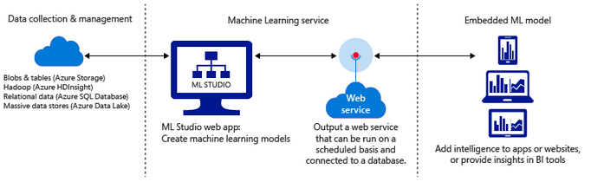
1. The Azure Machine Learning
1.1 Azure Machine learning uses computers to run predictive models that learn from existing data in order to forecast future behaviors, outcomes, and trends.
1.2 Azure Machine Learning is a powerful cloud-based predictive analytics service

Slide 4
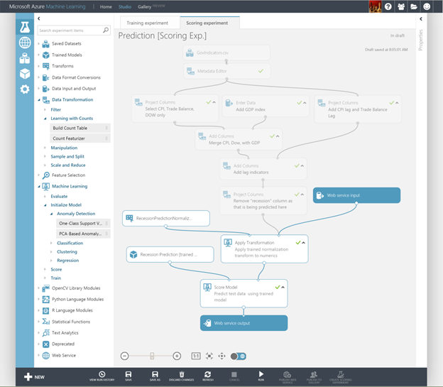
Machine Learning Studio: Create predictive models

Slide 5
What is predictive analytics?
Predictive analytics uses various statistical techniques - machine learning - to analyze collected or current data for patterns or trends in order to forecast future events.

Slide 6
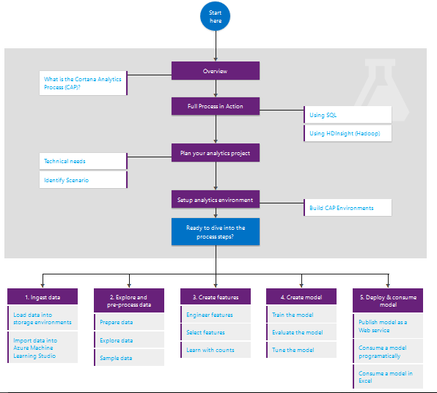
The Architecture Predictive Analytics Process

Slide 7
2. Ingest data
2.1 Data set source (URL): http://chriswhong.com/open-data/foil_nyc_taxi/
18.7 G
2.2 Specifiction of experimental equipment:
Number Of Nodes : 6 (Worker node A7 : 4 & Head Node A3 : 2)
Memory Size: 605GB(Worker node) & 285GB(Head node)
CPU/core speed: 56GB(Worker node) & 7GB(Head node)
2.3 Gitlab/Github information:
https://gitlab.com/kmarvan/Analysis.git
https://github.com/kmarvan/Analysis-on-NYC-taxi-Data-using-Hive-and-Machine-Learning

Slide 8
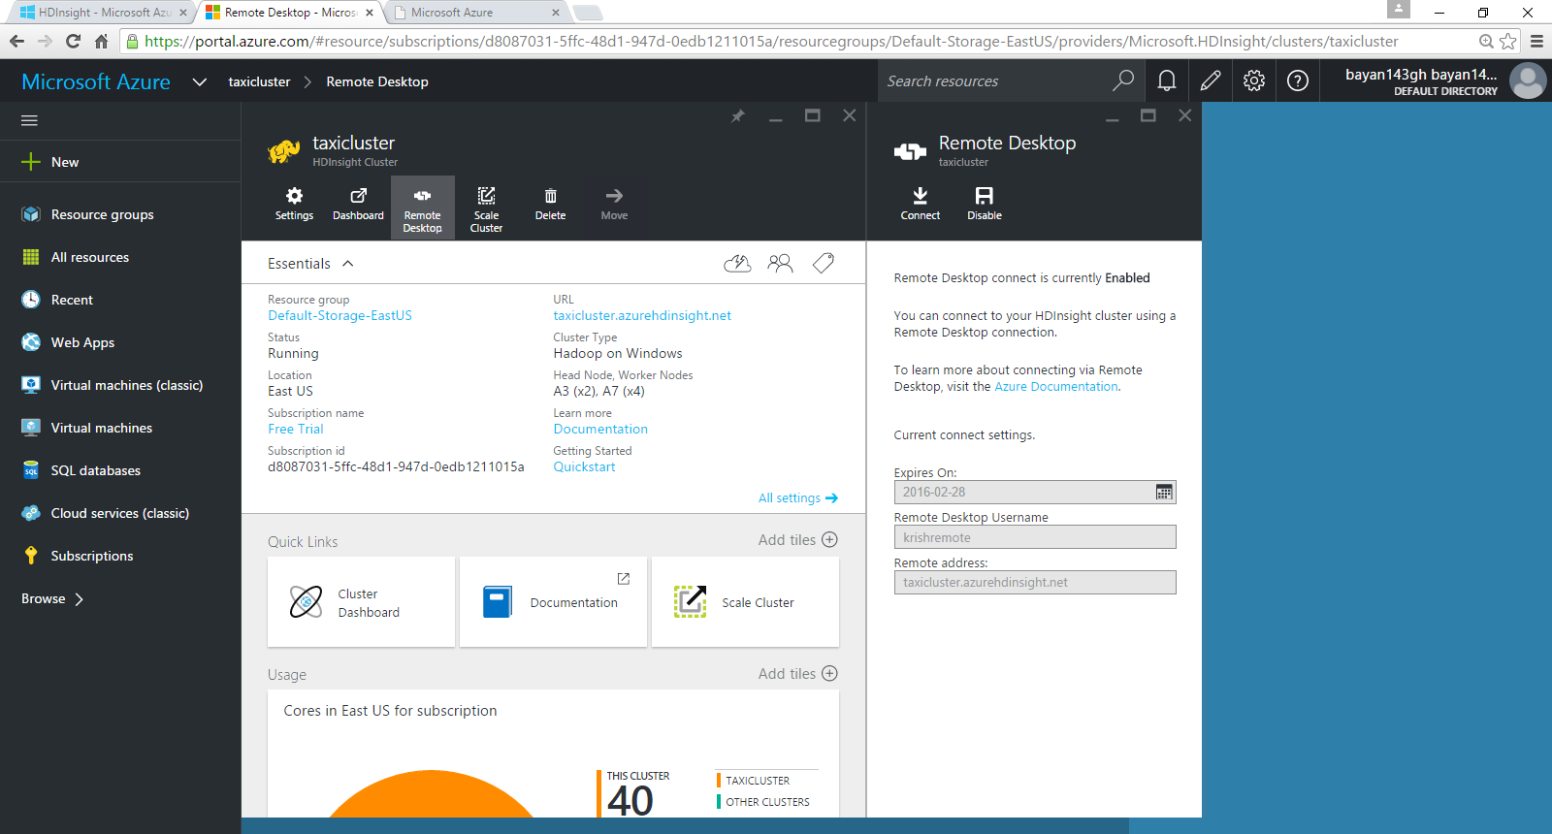
Why Hive Through(RD) ?

Slide 9
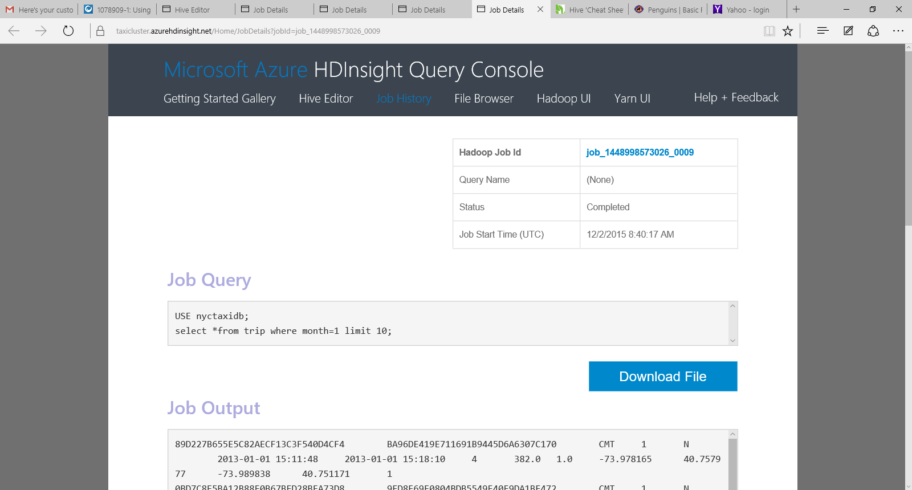
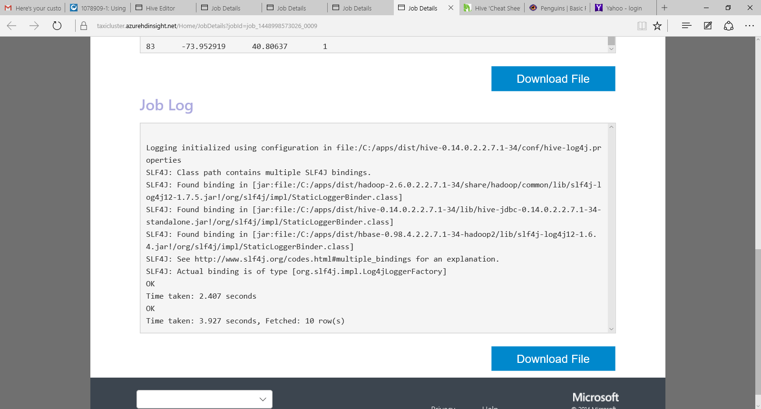
Open HDInsight Query console

Slide 10
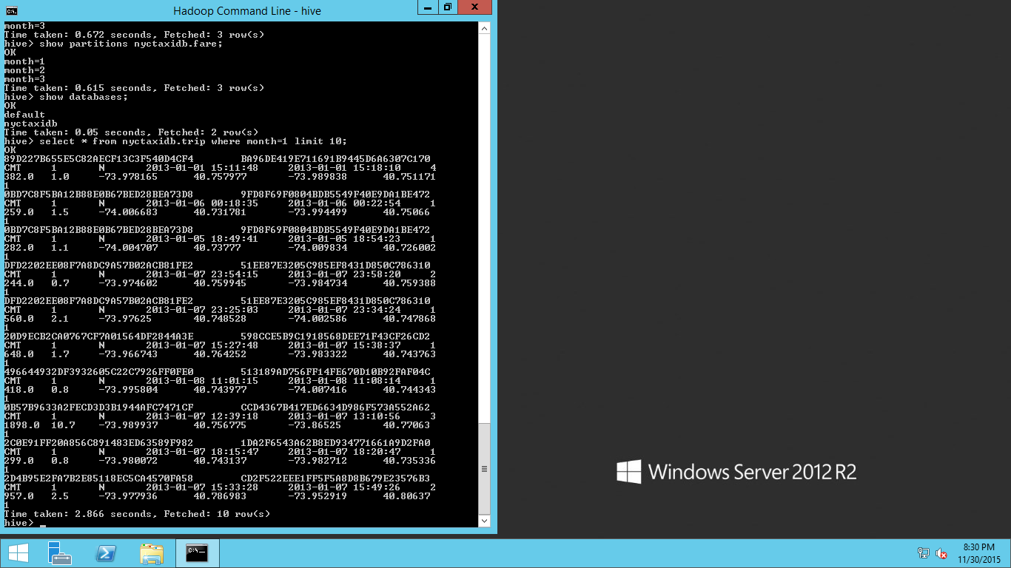

Slide 11
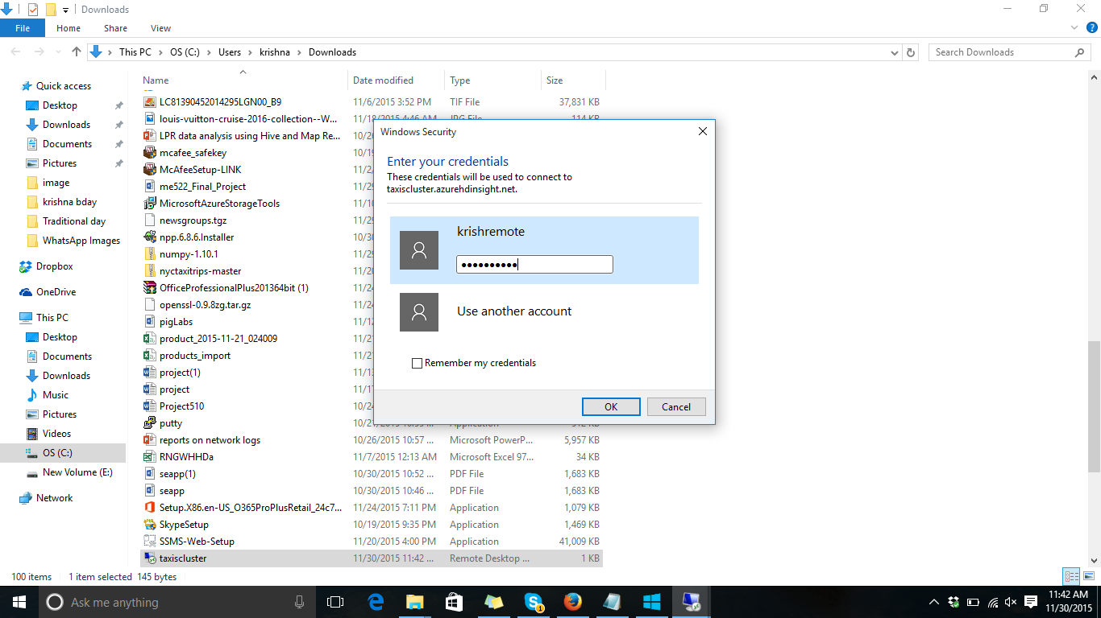
Remote desktop->connect->will download file and use it.

Slide 12
Run Hive
Connect to an HDInsight cluster by using Remote Desktop,
Run Hive queries by using the Hadoop Command Line console .
Enter the following command to start the Hive CLI:
%hive_home%\bin\hive

Slide 13
4. Explore data: in Azure HDInsight Hive tables
Submit the Hive queries from the Hadoop Command Line console on the head node of the Hadoop cluster:
A. Log into the head node of the Hadoop cluster,
B. Open the Hadoop Command Line console
C. Submit the Hive queries from there

Slide 14
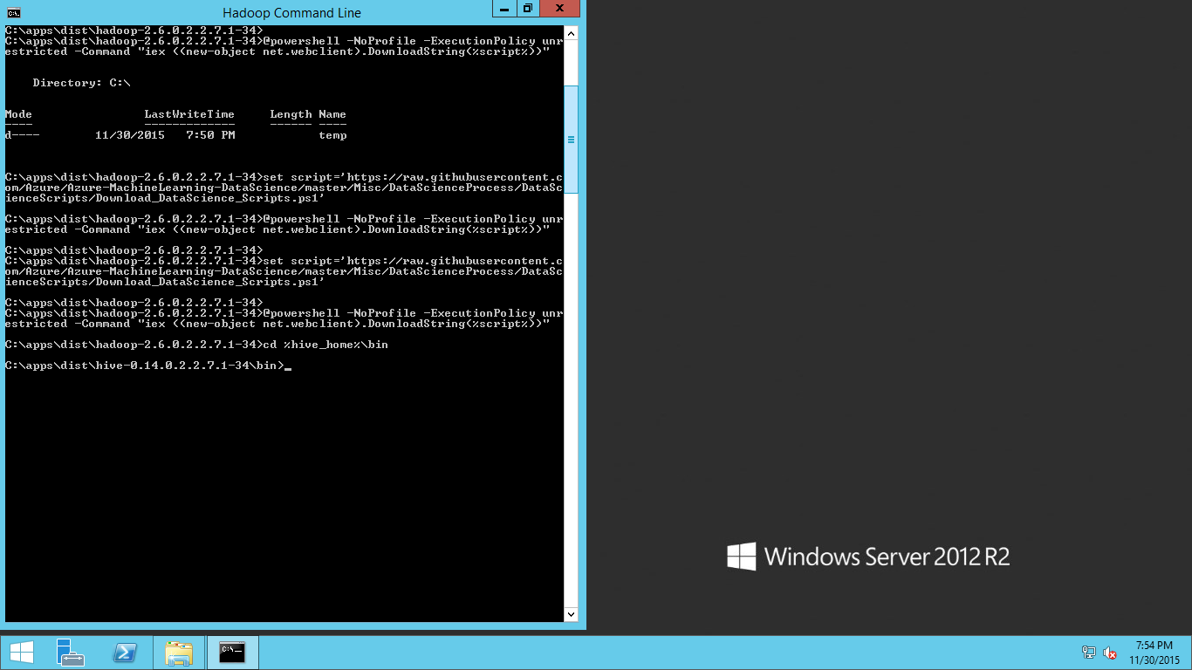
Run Hive: %hive_home%\bin\hive

Slide 15
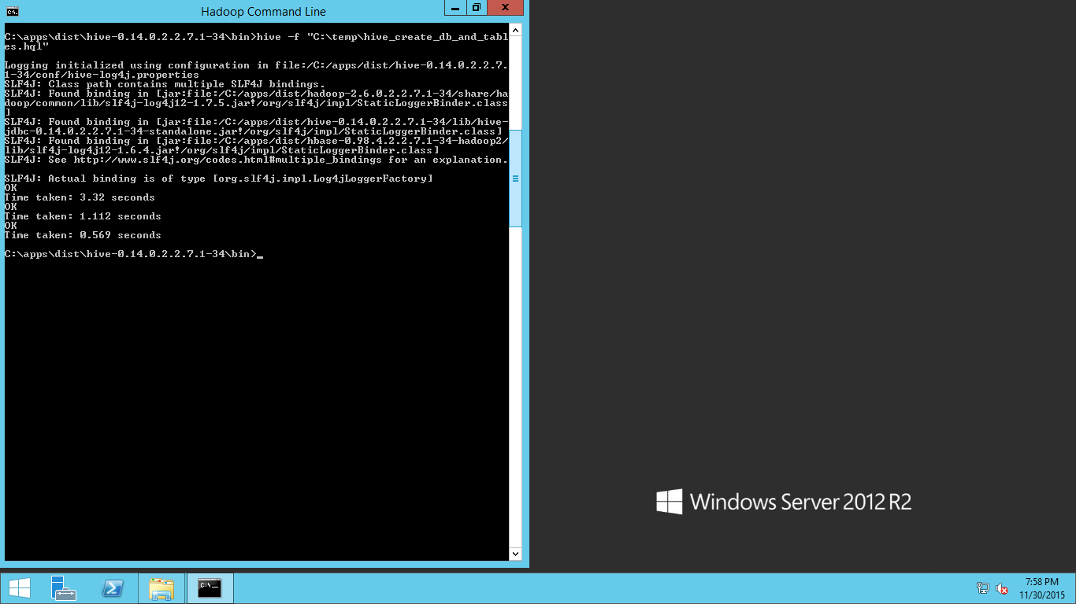

Slide 16
Retrieve trip records for month 1 and limit them to 10 rows

Slide 17
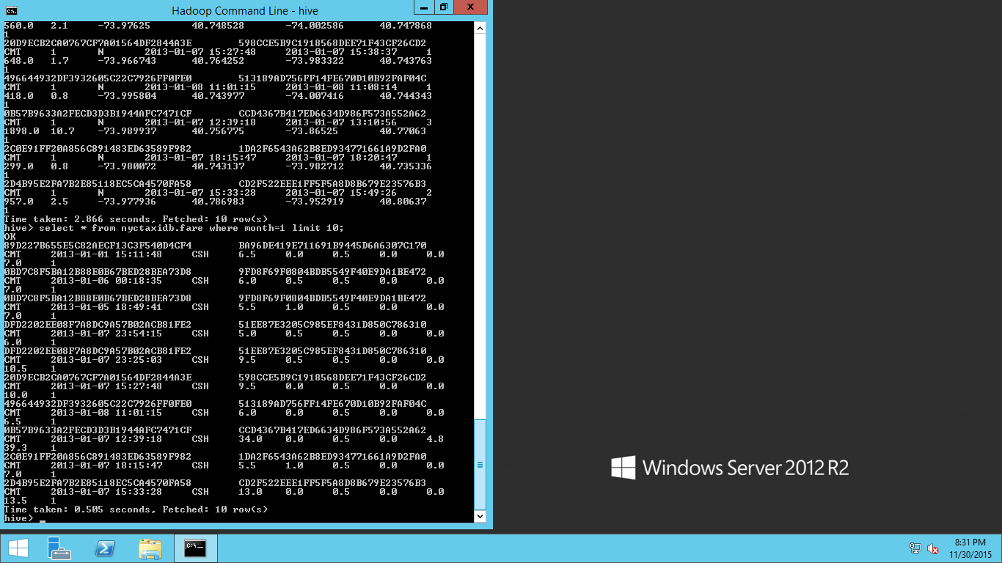
Retrieve Fare records for month 1 and limit them to 10 rows

Slide 18
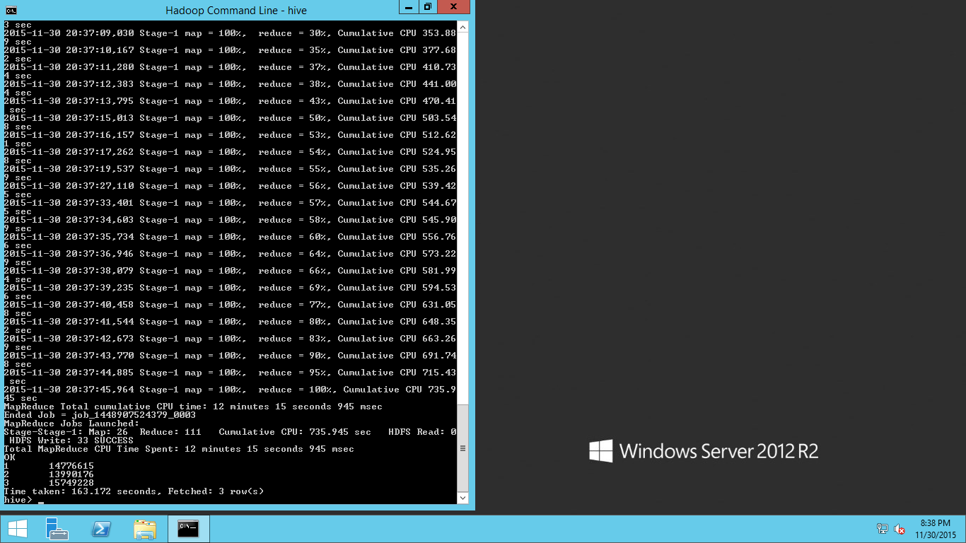
View the total number of trip in each moth

Slide 19
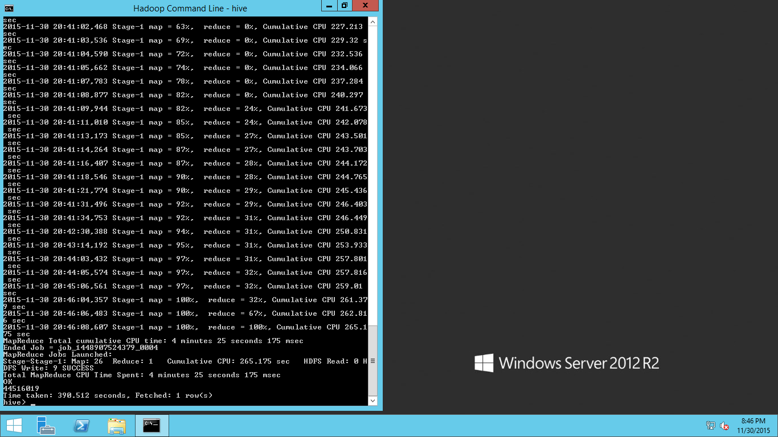
View the total number of trip for all the three month

Slide 20
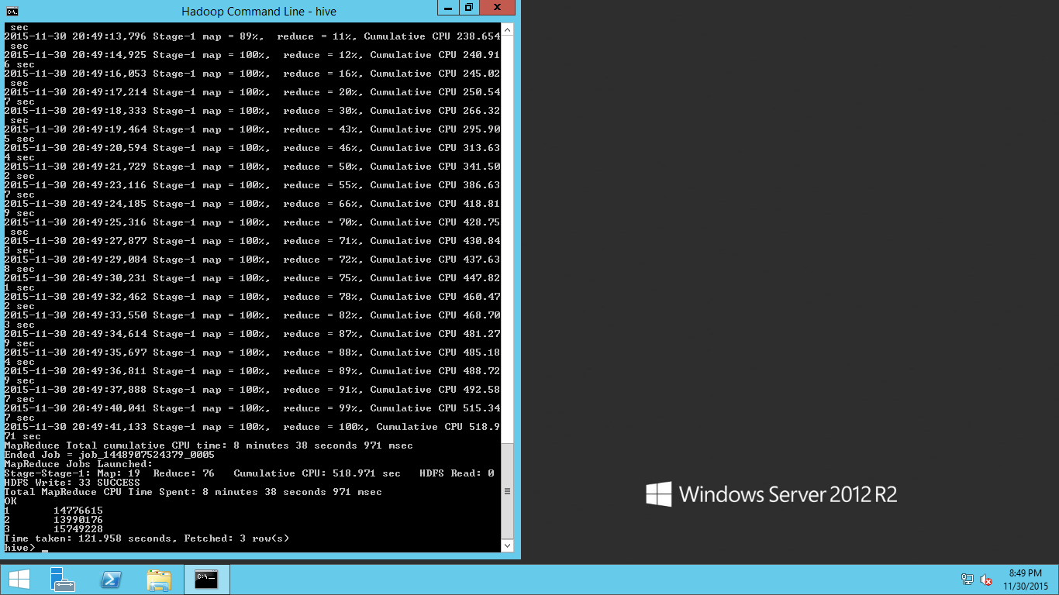
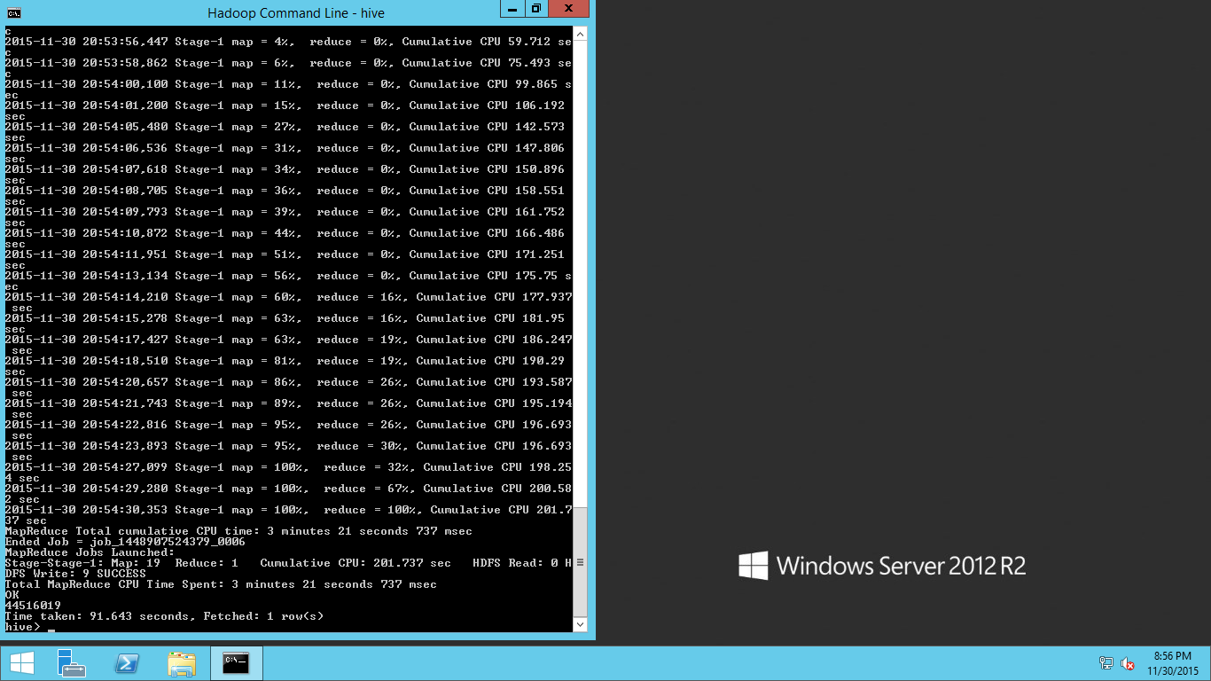
View the total number of trip for per each months and all overall total From the Fare trip file (Accuracy)

Slide 21
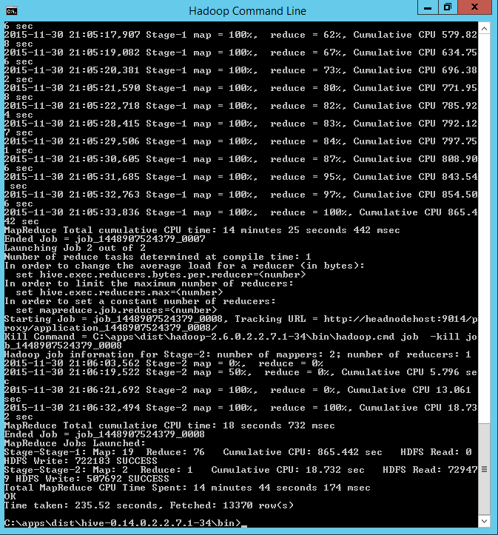
Saving the result

Slide 22
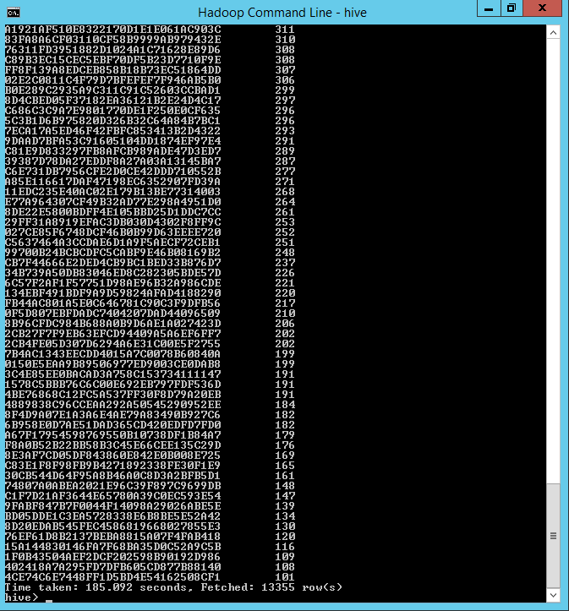
Count per medallion
SELECT medallion, COUNT(*) as med_count
FROM nyctaxidb.fare
WHERE month<=2
GROUP BY medallion
HAVING med_count > 100
ORDER BY med_count desc;

Slide 23
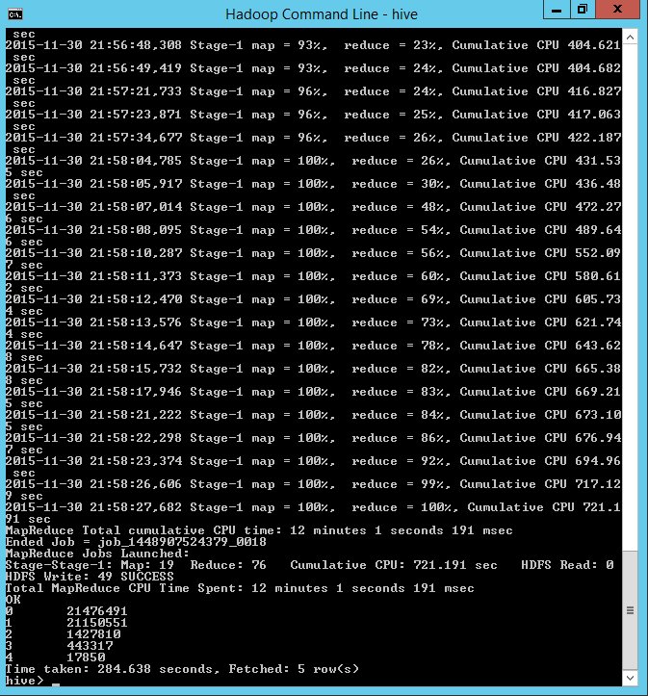
Tip class

Slide 24
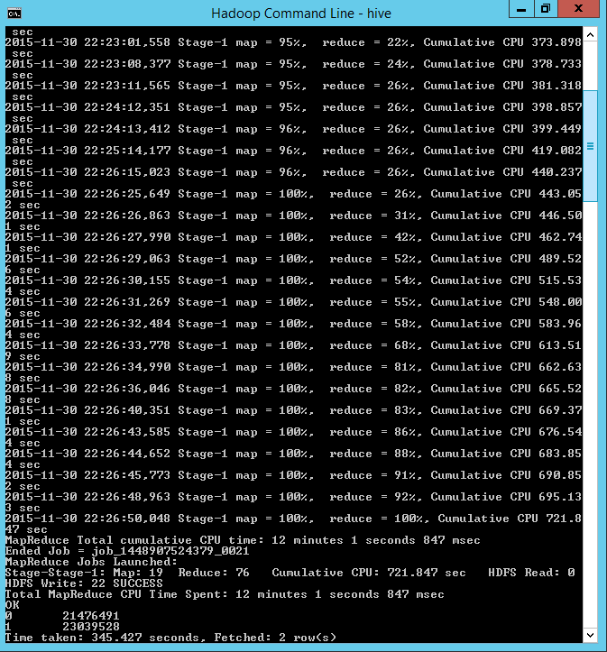
Tip or Not

Slide 25
5. Visualize Data

Slide 26
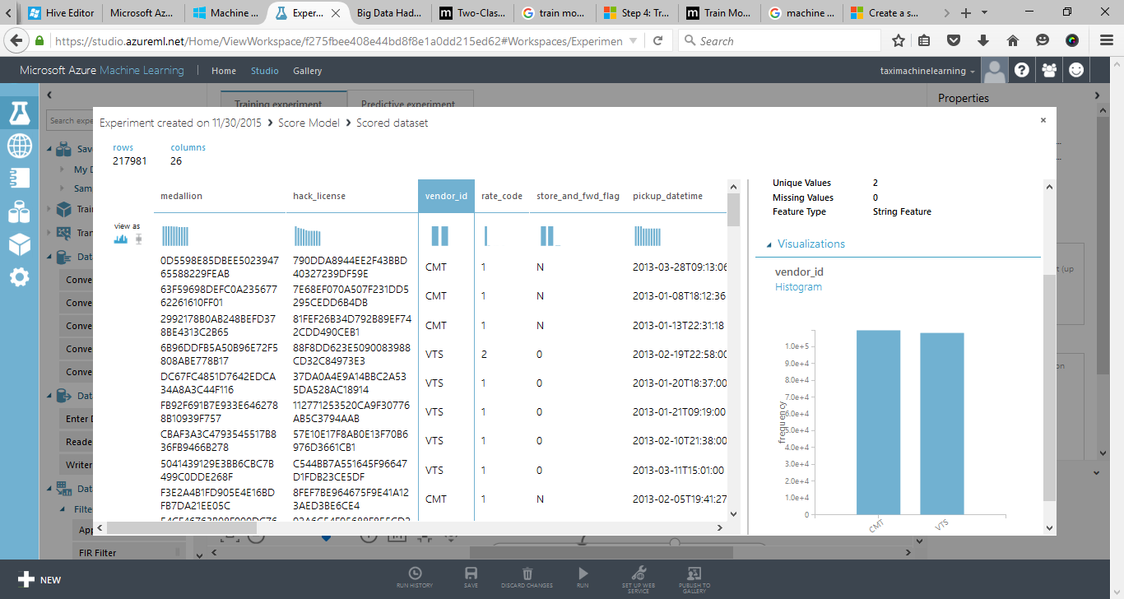
Vendors

Slide 27
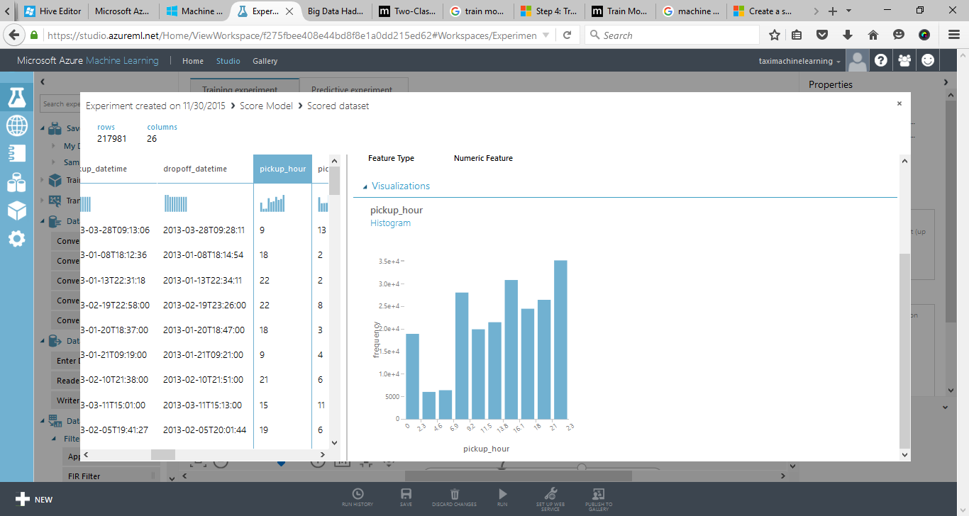
Pickup_hour

Slide 28
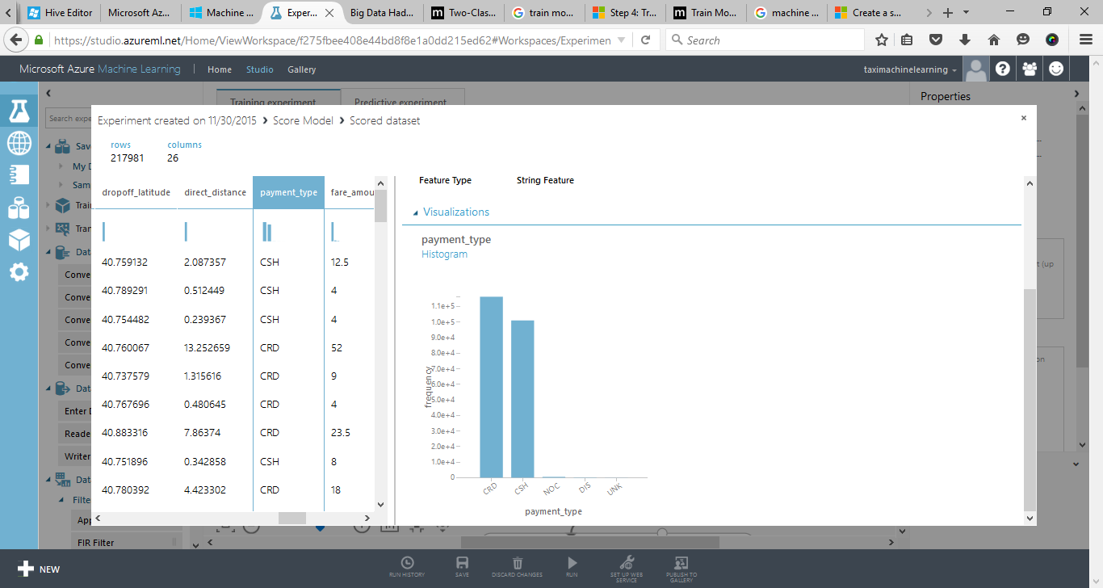
Payment_type

Slide 29
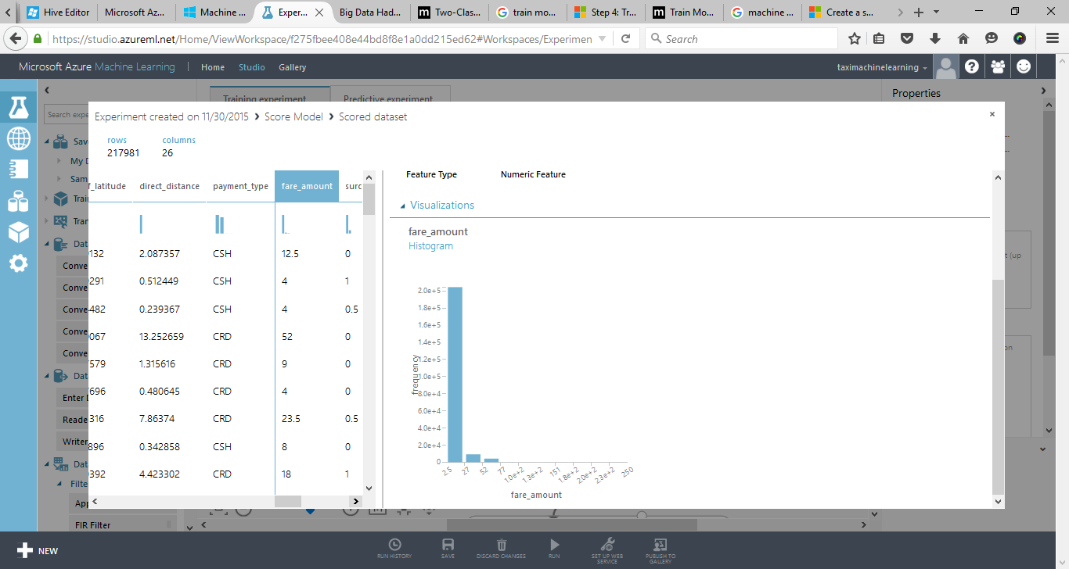
Fare_amount

Slide 30
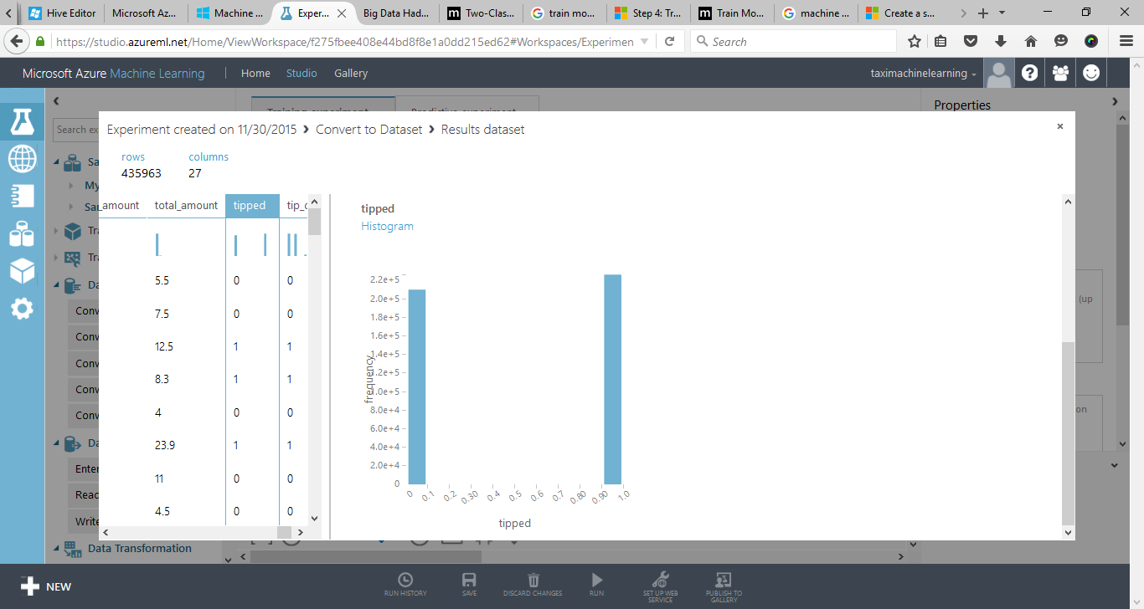
Tipped

Slide 31
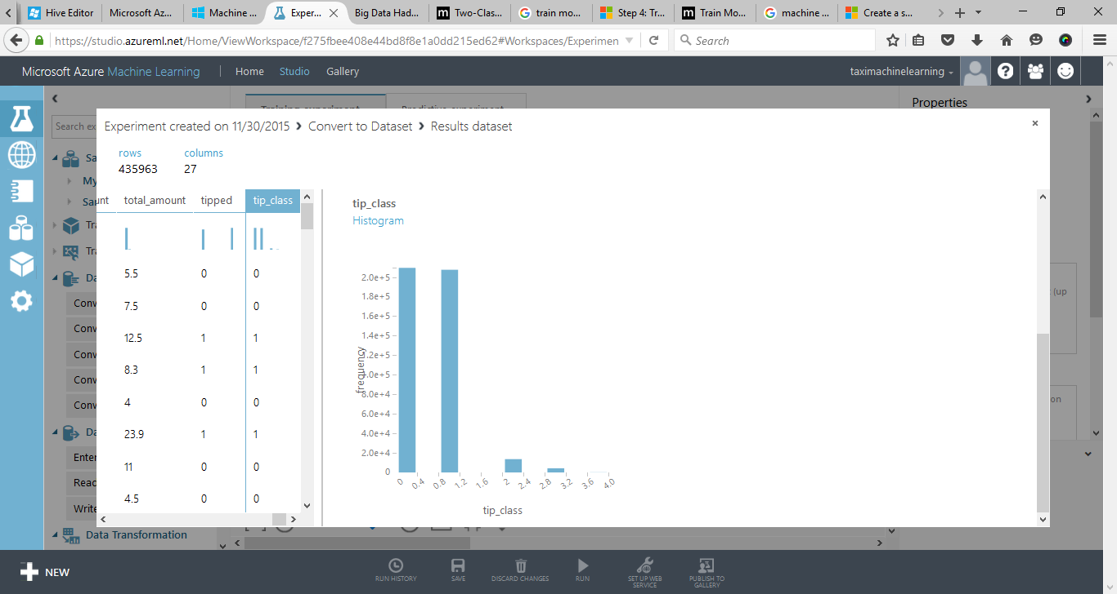
Tip_class

Slide 32
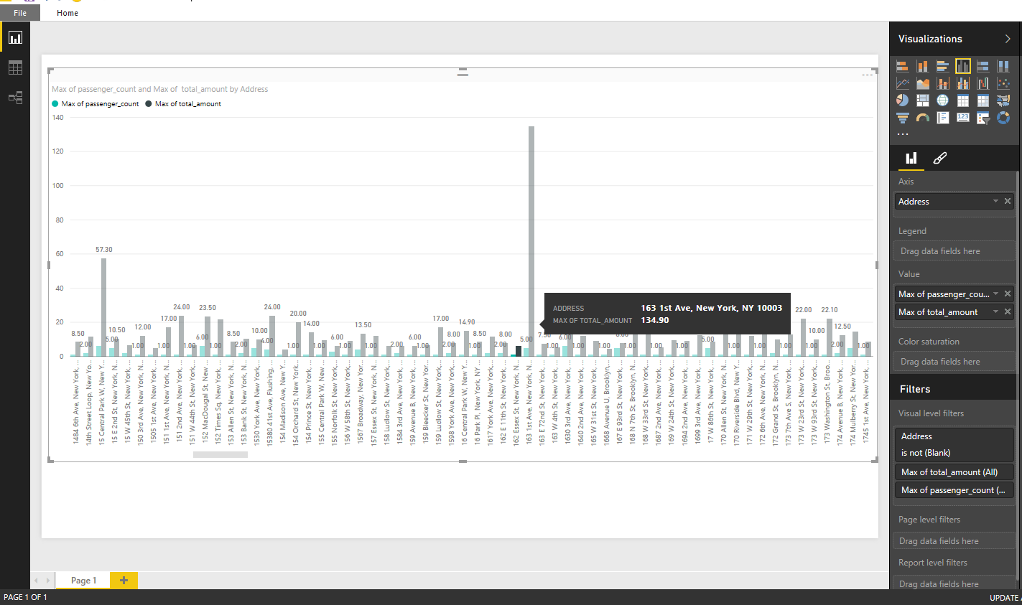
Total amount per Location

Slide 33
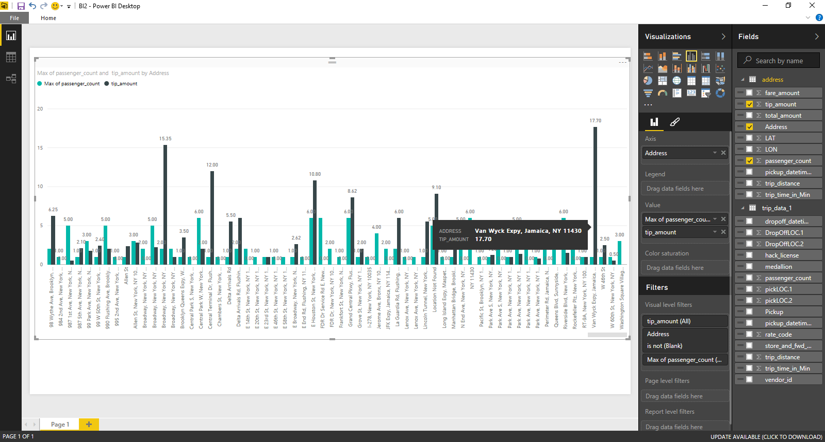
Maximum Tip

Slide 34
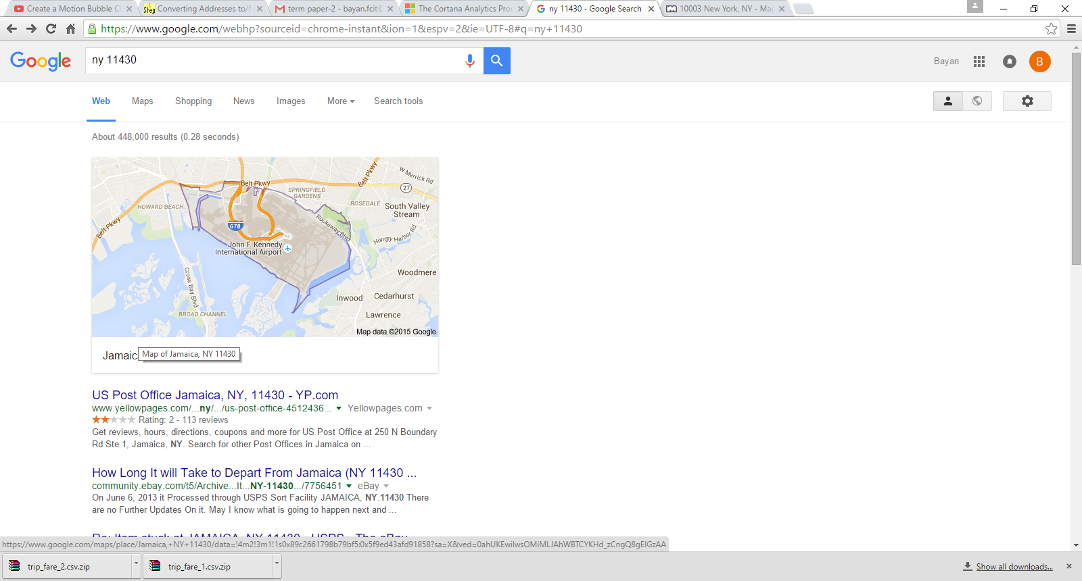

Slide 35
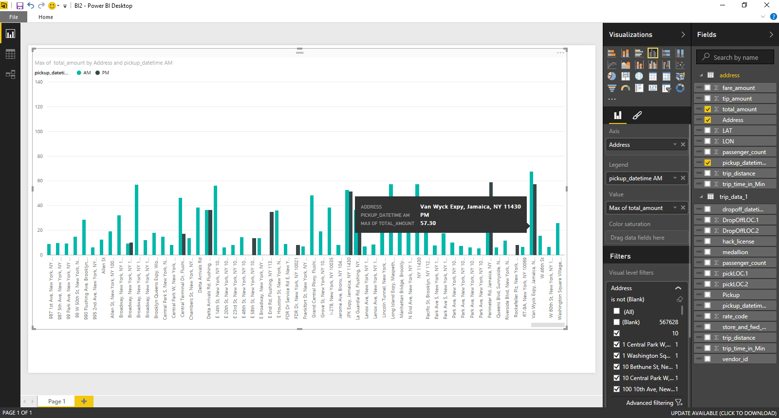
Maximum Total amount in PM

Slide 36
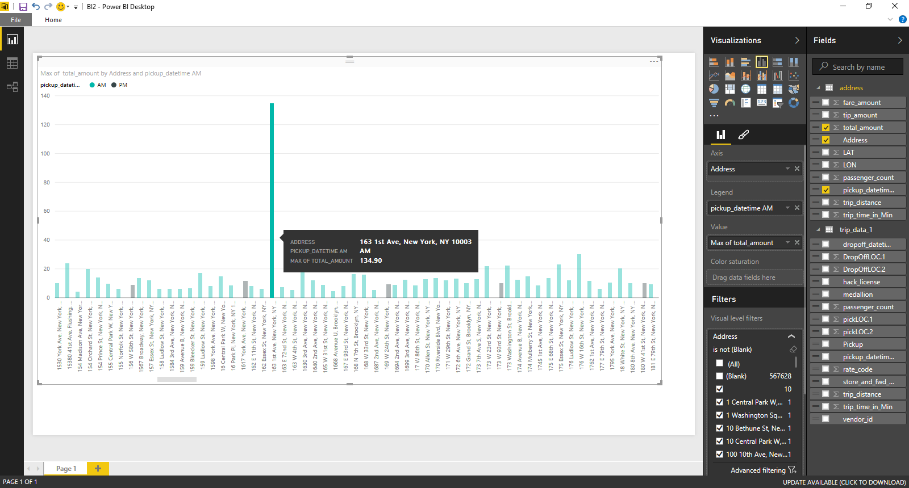
Maximum Total amount in AM

Slide 37
7. Predictive Analytics

Slide 38
6. Algorithms for Microsoft Azure Machine Learning
Two-Class Logistic Regression
Two-Class Logistic Regression module is to create a logistic regression model that can be used to predict one of two states of the target variable. Logistic regression is a well-known statistical technique that is used for modeling many kinds of outcomes.

Slide 39
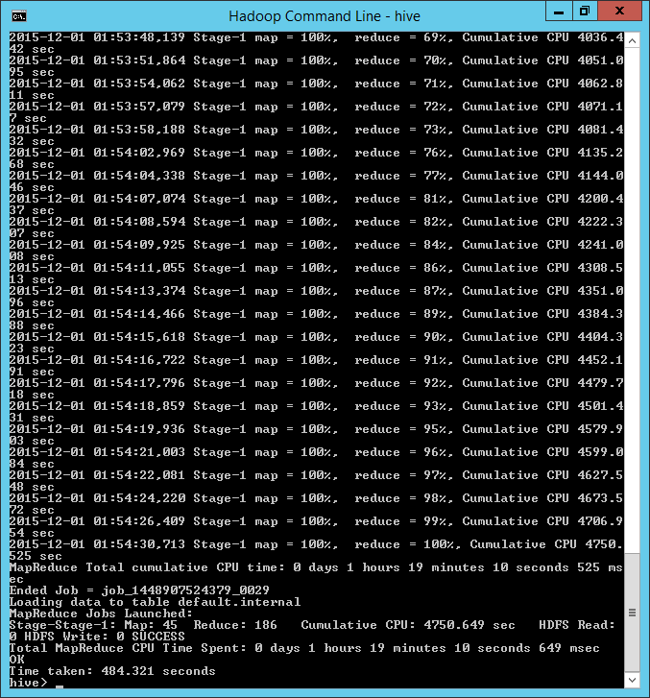
Internal Table

Slide 40
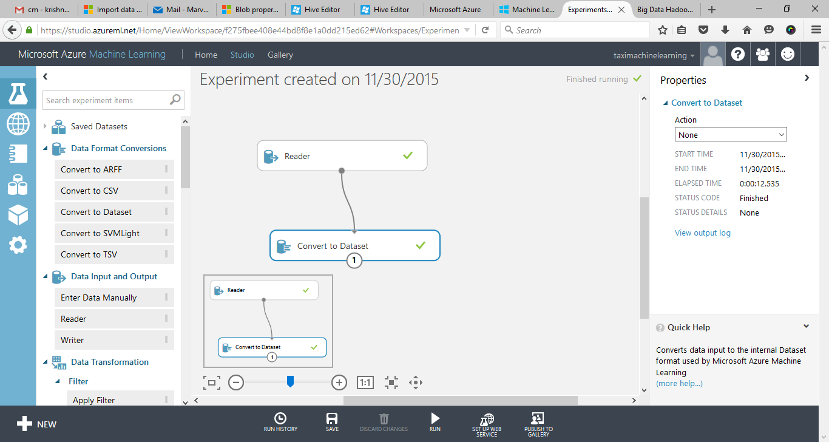
Creating the Experiment Reader module

Slide 41
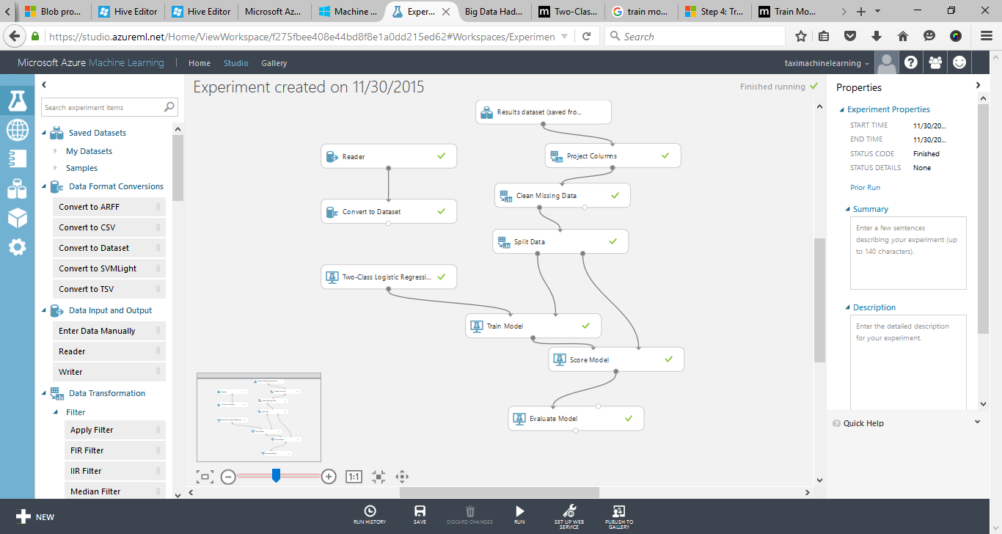
What Can we predict ?

Slide 42
Evaluate and compare
This model shows that Accuracy is 0.984 that the driver will be tipped.
This model could take a further step to be use for web services.

Slide 43
Q & A

Slide 44
Thank You

