Slide 1
Empirical Analysis of Sorting Algorithms
Bubble Sort | Merge Sort | Quick Sort

Slide 2
Introduction
In this project, we analyze the performance of three sorting algorithms:
- Bubble Sort
- Merge Sort
- Quick Sort
We measured the execution times on input sizes: 10, 1000, and 10000.

Slide 3
Methodology
• Each algorithm was run 3 times per input size.
• Input types: Random, Sorted, Reverse (simulated by random data).
• Execution time measured using std::chrono in C++.
• Results saved to CSV and averaged.

Slide 4
Average Execution Times (seconds)
BubbleSort (n=10): 0.000001
BubbleSort (n=1000): 0.005550
BubbleSort (n=10000): 0.557124
MergeSort (n=10): 0.000003
MergeSort (n=1000): 0.000368
MergeSort (n=10000): 0.004465
QuickSort (n=10): 0.000001
QuickSort (n=1000): 0.003581
QuickSort (n=10000): 0.235542

Slide 5
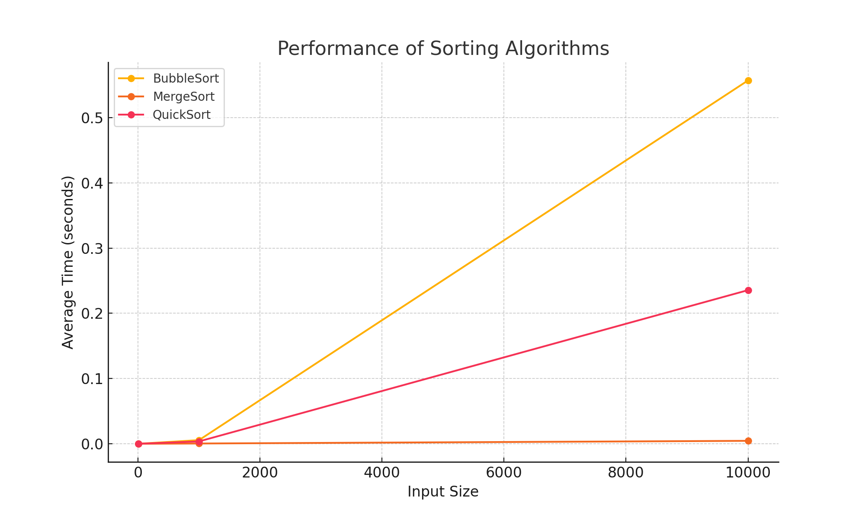
Performance Comparison Chart

Slide 6
Conclusion
- Bubble Sort is the slowest.
- Merge Sort is the most efficient.
- Quick Sort is fast but input-sensitive.
→ Merge Sort is the best overall choice.

