Slide 1
CIRCULAR CONCRETE · NETHERLANDS · BUSINESS CASE 2026–2036
A stand-alone circular concrete plant in the Netherlands does not pay
We tested one circular ready-mix plant in Zuid-Holland against four viability tests set in advance. Verdict: NOT VIABLE. Our ask is a €50–100k due-diligence phase, not an investment.
−€5.33M
−13.9%
€7.09M
1 of 4
NPV at 8% real
IRR (real)
funding need
viability tests passed
Investor and jury pitch · 22 October 2026 · real 2026 €, excl. VAT · base case: permits 2026, build 2027, first sales 2028
Notes:
Thank you for having us. This is a business case for a circular concrete plant in the Netherlands: a ready-mix plant that uses recycled concrete as aggregate. We set four viability tests before we built the model, and we kept them. The honest result is that a stand-alone plant does not pay. The base case has a net present value of minus 5.33 million euro at an 8% real discount rate, an IRR of minus 13.9%, no payback within ten years, and a funding need of 7.09 million euro. It passes only one of the four tests. So we are not asking you for an investment today. We will show why the plant fails, what would have to change, and the small, gated test we propose instead. Source: model/results.json, base case after the red-team review (first sales 2028).

Slide 2
Concrete carries a large CO₂ load, and most Dutch concrete rubble is downcycled into road base
3.5–4 Mt
11.5–15 Mt
8–15%
cement used in the Netherlands each year; cement is the main CO₂ source in concrete
concrete rubble released each year (about 60% of all stony demolition waste)
of that rubble goes back into new concrete today; the rest is mostly road base
Where Dutch concrete rubble goes today (2023–2025, share of tonnes)
Road base and fill: ~85–90%
Back into new concrete: ~8–15%
CO₂ per m³ depends on the cement: a CEM I mix emits ~286 kg CO₂/m³; the Dutch standard CEM III/B mix ~129 kg. Landfill is near zero, so the issue is downcycling, not dumping.
Sources: market.md §1–2 (MKT-01, MKT-03, MKT-05–MKT-09, MKT-11); CO₂ per m³ from price_breakdown.md §12 [ESTIMATE, Betonakkoord A1–A3 basis].
2
Notes:
Two problems meet here. First, CO₂. The Netherlands uses about 3.5 to 4 million tonnes of cement a year, and cement drives the CO₂ of concrete. A mix with pure Portland cement, CEM I, emits about 286 kg CO₂ per cubic metre. The Dutch standard blast-furnace cement mix, CEM III/B, is already much lower at about 129 kg. These per-m³ figures are our estimates on the Betonakkoord basis. Second, waste. Every year 11.5 to 15 million tonnes of concrete rubble are released. Almost none is landfilled, but only 8 to 15% goes back into new concrete. The rest is crushed into road base, which is a lower-value use. Road-base demand is shrinking, because few new roads are built and policy caps concrete in road-base granulate. Sources: market.md, MKT-01 to MKT-11.

Slide 3
Policy will push rubble out of road base and into new concrete from 2027 onwards
2025
2027
2028
2030
2034
Road-base cap: max 30% concrete in mixed granulate
Cap falls to 15%; target 30% of rubble back into concrete
GWW decree: max MKI for concrete in every public civil-works tender (base date)
Cap 5%; target >60% of rubble back into concrete
EU ETS free allocation for cement ends (may slip to 2038)
But policy pushes supply, not our selling price
• MPG tightening for new homes was cancelled (June 2025).
• The new waste plan (CMP) still counts road base as recycling.
• No levy on primary sand and gravel is proposed.
• MKI rewards depend on the binder, and competitors use the same CEM III/B.
Sources: policy.md §1, §3, §5, §10 (POL-01, POL-17, POL-18, POL-39, POL-42); market.md §2 (MKT-05, MKT-11). GWW decree start date is assumption A-POL-13.
3
Notes:
Policy is the tailwind. The Betonakkoord, the Dutch concrete agreement, caps concrete in mixed road-base granulate at 30% in 2025, 15% in 2027 and 5% in 2030. Its target for rubble going back into concrete rises from 20% in 2026 to more than 60% in 2030. A draft decree will make maximum MKI values, a shadow-cost measure of environmental impact, compulsory for concrete in every public civil-works tender. We assume a start on 1 January 2028; the levels are not set yet. EU ETS free allocation for cement ends in 2034 under current law, but a July 2026 proposal would slow this to 2038. The catch: these rules push supply of recycled aggregate up. They do not raise the price we can charge. Sources: policy.md, POL-01, POL-17, POL-39, POL-42; MKT-11.

Slide 4
Our product is standard ready-mix in which half of the coarse gravel is recycled concrete
1
2
3
4
5
Demolition rubble
Certified recycler
Recycled aggregate
Our mixing plant
Delivery
Clean concrete from demolition sites
Crushes and certifies coarse aggregate (BRL 2506)
We buy it at €24.5/t delivered; gravel costs €32/t
120 m³/h, waterside, Zuid-Holland, CEM III/B
Subcontracted truck mixers, ~20 km to contractors
What it is
What it is not
• 70,000 m³ a year at full output (from 2030); 60% circular mixes, 40% standard.
• Circular mix: 50% of the coarse aggregate is recycled (560 kg per m³).
• Capex €5.5M; 10 staff; trucks subcontracted.
• Price: €135/m³ plant average, the same as a standard mix.
• Not lower-CO₂ than the Dutch standard: ~132 vs ~129 kg CO₂/m³.
• Not a premium product: base premium is 1.5% on public work only.
• Not a recycler: in the base case we buy recycled aggregate; own crushing is an option we tested.
Sources: technology.md §1.1, §8; price_breakdown.md §2–3, §12; model/inputs.csv (A-CST-09, A-CST-11, A-TEC-28, A-FIX-02); model_summary.md §1.
4
Notes:
Here is how it works. A certified recycler crushes clean demolition concrete. We buy the coarse recycled aggregate at about 24.5 euro per tonne delivered, which is cheaper than barge gravel at 32 euro. Our plant mixes it with CEM III/B cement. The plant runs 120 cubic metres an hour on a 1.5-hectare waterside site in the Rotterdam–Drechtsteden area, and costs 5.5 million euro. Subcontracted truck mixers deliver about 20 kilometres. At full output we sell 70,000 cubic metres a year, 60% of it circular mixes. Be clear on one point: recycled aggregate gives circularity, not lower CO₂. Our circular mix emits about 132 kg CO₂ per cubic metre, against 129 kg for the standard mix, because it needs a little more cement. Sources: technology.md, price_breakdown.md, A-CST-09.

Slide 5
The market is worth €2.5bn a year, but one plant can realistically win only about 60–70k m³
TAM ≈ €2.5bn / yr
Reality check
All Dutch ready-mix and prefab concrete, 11.3 Mm³
• Our model plant sells 70k m³ a year: 2.1× the average Dutch plant (33.7k m³).
• 178 plants share 6.0 Mm³; volume fell 20% in 2023.
• Ready-mix is local (25–50 km), so the regional figure is what counts.
• Recycled feedstock is plentiful; certified supply and contracts are the constraint.
SAM ≈ €0.35bn / yr
Circular-addressable ready-mix, 2.6 Mm³ (43%)
Regional SAM ≈ €49M / yr
Within one plant's radius in Zuid-Holland, ~0.36 Mm³
SOM ≈ €8M / yr
One plant: ~60k m³ a year
Sources: market.md §1, §8 [ESTIMATE; ERMCO 2023 basis, CMP-43, A-MKT-30–32]; model/inputs.csv (steady-state output 70k m³, A-CST-01).
5
Notes:
The total Dutch market for ready-mix and prefab concrete is about 2.5 billion euro a year, or 11.3 million cubic metres. The circular-addressable ready-mix part, where a buyer has a reason to choose circular and the norms allow recycled aggregate, is about 2.6 million cubic metres, or 0.35 billion euro. Ready-mix is local: trucks drive 25 to 50 kilometres at most. Inside one Zuid-Holland plant's radius the addressable volume is about 0.36 million cubic metres. A realistic share for a newcomer is about 60,000 cubic metres, or 8 million euro a year. Our model uses 70,000, which is already twice the average Dutch plant of 33,700 cubic metres. The market is mature: ready-mix volume fell from 7.5 to 6.0 million cubic metres in 2023. All TAM, SAM and SOM values are estimates.

Slide 6
Incumbents already sell recycled and low-CO₂ mixes, and a specialist has just raised €100M
SL Materials (ex-Urban Mine)
everox (ex-C2CA)
Specialist · Zaandam
Specialist · 's-Gravendeel
€100M commitment from Aviva Investors and ABN AMRO (Oct 2026). Recovers sand, gravel and cement.
Plant with Dura Vermeer, permitted for 100 kt/yr; delayed, still being built in Sept 2026.
Heidelberg Materials: EcoCrete
Holcim: ECOPact
Incumbent · ~30 plants
Incumbent · public price list
Ready-mix with 30, 50 or 100% recycled aggregate; claims up to −70% CO₂.
Low-CO₂ line at only +€5–9/m³; +€4/m³ for up to 30% recycled granulate.
Five forces for a new stand-alone ready-mix entrant (5 = bad for us)
Rivalry 4/5
Supplier power 4/5
Buyer power 4/5
New entrants 3/5
Substitutes 3/5
Sources: competitors.md §1–2, §9 (CMP-04, CMP-05, CMP-16, CMP-17, CMP-28, CMP-29, CMP-35, CMP-43). Ratings are analyst judgement.
6
Notes:
We are not alone. SL Materials, formerly Urban Mine and spun off from Rutte Groep, received a 100 million euro commitment from Aviva Investors and ABN AMRO in October 2026. It recovers sand, gravel and cement from rubble. everox, formerly C2CA from TU Delft, is building a plant with Dura Vermeer in 's-Gravendeel, permitted for 100,000 tonnes a year but delayed. The incumbents already sell what we would sell. Heidelberg Materials, with about 30 plants, offers EcoCrete with 30 to 100% recycled aggregate. Holcim lists its low-CO₂ ECOPact at only 5 to 9 euro more per cubic metre. Rivalry, supplier power and buyer power are all high. For a stand-alone newcomer the market is low to medium attractive. Sources: competitors.md, CMP-04, CMP-05, CMP-17, CMP-35.

Slide 7
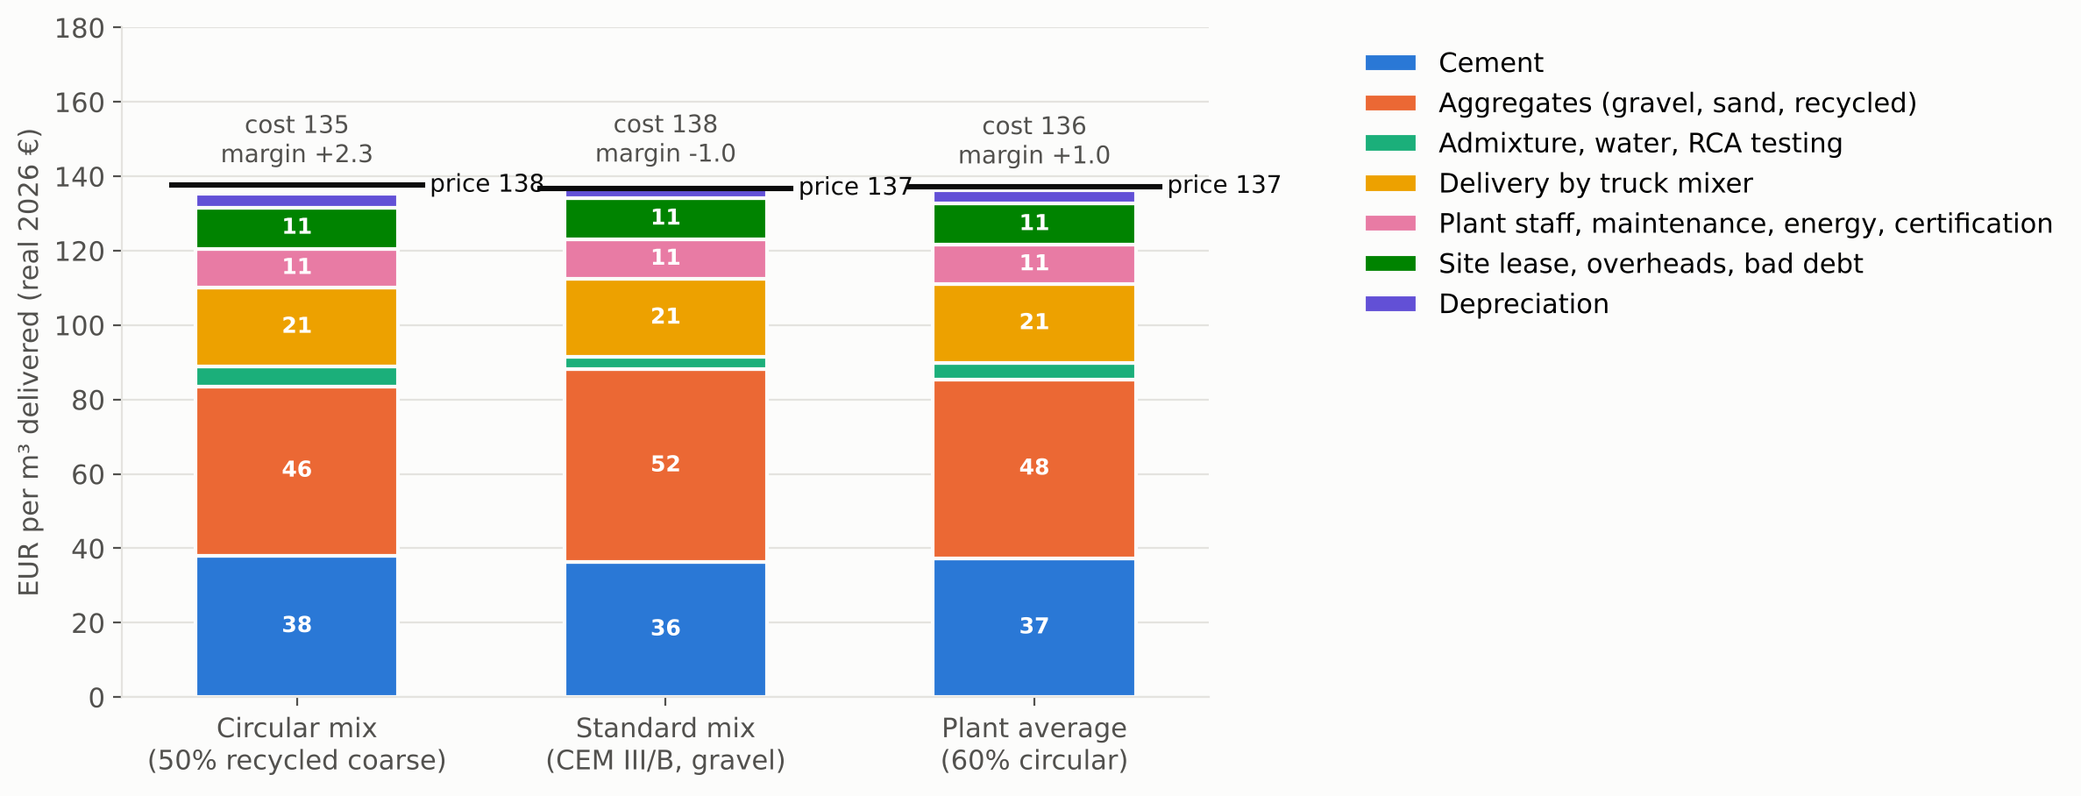
Our circular mix is €2.5/m³ cheaper to make, but every mix leaves only a thin margin
€ per m³ delivered in 2030 (first full year, 70k m³). Black line = selling price; cost includes depreciation.
−€2.5/m³
cash cost of the circular mix vs the standard mix (131.6 vs 134.1)
+€0.8/m³
green premium on circular volume (1.5% on public work only)
€4.6/m³
plant-average EBITDA in 2030, a 3.4% margin
Source: model UnitEconomics sheet, 2030 (first full-output year), model_summary.md §2; chart model/charts/unit_cost_stack.png (full cost incl. depreciation).
7
Notes:
This is cost per cubic metre in 2030, the first year at full output. The circular mix is not the problem. Its cash cost is 131.6 euro per cubic metre, against 134.1 for the standard mix, so it is 2.5 euro cheaper. The reason is simple: recycled aggregate at 24.5 euro a tonne is cheaper than gravel at 32. It also earns a small green premium of about 0.8 euro per cubic metre. The problem is the margin for every mix. Cement, aggregates and delivery take about three quarters of the price. After all costs the plant average earns 4.6 euro EBITDA per cubic metre, a 3.4% margin. The chart shows full cost including depreciation, so its cost labels are slightly higher than cash cost. Source: model UnitEconomics sheet, model_summary.md section 2.

Slide 8
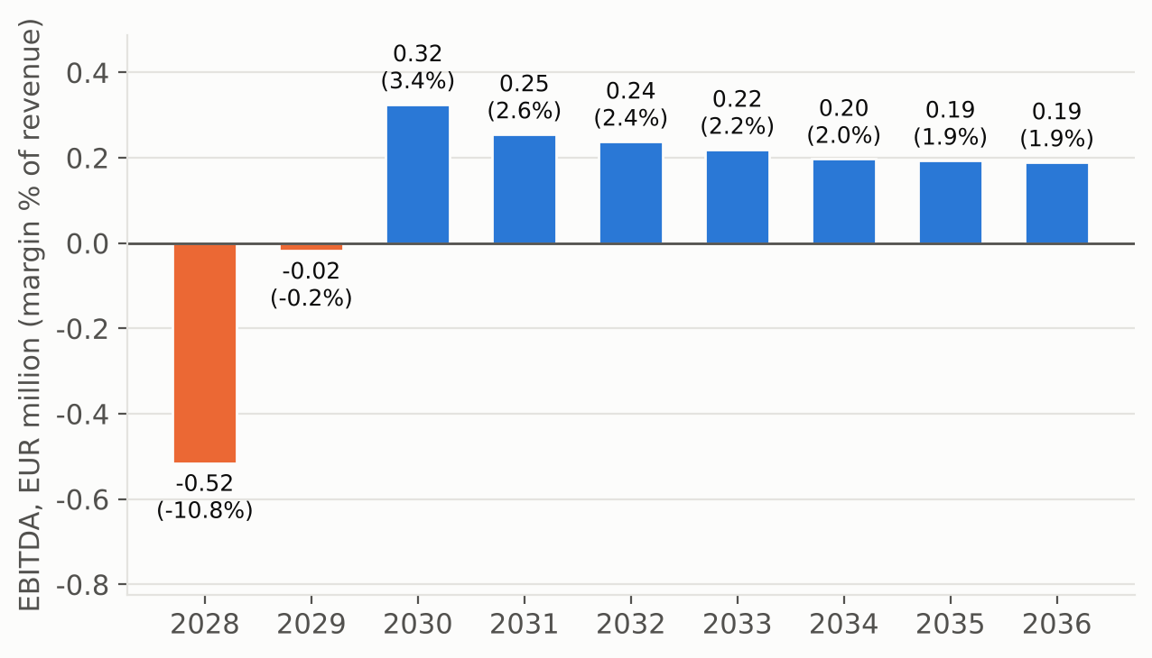
The plant earns €4.6 per m³ but needs about €11.7 per m³ to pay back its capital
EBITDA per year, € million (margin as % of revenue). Volume 35k / 55k / 70k m³ in 2028 / 2029 / 2030+.
Per m³, 2030
Earned (EBITDA)
€4.6
Needed to repay capex
€11.7
Gap ≈ €7/m³
about 5% of the selling price, every year, in a mature market
Source: model_summary.md §2 (capital recovery over 10 years at 8% real); chart deck/charts/ebitda_by_year.png; pass-through rates are key judgement calls (A-POL-09, A-CST-13).
8
Notes:
This is why the plant fails. EBITDA turns positive in 2030, the third operating year, at 0.32 million euro. Then it slowly falls to about 0.19 million, because cement carbon and slag costs rise faster than the 80% we assume we can pass on in prices. That pass-through rate is a judgement call without a source; at 100% NPV improves by only 0.4 million. Per cubic metre the plant earns 4.6 euro EBITDA. To recover 5.5 million euro of capex over ten years at 8%, it would need about 11.7 euro. The gap is about 7 euro per cubic metre, or 5% of the selling price. A mature, price-driven market does not give a newcomer 5% extra. Source: model_summary.md section 2, ebitda_by_year chart.

Slide 9
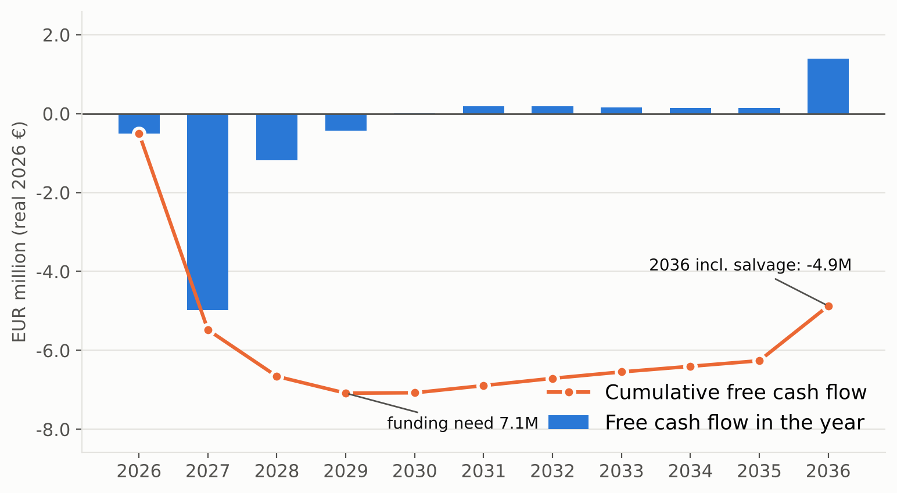
The base case destroys €5.33M of value and needs €7.09M of funding
Free cash flow per year (bars) and cumulative (line), € million. Build 2027, first sales 2028.
−€5.33M
−13.9%
NPV at 8% real (−97% of capex)
IRR, real
Not reached
+€0.32M
payback within 10 years
EBITDA 2030 (3rd operating year)
€7.09M
€5.5M
funding need (lowest point, 2029)
initial capex
Source: model/results.json (base case: permits 2026, build 2027, first sales 2028; unlevered; salvage-only terminal value); chart deck/charts/cashflow_10yr.png.
9
Notes:
The headline numbers. Net present value at 8% real is minus 5.33 million euro, which is minus 97% of the capex. The IRR is minus 13.9%. Cumulative cash never turns positive within the ten years, so there is no payback. EBITDA in the third operating year, 2030, is plus 0.32 million euro. The funding need, the deepest point of cumulative free cash flow, is 7.09 million euro, reached in 2029. Even with the 1.25 million euro salvage value in 2036, cumulative cash ends at minus 4.9 million. Two conservative choices were fixed in our plan: terminal value is salvage only, and working capital is not released. Undoing both, plus full price pass-through, still leaves NPV at minus 3.4 million. Source: model/results.json, model_summary.md section 2.

Slide 10
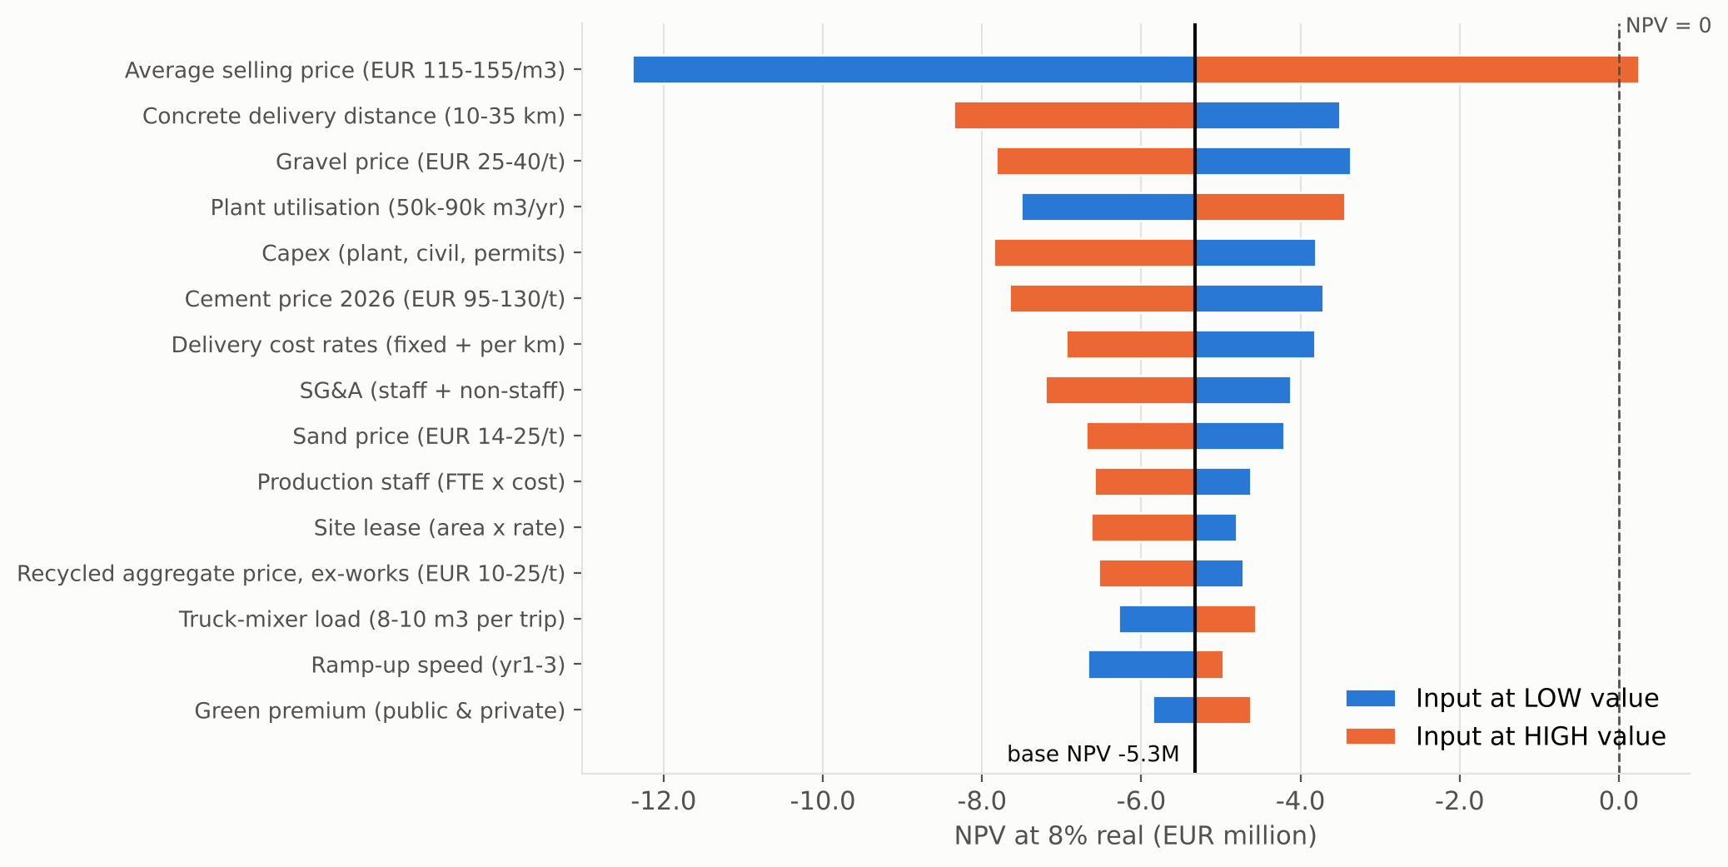
Selling price is the only single input that lifts NPV above zero; the green levers barely move it
NPV at 8% real (€ million) when one input moves to its low (blue) or high (orange) value.
+€0.25M
NPV at €155/m³: the only single change above zero
€1.2M
total swing from the green premium (0% to 3%)
−€7.1M
NPV at €130/m³; the price risk points down
Source: model/results.json → sensitivity (one input group at a time, low / high column of inputs.csv); chart deck/charts/tornado_npv.png. Price base €135/m³ has confidence L (A-MKT-16).
10
Notes:
We moved each input to its low and high value, one at a time. Selling price dominates. At 155 euro per cubic metre, 15% above base, NPV just reaches plus 0.25 million. No other single change gets above zero. Delivery distance, gravel price, utilisation, capex and cement price each move NPV by about 4 to 5 million, but all stay negative. The two circular levers matter little. The green premium from 0 to 3% swings NPV by only 1.2 million. The whole ETS and CBAM carbon path swings it by 0.45 million, because competitors pay the same carbon cost. And the price risk points down, not up. Our 135 euro base sits at or above the market average. At 130 euro, NPV is minus 7.1 million. Source: model sensitivity, A-MKT-16.

Slide 11
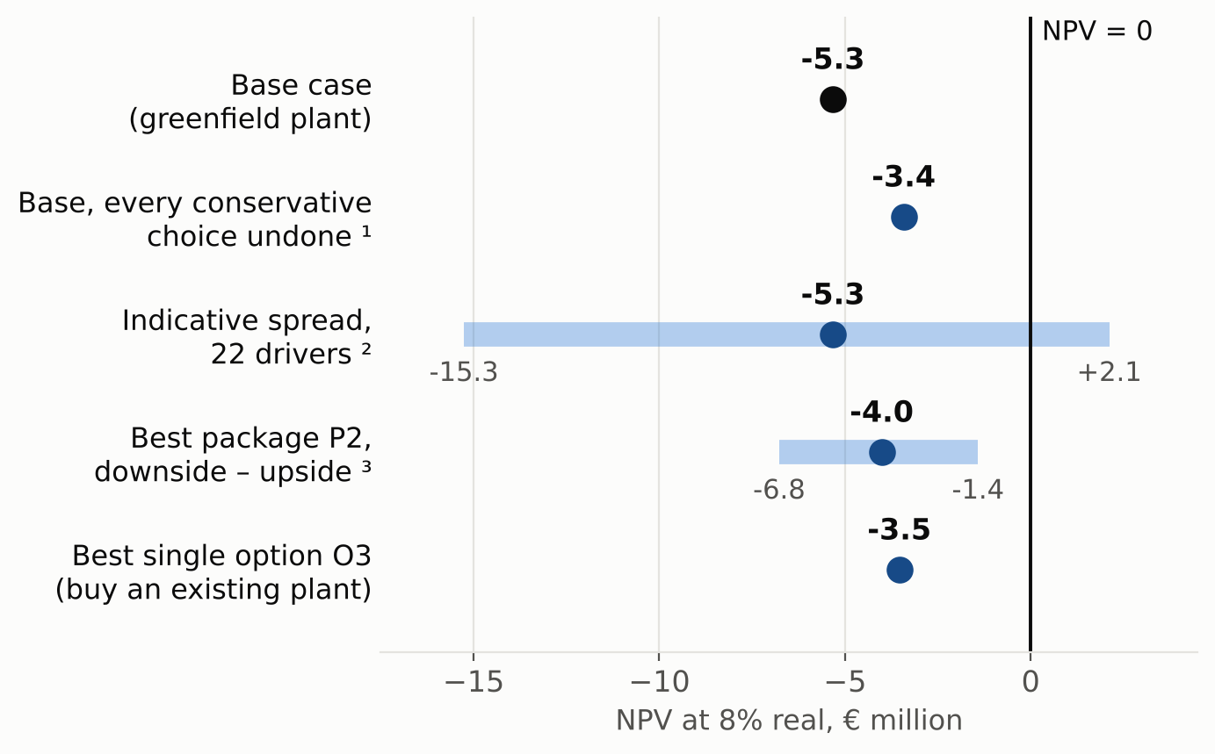
The base case fails three of the four viability tests that we fixed before modelling
# | Test (fixed in plan.md before results) | Base case | Result
1 | NPV > 0 at 8% real | −€5.33M | FAIL
2 | Payback < 7 years | not reached | FAIL
3 | EBITDA > 0 by 3rd operating year | +€0.32M (2030) | PASS, narrowly
4 | NPV > 0 with ≥ 2 of 6 drivers at pessimistic value | 0 of 6 | FAIL
Realistic NPV range, € million
Borderline band: NPV between −10% and 0% of capex. We are at −97%.
Sources: plan.md §2.1; model/results.json; results_options.json. ¹ 100% price pass-through, book-value salvage, working capital released. ² Base ± root-sum-square. ³ Stacked inputs.
11
Notes:
We wrote these four tests into our plan before any result existed, and we did not change them. NPV is negative, so test 1 fails. There is no payback within ten years, so test 2 fails. EBITDA is positive in the third operating year, but only just, so test 3 passes narrowly. Test 4 asks for a positive NPV with at least two of six main drivers at their pessimistic value. We get zero of six. NPV is minus 97% of capex, far outside the borderline band of minus 10% to zero. The right-hand chart shows the realistic range. Every point estimate is below zero. Only the top end of a rough, indicative spread crosses zero. The spread treats drivers as independent, so it is not a probability. Sources: plan.md, model results.

Slide 12
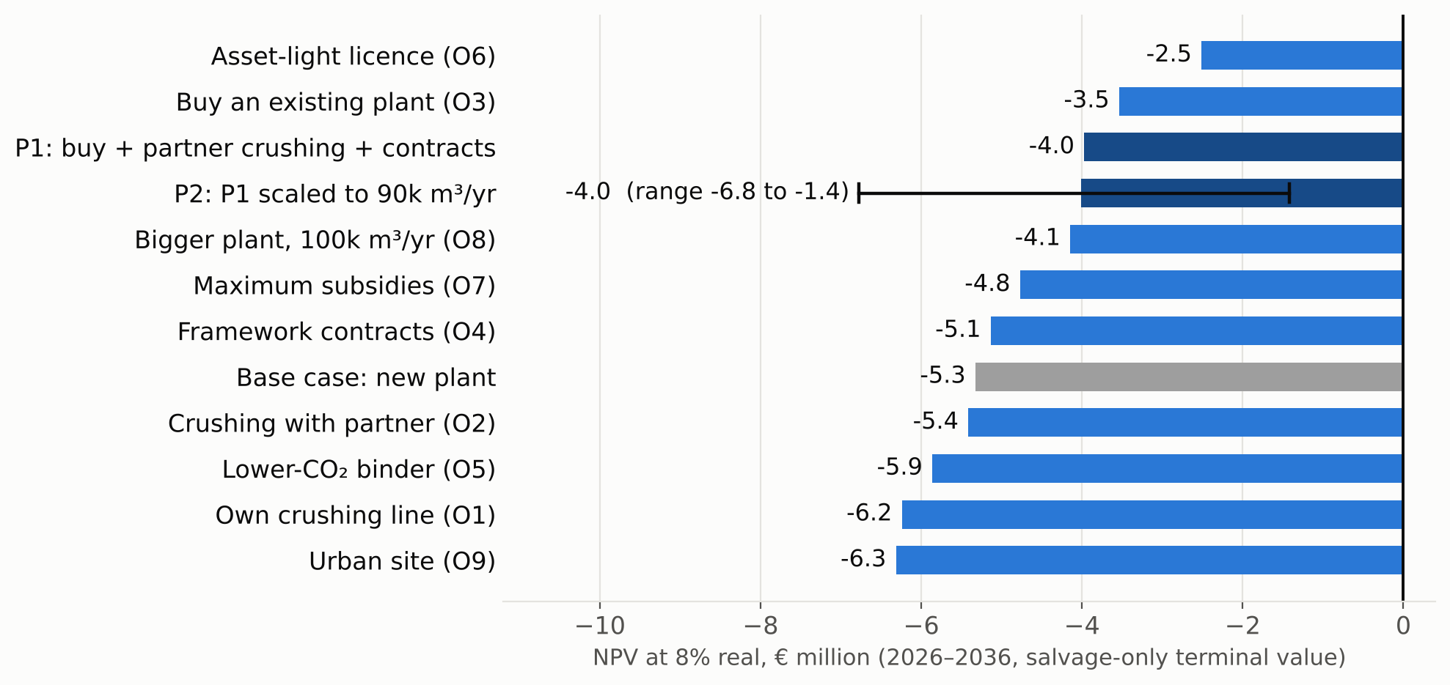
We tested ten options and two packages in the model, and every one has a negative NPV
NPV at 8% real per option, € million. Grey = base case; dark blue = packages.
−€3.5M
best plant route: buy an existing plant (O3)
−€4.0M
best package (P2),
range −€6.8M to −€1.4M
0 of 12
options that pass the robustness test
Source: model/results_options.json; research/viability_options.md §2, §4 (same numbers as model/charts/options_npv.png, shorter labels). P2 range = stacked downside / upside inputs.
12
Notes:
We did not stop at no. We tested ten single options and two packages in the same model. All have a negative NPV, between minus 2.5 and minus 6.3 million euro, and none passes the robustness test. Asset-light licensing loses least only because it invests almost nothing; its EBITDA never turns positive. The best plant route is buying an existing plant instead of building one: minus 3.5 million. Our best package, P2, buys a plant, crushes rubble with a demolition partner, signs framework contracts and scales to 90,000 cubic metres. That is a stack of favourable inputs, not a likely case. It gives minus 4.0 million, with a range of minus 6.8 to minus 1.4 million. The green levers, such as a lower-CO₂ binder, lose money. Source: results_options.json, viability_options.md.

Slide 13
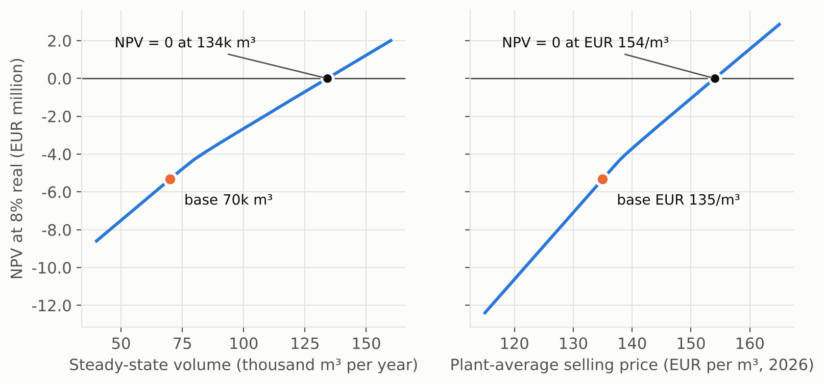
Reaching NPV = 0 would need conditions that the Dutch market does not offer today
NPV at 8% real (€ million) against volume and price; other inputs at base.
NPV = 0 would need | Today / base
134k m³ a year (+92%) | 70k base; average plant 33.7k
€154/m³ average price (+14%) | €135, likely at or above market
58.5% public green premium | 1.5% assumed (0–3%)
Gate fee ≈ €30/t (best package P2) | €0–1/t for clean rubble in bulk
A policy rescue | Aggregate levy: no level works; faster ETS: hurts
Source: model/results.json → extras; results_options.json → P2 stack and policy tests; gate-fee evidence market.md (MKT-20); chart deck/charts/breakeven.png (other inputs at base).
13
Notes:
What would have to be true for NPV to reach zero? Taking one condition at a time: volume of 134,000 cubic metres a year, almost four times an average Dutch plant. Or an average price of 154 euro, 14% above our base, which is already at or above the market. Or a public green premium of 58.5%, against 1.5% assumed. For our best package the key is the gate fee, the fee a demolition firm pays us to take clean rubble. NPV zero needs about 30 euro a tonne on base terms, or 15 euro if everything else goes our way. Bulk evidence today is 0 to 1 euro. Policy does not close the gap: a levy on primary aggregates hits us as much as competitors, and a faster ETS phase-out hurts. Sources: model extras, results_options.json, MKT-20.

Slide 14
Our ask: no investment now, only a €50–100k due-diligence phase with hard stop rules
Gate A — plant
Gate B — rubble (hard gate)
Gate C — volume
A waterside ready-mix plant in Zuid-Holland for ≤ €2.5M, with space and a permit route for rubble; expansion quote ≤ €1.0M.
A 7–10-year contract with a gate fee and steel split that give NPV ≥ 0 (≈ €15–30/t). Evidence today: €0–1/t.
Framework or offtake contracts for ≥ 40k m³ a year with civil-works contractors or public clients, signed before any purchase.
Status: untested
Status: likely fails on today's evidence
Status: untested
Stop rules
• Any gate fails → stop. The loss is capped at the €50–100k diligence budget.
• All gates pass → invest only if the model, re-run with the signed terms, passes all four tests.
• Never: a greenfield plant. Asset-light licensing only as a capped pilot (max €0.5M).
Sources: research/viability_options.md §7; value_proposition.md §6; review/response.md (M10). Gate B is expected to fail on today's evidence (MKT-20).
14
Notes:
Our recommendation follows the evidence. Do not build a greenfield plant. No route is investable today. The integrated acquisition route comes closest, so it is worth a small due-diligence phase of 50 to 100 thousand euro, not an investment. It tests three gates by the second quarter of 2027. Gate A: a waterside plant for 2.5 million euro or less. Gate B, the hard gate: a seven to ten year rubble contract with a gate fee and steel split that bring NPV to zero or above. Gate C: framework contracts for at least 40,000 cubic metres a year. If any gate fails, we stop, and the loss is capped at the diligence budget. Even if all pass, we invest only if the re-run model passes all four tests. On today's evidence, gate B fails.

Slide 15
Appendix: the key assumptions behind these numbers, and how sure we are
Input | Base (low–high) | Label, ID | Conf.
Average selling price, delivered | €135/m³ (115–155) | ESTIMATE, A-MKT-16 | L
Steady-state volume; ramp 2028/29/30 | 70k m³; 50/79/100% | ESTIMATE, A-CST-01 | L
Capex: plant + civil + permits | €5.5M (4.0–8.0) | ESTIMATE, A-CST-02 | L
Cement CEM III/B; carbon pass-through | €110/t (95–130); 85% | ESTIMATE; judgement A-POL-09 | M / L
Concrete price pass-through of binder cost | 80% | Judgement call, A-CST-13 | L
Recycled aggregate delivered vs gravel | €24.5/t vs €32/t | ESTIMATE, price_breakdown §3 | M
Delivery cost (9 m³ loads, 20 km) | €21.1/m³ | ESTIMATE, A-TEC-28, A-FIX-02 | M
Public green premium (private 0%) | 1.5% (0–3%) | ASSUMPTION, A-FIX-03 | L
Discount rate; terminal value | 8% real; salvage 25% | Client choice, plan.md §2 | –
Gate fee for clean rubble (bulk) | €1/t (0–10) | ESTIMATE, A-MKT-15, MKT-20 | L
Full lists: research/assumptions.md, research/sources.md, model/inputs.csv. Labels: VERIFIED = source read; ESTIMATE = derived; ASSUMPTION = no source. Confidence H / M / L.
15
Notes:
This appendix lists the inputs that matter most, with their labels. The selling price of 135 euro per cubic metre is the most important and the least certain input: confidence low, and the error probably points down. Capex and the ramp-up have no vendor quote. The two pass-through rates are judgement calls without a source. For completeness: the model also has stress bounds where every input goes wrong or right at the same time, minus 35.5 and plus 24.5 million euro. These are not likely cases, so we do not use them in the pitch. The interviews that would change our view fastest are bulk gate fees for clean rubble, prices paid for small ready-mix plants, and real project prices by strength class. Sources: assumptions.md, inputs.csv, model_summary.md.

