Slide 1


Beyond Win, Draw and Loss: A Comparative Study of Count Regression Models for English Premier League Football Score Prediction
Department of Mathematical Sciences
School of Basic and Applied Sciences
Adamas University
Presented By
MASUMA KHATUN
M.Sc. Tech (Statistics and Data Science)
Registration No: AU/2024/0003218
Roll No: PG/SOBAS/12/24/003
Supervisors: Dr. Tathagata Mandal & Mr. Sambaran Saha

Slide 2
Outline
01
Introduction
06
Methodology
02
Research Objectives
07
Results of Three Models
03
Data Description & Summary Statistics
08
Comparative Analysis of the Three Models
04
Literature Review
09
Discussion & Conclusion
05
Motivation of the Research
10
Reference

Slide 3
Introduction
Football analytics has emerged as an important application area of statistical modelling due to the increasing availability of sports data.
Predicting football scores is challenging because match outcomes are influenced by factors such as team performance, home advantage, tactics, and uncertainty.
Since goals are discrete count data, count regression models such as Poisson and Negative Binomial Regression provide suitable frameworks for score prediction.
Traditional models often ignore overdispersion and the dependency between home and away team scores, motivating the use of more advanced models like Bivariate Poisson Regression.
This study aims to predict actual goal counts in English Premier League (EPL) matches and compare the performance of Poisson, Negative Binomial, and Bivariate Poisson Regression models.
Challenges in Football Score Prediction
Uncertainty in match outcomes
Influence of home advantage
Presence of overdispersion in goal counts
Dependence between home and away scores
Selection of an appropriate prediction model
Why Football Score Prediction Matters?
The growing availability of football data has created opportunities for applying advanced statistical models to improve score prediction and decision making in sports analytics

Slide 4

Research Objectives
To apply Poisson Regression and Negative Binomial Regression separately for home and away goal prediction.
To apply a Bivariate Poisson Regression model for jointly modelling home and away team goal counts.
To compare the performances of Poisson Regression, Negative Binomial Regression, and Bivariate Poisson Regression models using different statistical evaluation measures.
EPL Match Data (Last 10 Seasons)
Data Preprocessing
Poisson, NB, Bivariate Poisson Regression Model
Goal Prediction
Model Comparison

Slide 5
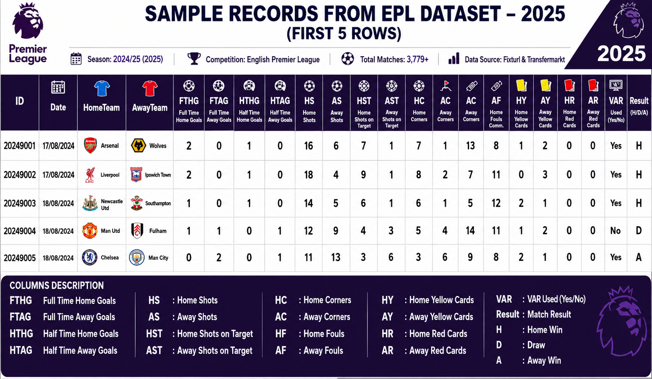
Data Description & Summary Statistics
10
3770
1.55
EPL
Seasons
Matches
Analysed
Avg Home
Goals/Match
1.28
1.74
1.46
Avg Away
Goals/Match
Variance Home
Goals/Match
Variance Away
Goals/Match
⚠ Overdispersion Detected: Variance of Goals > Mean

Slide 6
Literature Review
[1982] Maher [1]
[2015] Koopman & Lit [7]
Applied Poisson distribution for modelling football scores and team strengths.
Dynamic bivariate Poisson models for football prediction.
[1997] Dixon & Coles [2]
[2018] Boshnakov et al. [8]
Modified Poisson model for football match prediction and betting markets.
Evaluated different statistical models for football score prediction.
[2001 & 2003] Karlis & Ntzoufras [4][5]
[2021] Hubáček et al. [9]
Introduced Bivariate Poisson model for football scores and Bayesian analysis of football outcomes using Bivariate Poisson models..
Football outcome prediction using machine learning and statistical models.

Slide 7
Motivation of the Research
Football is inherently a low-scoring sport, where even a single goal can significantly influence the final match outcome.
⚽
Number of Goals is a discrete and nonnegative count variables, count regression models provide an appropriate statistical framework for modelling football scores.
⚽
Most existing studies focus primarily on predicting match outcomes (Win/Draw/Loss), often overlooking the underlying goal-scoring process.
⚽
This study emphasizes the prediction of actual home and away goal counts, from which match outcomes can subsequently be derived.
⚽
Accurate modelling of goal counts can provide deeper insights into team performance and improve the reliability of football score prediction.
⚽

Slide 8
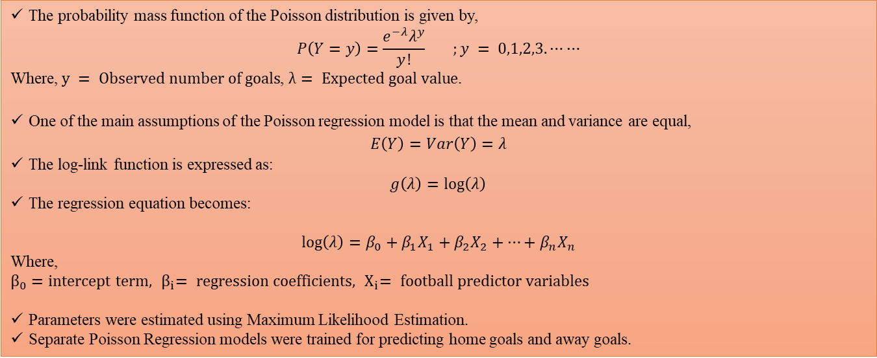
Methodology — Poisson Regression
Poisson Regression was employed as the baseline count regression model to predict the number of goals scored in EPL matches. The model assumes that the response variable follows a Poisson distribution, where the mean and variance are equal.
The probability mass function of the Poisson distribution is given by,
$$P\left(Y=y\right)=\frac{e^{−λ}λ^{y}}{y!} ;y = 0,1,2,3.⋯⋯$$
Where, $y = Observed number of goals$, $λ= Expected goal value$.
One of the main assumptions of the Poisson regression model is that the mean and variance are equal,
$$E\left(Y\right)=Var\left(Y\right)=λ$$
The log-link function is expressed as:
$$g\left(λ\right)=\log\left(λ\right)$$
The regression equation becomes:
$$\log\left(λ\right)=β_{0}+β_{1}X_{1}+β_{2}X_{2}+…+β_{n}X_{n}$$
Where,
$$β_{0}=intercept term, { β}_{i}= regression coefficients, { X}_{i}= football predictor variables$$
Parameters were estimated using Maximum Likelihood Estimation.
Separate Poisson Regression models were trained for predicting home goals and away goals.

Slide 9
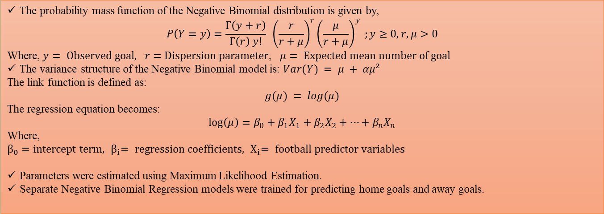
Methodology — Negative Binomial Regression
Since football goal data may exhibit overdispersion, the Negative Binomial Regression model was used as an extension of the Poisson model. It incorporates an additional dispersion parameter to account for variability exceeding the mean.
The probability mass function of the Negative Binomial distribution is given by,
$$P\left(Y=y\right)=\frac{Γ\left(y+r\right)}{Γ\left(r\right) y!} {\left(\frac{r}{r+μ}\right)}^{r}{\left(\frac{μ}{r+μ}\right)}^{y} ;y≥0, r,μ>0$$
Where, $y= Observed goal, r=Dispersion parameter$, $μ= Expected mean number of goal$
The variance structure of the Negative Binomial model is: $Var(Y) = μ + αμ²$
The link function is defined as:
$$g(μ) = log(μ)$$
The regression equation becomes:
$$\log\left(μ\right)=β_{0}+β_{1}X_{1}+β_{2}X_{2}+…+β_{n}X_{n}$$
Where,
$$β_{0}=intercept term, { β}_{i}= regression coefficients, { X}_{i}= football predictor variables$$
Parameters were estimated using Maximum Likelihood Estimation.
Separate Negative Binomial Regression models were trained for predicting home goals and away goals.

Slide 10
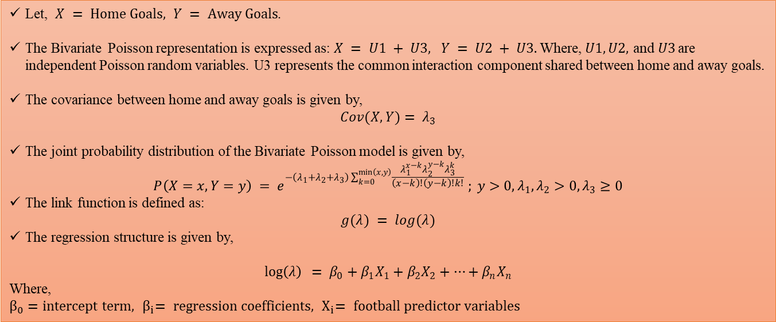
Methodology — Bivariate Poisson Regression
The Bivariate Poisson Regression model was used to jointly analyse home and away team goals. By capturing the dependence between the two goal counts, it provides a more realistic framework for modelling football match outcomes.
Let, $X = Home Goals, Y = Away Goals$.
The Bivariate Poisson representation is expressed as: $X = U1 + U3, Y = U2 + U3.$Where, $U1, U2,$ and$U3$ are independent Poisson random variables. U3 represents the common interaction component shared between home and away goals.
The covariance between home and away goals is given by,
$$Cov(X,Y)= λ_{3}$$
The joint probability distribution of the Bivariate Poisson model is given by,
$$P\left(X=x,Y=y\right) = e^{−\left(λ_{1}​+λ_{2}​+λ_{3}​\right)\sum_{k=0}^{\min\left(x,y\right)​}{\frac{λ_{1}^{x−k}λ_{2}^{y−k}λ_{3}^{k}}{\left(x−k\right)!\left(y−k\right)!k!}}} ; y>0,λ_{1},λ_{2}>0, λ_{3}≥0$$
The link function is defined as:
$$g(λ) = log(λ)$$
The regression structure is given by,
$$\log\left(λ\right) = β_{0}+β_{1}X_{1}+β_{2}X_{2}+…+β_{n}X_{n}$$
Where,
$$β_{0}=intercept term, { β}_{i}= regression coefficients, { X}_{i}= football predictor variables$$

Slide 11
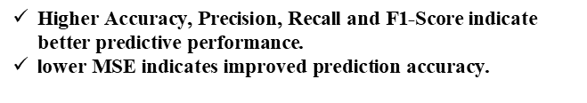
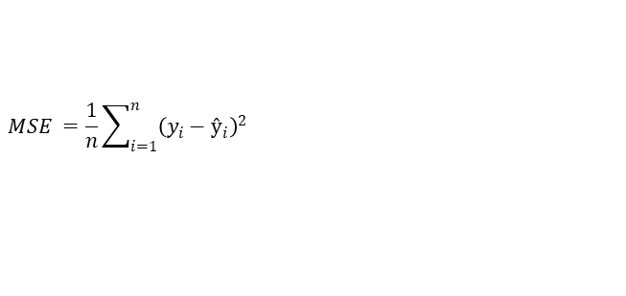
Model Evaluation Metrics
Accuracy
F1-Score
$$Accuracy=\frac{\left(TP+TN\right)}{\left(TP+TN+FP+FN\right)}$$
$$F1 = 2 × [(Precision × Recall) / (Precision + Recall)]$$
Proportion of correctly classified outcomes
Harmonic Mean of Precision & Recall
Precision
MSE
MSE
$$Precision=\frac{TP}{\left(TP+FP\right)}$$
1/n Σ(yᵢ - ŷᵢ)²
$$MSE =\frac{1}{n}\sum_{i=1}^{n}{{\left(y_{i}−ŷ_{i}\right)}^{2}}$$
Proportion of predicted positives that are correct
Average squared goal-count error
Average squared difference between observed and predicted goals
MSE
Recall
Interpretation
$$Recall=\frac{TP}{\left(TP+FN\right)}$$
1/n Σ(yᵢ - ŷᵢ)²
$\text{Higher} \text{Accuracy}\text{, }\text{Precision}\text{, }\text{Recall} \text{and} \text{F}\text{1−}\text{Score} \text{indicate} \text{better} \text{predictive} \text{performance}$.
$\text{lower} \text{MSE} \text{indicates} \text{improved} \text{prediction} \text{accuracy}\text{.}$
Proportion of actual positives correctly identified
Average squared goal-count error

Slide 12
Results — Poisson Regression
Parameter Estimates of Poisson Regression Model for Home Team Goals
Parameter Estimates of Poisson Regression Model for Away Team Goals
Variable | Coef. | Std. Err. | z-value | p-value
HomeShots | 0.038 | 0.017 | 2.24 | 0.025*
AwayShots | -0.024 | 0.016 | -1.5 | 0.134
HomeShotsOnTarget | 0.246 | 0.018 | 13.67 | 0.000*
AwayShotsOnTarget | -0.043 | 0.02 | -2.15 | 0.032*
HomeCorners | 0.031 | 0.015 | 2.07 | 0.038*
AwayCorners | -0.018 | 0.015 | -1.2 | 0.230
HomeFouls | -0.006 | 0.013 | -0.46 | 0.646
AwayFouls | 0.019 | 0.014 | 1.36 | 0.174
HomeYellowCards | -0.034 | 0.015 | -2.27 | 0.023*
AwayYellowCards | 0.026 | 0.014 | 1.86 | 0.063
HomeRedCards | -0.071 | 0.028 | -2.54 | 0.011*
AwayRedCards | 0.049 | 0.027 | 1.81 | 0.070*
HomeAge | 0.009 | 0.013 | 0.69 | 0.490
AwayAge | -0.011 | 0.013 | -0.85 | 0.395
VARUsed | -0.018 | 0.012 | -1.5 | 0.134
Variable | Coef. | Std. Err. | z-value | p-value
HomeShots | -0.018 | 0.016 | -1.13 | 0.258
AwayShots | 0.041 | 0.018 | 2.28 | 0.023*
HomeShotsOnTarget | -0.052 | 0.02 | -2.6 | 0.009*
AwayShotsOnTarget | 0.258 | 0.019 | 13.58 | 0.000*
HomeCorners | -0.016 | 0.015 | -1.07 | 0.285
AwayCorners | 0.034 | 0.015 | 2.27 | 0.023*
HomeFouls | 0.017 | 0.014 | 1.21 | 0.226
AwayFouls | -0.012 | 0.013 | -0.92 | 0.358
HomeYellowCards | 0.028 | 0.014 | 2 | 0.045*
AwayYellowCards | -0.031 | 0.015 | -2.07 | 0.038*
HomeRedCards | 0.063 | 0.027 | 2.33 | 0.020*
AwayRedCards | -0.068 | 0.028 | -2.43 | 0.015*
HomeAge | 0.006 | 0.013 | 0.46 | 0.646
AwayAge | -0.007 | 0.013 | -0.54 | 0.589
VARUsed | 0.015 | 0.012 | 1.25 | 0.211
Shots on Target is the strongest predictor of goals for both teams, while disciplinary factors such as yellow and red cards also show a significant negative impact on goal scoring performance.

Slide 13
Results — Poisson Regression
Confusion Matrix
69.99%
 | Predicted: Home | Predicted: Draw | Predicted: Away
Actual: Home | 1500 | 80 | 100
Actual: Draw | 400 | 240 | 241
Actual: Away | 140 | 170 | 899
Accuracy
Per-Class Metrics
Class | Precision | Recall | F1-Score
Home | 0.74 | 0.89 | 0.81
Away | 0.73 | 0.74 | 0.73
Draw | 0.49 | 0.27 | 0.35
Weighted Avg | 0.68 | 0.70 | 0.68

Slide 14
Results — Negative Binomial Regression
Parameter Estimates of Negative Binomial Regression Model for Home Team Goals
Parameter Estimates of Negative Binomial Regression Model for Away Team Goals
Variable | Coef. | Std. Err. | z-value | p-value
HomeShots | 0.028 | 0.019 | 1.47 | 0.141
AwayShots | -0.031 | 0.02 | -1.55 | 0.121
HomeShotsOnTarget | 0.341 | 0.029 | 11.76 | 0.000*
AwayShotsOnTarget | -0.046 | 0.022 | -2.09 | 0.037*
HomeCorners | 0.043 | 0.018 | 2.39 | 0.017*
AwayCorners | -0.016 | 0.018 | -0.89 | 0.374
HomeFouls | -0.009 | 0.017 | -0.53 | 0.596
AwayFouls | 0.012 | 0.017 | 0.71 | 0.479
HomeYellowCards | -0.037 | 0.018 | -2.06 | 0.039*
AwayYellowCards | 0.018 | 0.018 | 1 | 0.317
HomeRedCards | -0.081 | 0.033 | -2.45 | 0.014*
AwayRedCards | 0.052 | 0.031 | 1.68 | 0.093
HomeAge | 0.021 | 0.018 | 1.17 | 0.242
AwayAge | -0.01 | 0.018 | -0.56 | 0.576
VARUsed | -0.014 | 0.017 | -0.82 | 0.413
Variable | Coef. | Std. Err. | z-value | p-value
HomeShots | -0.019 | 0.02 | -0.95 | 0.341
AwayShots | 0.039 | 0.019 | 2.05 | 0.040*
HomeShotsOnTarget | -0.051 | 0.023 | -2.22 | 0.026*
AwayShotsOnTarget | 0.352 | 0.03 | 11.73 | 0.000*
HomeCorners | 0.014 | 0.018 | 0.78 | 0.437
AwayCorners | 0.041 | 0.018 | 2.28 | 0.023*
HomeFouls | -0.012 | 0.017 | -0.71 | 0.477
AwayFouls | -0.009 | 0.017 | -0.53 | 0.596
HomeYellowCards | 0.029 | 0.018 | 1.61 | 0.108
AwayYellowCards | -0.036 | 0.018 | -2 | 0.046*
HomeRedCards | 0.068 | 0.031 | 2.19 | 0.029*
AwayRedCards | -0.082 | 0.033 | -2.48 | 0.013*
HomeAge | -0.009 | 0.018 | -0.5 | 0.617
AwayAge | -0.006 | 0.018 | -0.33 | 0.742
VARUsed | 0.011 | 0.017 | 0.65 | 0.516
Similar to the Poisson model, Shots on Target remains the strongest predictor of goals, while yellow and red cards negatively influence team scoring performance, highlighting the role of both attacking efficiency and discipline.

Slide 15
Results — Negative Binomial Regression
78.73%
 | Predicted: Home | Predicted: Draw | Predicted: Away
Actual: Home | 1550 | 60 | 70
Actual: Draw | 220 | 470 | 191
Actual: Away | 110 | 140 | 959
Best Accuracy
Per-Class Metrics
Class | Precision | Recall | F1-Score
Home | 0.82 | 0.92 | 0.87
Away | 0.79 | 0.79 | 0.79
Draw | 0.70 | 0.53 | 0.60
Weighted Avg | 0.79 | 0.79 | 0.78

Slide 16
Results — Bivariate Poisson Regression
Parameter Estimates of Bivariate Poisson Regression Model for Home Team Goals
Parameter Estimates of Bivariate Poisson Regression Model for Away Team Goals
Variable | Coef. | Std. Err. | z-value | p-value
HomeShots | 0.024 | 0.017 | 1.41 | 0.158
AwayShots | -0.031 | 0.018 | -1.72 | 0.085
HomeShotsOnTarget | 0.186 | 0.014 | 13.29 | 0.000*
AwayShotsOnTarget | 0.061 | 0.016 | 3.81 | 0.000*
HomeCorners | -0.049 | 0.015 | -3.27 | 0.001*
AwayCorners | 0.016 | 0.016 | 1 | 0.317
HomeFouls | -0.001 | 0.014 | -0.07 | 0.944
AwayFouls | 0.007 | 0.014 | 0.5 | 0.617
HomeYellowCards | -0.016 | 0.011 | -1.45 | 0.147
AwayYellowCards | -0.006 | 0.011 | -0.55 | 0.582
HomeRedCards | -0.022 | 0.015 | -1.47 | 0.142
AwayRedCards | 0.016 | 0.012 | 1.33 | 0.184
HomeAge | 0.017 | 0.014 | 1.21 | 0.226
AwayAge | -0.013 | 0.014 | -0.93 | 0.352
VARUsed | -0.011 | 0.014 | -0.79 | 0.430
ShotDiff | 0.008 | 0.01 | 0.8 | 0.424
TargetDiff | 0.083 | 0.008 | 10.38 | 0.000*
PressureRatio | 0.002 | 0.01 | 0.2 | 0.842
CardDiff | 0.007 | 0.008 | 0.88 | 0.379
Variable | Coef. | Std. Err. | z-value | p-value
HomeShots | 0.001 | 0.02 | 0.05 | 0.96
AwayShots | 0.037 | 0.02 | 1.85 | 0.064
HomeShotsOnTarget | 0.052 | 0.016 | 3.25 | 0.001*
AwayShotsOnTarget | 0.214 | 0.016 | 13.38 | 0.000*
HomeCorners | 0.021 | 0.017 | 1.24 | 0.214
AwayCorners | -0.049 | 0.017 | -2.88 | 0.004*
HomeFouls | -0.014 | 0.016 | -0.88 | 0.378
AwayFouls | -0.009 | 0.015 | -0.6 | 0.549
HomeYellowCards | 0.025 | 0.011 | 2.27 | 0.023*
AwayYellowCards | 0.028 | 0.011 | 2.55 | 0.011*
HomeRedCards | 0.02 | 0.012 | 1.67 | 0.095
AwayRedCards | -0.031 | 0.016 | -1.94 | 0.052*
HomeAge | 0.001 | 0.015 | 0.07 | 0.944
AwayAge | -0.007 | 0.015 | -0.47 | 0.639
VARUsed | -0.003 | 0.016 | -0.19 | 0.849
ShotDiff | -0.003 | 0.01 | -0.3 | 0.764
TargetDiff | -0.076 | 0.008 | -9.5 | 0.000*
PressureRatio | -0.006 | 0.024 | -0.25 | 0.803
CardDiff | 0.002 | 0.008 | 0.25 | 0.803

Slide 17
Results — Bivariate Poisson Regression
75.33%
 | Predicted: Home | Predicted: Draw | Predicted: Away
Actual: Home | 885 | 155 | 169
Actual: Draw | 175 | 510 | 196
Actual: Away | 110 | 125 | 1445
Accuracy
Per-Class Metrics
Class | Precision | Recall | F1-Score
Home | 0.79 | 0.84 | 0.81
Away | 0.76 | 0.73 | 0.74
Draw | 0.61 | 0.58 | 0.59
Weighted Avg | 0.75 | 0.75 | 0.74

Slide 18
Comparative Analysis of the Three Models
78.73%
75.33%
69.99%
Accuracy
Poisson
Regression
Negative
Binomial
Bivariate
Poisson
Criteria | Poisson | Negetive Binomial ★ | Bivariate Poisson
Handles Overdispersion | ✖ No | ✔ Yes | Partially
Uses Interaction Features | No | No | Yes
Accuracy (%) | 69.99 | 78.73 | 75.33
Precision / Recall / F1 | 0.68 / 0.70 / 0.68 | 0.79 / 0.79 / 0.78 | 0.75 / 0.75 / 0.74

Slide 19
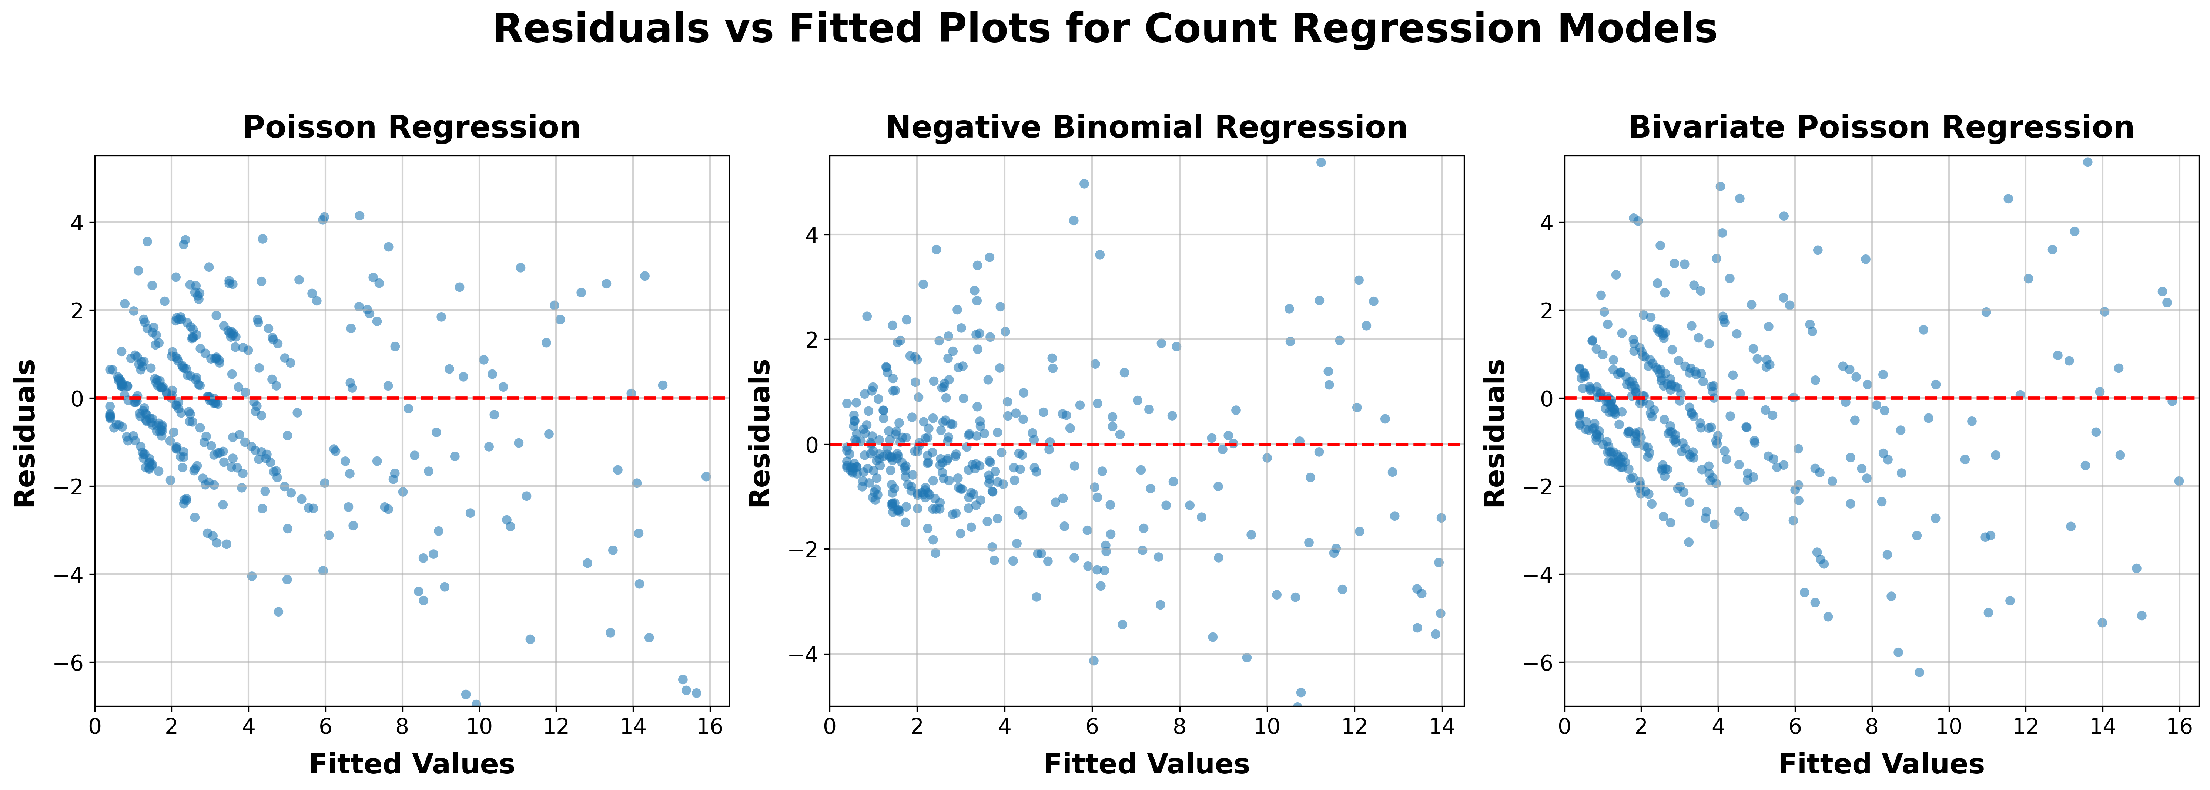
Residual Analysis of the Three Models
Residuals are generally cantered around the zero line for all three models, indicating an overall satisfactory fit to the observed goal data.
The Negative Binomial Regression model exhibits a comparatively more balanced and stable residual distribution, with less pronounced systematic deviation than the Poisson and Bivariate Poisson models.
This suggests that the Negative Binomial model is more effective in capturing the variability present in goal counts.

Slide 20
Discussion & Conclusion
Negative Binomial Regression achieved the highest predictive accuracy (78.73%), indicating that accounting for overdispersion significantly improves football score prediction.
⚽
Bivariate Poisson Regression obtained an accuracy of (75.33%), demonstrating that modelling the dependence between home and away goals can enhance prediction performance, although the improvement was lower than that of the Negative Binomial model.
⚽
Standard Poisson Regression showed the lowest accuracy (69.99%), suggesting that the equidispersion assumption is not suitable for EPL goal data.
⚽
Match outcomes were derived from predicted goal counts, allowing the models to provide both score predictions and outcome predictions, which offer richer insights than direct classification approaches.
⚽
The findings demonstrate that count regression models provide an effective statistical framework for football analytics and match forecasting.
⚽

Slide 21
Future Scope
Incorporate player level statistics such as player performance ratings, injuries, and team budgets.
⚽
Include temporal and dynamic factors such as managerial changes, transfer activities, and fixture congestion.
⚽
Extend the analysis to other major football leagues such as La Liga, Bundesliga, Serie A, and UEFA competitions.
⚽
Explore machine learning and deep learning models to get better forecasts.
⚽
Future studies may focus on predicting the chances of different match outcomes rather than only providing point predictions.
⚽

Slide 22
Reference
[1] Maher, M. J. (1982). Modelling association football scores. Statistica Neerlandica, 36(3), 109–118.
[2] Dixon, M. J., & Coles, S. G. (1997). Modelling association football scores and inefficiencies in the football betting market. Journal of the Royal Statistical Society: Series C (Applied Statistics), 46(2), 265–280.
[3] Rue, H., & Salvesen, Ø. (2000). Prediction and retrospective analysis of soccer matches in a league. Journal of the Royal Statistical Society: Series D (The Statistician), 49(3), 399–418.
[4] Karlis, D., & Ntzoufras, I. (2001). On modelling soccer data. Student, 4, 229–244.
[5] Karlis, D., & Ntzoufras, I. (2003). Analysis of sports data using bivariate Poisson models. Journal of the Royal Statistical Society: Series D (The Statistician), 52(3), 381–393.
[6] Joseph M. Hilbe (2011). Negative Binomial Regression (2nd ed.). Cambridge University Press.
[7] Koopman, S. J., & Lit, R. (2015). A dynamic bivariate Poisson model for analysing and forecasting match results in the English Premier League. Journal of the Royal Statistical Society: Series A (Statistics in Society), 178(1), 167–186.
[8] Boshnakov, G., Kharrat, T., & McHale, I. G. (2018). Predictive modelling of football scores using statistical methods. International Journal of Forecasting, 34(2), 339–350.
[9] Hubáček, O., Šourek, G., & Železný, F. (2021). Exploiting sports-betting market using machine learning. International Journal of Forecasting, 37(2), 783–796.
[10] https://fbref.com/en/comps/9/Premier-League-Stats

Slide 23

Reference

