Slide 1

Controller Config
TLG NDE
Python Project
Keith Matthews

Slide 2
Agenda
Personal introduction
Project Overview
Code Execution
Demonstration
Continuing development
Summary

Slide 3












Who am I?
3d printer
Robotics
Electronics
Boat project
Maker
Home lab
National Guard
Marine Corps

Slide 4
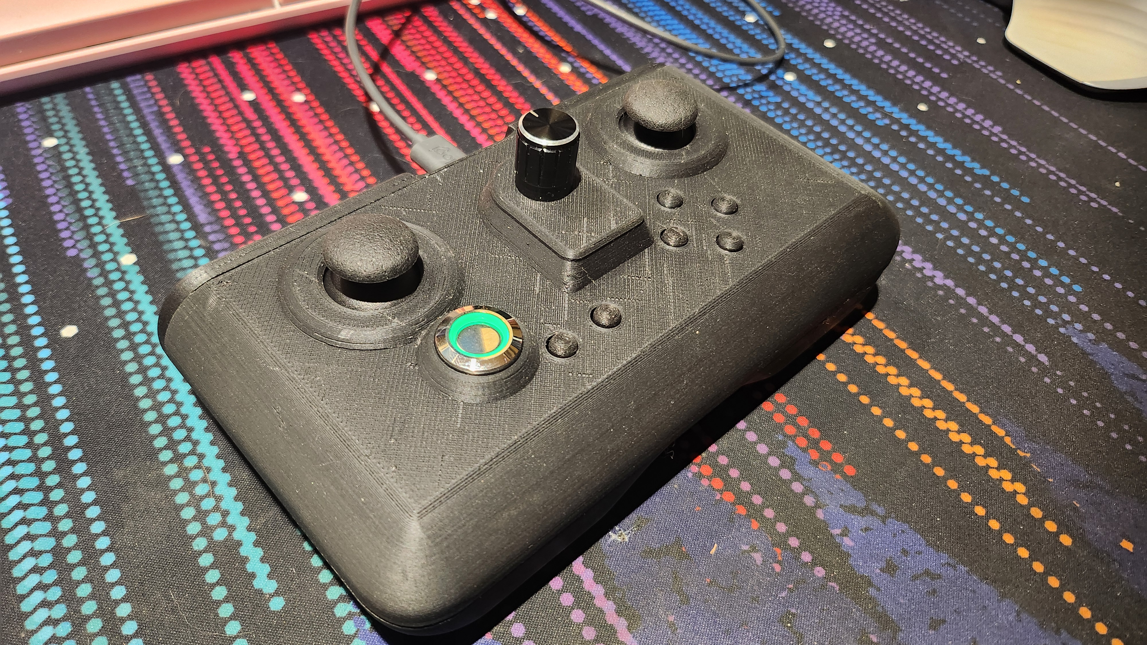
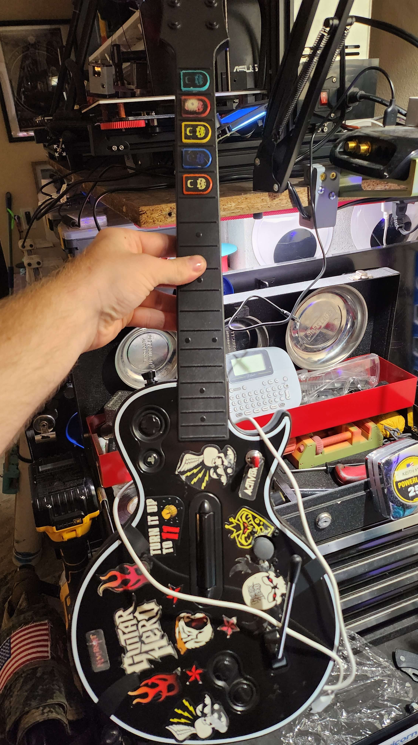
Project Overview
Why Game pads?
Joystick_XL
Previous builds
Project Scope
Circuit python image
Joystick_xl Github link

Slide 5
Code Breakdown
Functions!
What gets created
Customized from default

Slide 6
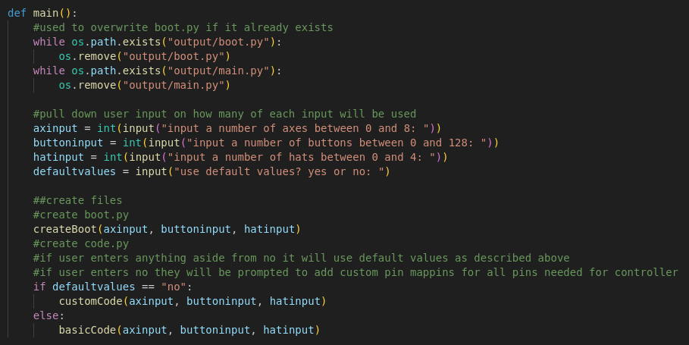
Main

Slide 7
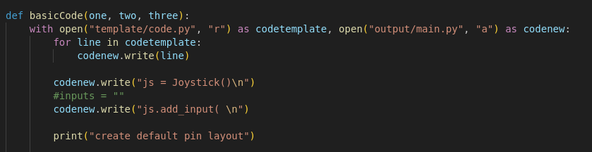
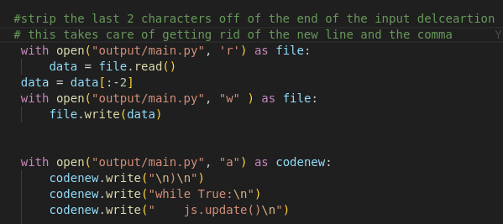

Slide 8
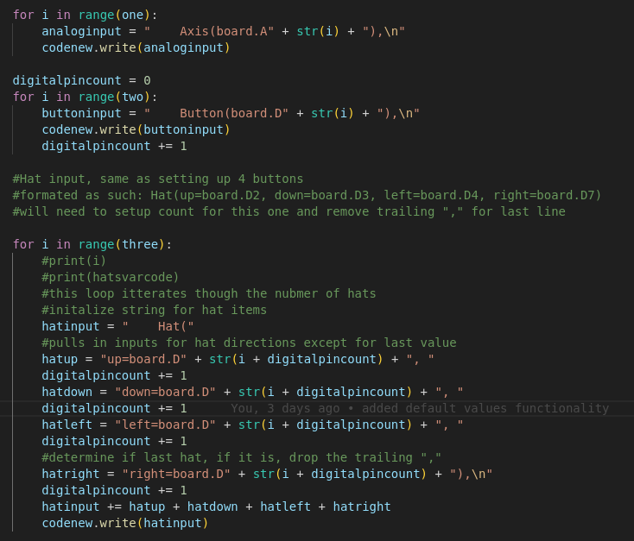

Slide 9
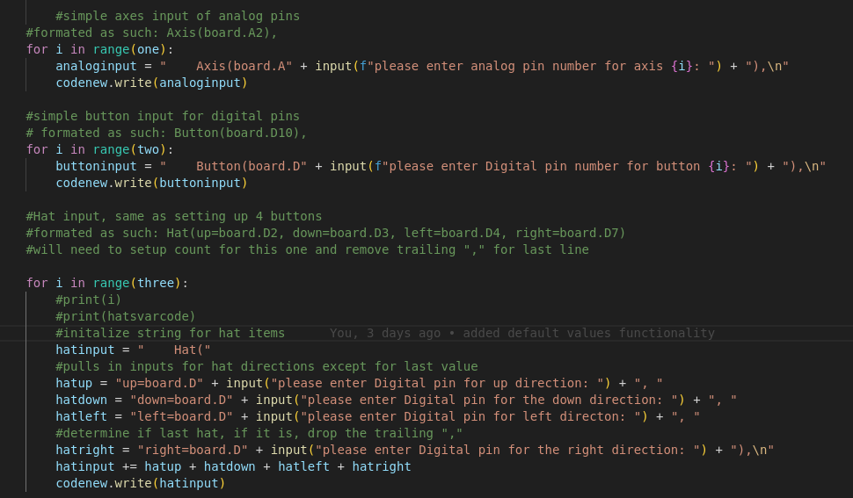

Slide 10
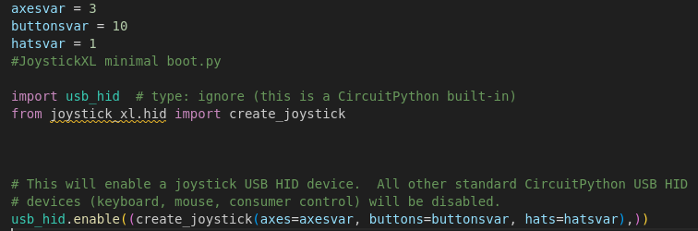
What gets created?

Slide 11
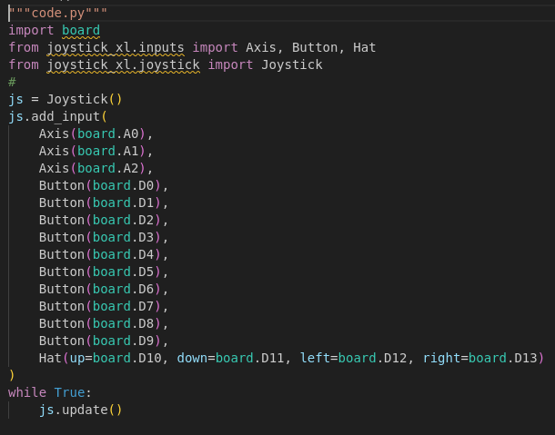

Slide 12
Demo time
How will this work?
Example running on Grand Central
Example of heavily customized code from previous controller

Slide 13
What next?
Future plans for this code
  build a flask app into a docker container for easy deployment of config app
  Import pin counts for any circuit python boards to correct for declaring nonresistant pins
  Board vs microcontroller.pin, additional input variables
building more game pads/flight sticks/ accessibility controls

Slide 14
Summary
Why did I choose this project?
If I had more time, what would I add?
What was the most challenging part?
Do I plan on continuing development?
Favorite part of learning python?

