Slide 1
Assessment of Toronto Crime through Exploratory Data Analysis and Classification
Katherine Ault
501092397

Slide 2

Presentation Contents
Introduction & Project Rationale
Research Questions
Project Approach
Exploratory Data Analysis
Feature Selection & SMOTE Oversampling
Training, Testing & Model Selection
Conclusions
Recommendations
Notes:
Image retrieved from: https://www.techrepublic.com/article/machine-learning-the-smart-persons-guide/

Slide 3

Introduction & Project Rationale
The potential use of predictive analytics in the field of crime analysis and forecasting first recognized in the 1990s.
‘Pre-Emptive Policing’ was recognized by Time Magazine as one of the 50 best inventions of 2011 (Grossman et al., 2011).
The availability of open crime datasets has allowed for the field of crime analysis and detection to expand; numerous studies conducted over the past decade on the application of machine learning models in crime prediction.
ML model results used to support evidence-based decisions by law enforcement agencies such as informing choices regarding resource allocation, deployment, divisional staffing, and patrol plans.
Notes:
Grossman, L., Thompson, M., Kluger, J., Park, A., Walsh, B., Suddath, C., Dodds, E., Webley, K., Rawlings, N., Sun, F., Brock-Abraham, C., and Carbone, N. (2011 Nov 28). The 50 Best Inventions. The year’s most inspired ideas, innovations and revolutions, from the microscopic to the stratospheric.

Slide 4

Research Questions
Toronto Major Crime Indicators Dataset (2014 – 2021): Primary Research Questions
Can major crime indicator categories be accurately predicted?
Which predictive model exhibits the most potential to forecast crime in Toronto?
Which Toronto neighbourhoods have the highest/lowest incidence of crime?
Are there recognizable temporal and spatial trends in overall crime and MCI categories?
Notes:
Image: https://www.freepik.com/

Slide 5
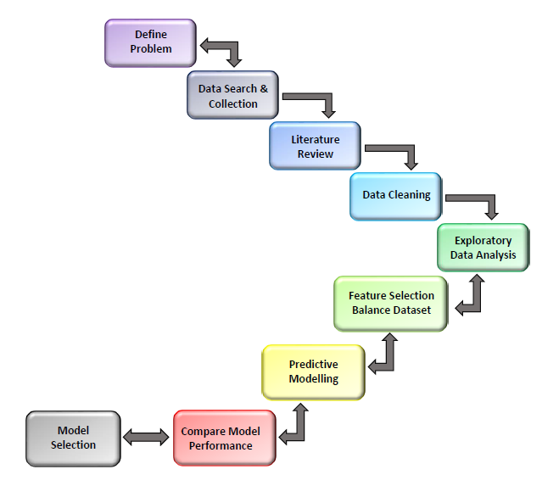
Project Approach

Slide 6
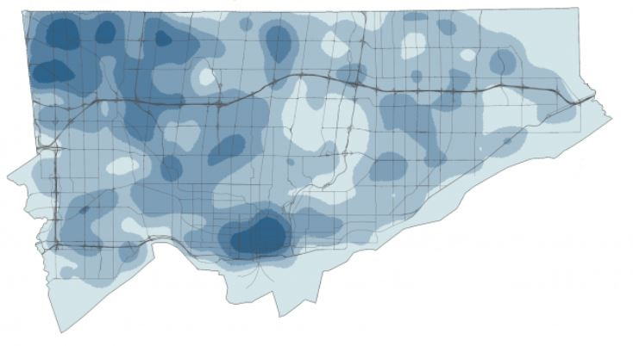
MCI Dataset
Crime analysis and prediction was conducted using the 2014 – 2021 Toronto Major Crime Indicator (MCI) dataset
The MCI dataset contained 281,692 records and 30 variables for founded incidents categorized as Assault, Break and Enter, Auto Theft, Robbery, and Theft over $5000.
Data types were mixed: character (14), integer (12), and numeric (4).
The dataset contained no NA values, 20,233 duplicated rows (based on event ID and offense), and 1372 entries for occurrences prior to 2014
Notes:
Image: https://ecce.esri.ca/uoft-blog/2020/08/04/analyzing-toronto-crime-data-using-kernel-density/

Slide 7
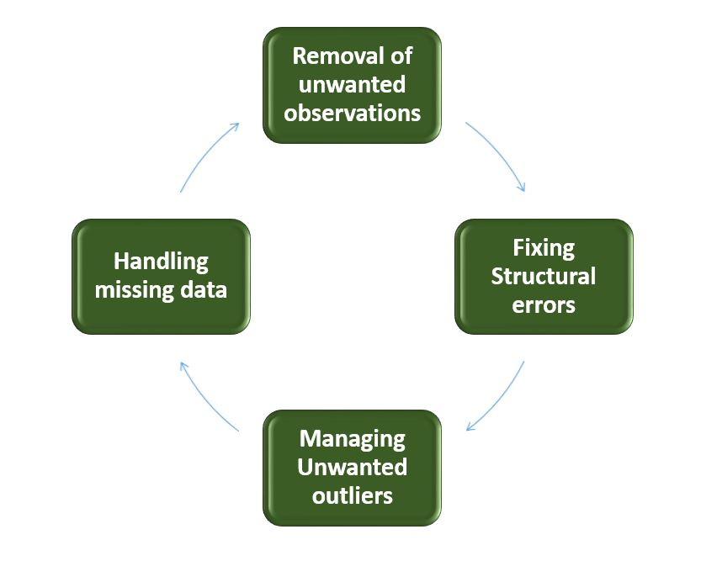
Data Cleaning
Removal of 20,233 duplicated rows (based on event ID and offense), 1,372 entries for occurrences prior to 2014, and 15 redundant variables.
Addition of 2 columns: weights associated with UCR codes and season.
Convert categorical variables (e.g., day, month, crime time, premises type) to factors to avoid potential complications during analysis.
The cleaned Toronto MCI dataset contained 260,175 observations and 17 variables.
Notes:
Image: https://www.geeksforgeeks.org/data-cleansing-introduction/

Slide 8
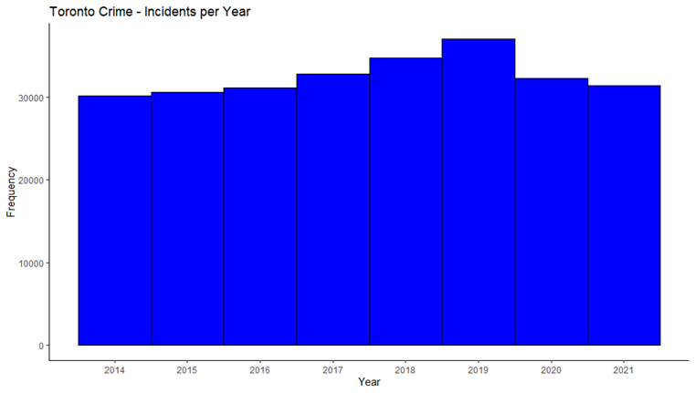
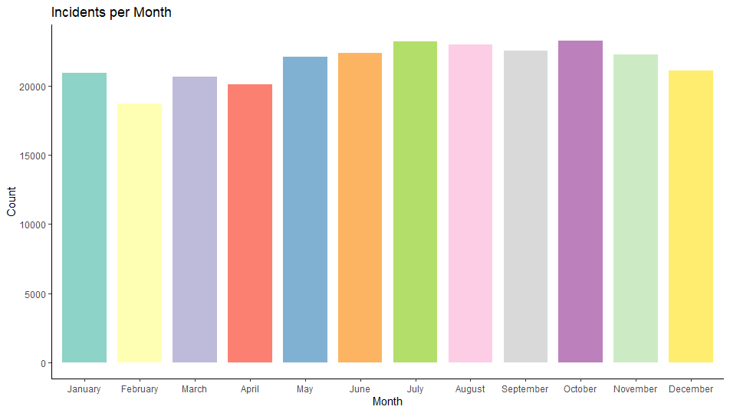
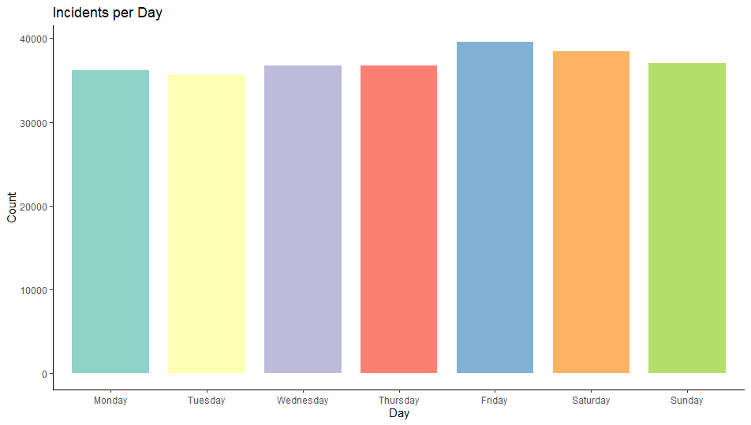
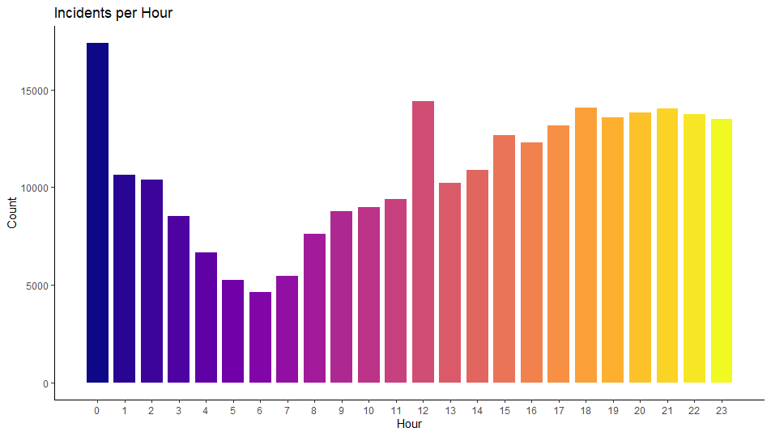
Exploratory Data Analysis

Slide 9
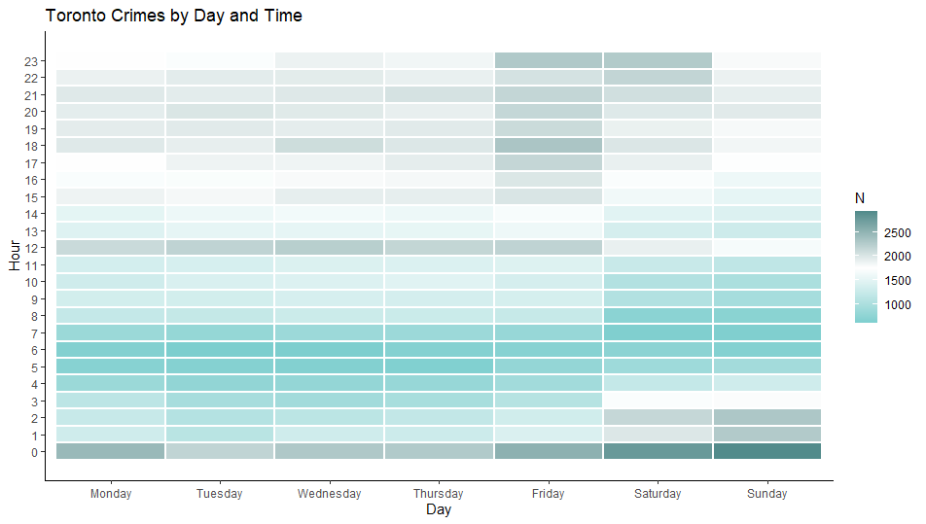
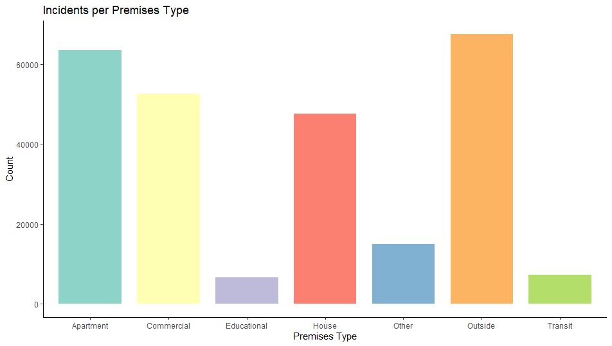
Exploratory Data Analysis

Slide 10
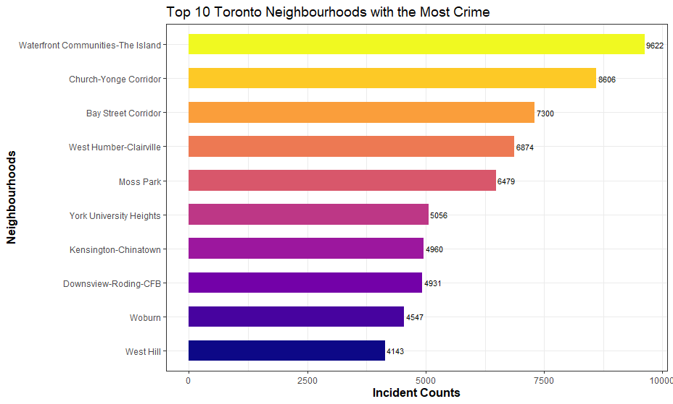
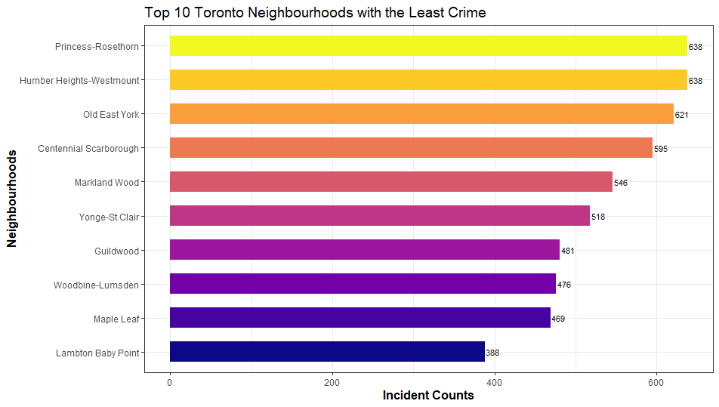
Exploratory Data Analysis

Slide 11
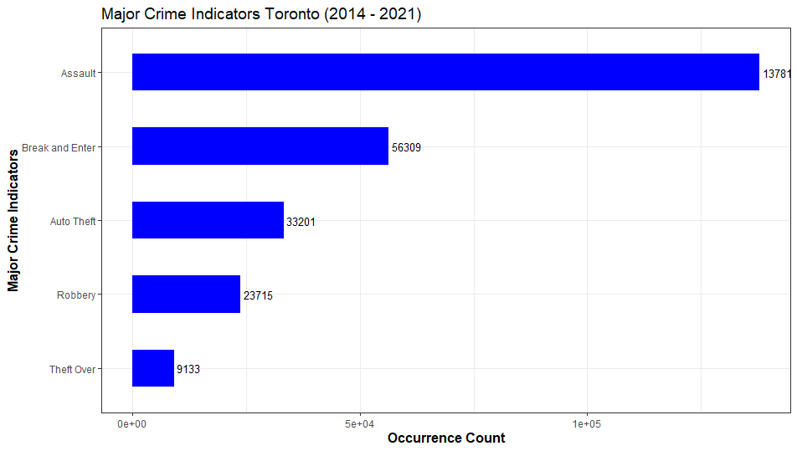
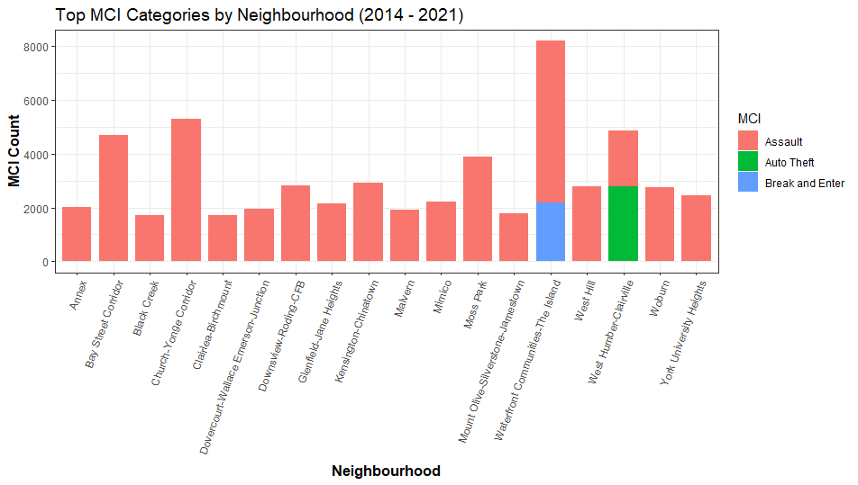
Exploratory Data Analysis

Slide 12
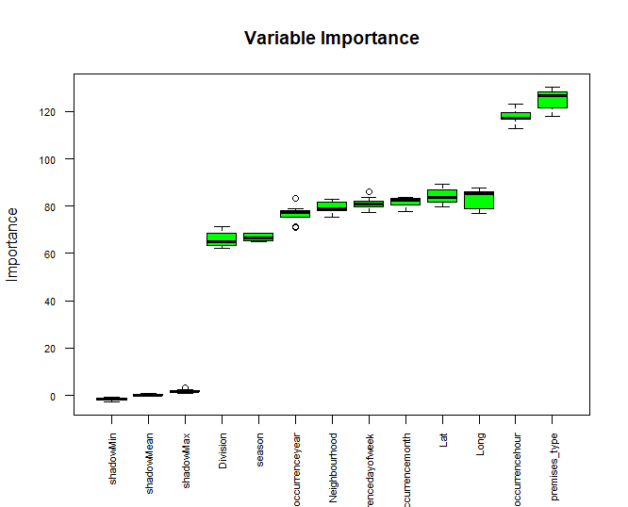
Feature Selection & SMOTE Oversampling
MCI Category | % - Before | % - After
Assault | 53 | 28
Auto Theft | 14 | 7
Break & Enter | 21 | 11
Robbery | 8 | 4
Theft Over $5000 | 4 | 49
Applied Boruta feature selection method to dataset followed by stepwise regression for comparison.
Dataset heavily imbalanced toward the Assault category.
Premises type, occurrence hour, latitude and longitude were the most significant features associated with the major crime indicators.
SMOTE oversampling served to re-balance the dataset by significantly increasing the minority class and reducing the majority class.

Slide 13
Algorithm Selection & Training
Selected classifiers that were typically used in studies of crime data: decision tree, random forest, k-NN, Naïve Bayes, and multivariate logistic regression.
Classifier | Accuracy | Kappa | Training Time
Random Forest | 79.9% | 0.692 | 61 min.
Decision Tree | 76.2% | 0.635 | 8 min.
k-NN | 72.1% | 0.578 | 4 hrs.
Naïve Bayes | 61.6% | 0.348 | 10 sec.
Multinomial Logistic Regression | 49.2% | 0.0039 | 3 min.
Dataset split into 75% training and 25% testing subsets.
Settings applied were either default or recommended by previous studies to get a general idea of performance.
Algorithms executed twice to ensure consistency and evaluated using 10-fold cross validation.

Slide 14
Model Testing & Selection
Classifier | Accuracy | Kappa | NIR%
Random Forest | 80.5% | 0.697 | 48.1
Decision Tree | 76.4% | 0.637 | 48.0
k-NN | 72.5% | 0.583 | 49.6
Naïve Bayes | 61.9% | 0.356 | 64.8
Multinomial Logistic Classification | 49.2% | 0.0038 | 99.4
Results on test set nearly identical compared to training set.
The MCI categories of Assault and Theft Over $5000 were correctly classified most often compared to Auto Theft, Break & Enter, and Robbery which were either poorly classified or not classified at all.
MCI Category | DT* | ML | NB | RF | KNN
Assault | 0.689 | 0.016 | 0.557 | 0.734 | 0.622
Auto Theft | 0.413 | NA | NA | 0.482 | 0.334
Break & Enter | 0.494 | NA | 0.254 | 0.553 | 0.439
Robbery | 0.159 | NA | NA | 0.268 | 0.252
Theft Over $5000 | 0.956 | 0.660 | 0.766 | 0.977 | 0.947
The random forest classifier consistently outperformed all other algorithms, with decision tree and k-NN returning comparable results.
*F1-Score

Slide 15
Model Performance Measures
RF: MCI Category | Sensitivity | Specificity | Accuracy | Precision | F1-Score
Assault | 0.659 | 0.928 | 79.3% | 0.829 | 0.734
Auto Theft | 0.551 | 0.955 | 75.3% | 0.428 | 0.482
Break & Enter | 0.598 | 0.939 | 76.9% | 0.515 | 0.553
Robbery | 0.497 | 0.962 | 73.0% | 0.183 | 0.268
Theft Over $5000 | 0.988 | 0.968 | 97.9% | 0.967 | 0.977
DT: MCI Category | Sensitivity | Specificity | Accuracy | Precision | F1 Score
Assault | 0.627 | 0.902 | 76.5% | 0.765 | 0.689
Auto Theft | 0.454 | 0.950 | 70.2% | 0.378 | 0.413
Break & Enter | 0.524 | 0.933 | 72.9% | 0.468 | 0.494
Robbery | 0.285 | 0.959 | 62.1% | 0.110 | 0.159
Theft Over $5000 | 0.965 | 0.950 | 95.8% | 0.948 | 0.956
In classifying each MCI category, the random forest model typically provided the highest values for each performance metric.
kNN: MCI Category | Sensitivity | Specificity | Accuracy | Precision | F1 Score
Assault | 0.622 | 0.855 | 73.9% | 0.622 | 0.622
Auto Theft | 0.350 | 0.946 | 64.8% | 0.319 | 0.334
Break & Enter | 0.432 | 0.929 | 68.1% | 0.446 | 0.439
Robbery | 0.256 | 0.965 | 61.0% | 0.249 | 0.252
Theft Over $5000 | 0.943 | 0.953 | 94.8% | 0.951 | 0.947
The highest sensitivity values were returned for the majority classes while the highest specificity values were typically returned for the minority classes; none of the models were able to classify the minority classes particularly well.
NB: MCI Category | Sensitivity | Specificity | Accuracy | Precision | F1 Score
Assault | 0.528 | 0.836 | 68.2% | 0.590 | 0.557
Auto Theft | 0.00 | 0.925 | 46.2% | 0.00 | NA
Break & Enter | 0.458 | 0.903 | 68.1% | 0.176 | 0.254
Robbery | 0.00 | 0.955 | 47.8% | 0.00 | NA
Theft Over $5000 | 0.673 | 0.842 | 75.8% | 0.888 | 0.766
MLR: MCI Category | Sensitivity | Specificity | Accuracy | Precision | F1 Score
Assault | 0.404 | 0.723 | 56.4% | 0.008 | 0.016
Auto Theft | 0.00 | 0.925 | 46.2% | 0.00 | NA
Break & Enter | NA | 0.887 | NA | NA | NA
Robbery | NA | 0.955 | NA | NA | NA
Theft Over $5000 | 0.493 | 0.727 | 61.0% | 0.997 | 0.660

Slide 16
Conclusions
Most crime in Toronto occurred from Friday to Sunday between midnight and 1 am; least number of incidents between 3 am and 11 am each day. Crime counts were the highest between May and October.
Lambton-Baby Point and Maple Leaf neighbourhoods had the lowest incidence of crime and the Waterfront Communities, and the Church-Yonge Corridor the highest.
Assault was the most prevalent of the MCI categories followed by break and enter, auto theft, robbery, and theft over $5000; assault was also the highest MCI category per neighbourhood.
The random forest model outperformed decision tree, k-NN, Naïve Bayes, and multivariate logistic classifiers, demonstrating the most potential for use as a crime forecasting tool.
Those MCI categories with the highest proportions (i.e., Assault and Theft Over $5000) were most often correctly classified compared to Auto Theft, Break & Enter, and Robbery which were either poorly classified or not classified at all.

Slide 17
Recommendations
The majority classes were predicted with the highest accuracy - consider combining some crime categories to produce general classes such as property crime or crimes against person which could serve to increase general model performance and predictive capability for minority classes.
Consider introducing some of the higher ranking ‘tentative’ independent variables to see how they influence model performance.
Compare performance results using upsampled, down sampled, and original imbalanced data to those returned using SMOTE oversampled data.
Models should be re-developed through the adjustment or addition of hyperparameters, and comparative performance be evaluated to determine whether this optimization significantly influenced classification results.
Investigate whether a Gradient Boost classifier outperforms the random forest model.
Conduct cluster analysis to further detect patterns in the data.

