Slide 1
Circle Session
Max Kanter

Slide 2
Objectives
Allow music creation
Enable collaboration with others
Mimic entertainment value of childhood game

Slide 3
Progress
Server functioning
Client working
Music creation

Slide 4
Problems
Synchronization
UI
Sound samples

Slide 5
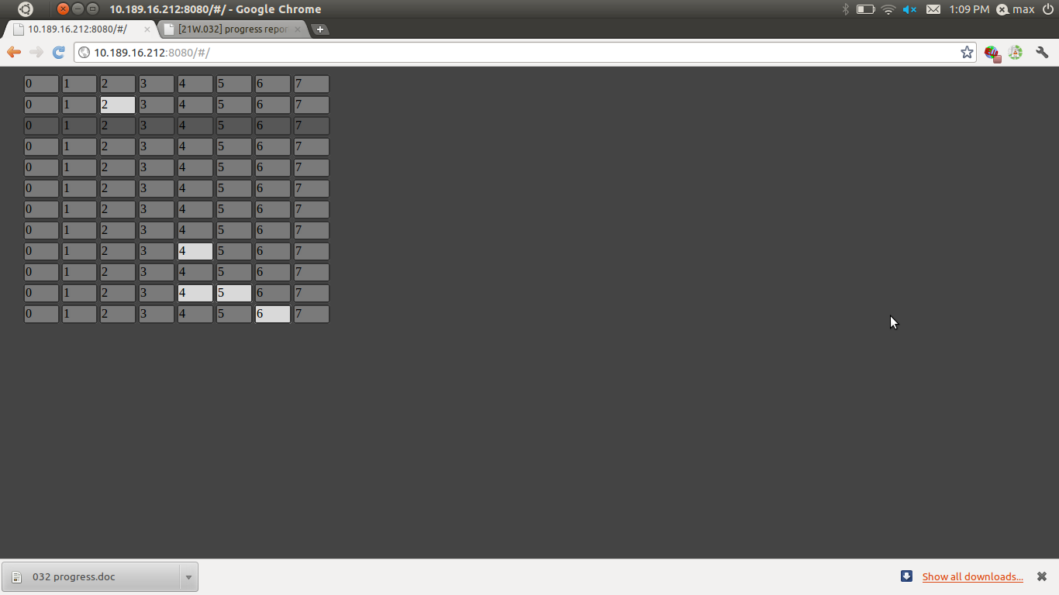
Demo

