Slide 1
Static Website Hosting on AWS with Custom Domain Setup

Slide 2
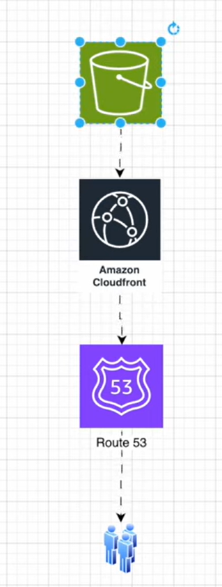
GOAL
The primary objective of this project was to design and deploy a fully functional static website using AWS cloud services.
Develop a cost-effective, highly available, and secure static website.
Integrate a custom domain (travelaws.xyz) purchased from GoDaddy.
Leverage modern cloud technologies to deliver content globally with minimal latency.

Slide 3
Tools and Technologies Used
Amazon S3 (Simple Storage Service):
Used to store and host the static website files, including HTML, CSS, and JavaScript.
Amazon CloudFront:
A global Content Delivery Network (CDN) used to distribute website content with low latency and high transfer speeds.
Amazon Route 53:
Provides DNS management and routing for the custom domain.
AWS Certificate Manager (ACM):
Used to provision and manage SSL/TLS certificates for enabling HTTPS on the website.
GoDaddy:
Domain registrar from which the custom domain travelaws.xyz was purchased.
IAM (Identity and Access Management):
Ensures secure access by managing user roles and permissions, particularly for the S3 bucket.
HTML, CSS, JavaScript:
Core web technologies used to develop the static website content.

Slide 4
Methodology
Website Creation
Designed a static website using HTML, CSS, and JavaScript.
Ensured the site was responsive, lightweight, and cross-browser compatible.
2. Amazon S3 Bucket Configuration
Created an S3 bucket named travelaws.xyz to match the custom domain.
Uploaded all website files (HTML, CSS, JS).
Enabled static website hosting on the bucket.
Configured the bucket policy to allow public read access for static content.
3. CloudFront Setup
Created an Amazon CloudFront distribution linked to the S3 bucket as the origin.
Enabled caching and optimized distribution settings for better performance.
Requested an SSL certificate via AWS Certificate Manager (ACM) for:
travelaws.xyz
www.travelaws.xyz
4. Route 53 Configuration
Created a hosted zone for travelaws.xyz in Amazon Route 53.
Added the necessary A (Alias) and CNAME records pointing to the CloudFront distribution.
Updated GoDaddy’s nameservers to point to Route 53, connecting the domain to AWS infrastructure.

Slide 5
PROBLEM STATEMENT
Many startups and individuals aiming to publish a simple website often encounter the following challenges:
High costs associated with traditional web hosting services
Complex setup processes for domain registration and integration.
Limited scalability and performance in conventional hosting environments. This project solves these issues by leveraging AWS's serverless and scalable architecture to deploy a static website efficiently, securely, and at minimal cost.

Slide 6
SOLUTIONS
By integrating multiple AWS services with a third-party domain provider, this project successfully achieved the following:
Hosted a static website with global availability using AWS S3 and CloudFront.
Enabled secure communication through HTTPS using AWS Certificate Manager.
Improved performance with CloudFront caching, reducing latency and speeding up content delivery.
Delivered a low-cost, highly scalable, and maintenance-free solution—ideal for blogs, portfolios, or business landing pages.

Slide 7
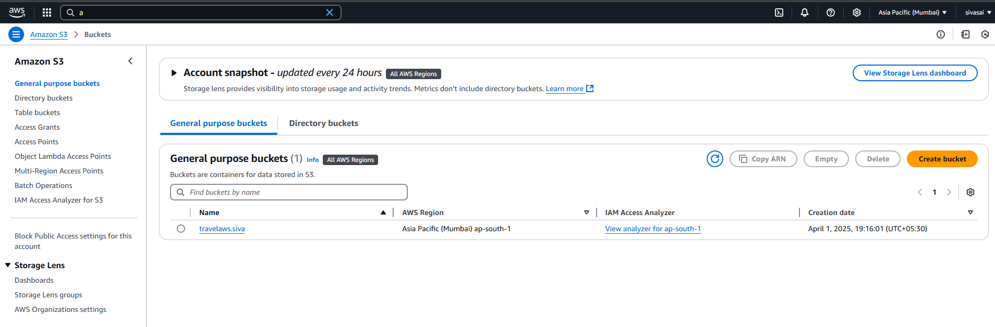
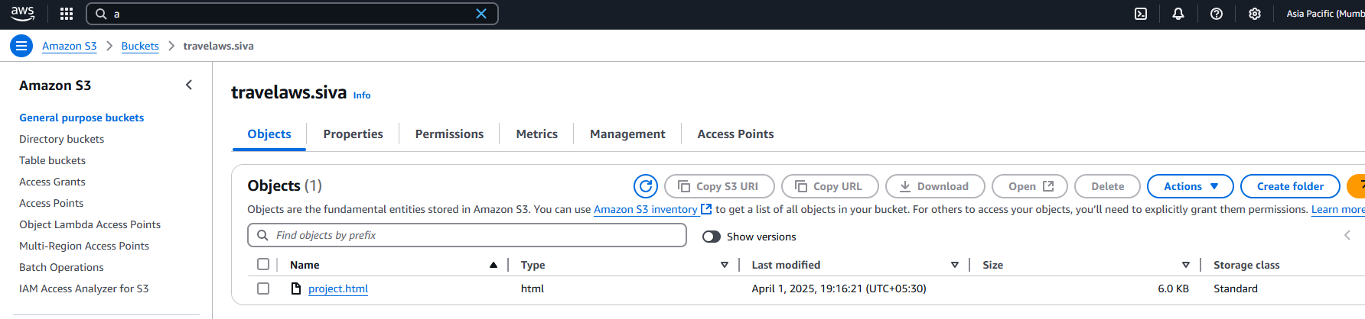
Screenshots & Output Pages
I created an Amazon S3 bucket named travelaws.mayuk to serve as the foundation for hosting the static website.Uploaded all necessary frontend assets, including HTML, CSS, and JavaScript files.Enabled the static website hosting feature within the S3 bucket settings.Configured bucket permissions and policies to allow public read access, ensuring the website could be accessed over the internet.

Slide 8
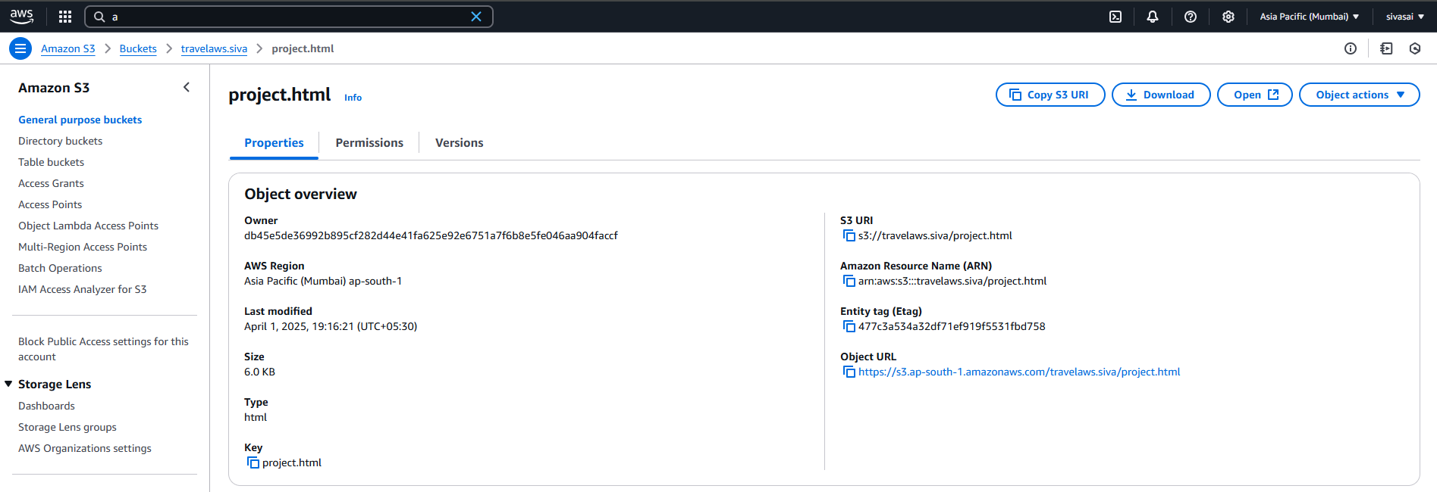
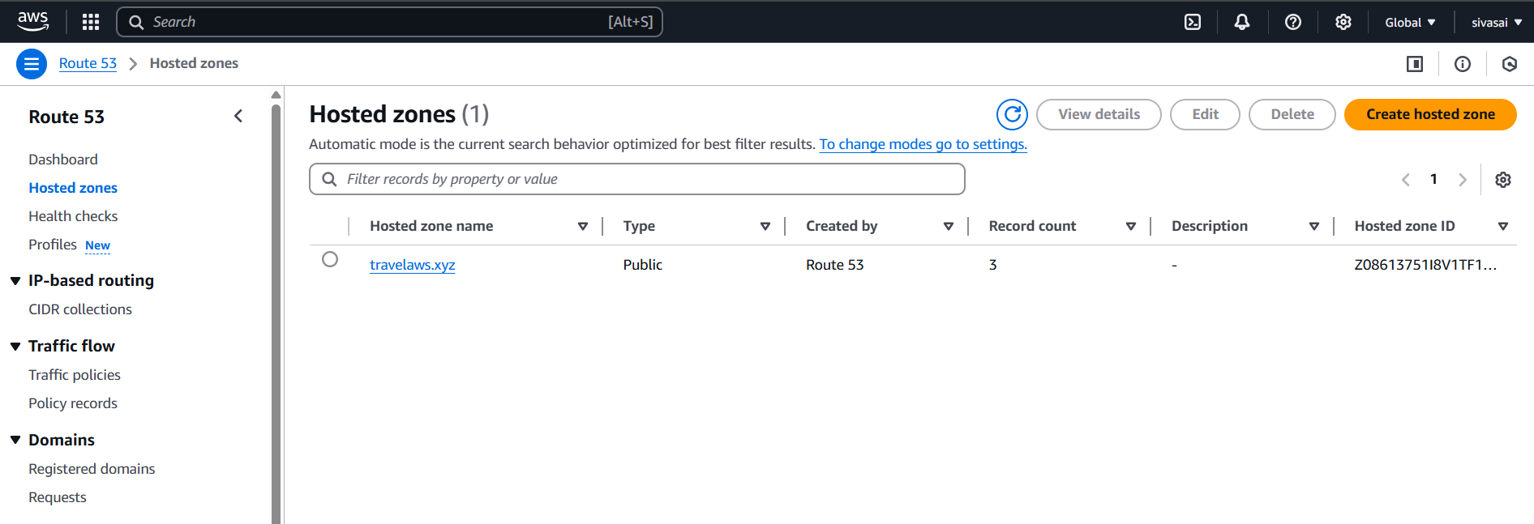
After acquiring the custom domain travelaws.xyz from GoDaddy, I configured DNS routing to integrate it with AWS services. This involved creating a hosted zone in Amazon Route 53 for the domain, which provided a set of nameserver (NS) records. I then updated the domain settings in GoDaddy by replacing the default nameservers with the ones generated by Route 53. This configuration delegated DNS management to Route 53, allowing it to handle all DNS queries for the domain and successfully route traffic to the AWS-hosted static website.

Slide 9
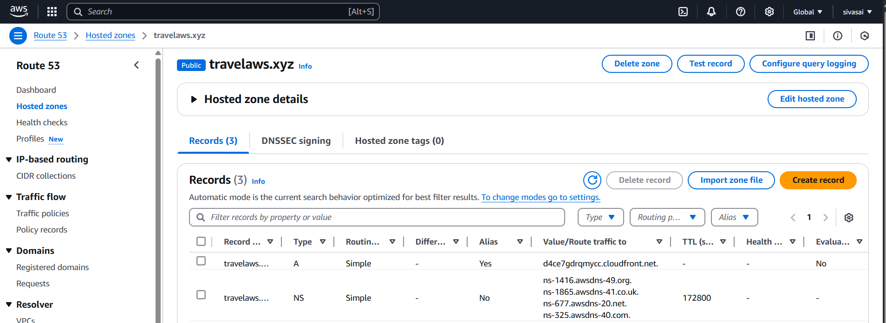
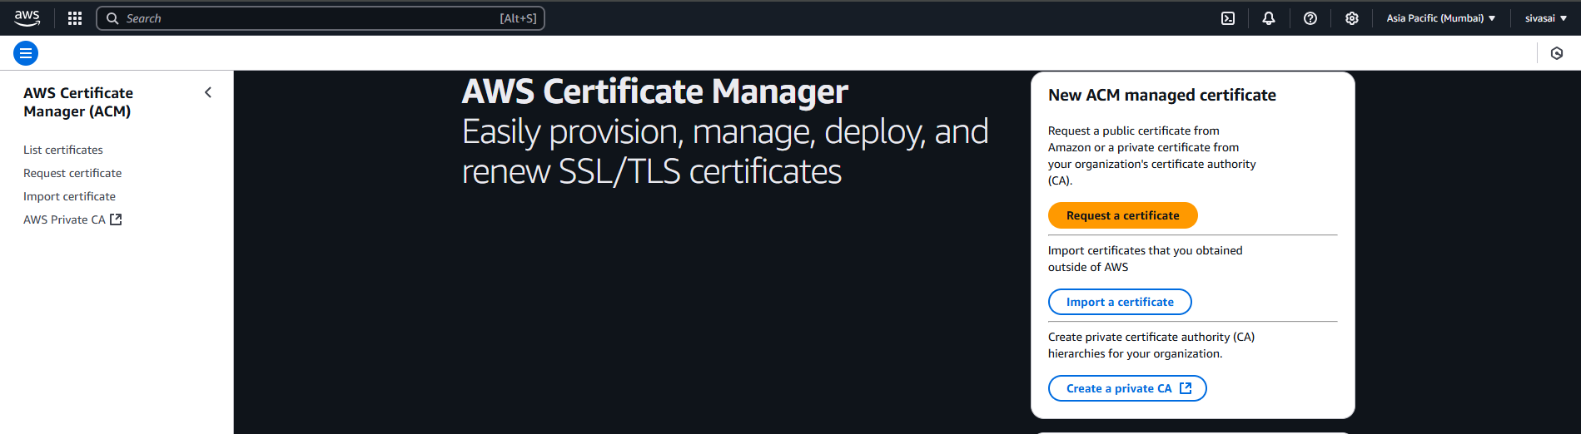
After the DNS was configured, I moved on to securing the website by enabling HTTPS. For this, I used AWS Certificate Manager (ACM)
to request an SSL certificate for both travelaws.xyz and www.travelaws.xyz. Once the request was validated and the certificate was successfully issued, I was able to use it to encrypt data transferred between users and the website, ensuring a secure browsing experience.

Slide 10
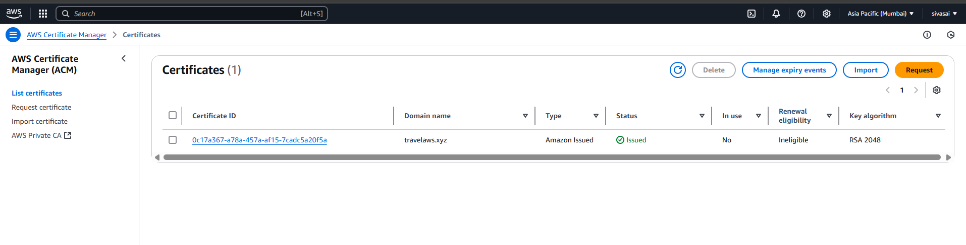
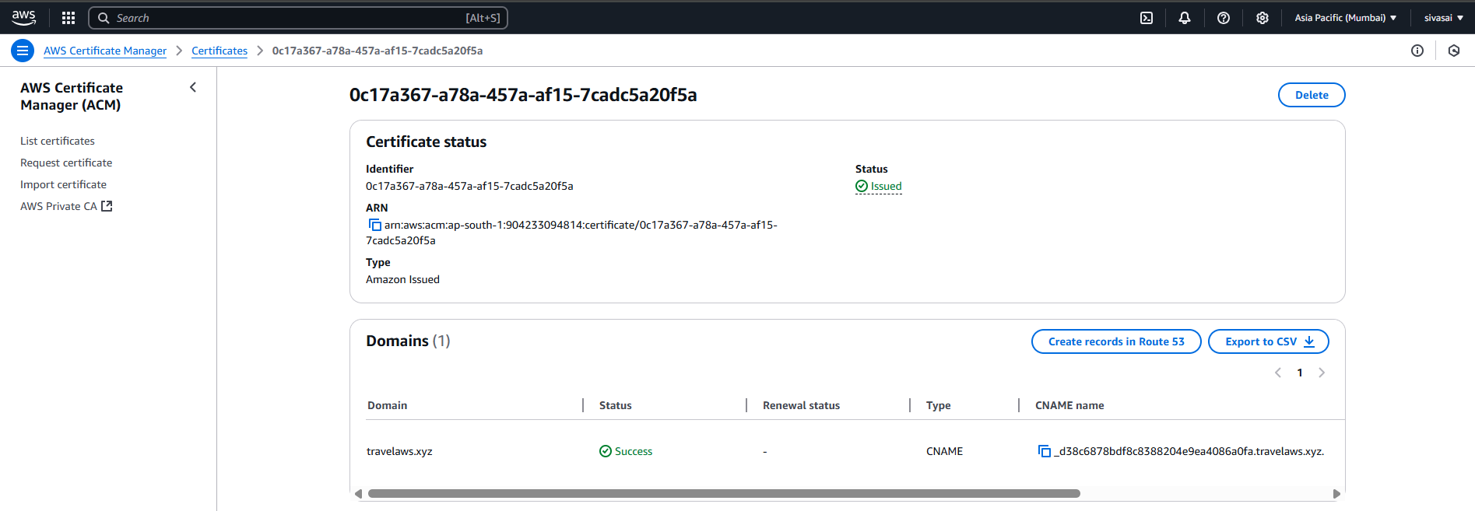
With the certificate in place, I proceeded to set up Amazon CloudFront, AWS's Content Delivery Network (CDN). I created a new CloudFront distribution and set the S3 bucket (travelaws.siva) as the origin. The CloudFront distribution was configured to serve content over HTTPS using the SSL certificate from ACM. It also allowed the website’s static assets to be cached and delivered through AWS's global network of edge locations, significantly reducing latency and improving load times for users around the world.

Slide 11
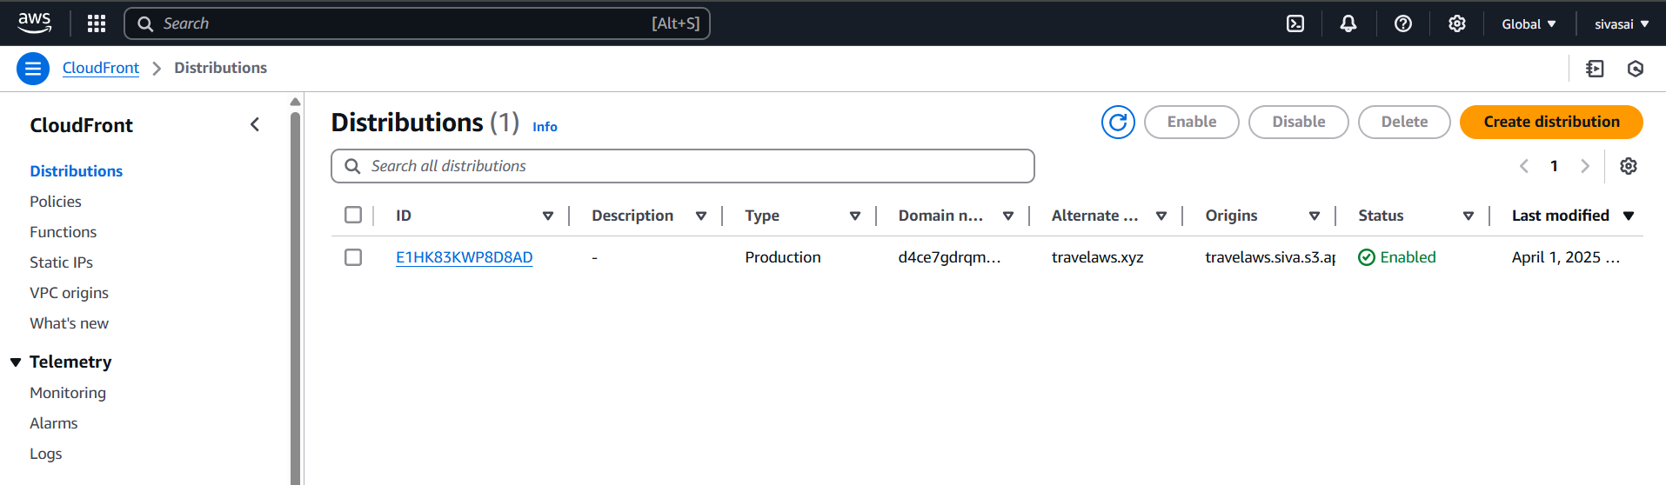
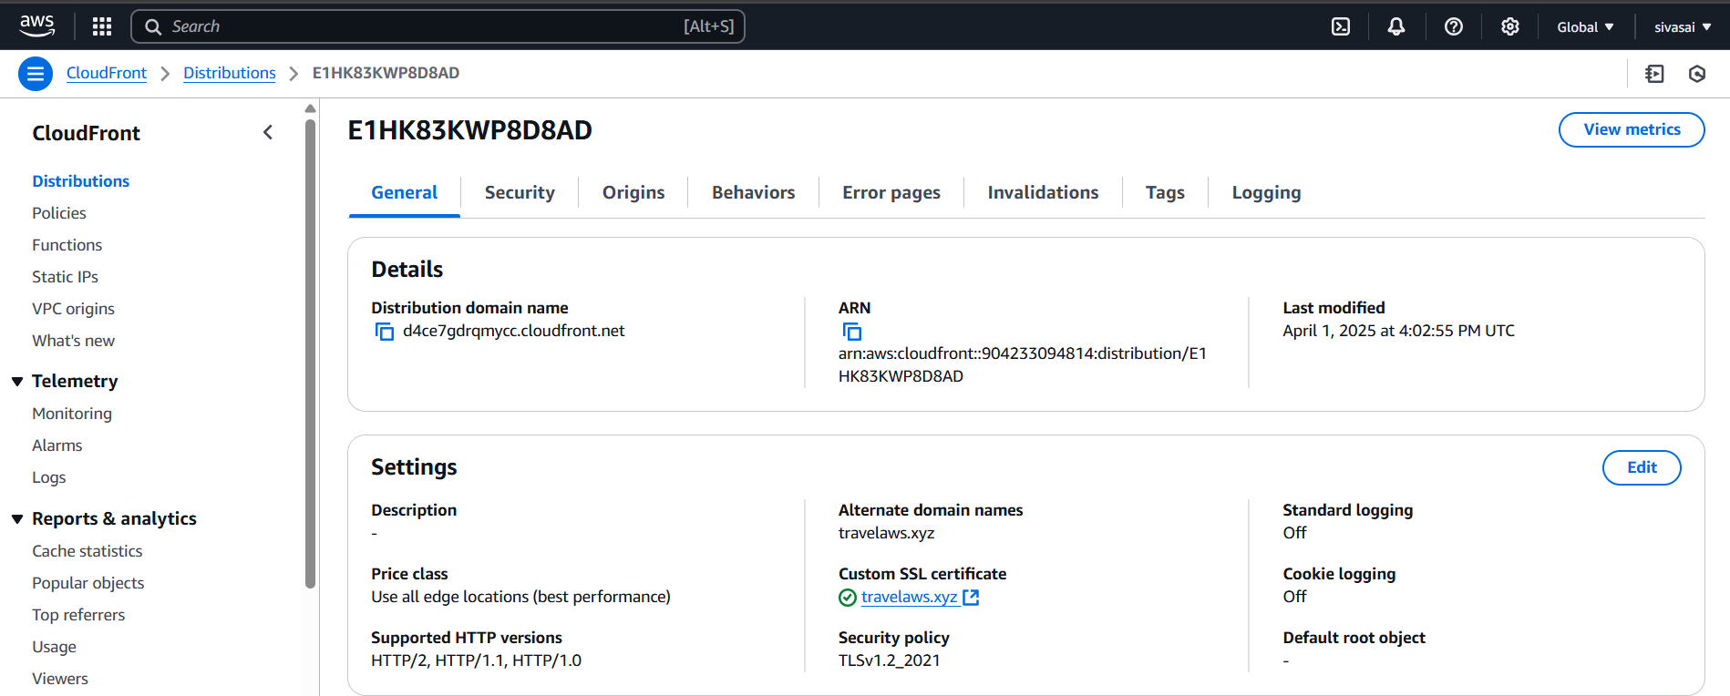
To finalize the setup, I returned to Route 53 and created a new DNS record that pointed the domain travelaws.xyz to the CloudFront distribution. This record acted as the final
link in the chain, ensuring that when users typed https://travelaws.xyz into their browsers, their requests would be routed to CloudFront, which would then serve the content securely and efficiently from the S3 bucket.

Slide 12
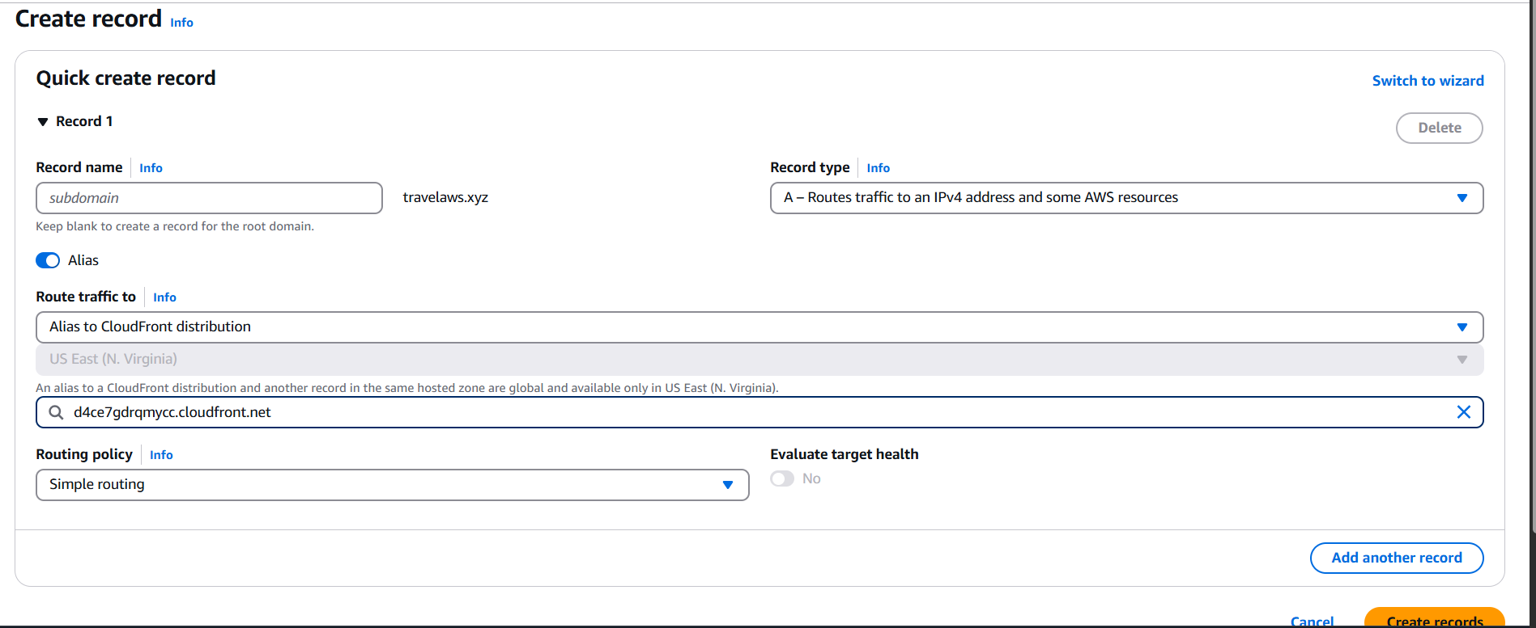
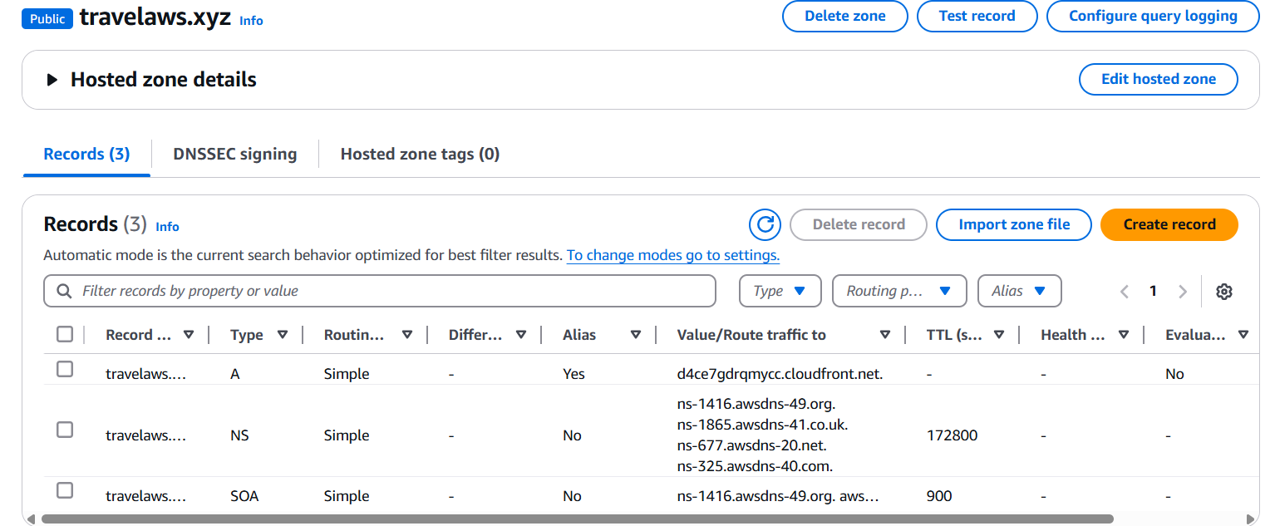
To finalize the setup, I created a new DNS record in Amazon Route 53 that pointed the domain travelaws.xyz to the CloudFront distribution. This step served as the final link in the deployment process, ensuring that when users accessed https://travelaws.xyz in their browsers, their requests would be routed through CloudFront. CloudFront then securely and efficiently delivered the website content from the underlying S3 bucket, completing a fully integrated, scalable, and secure static website hosting solution.

Slide 13
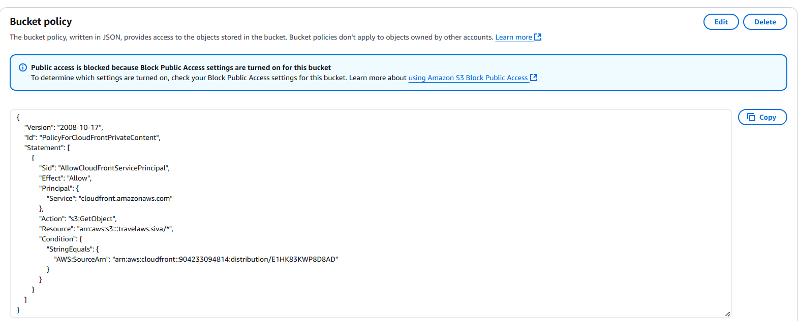
After completing the core setup, I focused on optimizing the security and access control of the S3 bucket. Using S3 Control, I reviewed and updated the bucket policy to follow best practices for public access. This included:
Restricting access only to CloudFront by allowing traffic from the CloudFront origin access identity (OAI) or origin access control (OAC), instead of leaving the bucket open to
the public.
Removing unnecessary public permissions to reduce the attack surface.
Ensuring that only the CloudFront distribution could retrieve content from the S3 bucket, thus enforcing secure and restricted content delivery.

Slide 14
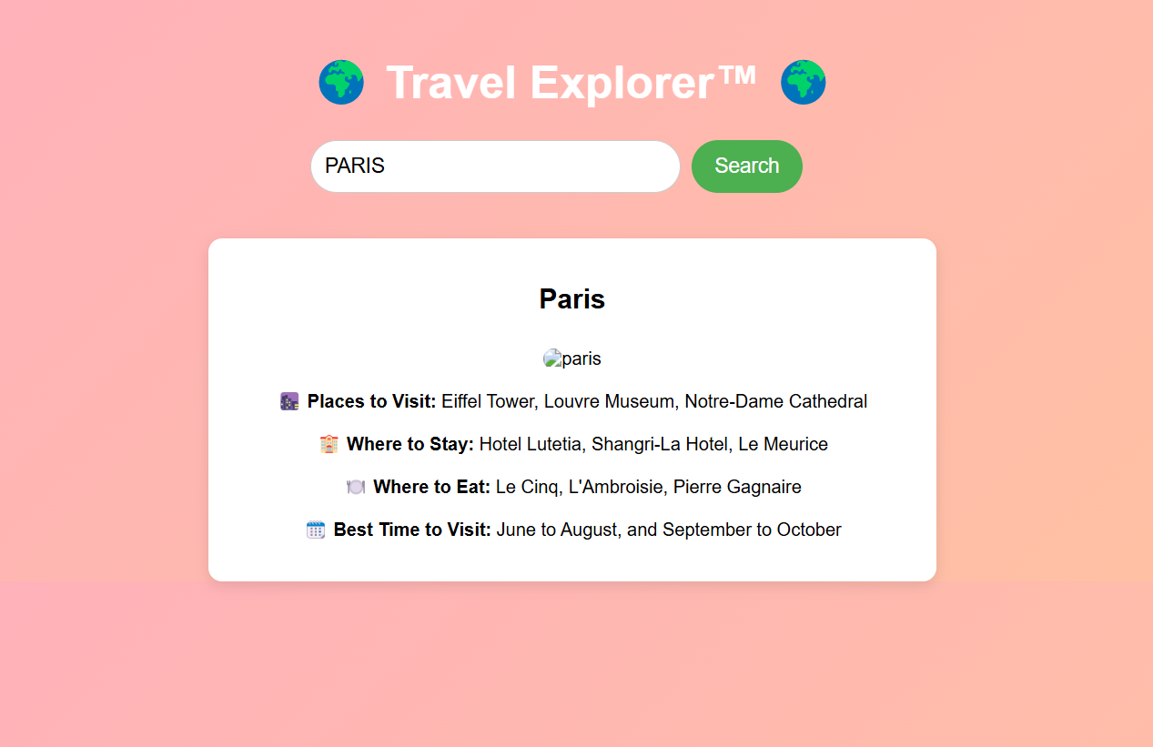
The figure shown below is the final output of the project – the live static website successfully hosted using various AWS services. It demonstrates the fully functional deployment of the site via Amazon S3, CloudFront, Route 53, and ACM, accessible through the custom domain https://travelaws.xyz."

Slide 15
CONCLUSION
This project demonstrates practical cloud deployment skills using Amazon Web Services (AWS), highlighting the ability to build secure and scalable websites with minimal infrastructure. It also showcases proficiency in integrating third-party services, such as domain registrars like GoDaddy, and a solid understanding of DNS management, content delivery networks, and security configurations in real-world scenarios. Through this project, I gained valuable hands-on experience in cloud architecture, static website hosting, domain linking, and optimizing content delivery using AWS.

