Slide 1







Analysis of Stack Overflow Developer Survey 2019
Karim Ali
07.11.2023

Slide 2



OUTLINE
Executive Summary
Introduction
Methodology
Results
Visualization – Charts
Dashboard
Discussion
Findings & Implications
Conclusion
Appendix

Slide 3

EXECUTIVE SUMMARY
The analysis of programming language and database trends from the Stack Overflow Developer Survey 2019 reveals critical insights into the tech industry.
The analysis of current technology trends underscores the significance of HTML/CSS, Bash/Shell/PowerShell, C#, and JavaScript, which have firmly established themselves as dominant languages.
Python and Go also show notable growth, presenting promising opportunities for developers and organizations to explore.
As the future unfolds, HTML/CSS, Bash/Shell/PowerShell, and C# are expected to maintain their positions, emphasizing their continued relevance in the evolving tech sphere.
In the database landscape, MySQL, Microsoft SQL Server, and PostgreSQL stand out, with MongoDB and Elasticsearch showing robust potential for the future.
When it comes to platforms, AWS reigns supreme, while Docker, Android, Google Cloud Platform, and Kubernetes are poised for significant growth.
The ever-popular Angular, React.js, and ASP.NET web frameworks continue to dominate web development. In demographics, addressing gender disparities and recognizing the global reach of tech talent become crucial for building a more inclusive and globally relevant industry.

Slide 4

INTRODUCTION
In today's ever-evolving digital landscape, the choices made by software developers have a profound impact on the technology we use and the future of the industry.
This analysis delves into the programming languages, databases, platforms, and web frameworks that developers are utilizing in their current projects.
Furthermore, it explores the trends that are shaping the technology landscape, providing valuable insights into the direction of the industry.
The demographics of survey respondents also provide a glimpse into the diversity of voices and perspectives in the world of software development.
This report offers a comprehensive overview of the current state of technology and provides a basis for understanding future shifts and emerging trends.

Slide 5

METHODOLOGY
Our analysis was conducted through a meticulous process of data extraction(web scrapping and SQLite) , cleaning, preparation, and visualization using Python and specialized data dashboarding tools (IBM cognos embedded).
Our results are presented in three sections:
"Results,"
"Discussion," and
"Conclusion."

Slide 6
RESULTS

Slide 7
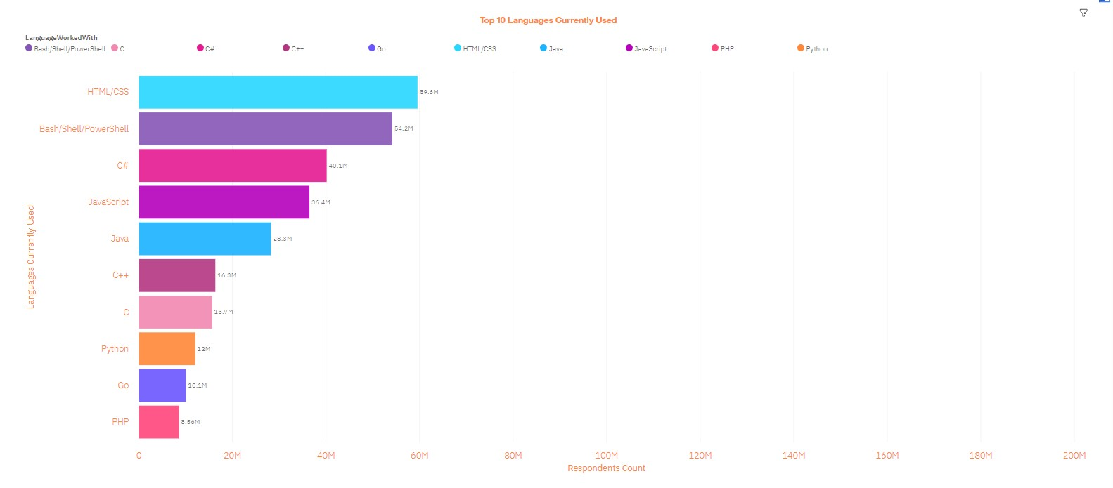
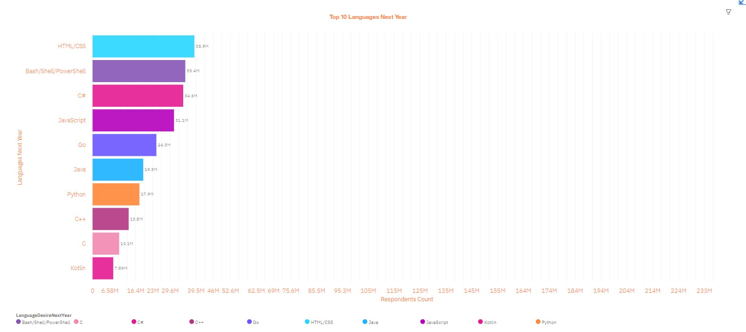
PROGRAMMING LANGUAGE TRENDS
TOP 10 Languages Current Year
TOP 10 Languages Next Year

Slide 8
PROGRAMMING LANGUAGE TRENDS - FINDINGS & IMPLICATIONS
In the current technology landscape, HTML/CSS is the most used language,
followed by Bash/Shell/PowerShell, C#, and JavaScript.
Python and Go are also gaining prominence.
For future trends, HTML/CSS, Bash/Shell/PowerShell, and C# are anticipated to remain popular, while Kotlin is expected to grow.
Developers should continue to focus on HTML/CSS, Bash/Shell/PowerShell, C#, and JavaScript skills to stay relevant.

Slide 9
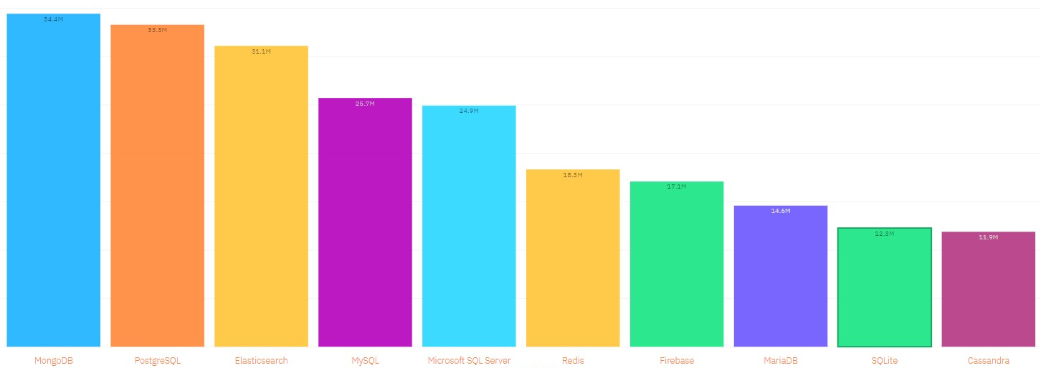
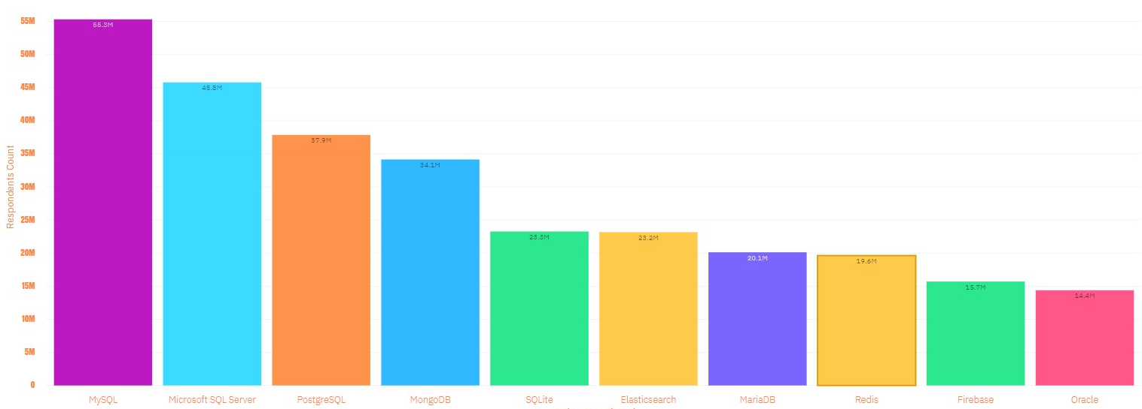
DATABASE TRENDS
TOP 10 Databases Current Year
TOP 10 Databases Next Year

Slide 10
DATABASE TRENDS - FINDINGS & IMPLICATIONS
MySQL is the most widely used database, with Microsoft SQL Server and PostgreSQL following closely.
MongoDB and Elasticsearch are also widely adopted.
For future trends, MongoDB and PostgreSQL are poised to maintain their popularity, with Redis and Firebase showing significant growth potential.
Database administrators must be proficient in MySQL, Microsoft SQL Server, and PostgreSQL.

Slide 11

DASHBOARD
https://eu-gb.dataplatform.cloud.ibm.com/dashboards/f3dbcee8-c010-4221-afcc-2b80b1207438/view/5769df7703f110de43d1f6e407cf2e507e3f250cbbbbd15083807b490b637197f36a1296c826485e8e100761f5ef125cc9

Slide 12
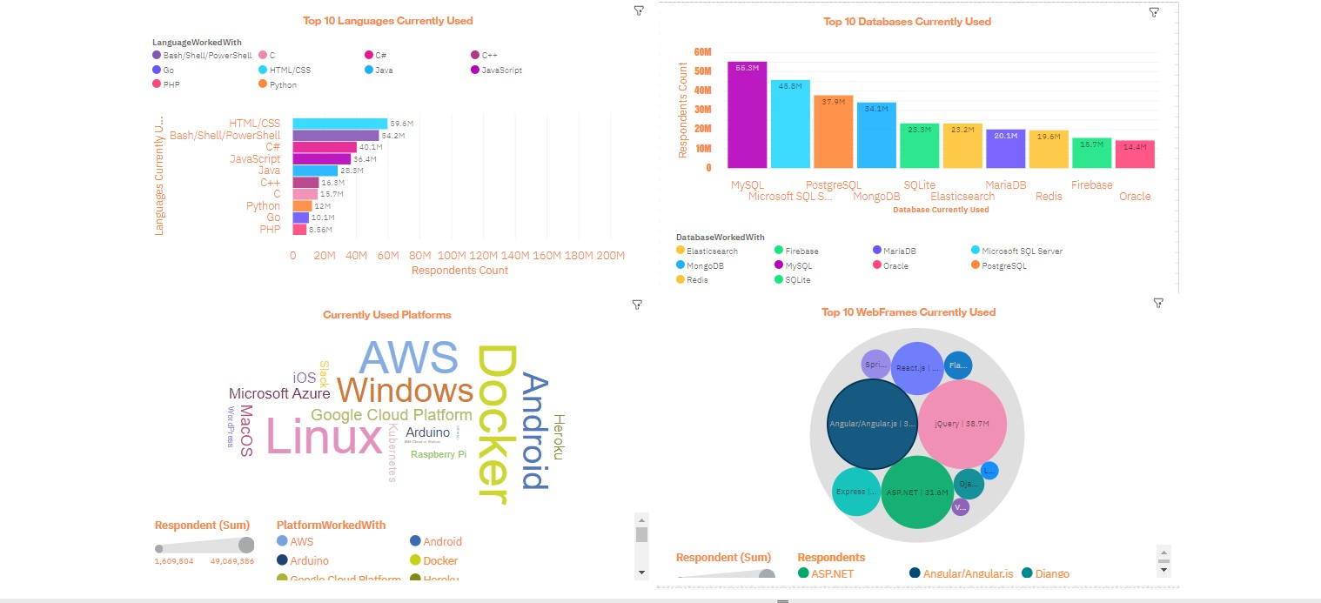
CURRENT TECHNOLOGY USAGE

Slide 13
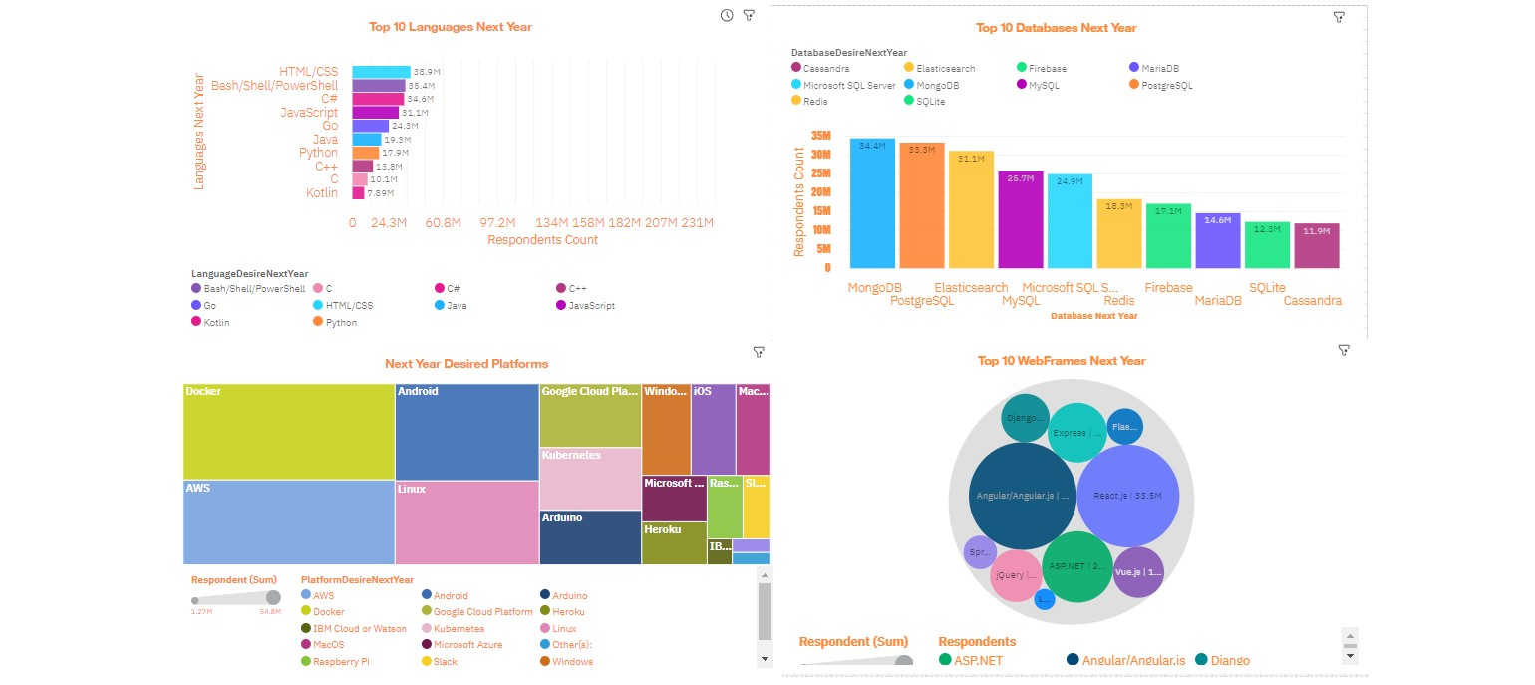
FUTURE TECHNOLOGY TREND

Slide 14
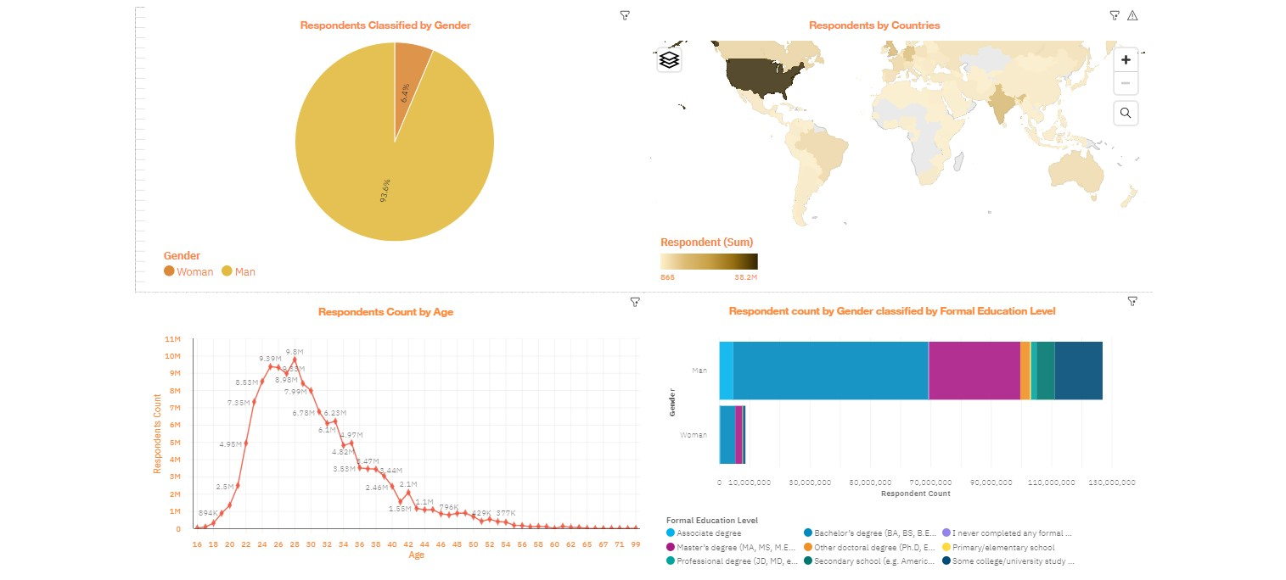
DEMOGRAPHICS

Slide 15
DISCUSSION
The analysis of current technology trends underscores the pivotal role of HTML/CSS, Bash/Shell/PowerShell, C#, and JavaScript in the software development landscape.
These languages are the bedrock of modern programming, demanding continuous skill development.
As Python and Go gain prominence, professionals should consider diversifying their skill sets to adapt to industry evolution.
Database trends affirm the dominance of MySQL, with the emergence of MongoDB and PostgreSQL on the horizon.
The prevalence of AWS and Docker in platform trends implies the significance of cloud and containerization technologies.
In web frameworks, Angular, jQuery, React.js, and ASP.NET remain popular, presenting opportunities for web developers.
Gender disparity in demographics necessitates efforts to achieve greater diversity, and the global participation of respondents reiterates the survey's global impact, with the USA, India, the UK, and Germany at the forefront.
Staying updated with these trends is crucial for professionals and organizations to thrive in the ever-changing tech landscape.

Slide 16
OVERALL FINDINGS & IMPLICATIONS
Programming Language Trends:
HTML/CSS, Bash/Shell/PowerShell, C#, and JavaScript are the most used languages today, with Python and Go gaining ground. HTML/CSS, Bash/Shell/PowerShell, and C# are set to maintain their popularity, and Kotlin is on the rise.
Implications:
Developers should strengthen their HTML/CSS, Bash/Shell/PowerShell, and C# skills.
Learning Python and Go opens doors to expanding opportunities.
Database Trends:
MySQL is the top database, closely followed by Microsoft SQL Server and PostgreSQL, underlining their significance in enterprise solutions. The emergence of MongoDB and Elasticsearch reflects the demand for flexible data handling. MongoDB and PostgreSQL are expected to keep their appeal, while Redis and Firebase indicate growth in real-time and cloud-based databases.
Implications:
Database administrators should master MySQL, Microsoft SQL Server, and PostgreSQL.
Exploring MongoDB can offer competitive advantages in NoSQL data management.
Redis and Firebase proficiency is vital for addressing real-time and cloud data requirements.

Slide 17
OVERALL FINDINGS & IMPLICATIONS
Platform Trends:
AWS leads the platform arena with its comprehensive cloud services, followed by Windows, Linux, and Docker. Docker is gaining significance, and Android, Google Cloud Platform, and Kubernetes are on the rise, meeting evolving mobile and cloud-based solution needs.
Implications:
Organizations should consider AWS for robust cloud solutions.
Proficiency in Docker is essential for modern software development and DevOps.
Developers should embrace Android, Google Cloud Platform, and Kubernetes for application deployment.
Web Framework Trends:
Angular and jQuery dominate web development, with React.js and ASP.NET also well-received. Angular is expected to maintain its lead, with React.js and ASP.NET remaining popular for web application development.
Implications:
Web developers should focus on Angular and jQuery for feature-rich websites.
Proficiency in React.js and ASP.NET empowers developers in creating modern, interactive web applications.
Demographics:
The survey reveals a gender imbalance, with 93.6% of respondents identifying as men and 6.4% as women. The USA, India, the UK, and Germany host the highest respondent numbers, emphasizing the survey's global reach.
Implications:
The tech industry should prioritize diversity and inclusivity for better gender balance.
Global perspectives should guide tech-related decisions, ensuring broader relevance and impact.

Slide 18

CONCLUSION
The analysis of current and future technology trends underscores the prominence of HTML/CSS, Bash/Shell/PowerShell, and C# in the software development landscape, with Python and Go gaining traction.
In the database realm, MySQL leads the pack, while MongoDB and PostgreSQL maintain their appeal for the future.
AWS and Docker continue to dominate the platform space, and Angular remains a key player in web development, with React.js and ASP.NET showing promise.
The gender disparity in survey participation and the survey's global reach demonstrate the need for increased diversity efforts and underline its impact on the industry.

Slide 19

APPENDIX
For a detailed examination of the data, additional charts, code snippets, and in-depth analysis, please refer to the following link:
https://eu-gb.dataplatform.cloud.ibm.com/dashboards/f3dbcee8-c010-4221-afcc-2b80b1207438/view/5769df7703f110de43d1f6e407cf2e507e3f250cbbbbd15083807b490b637197f36a1296c826485e8e100761f5ef125cc9

Slide 20
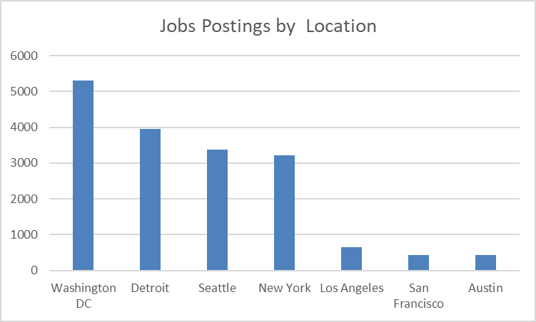
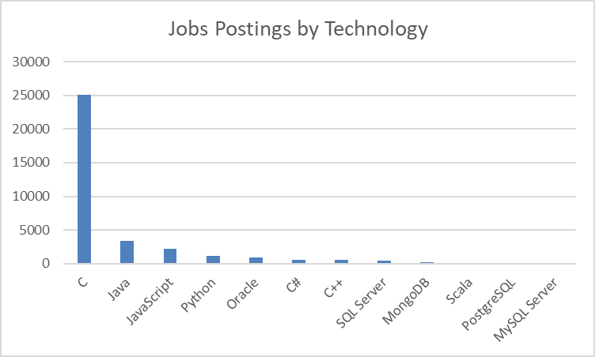
JOB POSTINGS

Slide 21
POPULAR LANGUAGES

