Slide 1

NYC Taxi Shiny App
By Kent Burgess

Slide 2
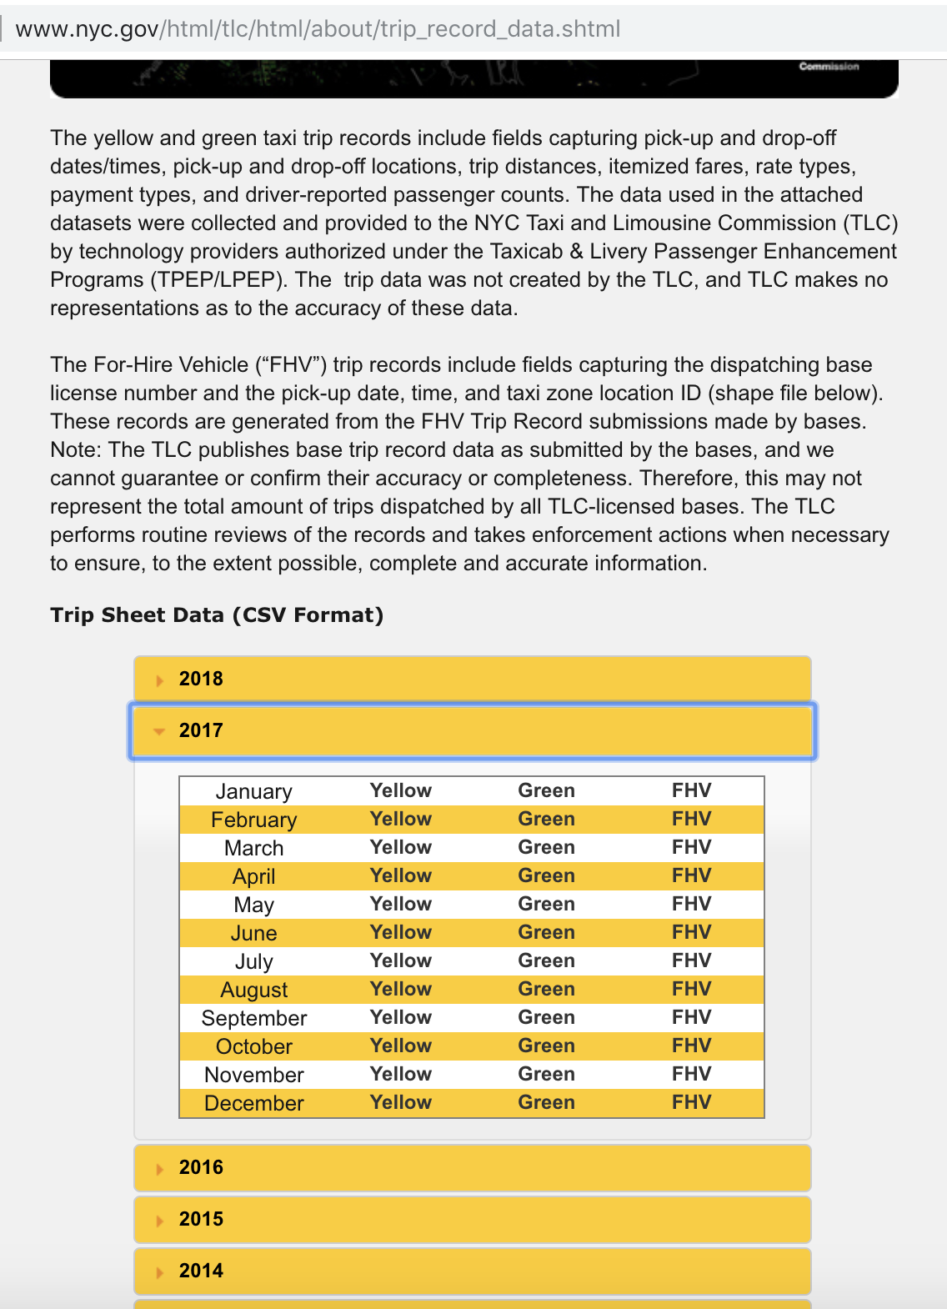
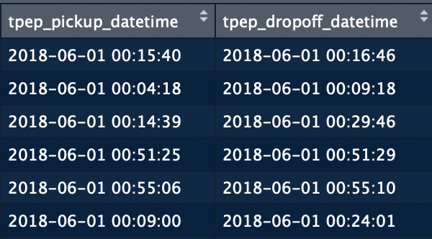
Data Retrieval/Cleaning
nyc.gov
Cleaning the data of negative or 0 amount totals and specific PU and DO locations that are coded as NA
For building my app I just used a sample size of 1M of the rows for the month, for ease of checking, for the production I have 8.5M rows
I had to manipulate the PU and DO into a POSIX class to able to calculate travel time, classify the day of the week, and time of day columns, and lastly joined a separate table of zone IDs to do lookups on zone names
Notes:
NYC has a law here that is transparent with all its data regarding public municpilaties.Therefore if you go to opendata.cityofnewyork.us it links you to a wealth of data regarding public works from 311 calls to taxi information. I choose to focus on taxi information because there was such a wealth of it and it affects me directly being a direct consumer. The city has all taxi rides databased from june 2018 through jan 2009.

