Slide 1

NYC Taxi Shiny App
By Kent Burgess

Slide 2
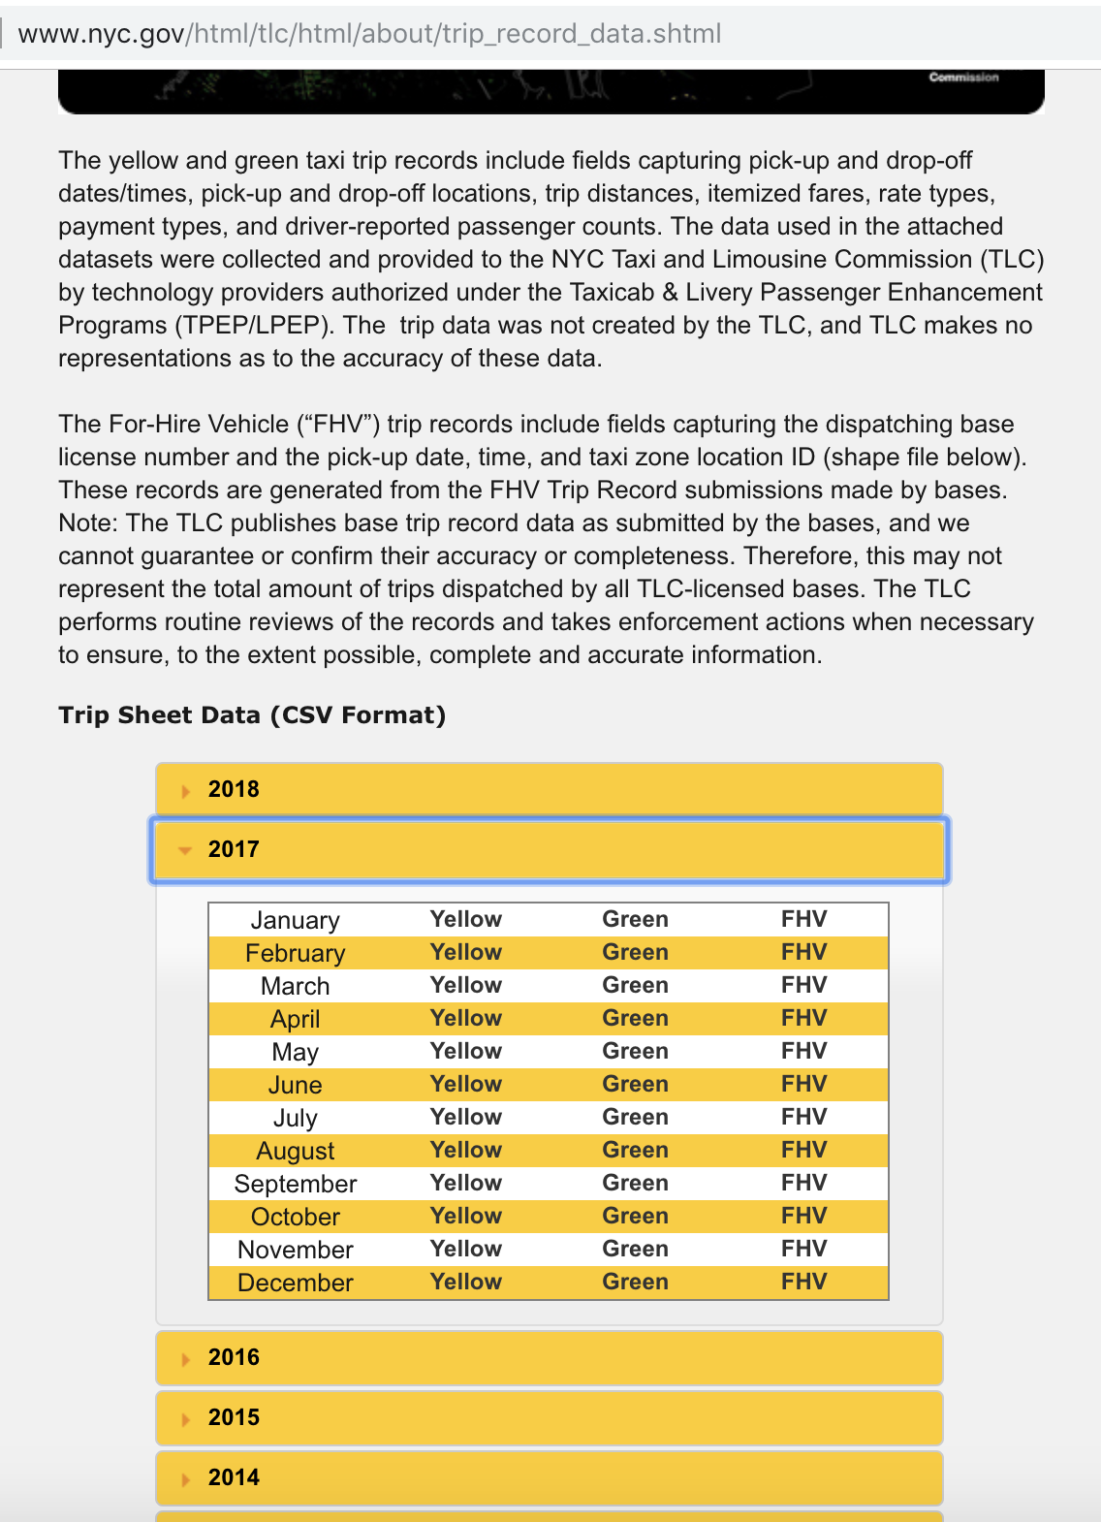
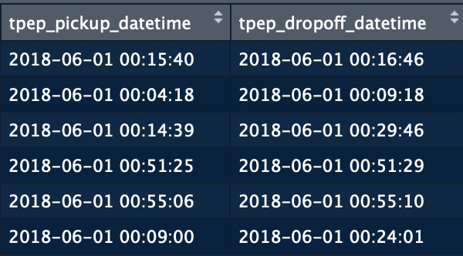
Data Retrieval/Cleaning
nyc.gov
Cleaning the data or negative or 0 amount totals and specific PU and DO locations that are coded as NA
For building my app I just used a sample size of 1M of the rows for the month, for ease of checking, for the production I have 8.5M rows
I had to manipulate the PU and DO into a POSIX class to able to calculate travel time, classify the day of the week, and time of day columns, and lastly joined a separate table of zone IDs to do lookups on zone names

