Slide 1

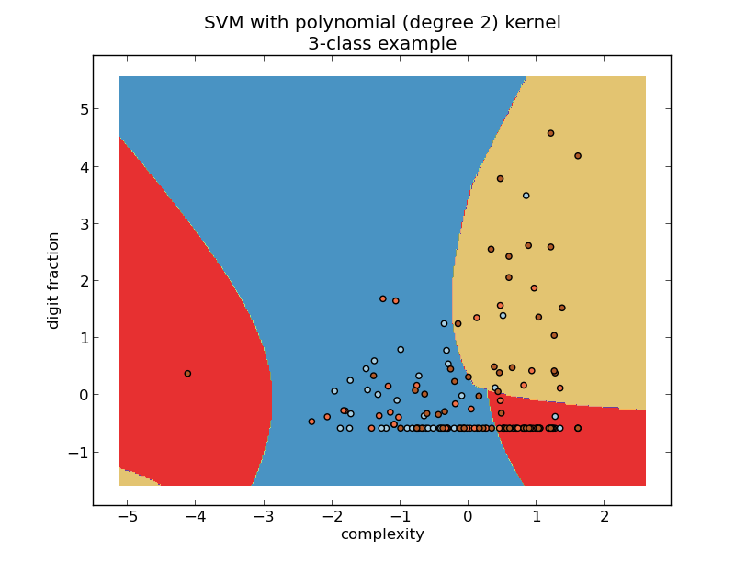
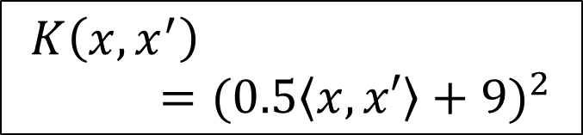

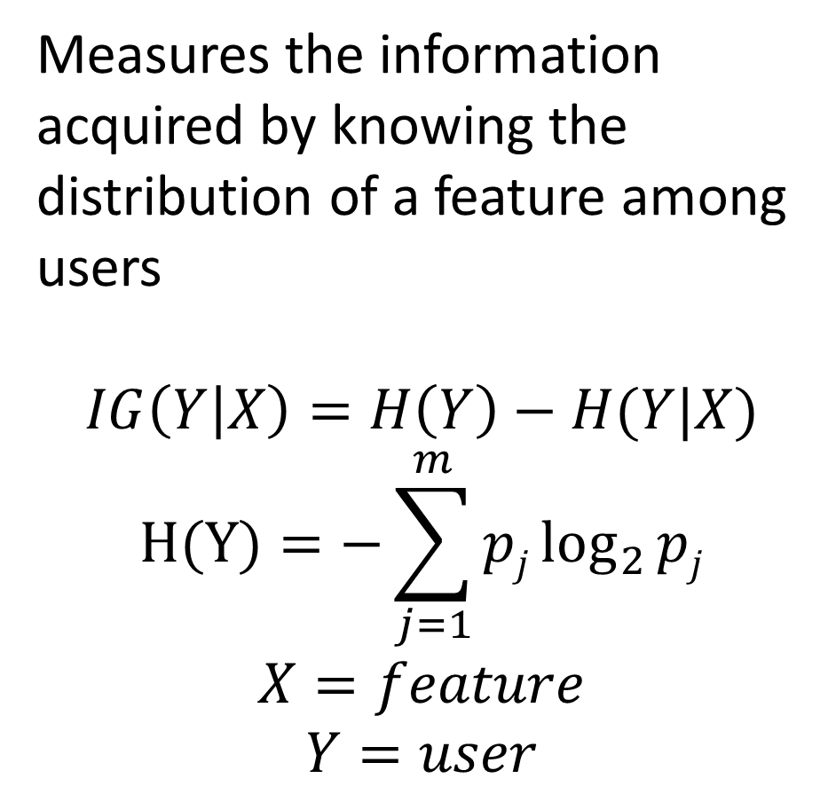
STYLOMETRY FOR ONLINE FORUMS
Identifying Authors by Writing Style
Kurt Barry
Katherine Luna
Given a set of posts from an online forum, we ask the question: can a post’s author be identified solely via writing style? We apply several machine learning techniques in order to explore this question and contrast the effectiveness of the methods chosen. We quantitatively select effective features using information gain, and utilize the multinomial Naïve Bayes and Support Vector Machine (SVM) algorithms with ten-fold cross validation to estimate the probability of predicting the correct author of a post. We find that our methods significantly outperform random chance.
Abstract
Background
Stylometry, the study of linguistic style, was used long before the internet existed to resolve historical authorship disputes . In the information age, it has been studied as a means to identify bloggers [1,2]. It is essentially the only tool one has to attempt to reveal or track anonymous individuals in web forums. However, this environment presents challenges. The very short length of many forum posts yields little stylometric information. Many users are only active on a forum for a brief time, making few posts before their activity ceases. It is an open question as to what extent stylometry can succeed in such an environment.
Data
Posts from an online forum were scraped via a custom PHP script. We removed quotations to prevent confusing text written by different authors.
331 unique user names
16,052 posts
31 most frequent posters account for 73% of all posts
6 most frequent posters account for 41% of all posts
Introduction
Are you really anonymous?...
Features
Number of words
Complexity
Fraction of letters
Fraction of upper case letters
Time of posting
Number of characters
Fraction of white space
Characters per word
Fraction of digits
Fraction of punctuation
Fraction of special characters
Fraction of emoticons
Apostrophes per word
Bigram frequencies (aa, ab, etc.)
Letter frequencies
Feature Selection
Classification Algorithms
Information Gain
Multinomial Naïve Bayes
Techniques
Measures the information acquired by knowing the distribution of a feature among users
$$IG\left(Y | X\right)=H\left(Y\right)−H(Y|X)$$
$$H(Y)=−\sum_{j=1}^{m}{pj\log_{2}{pj}}$$
$$X=feature$$
$$Y=user$$
Discretization bins are optimized
K-fold cross validation
Laplace smoothing
Support Vector Machine
Linear, exponential, and polynomial Kernels
$$K asdfjasdlfkjasldfaK$$
Accuracy
 | Naïve Bayes | SVM | Random Chance
Users with 500+ posts | 40% | 53% | 17%
Users with 50+ posts | 20% | 33% | 2%
Results
$$K\left(x,x^{′}\right)={(0.5\left\langle x,x′\right\rangle +9)}^{2}$$
The project successfully demonstrates proof-of-concept stylometric techniques in online forums, where data is often noisy and less abundant than in other written environments. Our methods are certainly not fully optimized. While it is difficult to imagine significant progress on attributing extremely short posts (e.g., “Welcome to the forum!”), the use of more extensive feature sets may improve accuracy for longer posts. Examples of promising features include “function word” frequencies [2] and recognition of particular phrases or grammatical constructs preferred by posters.
Conclusion
References:
[1] Andrew W.E. McDonald et. al. “Use Fewer Instances of the Letter “I”: Toward Writing Style Anonymization.” 12th Privacy Enhancing Technologies Symposium.
[2] Arvind Narayanan et. al. “On the Feasibility of Internet-Scale Author Identification.” IEEE Symposium on Security and Privacy 2012: 300-314.

