Slide 1




Bundesliga Full-Back Scouting: Recruitment for Blackburn Rovers
Identifying top-performing Bundesliga full-backs and assessing their suitability for Blackburn Rovers.
Introduction: Data Collection and Cleaning
Initial Data Processing
Identifying Preferred Position
KPI Integration and Filtering
Loaded player and event files. Performed data type cleaning and initial inspection to ensure integrity.
Inferred the preferred position for each player based on event counts, cross-validated with lineup data.
Joined event KPIs to player data and filtered the dataset to focus exclusively on full-backs.

Slide 2
Phase 1: Collection of Actual Performance Data
We focused on specific event types and key performance indicators (KPIs) to quantify the full-back's contribution.
General Purpose Metrics
Full-Back Specific Metrics
Minutes Played, Event Counts, Goals, Assists (xG/xThreat).
Crossing volume and success rates (types of crosses).
Progressive Passes (10m+ in the X coordinate).
Offensive metrics: Touches, Passes, Dribbles, PxT KPI.
Dribbles into the Final Third.
Ball Security: Ball Losses and Critical Ball Losses.
Defensive KPIs: Duels, Interceptions, and PxT decrease prevented from opponents.
Progression: Forwardness Angle and Forward Distance of Passes.
All values were normalized per 90 minutes for direct comparison.

Slide 3
Phase 2: Feature Engineering
A crucial step involved engineering synthetic metrics to capture efficiency, risk, and reliability in play.
Efficiency Ratios
Cross Value
Progressive Pass Efficiency and Carry to Progressive Pass Ratio.
Calculated using PxT to quantify the threat generated from wide areas.
Risk/Safety Indexes
Meta-Features
Risk Index: Ball losses weighted against progressive actions. Safety Index: Pass accuracy weighted against ball losses.
Generated higher-order features from the initial engineered metrics for deeper analysis (e.g., xGI, Cross to Pass Ratio).

Slide 4
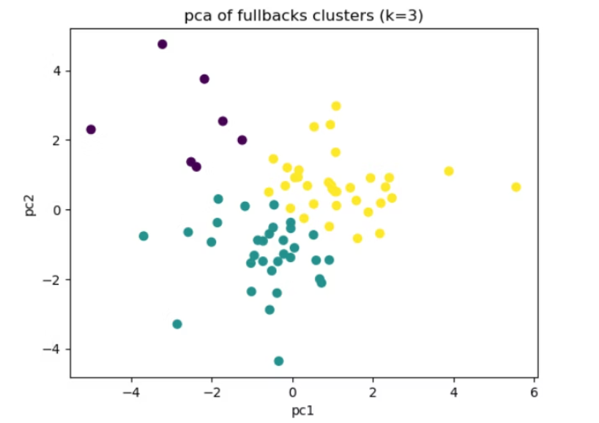
Phase 3: Player Archetype Clustering
KMeans clustering on engineered features yielded three distinct full-back archetypes for targeted scouting.
Conservative/Low Involvement (Label 1)
1
Low attack-to-defense ratio, low risk, high pass accuracy, and low average forward distance. Focus on security and safe decisions.
Traditional/High Defensive Load (Label 2)
2
High defensive metrics (PxT prevented, interceptions, duels). Balanced profiles, with a strong defensive inclination.
Attacking/Creative (Label 3)
3
High attack-to-defense ratio, high xGI, and greater forward distance won. Lower defensive contribution.
An interesting finding: Full-backs from bigger teams show higher critical ball losses due to high-risk pressing, often leading to immediate counter-attacks when possession is lost in advanced areas.

Slide 5
Phase 4: Development of Thematic Indexes
Five thematic indexes were created using mean normalized scores of key features to quantify a player's capability across different functional areas.
Theme 1: Passing
Metrics: Pass Accuracy, Cross Accuracy, Successful Progressive Passes P90. (High passing ability and precision)
Theme 2: Progressiveness
Metrics: Prog Passes P90, Carry vs. Pass Progress Ratio, Avg. Forward Distance, Carries into Final Third P90. (Willingness and success in advancing play)
Theme 3: Defending
Metrics: Ground Duels Won P90, Interceptions P90, PxT Prevented P90, Ball Recoveries P90. (Volume and quality of defensive actions)
Theme 4: Chance Creation
Metrics: XGI P90, Cross Value (PxT), Goal Involvement P90. (Generating threat and expected goals/assists)
Theme 5: Security
Metrics: Inverse Ball Losses P90, Inverse Critical Losses P90, Safety Index. (Reliability and ball retention)

Slide 6
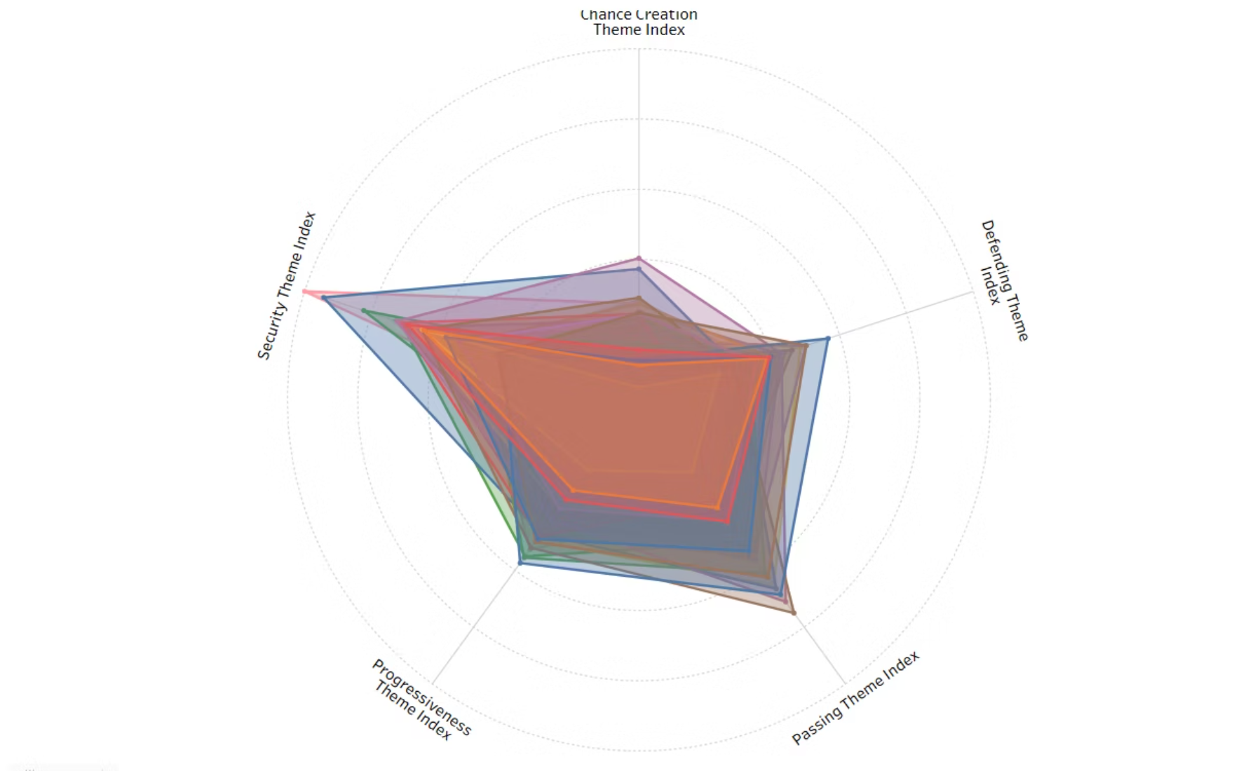
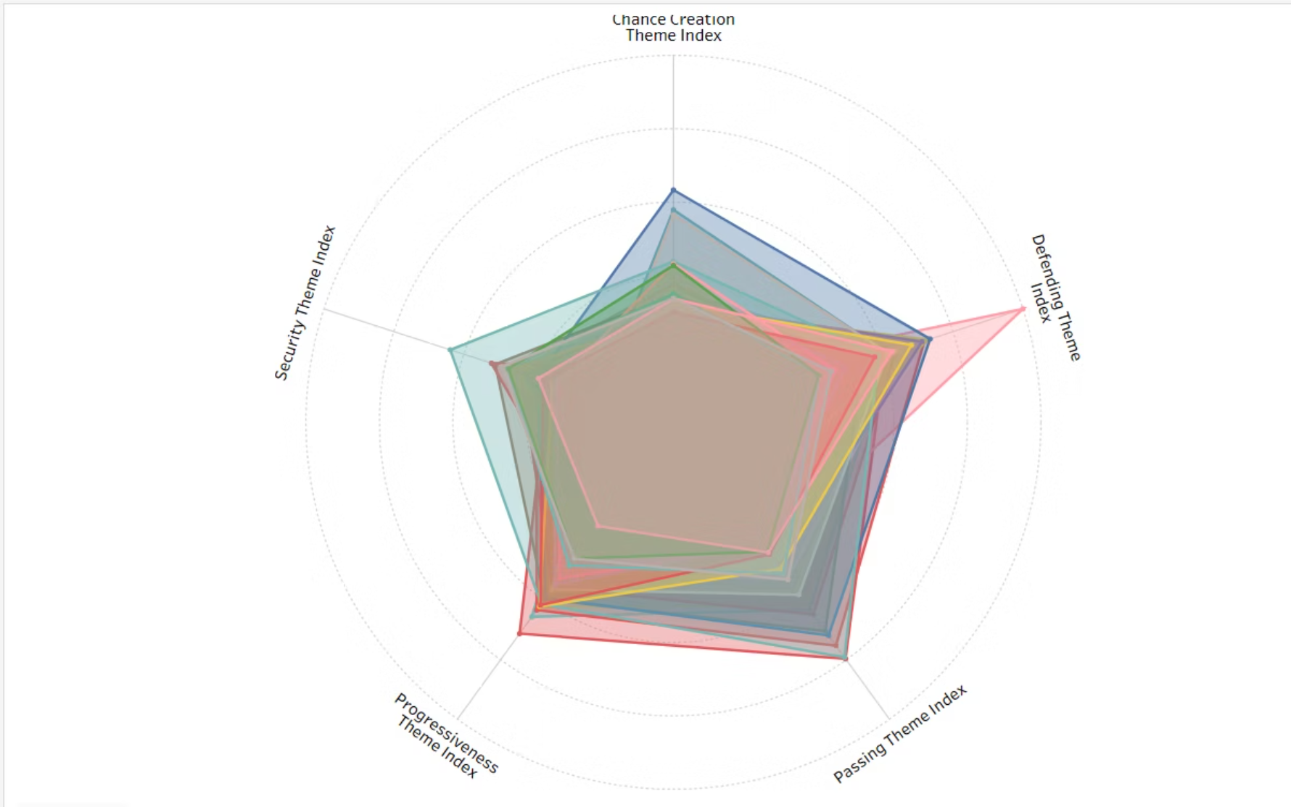
Phase 5: Radar Chart Validation of Archetypes
Radar charts visualize how each cluster profile performs across the five thematic indexes, confirming the clustering logic.
Conservative / Low Involvement
Traditional / High Defensive Load
Safety-focused, low Chance Creation, and low Progressiveness.
Examples: Ramy Bensebaini, Philipp Max.
High Defending metrics with good all-around performance.
Examples: Benjamin Henrichs, Noussair Mazraoui, and surprisingly, Alphonso Davies.

Slide 7
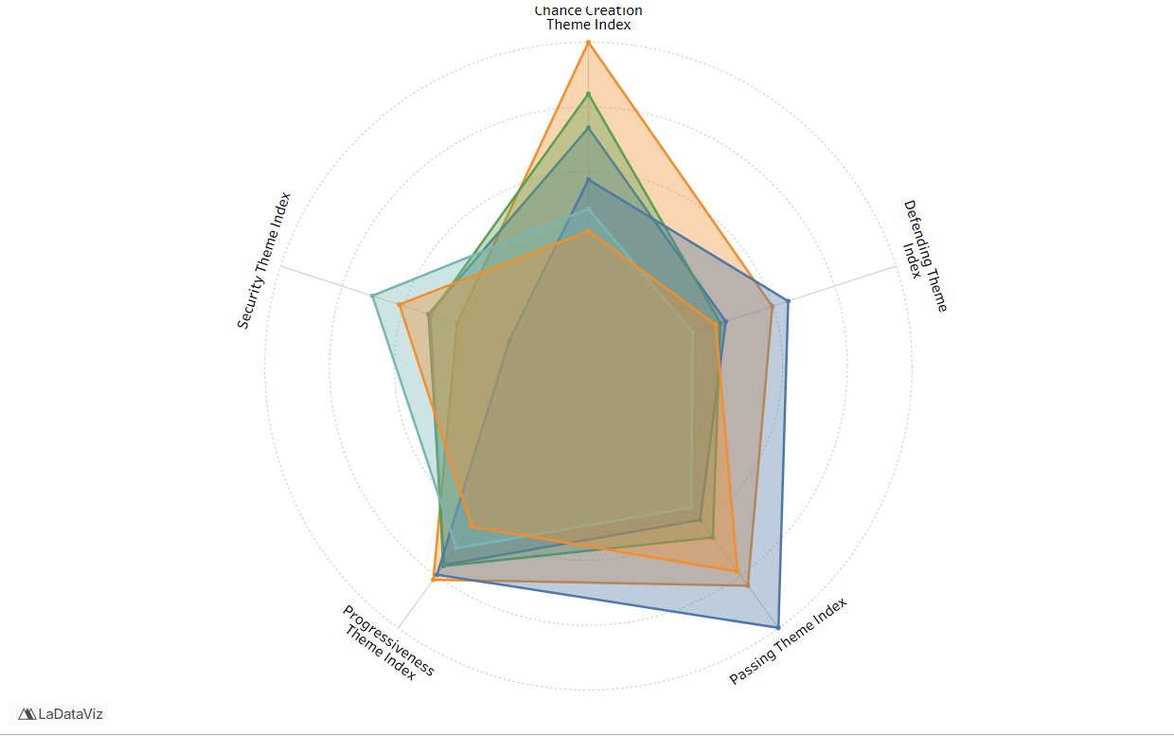
Phase 5 Continued: Radar Chart Validation of Archetypes
Attacking / Creative Archetype
Characterized by high Chance Creation and Progressiveness, with generally lower Security.
Examples: Jeremie Frimpong, Alejandro Grimaldo.

Slide 8

Phase 6: Blackurn Rovers' Full-Back Needs
Blackburn's 3-4-1-2 formation places high tactical demands on the full-backs (or wing-backs).
Role Demands
Defensive Responsibility
Chance Creation
Must provide width and be primary contributors to possession progression.
Requires quick recovery runs to form a solid back five out of possession.
Often relied upon for crosses and cutbacks as a main source of attack creation.
Desired Player Profile
A high-involvement player who excels in Progression, Chance Creation (xGI and Cross Quality), Defensive Work Rate, and Security (minimal high-value ball losses).
Initial Shortlist Filters
Minimum playing minutes (above 25th percentile) for reliable assessment.
Age under 30 to ensure longevity and potential resale value.
Usually Involved, Low Involvement players are excluded

Slide 9
Phase 7: Recommendation Criteria & Scoring
Players were evaluated across two primary layers: Role Fit and Quality, utilizing the thematic indexes.
Layer 2: Quality Score
Layer 1: RoleFit Score
Measures overall performance using equal-weighted thematic indexes against all full-backs in the dataset.
Measures performance against the player's specific cluster (archetype). E.g., Attacking Creatives are weighted more on Chance Creation.
Value Adjustment
Average Score
Scores are slightly adjusted based on the player's market value (Transfermarkt data) to identify optimal value for money.
Calculation of the combined score for initial ranking.

Slide 10
Key Recommendations
Final recommendations balance performance, role fit, and market value.
Attacking Creative Full-Backs
Franck Honorat is the recommended target. While Jeremy Frimpong scored higher (0.721), his high market value makes Honorat a better option, offering 84% of Frimpong's performance index at only 25% of the estimated price.
Traditional Full-Backs
Maximilian Mittelstädt is the top target. Omar Traoré ranks second; his significantly cheaper price elevated his adjusted score past several higher-scoring players, making him an excellent budget-friendly option.
More Detailed Numerical Results on Shortlisted Players can be found in the Shortlist sheet

Slide 11
Scope for Improvement and Constraints
A summary of current limitations and real-world constraints to be considered.
Limitations of Current Analysis
Real-World Constraints
The analysis is based on Event Data. More granular data would enhance accuracy.
Realistic Budgetary Constraints must dictate final selection.
Physical Data is missing. EFL requires high intensity, duels, and crossing; quantifying intensity is crucial.
Player Injury Records usually need review.
League Adaptation potential (Bundesliga to Championship).
Tracking Data/Off-Ball Movement is needed to quantify tactical elements like width, overlap frequency, recovery runs, and pressing distance.
Detailed Tactical Fit for specific match-day requirements and opposing teams.

