Slide 1

The Impact of Network Topology on Banking Default Dynamics
Anas Bachiri & Kārlis Mārtiņš Briedis

Slide 2
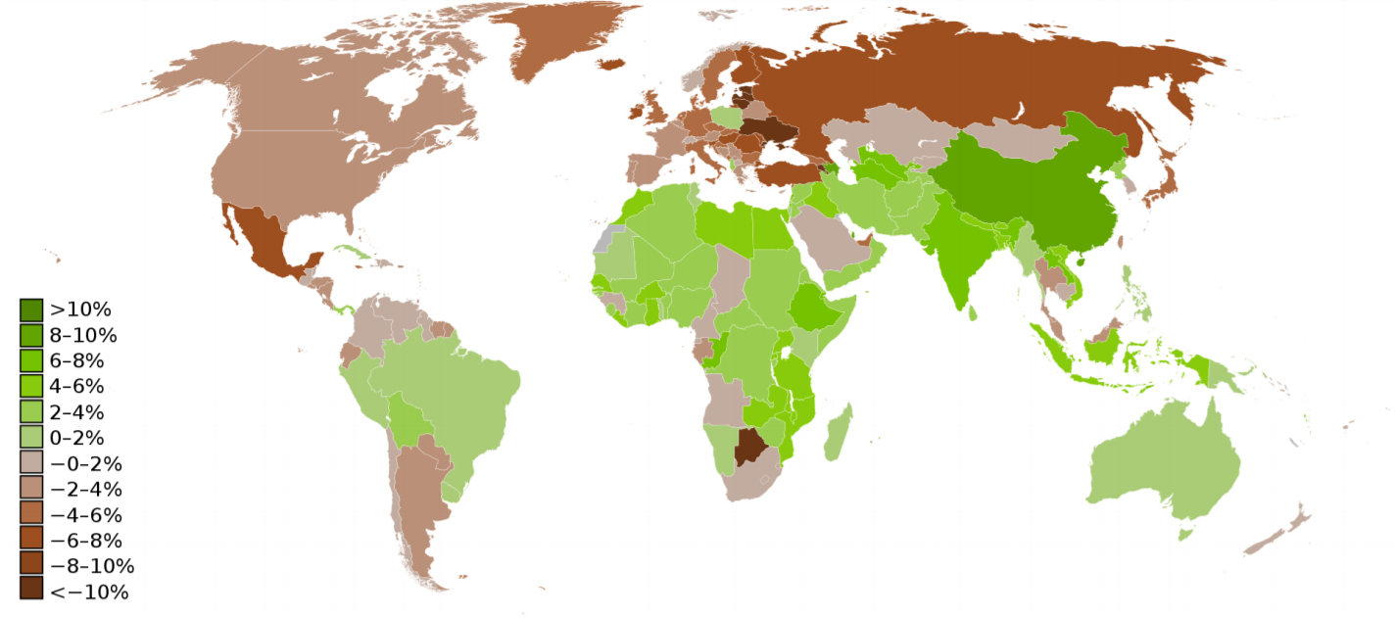
Financial crisis of 2008
Drastic financial losses
Decrease in the GDP growth rate
Bankruptcy of the 4th largest investment bank in USA Lehman brothers

Slide 3
Networks matter
Networks matter. The network structure is crucial to estimate systemic risk
Data scarce. This is one of the main challenges for empirical studies of financial networks
Systemic risk can be estimated. One measure of systemic risk is the DebtRank

Slide 4
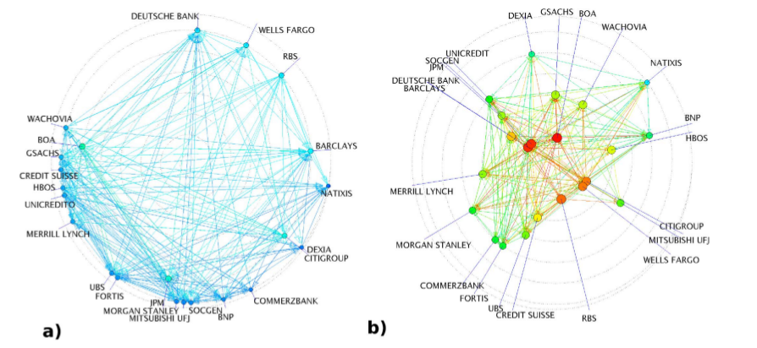
Debt rank
Network matters
Bank at the beginning (a) and at the peak of the financial crisis (b).

Slide 5
Project scope
Nier E., Yang J., Yorulmazer T., Alentorn A. «Network Models and Financial Stability» (2008)
Simulation of default contagion
Kashirin V. «Evolutionary Simulation of Complex Networks Structures with Specific Topological Properties» (2014)
Generation of complex networks
Our project:
Implementation of simulation model
Implementation of network generation
Observing the impact of network topology on default dynamics

Slide 6
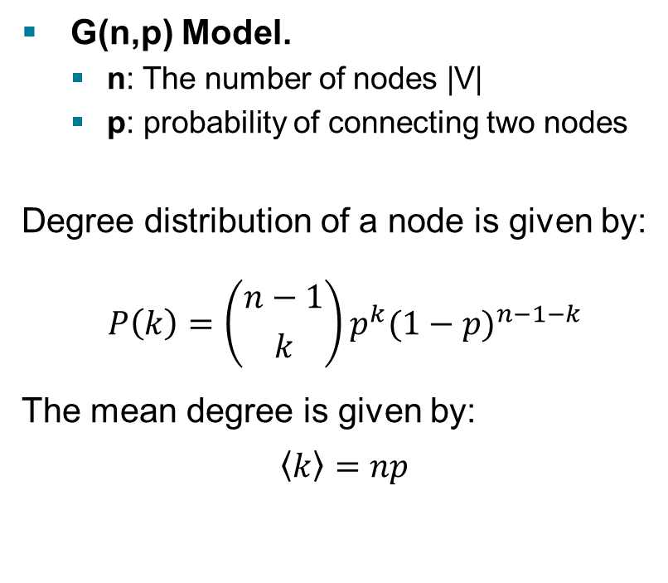
Generation of networks G(n,p)
Network models
G(n, p) model
Stochastic Block Model (SBM)
Complex network structure simulation
G(n,p) Model.
n: The number of nodes |V|
p: probability of connecting two nodes
Degree distribution of a node is given by:
$$P\left(k\right)=\left({n−1 \atop k}\right)p^{k}{(1−p)}^{n−1−k}$$
The mean degree is given by:
$$\left\langle k\right\rangle =np$$

Slide 7
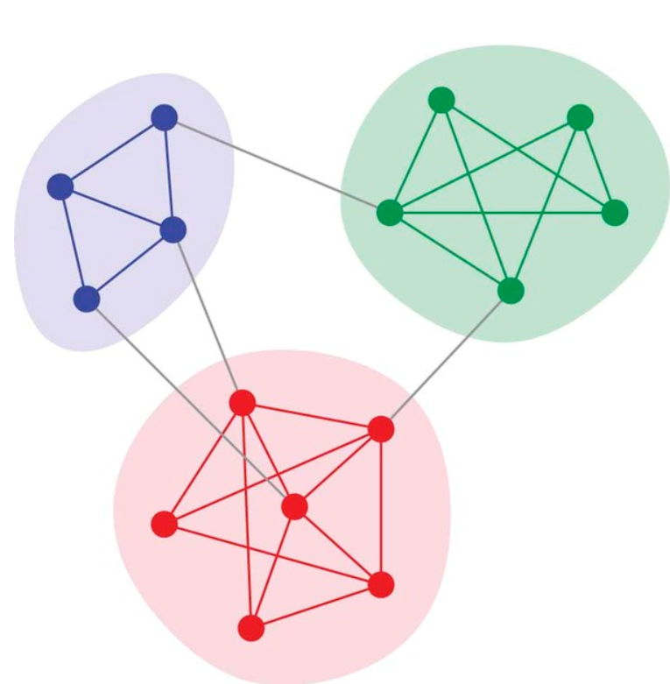
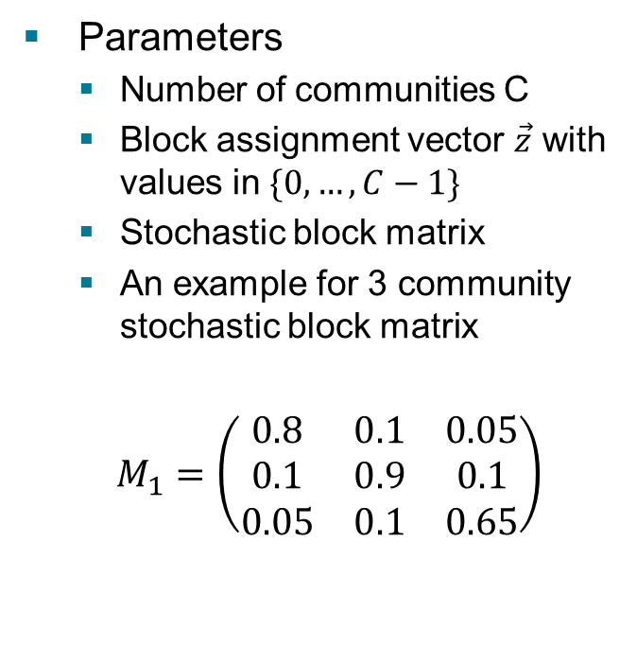
Generation of networks SBM
Generate Community like structure
Parameters
Number of communities C
Block assignment vector $\vec{z}$ with values in $\{0, …, C−1\}$
Stochastic block matrix
An example for 3 community stochastic block matrix
$$M_{1}=\left(\begin{matrix}0.8 & 0.1 & 0.05 \\ 0.1 & 0.9 & 0.1 \\ 0.05 & 0.1 & 0.65\end{matrix}\right)$$

Slide 8
Complex network structure simulation
Real-world complex networks are usually characterized by a set of specific topological characteristics:
High clustering coefficient
Short average path lengths
Communities
etc.

Slide 9
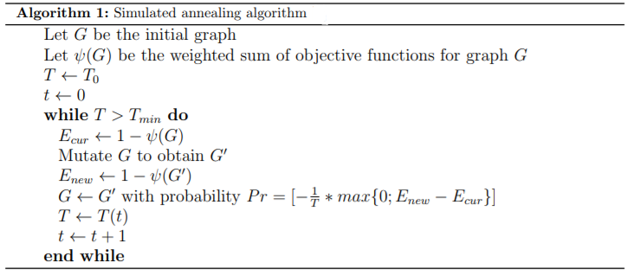

Simulated annealing
$$G^{∗}=\underset{G⊆R}{argmin}{1−ψ(G)}$$

Slide 10
Graph mutation
Global modifications
Connection of random pair of nodes
Rewiring a pair of randomly selected edges
Removal of random edge
Connecting local nodes
Local rewiring a pair of random edges
Local modifications

Slide 11
Compute-intensive task
Graph generation could run up to 6 hours on ETH Euler’s 48 cores
5 days of CPU time (for 10`000 graphs)
Must be parallelized!

Slide 12
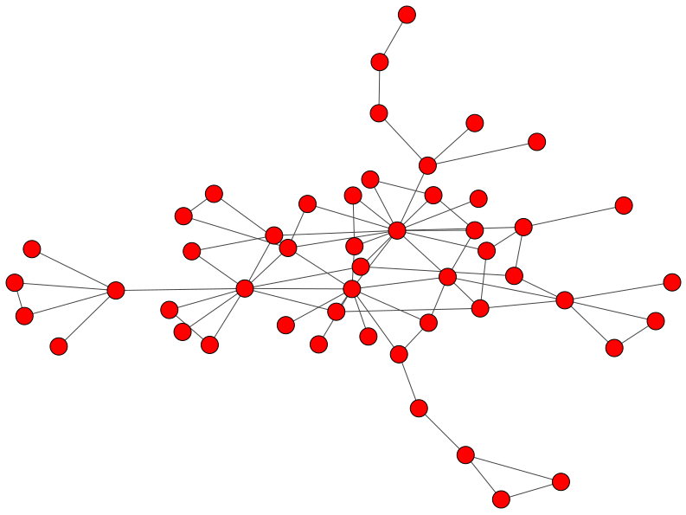
Example graphs
C = 0.52, apl = 3.55

Slide 13
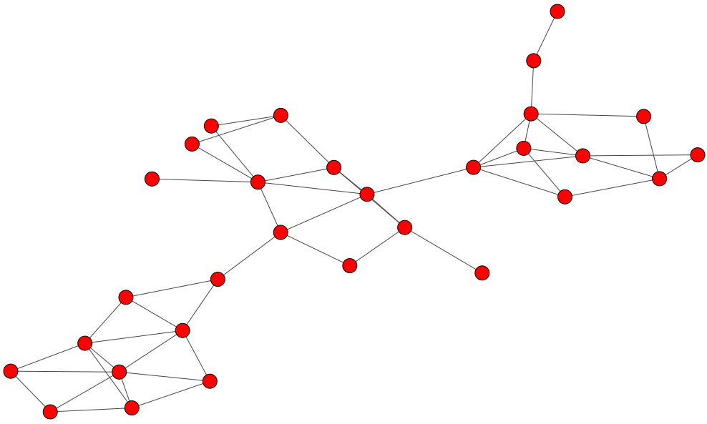
3 communities, 0.6 modularity

Slide 14
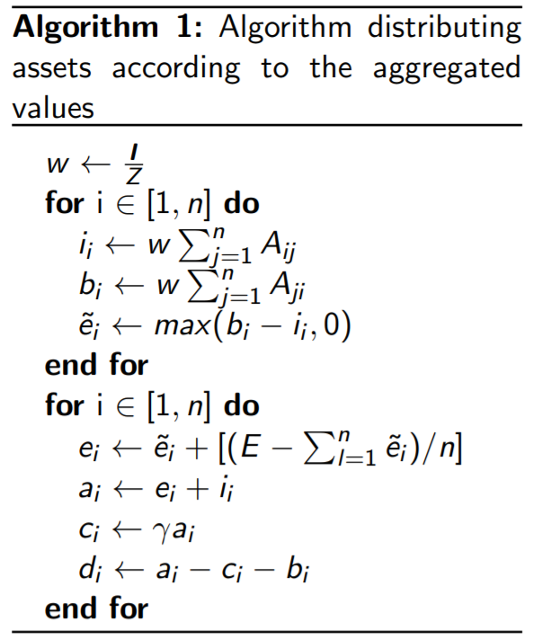
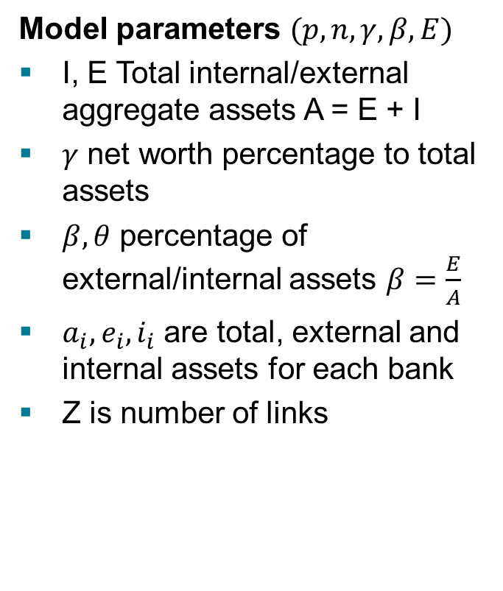
Shock and assets simulation model
Model parameters $(p, n, γ,β,E)$
I, E Total internal/external aggregate assets A = E + I
$γ$ net worth percentage to total assets
$β, θ$ percentage of external/internal assets $β=\frac{E}{A}$
$a_{i},e_{i}, i_{i}$ are total, external and internal assets for each bank
Z is number of links

Slide 15
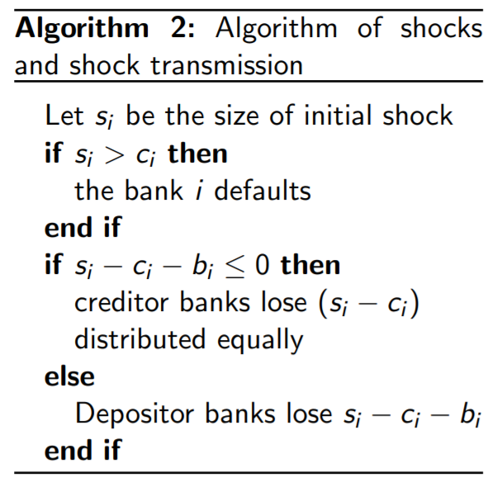
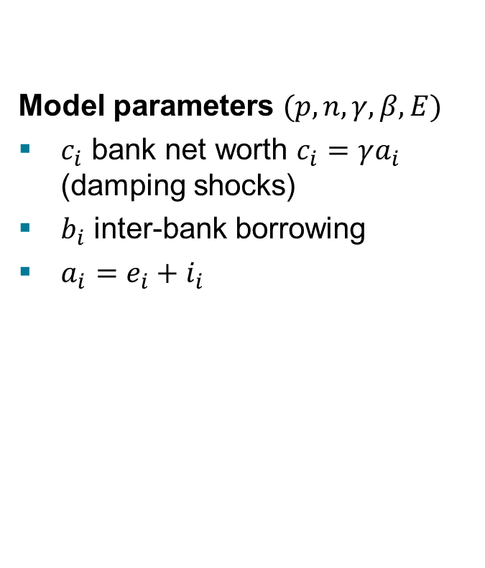
Shocks simulations
Model parameters $(p, n, γ,β,E)$
$c_{i}$ bank net worth $c_{i}=γa_{i}$ (damping shocks)
$b_{i}$ inter-bank borrowing
$a_{i}=e_{i}+i_{i}$

Slide 16
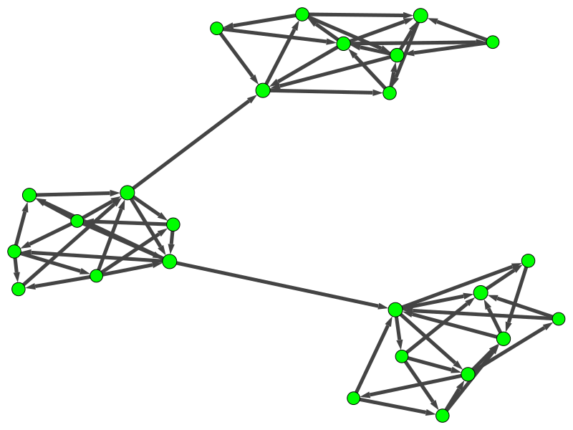

Slide 17
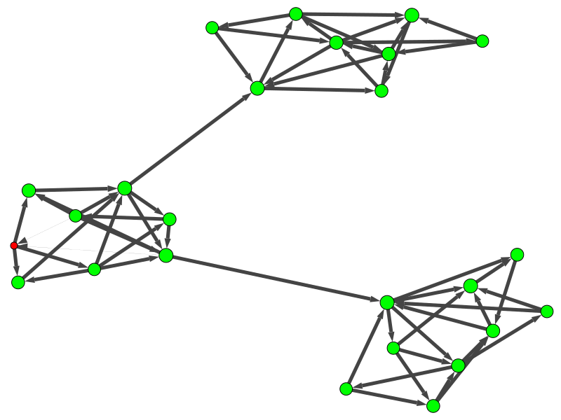

Slide 18
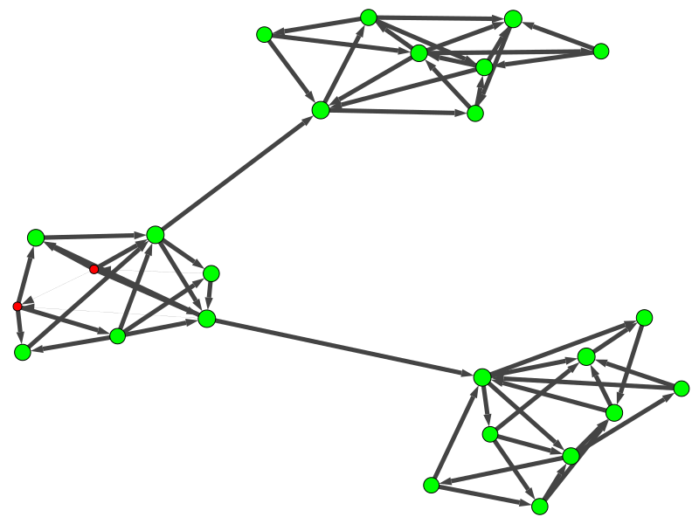

Slide 19
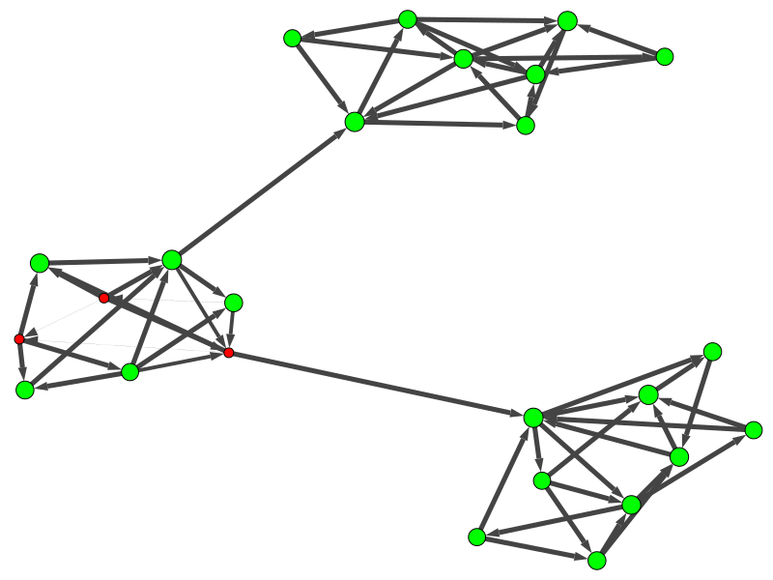

Slide 20
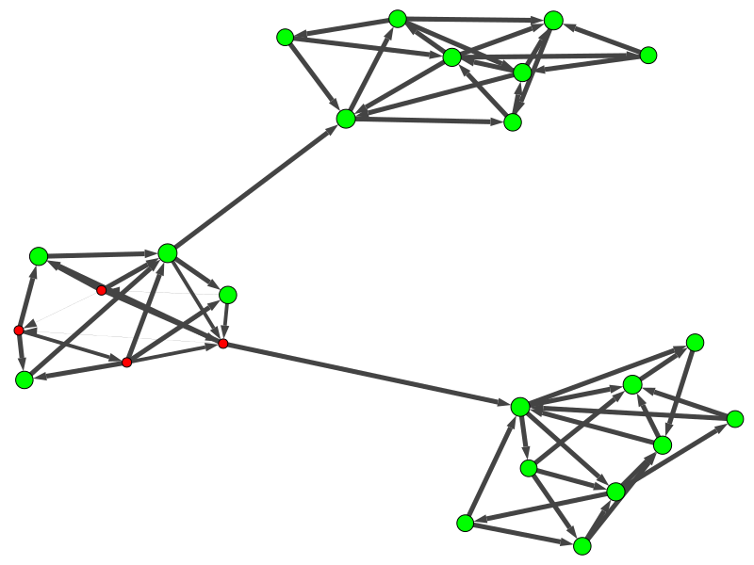

Slide 21


Slide 22
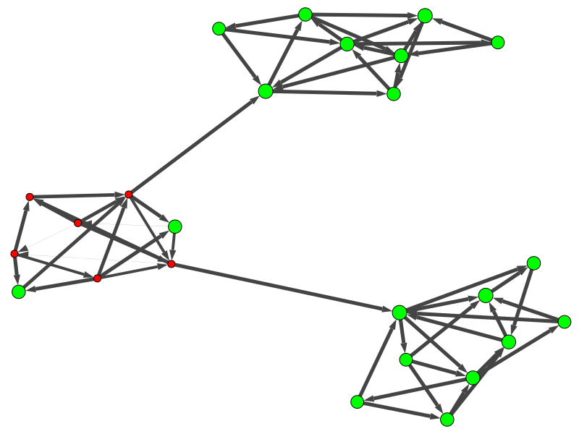

Slide 23
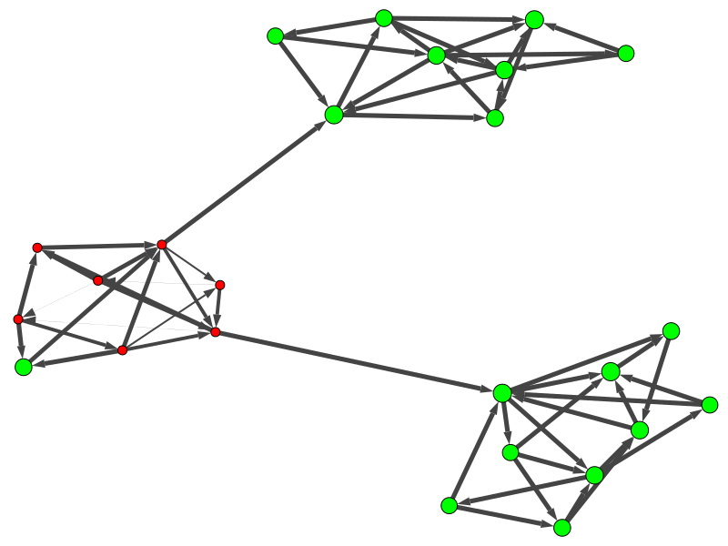

Slide 24
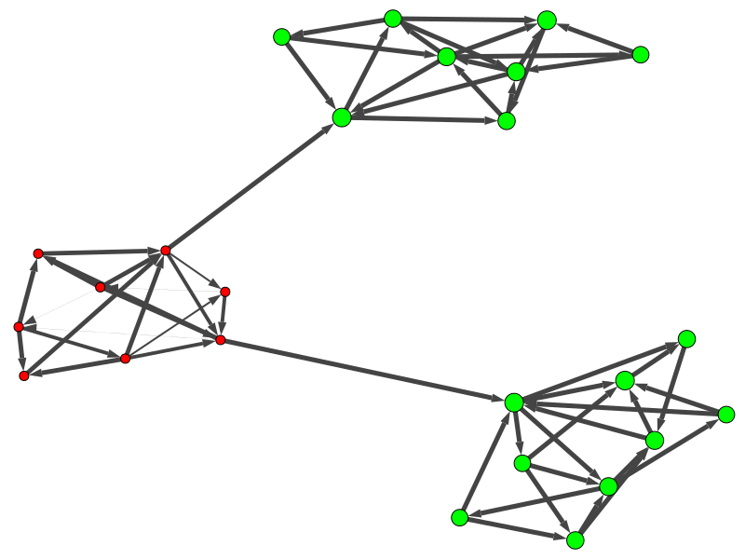

Slide 25
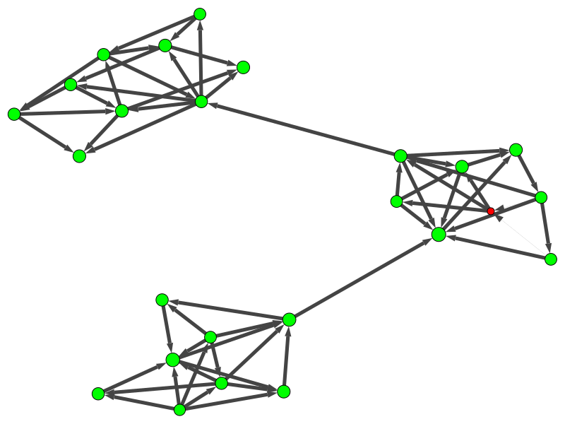
Different source

Slide 26
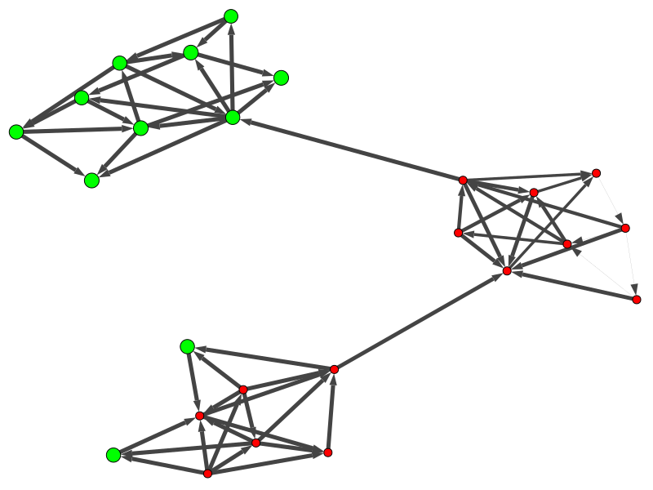

Slide 27
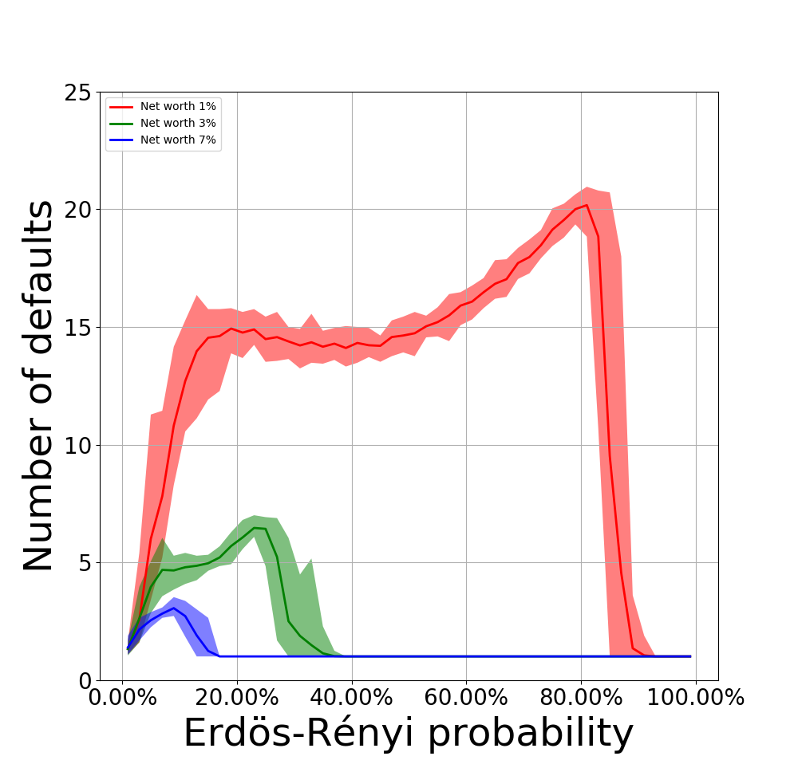
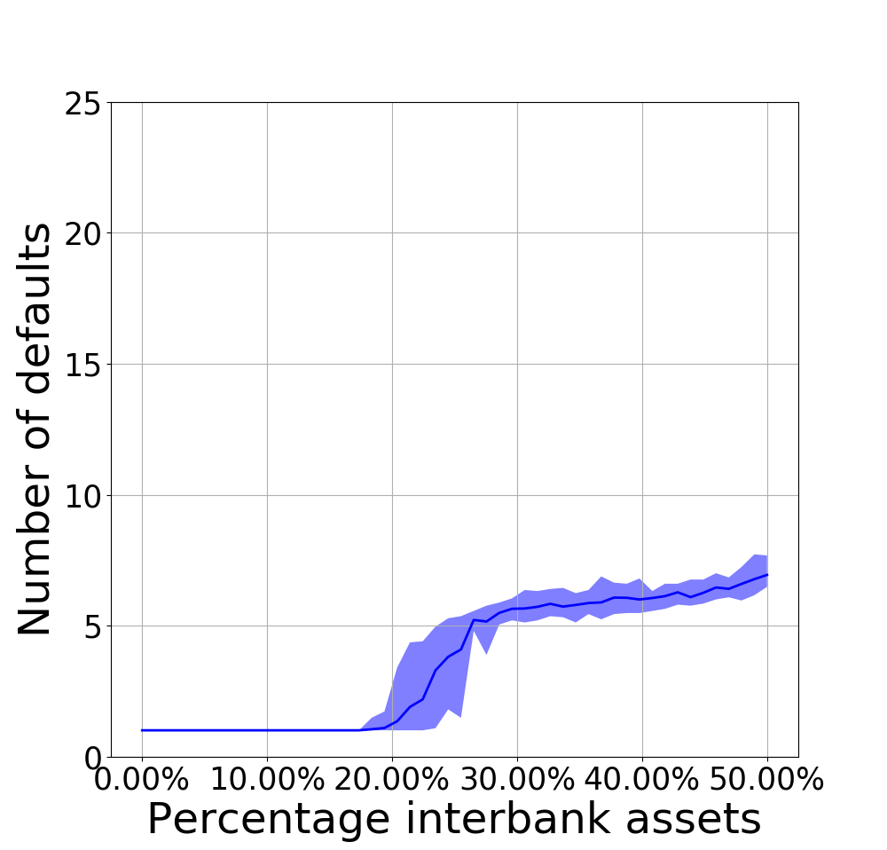

G(n, p) model results
We scan parameters $p$ and $θ$.
(a)
(b)

Slide 28
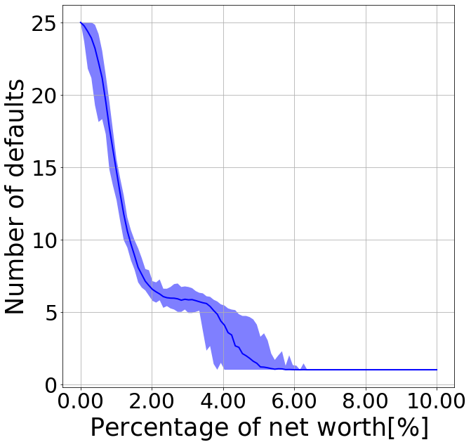


G(n, p) model results
We scan the parameter $γ$ (damping factor).

Slide 29
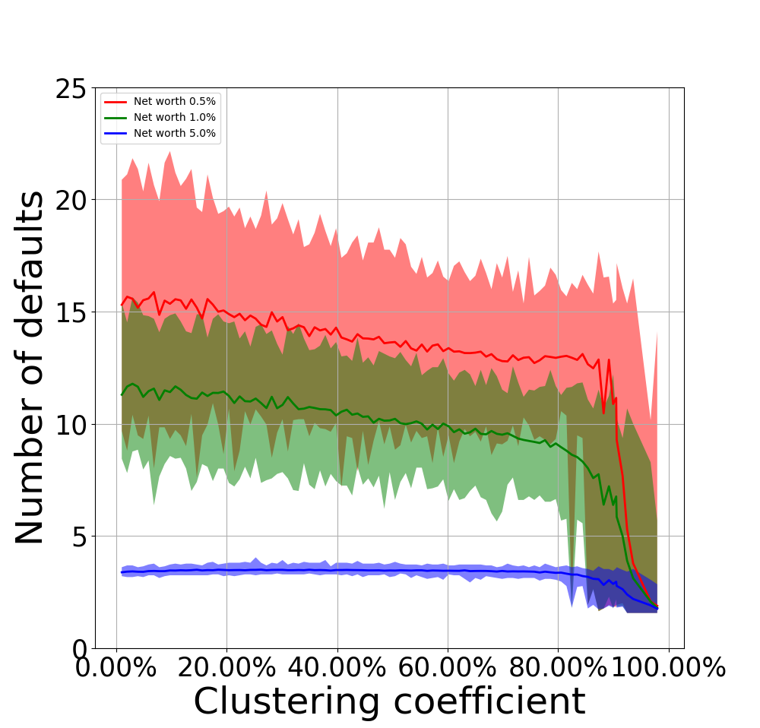
Impact of the clustering coefficient

Slide 30
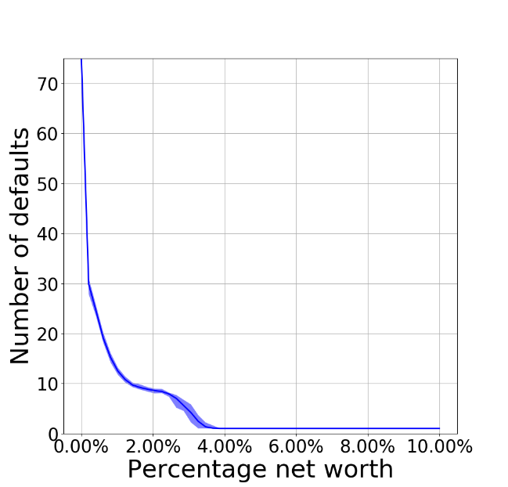
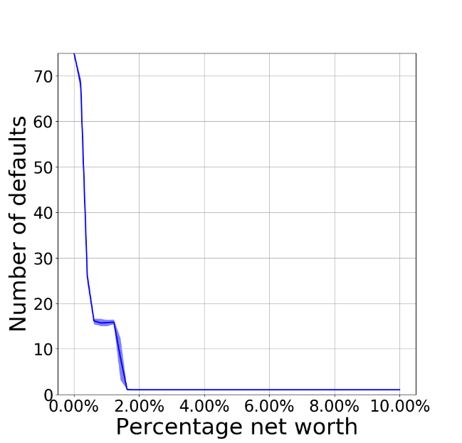
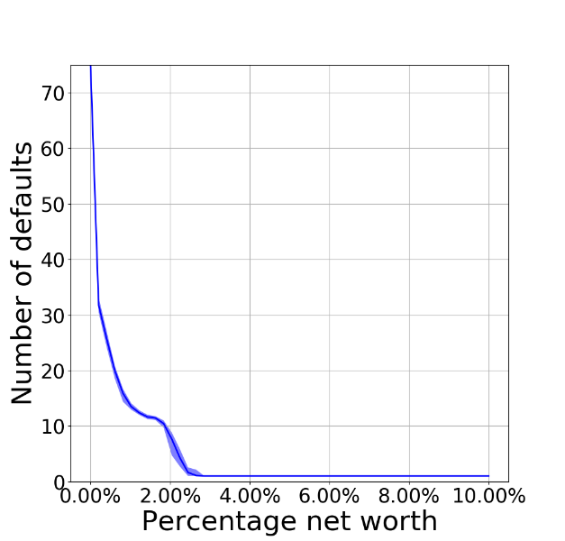
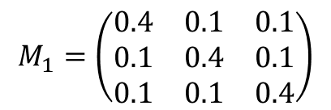
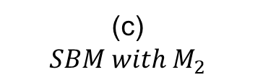
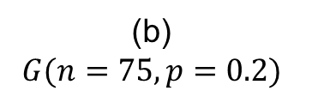
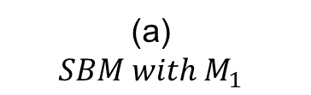
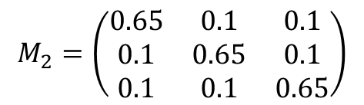
Results obtained from SBM
(a) $$SBM with M_{1}$$
(b) $$G(n=75,p=0.2)$$
(c) $$SBM with M_{2}$$
$$M_{1}=\left(\begin{matrix}0.4 & 0.1 & 0.1 \\ 0.1 & 0.4 & 0.1 \\ 0.1 & 0.1 & 0.4\end{matrix}\right)$$
$$M_{2}=\left(\begin{matrix}0.65 & 0.1 & 0.1 \\ 0.1 & 0.65 & 0.1 \\ 0.1 & 0.1 & 0.65\end{matrix}\right)$$

Slide 31
Summary
Implemented crisis simulation and network generation models
Models applied to observe the impact of different topological parameters on banking default dynamics
Propose regulations for the minimum percentage net worth
Full graph topology matters in real world banking networks
International banking networks require higher percentage net worth

Slide 32
Improvements
Use our framework to generate networks and observe the impact of variating other properties
Use different distributions of assets:
Observe the impact of distribution
Evaluate existing network to get the distribution
Introduce the temporal characteristic of networks

Slide 33
Thank you for your attention!

